Slide 1
Predicting 10-day VIX Change from Federal Reserve Text using Frozen FinBERT with Learned Sentence Attention and a Linear Regression Head
Zoe Tomlinson

Slide 2
Introduction
Relationship between the Fed Reserve and VIX
Federal Reserve: national central banking system
Tied to interest rates and single largest source of monetary policy in financial markets
VIX: stock markets measure of volatility, widely known as the fear gauge
I have always been interested in how politics affects the stock market
Difference in the Trump vs Biden regimes?
Quantitative finance
VIX

Slide 3
Dataset: 326 Fed documents (1993-2026)
Joined two document sources
FOMC minutes: 268
Humphrey-Hawkins testimony: 558
What are these and why these?
Where did it come from?
More detail on where (credibility)
Preprocessing
Each document was sentence-segmented with NLTK Punkt (Kiss & Strunk 2006), capped at the first 80 sentences
where the policy rationale is, everything after that not helpful
An Example from your dataset

Slide 4
FinBERT + Sentence Attention + Linear Head
FinBERT for embeddings
Pretrainhed on finance language to create embeddings that represent all the text, even the financially jargony ones
Sentence Attention for sentence weights
Attention!!!
Linear head for regression prediction
Regression and prediction
Why else?
Mention linear baseline TD-IDF Ridge and how it works
Diagram
80 sentence docs → finBERT → embeddings → sentence attention → weights → linear head → predictions

Slide 5
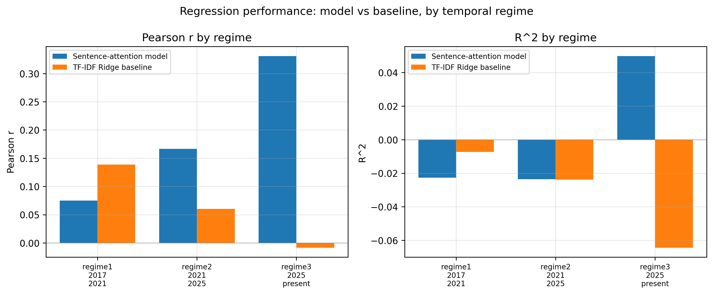
Your Results
What is one of your metrics?
How did it work?

Slide 6
Conclusions
What worked and what didn't
A point or two
Anything you would do differently
Acknowledgements
Anyone who helped, that you would like to thank

