Slide 1
Predicting 10-day VIX Change from Federal Reserve Text
Frozen FinBERT + learned sentence attention + linear regression head
Zoe Tomlinson
DSCI 410/510 Final Project, June 2026
Notes:
Hi everyone, I am Zoe and my project is about whether we can predict short-horizon changes in the stock market's fear gauge using only Federal Reserve text. I will walk you through the motivation, the dataset, the model architecture, the results, and what I would do next. Total time about five minutes.

Slide 2
Why this question is interesting
• The Federal Reserve sets U.S. interest rates and is the single largest source of monetary-policy signal in financial markets.
• FOMC minutes (released ~3 weeks after each meeting) and Humphrey-Hawkins testimony are the densest sources of policy text.
• The VIX is the market's 30-day implied volatility on the S&P 500, often called the "investor fear gauge" (Whaley 2000).
• Hypothesis: when Fed text surprises markets, expected volatility moves. Prior work shows Fed text affects Treasury yields and equities (Hansen, McMahon & Prat 2018; Lucca & Trebbi 2009).
• Secondary question: does the relationship hold across U.S. political regimes (Obama, Trump 1, Biden, Trump 2)?
• Personal: I'm interested in political effects on markets, and this is my first applied deep-learning project on text.
Notes:
The Federal Reserve is the U.S. central bank. When they signal a rate change, every other interest rate in the economy moves with it, so their words are extraordinarily market-moving. The FOMC is the committee inside the Fed that actually sets policy. They release minutes about three weeks after each meeting, and those minutes have the rationale for the decision. Humphrey-Hawkins is the twice-yearly testimony the Fed Chair gives to Congress.
The VIX is a real-time index that prices the market's expectation of 30-day volatility in the S&P 500. People call it the fear gauge because it spikes when traders pay more for downside protection.
My core question: does the text content of Fed communications predict a near-term move in expected volatility? There is published work (Hansen McMahon and Prat in QJE 2018, Lucca and Trebbi at NBER) showing Fed text moves yields and equities, so a connection to expected volatility is plausible.
The secondary question is political. Presidents have very different relationships with the Fed: Trump publicly pressured the Fed in his first term, Biden was hands-off, Trump's second term has resumed the pressure. If markets read the same Fed language differently under different political regimes, a model trained on pre-2017 data might degrade on later test data.

Slide 3
Dataset: 326 Fed documents (1993-2026)
• FOMC minutes from federalreserve.gov: 268 documents, 1993 to present, scraped across four URL conventions.
• Humphrey-Hawkins testimony: 58 documents, 1997 to present.
• Each document is sentence-segmented with NLTK Punkt (Kiss & Strunk 2006), capped at the first 80 sentences (where the policy rationale lives).
• Target: 10-day forward change in CBOE VIX (FRED VIXCLS), aligned to next trading day to avoid look-ahead leakage.
• Strictly temporal splits anchored to U.S. presidential inauguration days: train pre-2017-01-20 (233 docs), val (35 docs), regime 1 / 2 / 3 (40 / 40 / 13 docs).
Notes:
I scraped 326 documents from the Federal Reserve's website. 268 of them are FOMC minutes going back to 1993. 58 are Humphrey-Hawkins testimony going back to 1997. Each one is a long policy document, typically 5,000 to 10,000 words.
I cut each document down to its first 80 sentences using NLTK Punkt, which is the standard sentence segmenter from Kiss and Strunk 2006. The reason for the 80-sentence cap is that the opening sections of FOMC minutes carry the policy rationale and the forward-looking language, and the later sections like voting records and operational appendices are known to be low signal in the Fed-text-mining literature (Hansen, McMahon, and Prat 2018).
The target is the 10-day forward change in the CBOE VIX, pulled from FRED. I align to the next trading day after each release, which matters because some Humphrey-Hawkins testimony falls on holidays. Using the next day means I never use VIX data from before the release was public.
The splits are strictly temporal, no random shuffling. I train on everything before January 20, 2017, then evaluate separately on the Trump 1, Biden, and Trump 2 eras. That is what the inauguration-day anchoring gives me, a clean per-regime test.

Slide 4
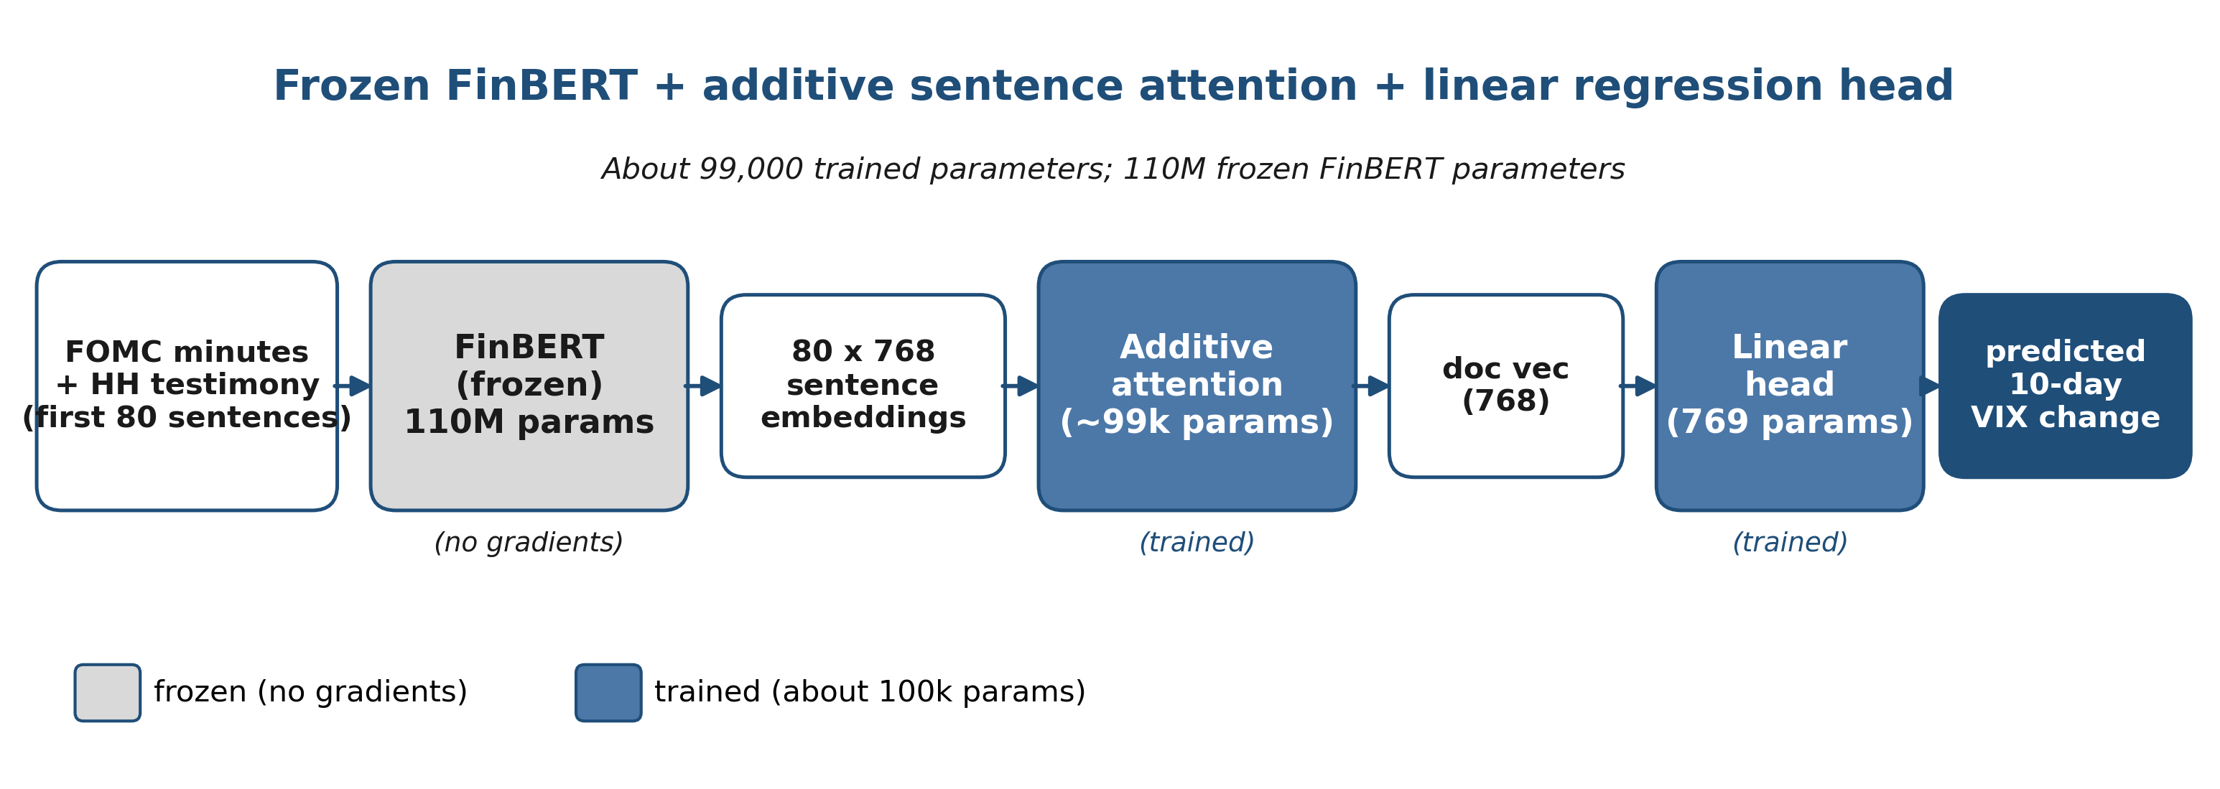
Model: frozen FinBERT + sentence attention + linear head
• FinBERT (Yang, Uy & Huang 2020): BERT-base further pretrained on 4.9B tokens of financial corpora. Better for Fed terminology than generic BERT.
• Frozen encoder because 233 training docs is hopelessly under-data for fine-tuning 110M parameters (Peters, Ruder & Smith 2019).
• Additive (Bahdanau-style) attention over sentences from Yang et al. 2016 "Hierarchical Attention Networks". Gives interpretable per-sentence weights.
• About 99k trained parameters total. Sweet spot for this dataset size.
Notes:
Here is the architecture from left to right. The input is the first 80 sentences of a Fed document. Those go through FinBERT, which is a BERT model that was further pretrained on financial text by Yang, Uy, and Huang in 2020. I keep FinBERT completely frozen, so no gradients flow back through it.
Why frozen? Two reasons. One, I only have 233 training documents, and a 110-million-parameter BERT will overfit catastrophically on that. Two, freezing the backbone is the standard small-data move in modern NLP, supported by Peters, Ruder, and Smith in 2019. They showed that for small downstream datasets, using the model as a frozen feature extractor often matches or beats fine-tuning.
FinBERT gives me a 768-dim embedding per sentence. To aggregate 80 sentences into one document vector, I use additive attention. This is the Hierarchical Attention Network formulation from Yang et al. 2016. The attention layer learns which sentences matter most for the prediction, which gives me a free interpretability story.
The aggregated document vector goes into a linear regression head that outputs the predicted 10-day VIX change. Counting the attention parameters and the linear head, I have about 99 thousand trained parameters total. That is the sweet spot for 233 training documents, small enough not to overfit, big enough to learn the attention pattern.

Slide 5
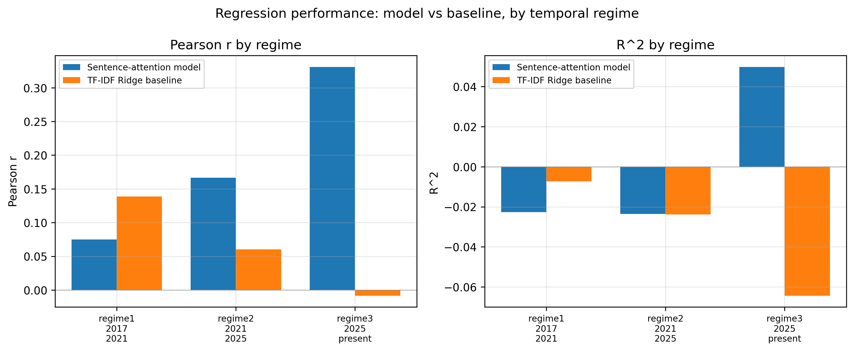
Results: Pearson r = 0.34, p = 0.045 on validation
Validation (n = 35)
Pearson r = 0.341 (p = 0.045) R² = +0.083 MSE = 6.59
Horizon ablation
3-day target: r = 0.15, p = 0.38 (not significant) 10-day target: r = 0.34, p = 0.045 (significant) Shorter horizon is dominated by non-Fed noise.
Per-regime vs. TF-IDF baseline
Model beats baseline in Biden and Trump 2 regimes. Trump 2: model r = +0.33 vs baseline r = -0.01.
Notes:
Here is the headline result. On the held-out validation set of 35 documents, the model achieves a Pearson correlation of 0.34 with a p-value of 0.045. That p-value crosses the conventional 0.05 significance threshold, so I can reject the null that the model has zero correlation with the target. The R-squared is positive at 0.083, meaning the model explains about 8% of the variance.
The horizon was a key methodological choice. I initially trained against a 3-day forward VIX change. That gave Pearson r of 0.15 with p = 0.38, which is not statistically significant. The 3-day horizon is dominated by other news events and microstructure that have nothing to do with the Fed. Extending the horizon to 10 trading days smooths out that noise and gives the textual signal room to manifest. That single change took the result from a null finding to a significant one.
The figure on the right shows the per-regime comparison against a TF-IDF plus Ridge regression baseline. The deep model beats the baseline in the Biden era and beats it by a large margin in the Trump 2 era. The Trump 2 result is r = 0.33 for the deep model versus essentially zero for the baseline. The sample size for Trump 2 is only 13 documents, so the per-regime p-value is not yet significant, but the direction is consistent with the political-regime hypothesis: the relationship between Fed text and volatility may be stronger during periods of public pressure on the Fed.

Slide 6
Conclusions and next steps
• Result: Fed text predicts 10-day VIX change with Pearson r = 0.34 (p = 0.045) on held-out validation. Not a null result.
• What worked: frozen FinBERT plus additive sentence attention. Small (about 100k trained params), interpretable, beat the linear baseline in regimes 2 and 3.
• Methodological finding: horizon matters. A 3-day target buries the signal in noise; 10 days is long enough for it to show up.
• What I would do differently with more time: use FOMC statements (released same-day, when markets actually react), use intraday VIX as the target, expand the corpus.
• What I learned: small-data deep learning lives or dies on the alignment between architecture capacity and dataset size; the right framing of the target matters more than the model.
Notes:
To summarize: I built a frozen FinBERT plus sentence-attention model that predicts the 10-day VIX change from Federal Reserve text, and I got a statistically significant result on held-out validation. Pearson r is 0.34 with p = 0.045. The model beat the linear baseline in two of the three test regimes.
The most important methodological finding for me was that the horizon of the target completely changed the conclusion. At 3 days, I had a null result. At 10 days, the same model and the same data produced a significant result. The lesson is that when you have a weak underlying signal in a noisy target, choosing the right time-window matters more than the architecture.
If I were doing this for real, I would switch to FOMC statements instead of minutes. Statements come out on the day of the meeting at 2pm Eastern, which is when markets actually move. Minutes are released 3 weeks later and most of the surprise is gone. I would also use intraday VIX data instead of daily closes so I could measure the response in the first hour or two after a release. The architecture I built here transfers cleanly to that setting.
Bigger takeaway from the project: in small-data deep learning, the balance between architecture capacity and data size is everything, and how you frame your target is at least as important as how you frame your model. Thanks for listening, happy to take questions.

