Slide 1




CHAPTER 7
HASHING
Search by Formula
There’s a theorem saying that
“Any algorithm that sorts
by comparisons only must have
a worst case computing time of
Ω( n log₂ n ).”
But we already have binary search
in O( ln n ) time after sorting.
And we already have algorithms for
sorting in optimal time O( n ln n )...
Interpolation Search :
Find key from a sorted list f [ l ].key, f [ l+1 ].key, ... , f [ u ].key.
What is hashing for?
Wait a minute — who said that
O( n ln n ) is the optimal time?
f[u].key
Then we just do something
else besides comparison.
key
For searching
f[l].key
l
i ?
u
If ( f [ i ].key < key ) l = i ;
Else u = i ;
n elements
1/14

Slide 2
§1 General Idea
Symbol Table ( == Dictionary) ::= { < name, attribute > }
〖Example〗 In Oxford English dictionary
name = since
attribute = a list of meanings
M[0] = after a date, event, etc.
M[1] = seeing that (expressing
reason)
…… ……
This is the worst disaster in California
since I was elected.
California Governor Pat Brown,
discussing a local flood
〖Example〗 In a symbol table for a compiler
name = identifier (e.g. int)
attribute = a list of lines that use the identifier, and some other fields
2/14

Slide 3
§1 General Idea
❖ Symbol Table ADT:
Objects: A set of name-attribute pairs, where the names are unique
Operations:
☞ SymTab Create(TableSize)
☞ Boolean IsIn(symtab, name)
☞ Attribute Find(symtab, name)
☞ SymTab Insert(symtab, name, attr)
☞ SymTab Delete(symtab, name)
3/14

Slide 4
§1 General Idea
Hash Tables
For each identifier x, we define a hash function
f ( x ) = position of x in ht[ ] (i.e.
the index of the bucket
that contains x )
[0]
[1]
… …
[s−1]
… …
ht [ 0 ]
… …
ht [ 1 ]
… …
… …
b buckets
 T ::= total number of distinct possible values for x
ht [b−1]
… …
 n ::= total number of identifiers in ht[ ]
s slots
 identifier density ::= n / T
 loading density λ ::= n / (s b)
4/14

Slide 5

§1 General Idea
 A collision occurs when we hash two nonidentical identifiers into the same bucket, i.e. f ( i₁ ) = f ( i₂ ) when i₁ ≠ i₂ .
 An overflow occurs when we hash a new identifier into a full bucket.
Collision and overflow happen
simultaneously if s = 1.
〖Example〗 Mapping n = 10 C library functions into a hash table ht[ ] with b = 26 buckets and s = 2.
Loading density λ = ?
10 / 52 = 0.19
Slot 0
Slot 1
0
acos
atan
To map the letters a ~ z to 0 ~ 25, we may define f ( x ) = ?
1
x [ 0 ] − ‘a’
2
char
ceil
3
define
acos
define
float
exp
char
4
exp
atan
ceil
floor
clock
ctime
5
float
floor
6
Without overflow,
T_{search} = T_{insert} = T_{delete} = O( 1 )
……
25
5/14

Slide 6


§2 Hash Function
Properties of f :
① f ( x ) must be easy to compute and minimizes the number of collisions.
② f ( x ) should be unbiased. That is, for any x and any i, we have that Probability( f ( x ) = i ) = 1 / b. Such kind of a hash function is called a uniform hash function.
f ( x ) = x % TableSize ; /* if x is an integer */
☹ What if TableSize = 10 and x’s are all end in zero?
☺ TableSize = prime number ---- good for random integer keys
6/14

Slide 7
§2 Hash Function
f ( x ) = (Σ x[i]) % TableSize ; /* if x is a string */
〖Example〗 TableSize = 10,007 and string length of x ≤ 8.
If x[i] ∈ [0, 127], then f ( x ) ∈ [0, ? ]
1016
☹
f ( x ) = (x[0]+ x[1]*27 + x[2]*27²) % TableSize ;
Total number of combinations = 26³ = 17,576
☹ Actual number of combinations < 3000
7/14

Slide 8
§2 Hash Function
f ( x ) = (Σ x[N − i − 1] * 32^{i} ) % TableSize ;
…………
x[0]
x[1]
x[N-2]
x[N-1]
Can you make it faster?
Faster than *27
Index Hash3( const char *x, int TableSize )
{
unsigned int HashVal = 0;
/* 1*/ while( *x != '\0' )
/* 2*/ HashVal = ( HashVal << 5 ) + *x++;
/* 3*/ return HashVal % TableSize;
}
 Carefully select some characters from x.
☹ If x is too long (e.g. street address), the early characters will be left-shifted out of place.
8/14

Slide 9
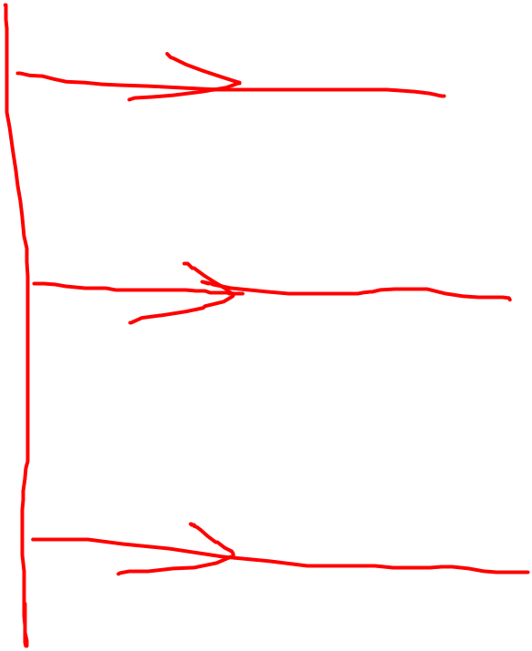

§3 Separate Chaining
---- keep a list of all keys that hash to the same value
struct ListNode;
typedef struct ListNode *Position;
struct HashTbl;
typedef struct HashTbl *HashTable;
struct ListNode {
ElementType Element;
Position Next;
};
typedef Position List;
/* List *TheList will be an array of lists, allocated later */
/* The lists use headers (for simplicity), */
/* though this wastes space */
struct HashTbl {
int TableSize;
List *TheLists;
};
9/14

Slide 10
☞ Create an empty table
§3 Separate Chaining
HashTable InitializeTable( int TableSize )
{ HashTable H;
int i;
if ( TableSize < MinTableSize ) {
Error( "Table size too small" ); return NULL;
}
H = malloc( sizeof( struct HashTbl ) ); /* Allocate table */
if ( H == NULL ) FatalError( "Out of space!!!" );
H->TableSize = NextPrime( TableSize ); /* Better be prime */
H->TheLists = malloc( sizeof( List ) * H->TableSize ); /*Array of lists*/
if ( H->TheLists == NULL ) FatalError( "Out of space!!!" );
for( i = 0; i < H->TableSize; i++ ) { /* Allocate list headers */
H->TheLists[ i ] = malloc( sizeof( struct ListNode ) ); /* Slow! */
if ( H->TheLists[ i ] == NULL ) FatalError( "Out of space!!!" );
else H->TheLists[ i ]->Next = NULL;
}
return H;
}
H
TheLists
……
TableSize
……
10/14

Slide 11
§3 Separate Chaining
☞ Find a key from a hash table
Position Find ( ElementType Key, HashTable H )
{
Position P;
List L;
L = H->TheLists[ Hash( Key, H->TableSize ) ];
P = L->Next;
while( P != NULL && P->Element != Key ) /* Probably need strcmp */
P = P->Next;
return P;
}
Your hash function
Identical to the code to perform a Find for general lists -- List ADT
11/14

Slide 12
☞ Insert a key into a hash table
§3 Separate Chaining
void Insert ( ElementType Key, HashTable H )
{
Position Pos, NewCell;
List L;
Pos = Find( Key, H );
if ( Pos == NULL ) { /* Key is not found, then insert */
NewCell = malloc( sizeof( struct ListNode ) );
if ( NewCell == NULL ) FatalError( "Out of space!!!" );
else {
L = H->TheLists[ Hash( Key, H->TableSize ) ];
NewCell->Next = L->Next;
NewCell->Element = Key; /* Probably need strcpy! */
L->Next = NewCell;
}
}
}
☹ Again?!
Tip: Make the TableSize about as large as the number of keys expected (i.e. to make the loading density factor λ≈1).
12/14

Slide 13
§4 Open Addressing
---- find another empty cell to solve collision (avoiding pointers)
Algorithm: insert key into an array of hash table
{
index = hash(key);
initialize i = 0 ------ the counter of probing;
while ( collision at index ) {
index = ( hash(key) + f(i) ) % TableSize;
if ( table is full ) break;
else i ++;
}
if ( table is full )
ERROR (“No space left”);
else
insert key at index;
}
Collision resolving function.
f(0) = 0.
Tip: Generally λ < 0.5.
13/14

Slide 14


§4 Open Addressing
f ( i ) = i ; /* a linear function */
1. Linear Probing
〖Example〗 Mapping n = 11 C library functions into a hash table ht[ ] with b = 26 buckets and s = 1.
Although p is small,
the worst case can be
LARGE.
Cause primary clustering: any key that hashes into the cluster will add to the cluster after several attempts to resolve the collision.
bucket
x
search time
acos atoi char define exp ceil cos float atol floor ctime
0
acos
1
1
atoi
2
2
char
1
Loading density λ = 11 / 26 = 0.42
3
define
1
4
exp
1
5
ceil
4
Average search time = 41 / 11 = 3.73
6
cos
5
7
float
3
8
atol
9
9
floor
5
Analysis of the linear probing show that the expected number of probes
10
ctime
9
… …
25
= 1.36
14/14

