Slide 1

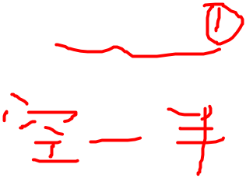
§4 Open Addressing
2. Quadratic Probing
f ( i ) = i ² ; /* a quadratic function */
【Theorem】If quadratic probing is used, and the table size is prime, then a new element can always be inserted if the table is at least half empty.
Proof: Just prove that the first ⎣TableSize/2⎦ alternative locations are all distinct. That is, for any 0 < i ≠ j ≤ ⎣TableSize/2⎦, we have
( h(x) + i ² ) % TableSize ≠ ( h(x) + j ² ) % TableSize
Suppose: h(x) + i ² = h(x) + j ² ( mod TableSize )
then: i ² = j ² ( mod TableSize )
( i + j ) ( i − j ) = 0 ( mod TableSize )
TableSize is prime
either ( i + j ) or ( i − j ) is divisible by TableSize
Contradiction !
For any x, it has ⎡ TableSize/2 ⎤ distinct locations into which it can go. If at most ⎣TableSize/2⎦ positions are taken, then an empty spot can always be found.
1/6

Slide 2

§4 Open Addressing
Note: If the table size is a prime of the form 4k + 3, then the quadratic probing f(i) = ± i ² can probe the entire table.
Read Figures 7.15 - 7.16 for detailed
representations and implementations of initialization.
Position Find ( ElementType Key, HashTable H )
{ Position CurrentPos;
int CollisionNum;
CollisionNum = 0;
CurrentPos = Hash( Key, H->TableSize );
while( H->TheCells[ CurrentPos ].Info != Empty &&
H->TheCells[ CurrentPos ].Element != Key ) {
CurrentPos += 2 * ++CollisionNum − 1;
if ( CurrentPos >= H->TableSize ) CurrentPos − = H->TableSize;
}
return CurrentPos;
}
f(i)=f(i−1)+2i−1
where 2* is really a bit shift
What if these two conditions are switched?
Faster than mod
What is returned?
2/6
Notes:
如果是empty，则key没有定义，先判断会出错。
假设探测步数i不超过TS/2+1步，即假设表<50%。这时CurrentPos+2i-1 <= 2TS-1，所以可以用减法。

Slide 3
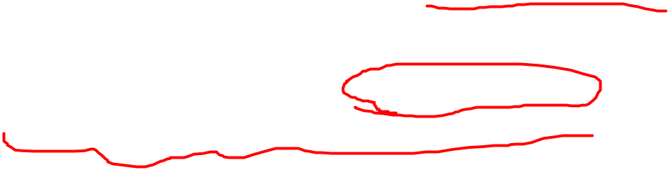
§4 Open Addressing
void Insert ( ElementType Key, HashTable H )
{
Position Pos;
Pos = Find( Key, H );
if ( H->TheCells[ Pos ].Info != Legitimate ) { /* OK to insert here */
H->TheCells[ Pos ].Info = Legitimate;
H->TheCells[ Pos ].Element = Key; /* Probably need strcpy */
}
}
Question: How to delete a key?
Note: ① Insertion will be seriously slowed down if there are too many deletions intermixed with insertions.
② Although primary clustering is solved, secondary clustering occurs – that is, keys that hash to the same position will probe the same alternative cells.
3/6

Slide 4
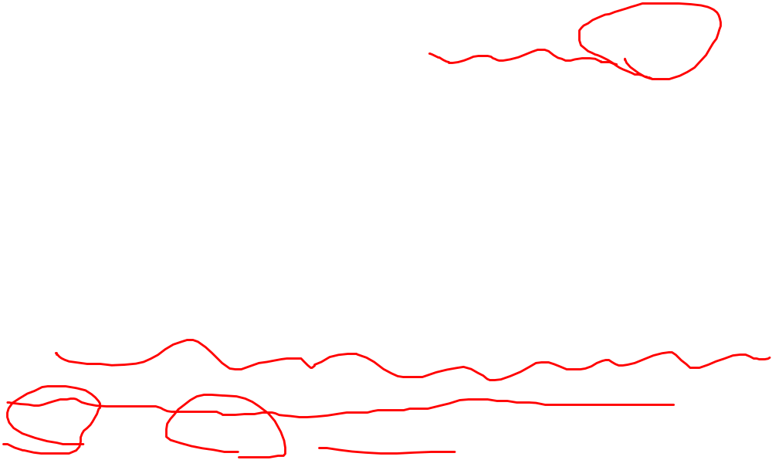
3. Double Hashing
§4 Open Addressing
f ( i ) = i * hash₂( x ); /* hash₂( x ) is the 2nd hash function */
 hash₂( x ) ≡ 0 ;
 make sure that all cells can be probed.
 Tip: hash₂( x ) = R – ( x % R ) with R a prime smaller than TableSize, will work well.
Note: ① If double hashing is correctly implemented, simulations imply that the expected number of probes is almost the same as for a random collision resolution strategy.
② Quadratic probing does not require the use of a second hash function and is thus likely to be simpler and faster in practice.
4/6

Slide 5
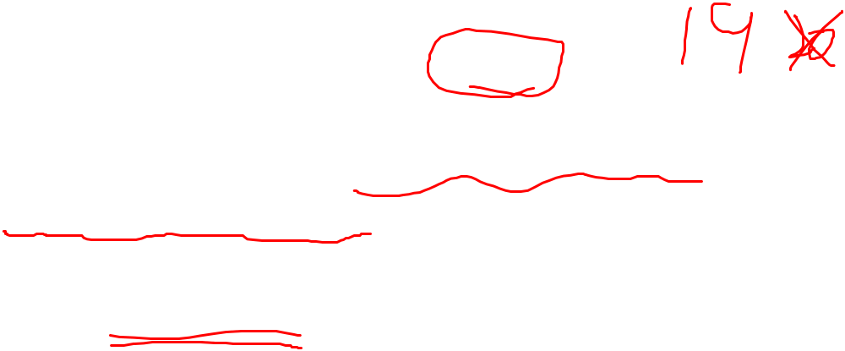


§5 Rehashing
Uhhhh…
insertion might fail ☹
What will happen
if the table is more than half full?
Because
I enjoy giving you headaches …
Just kidding ☺
Say which probing method
do you like?
Practically speaking
I would prefer to use quadratic hashing…
What, anything wrong with it?
Oh come on! Haven’t we had
enough hashing methods?
Why do we need rehashing ?
☞ Build another table that is about twice as big;
☞ Scan down the entire original hash table for non-deleted elements;
☞ Use a new function to hash those elements into the new table.
Then what can we do?
If there are N keys in the table, then T (N) =
O(N)
Question: When to rehash?
Answer:
① As soon as the table is half full
② When an insertion fails
③ When the table reaches a certain load factor
5/6

Slide 6
§5 Rehashing
Note: Usually there should have been N/2 insertions before rehash, so O(N) rehash only adds a constant cost to each insertion.
However, in an interactive system, the unfortunate user whose insertion caused a rehash could see a slowdown.
Read Figures 7.23
for detailed implementation of rehashing.
6/6

