Slide 1


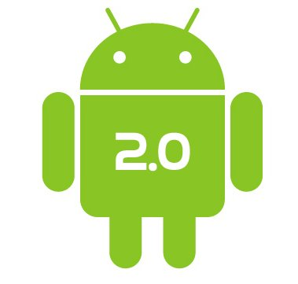
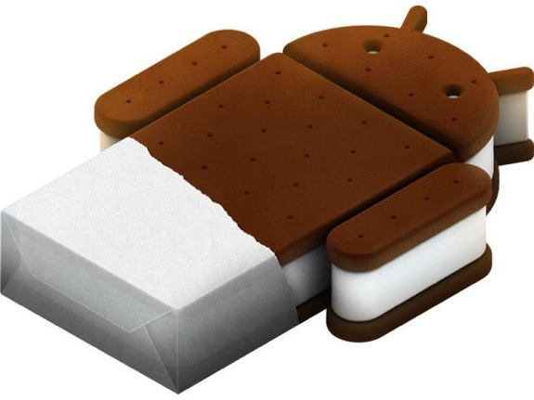

Android Architecture
Hardik Panchal

Slide 2
Outline
An Overview
Block Diagram
Linux Kernel
Libraries
Android Runtime
Application Framework
Application

Slide 3
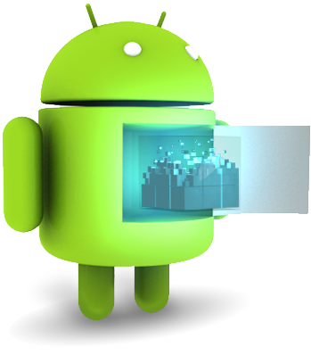
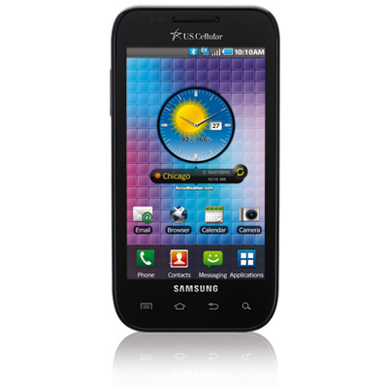

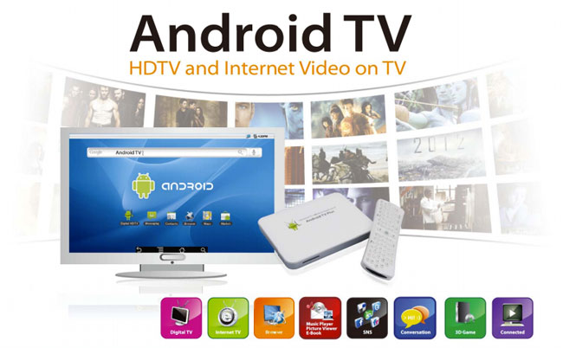
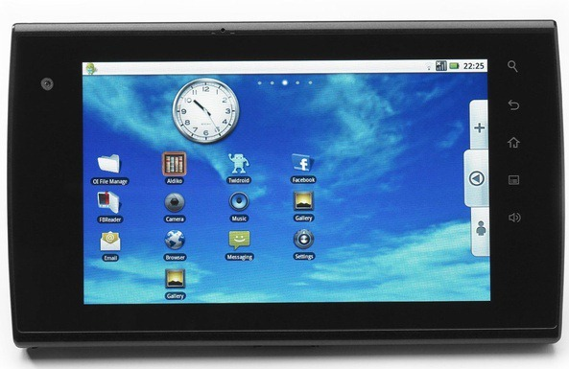
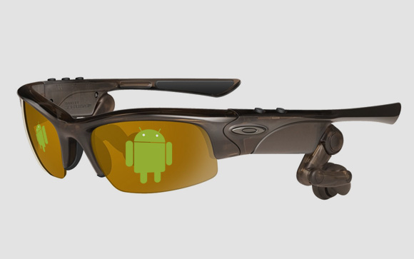
What is the Android?
Android is a Linux-based platform for mobile devices …
  Operating System
  Middleware
  Applications
  Software Development Kit (SDK)
Which kind of mobile devices … (examples)
?
SMARTPHONES
TABLETS
EREADERS
ANDROID TV
GOOGLE GLASSES

Slide 4
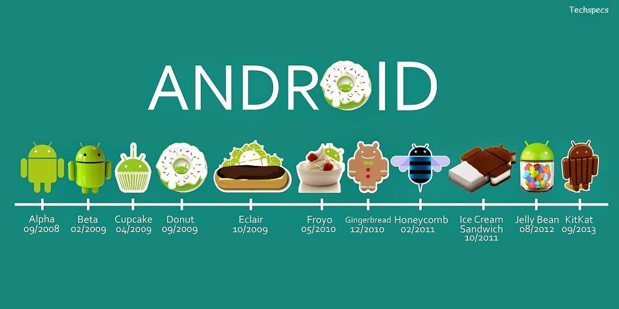


Android Version :
Lollipop 09/2014
Marshmallow 09/2014

Slide 5

The Android Architecture
}
Stack
Architecture

Slide 6
Linux Kernel :
Built on top of Linux kernel
Advantages:
Portability (i.e. easy to compile on different harwdare architectures)
Security (e.g. secure multi-process environment)
Power Management

Slide 7
Linux kernel :
Linux is the heart of Android architecture.
It provides a level of abstraction between the hardware devices and the upper layers of the Android software stack.
The Android operating system is based on the Linux kernel.
The Linux kernel is responsible for various device drivers such as Camera driver, Display driver, Bluetooth driver, Keypad driver, Memory management, Process management, Power management, etc.

Slide 8
Libraries :
Native Libraries
(C/C++ code)
Graphics (Surface Manager)
Multimedia (Media Framework)
Database DBMS (SQLite)
Font Management (FreeType)
WebKit
C libraries (Bionic)
….

Slide 9
Libraries :
Surface Manager : composing windows on the screen
SGL : 2D Graphics
Open GL|ES : 3D Library
Media Framework : Supports playbacks and recording of various audio, video and picture formats.
Free Type : Font Rendering
WebKit : Browser Engine
libc (System C libraries)
SQLite (Database)
Open SSL (Socket Secure Layer)
.

Slide 10
Android Runtime
Dalvik Virtual Machine (VM)
Novel Java Virtual Machine implementation (not using the Oracle JVM)
Open License (Oracle JVM is not open!)
Optimized for memory-constrained devices
Faster than Oracle JVM
….

Slide 11
Android Runtime :
The Dalvik Virtual Machine (commonly called the Dalvik VM), like the Java Virtual Machine (JVM), is a register based virtual machine that provides the necessary optimizations for running in low memory environments.
The Dalvik Virtual Machine converts the bytecodes (Java class files) having .class extensions that generated by the Java compiler into the Dalvik—executable files that have .dex extensions.
Such binaries are optimized to execute on smaller processors and low memory environments. The Dalvik Virtual Machine takes advantage of the core features of Linux that include multi-threading, process and device management, and memory management. Moreover, the DVM is provides support for platform neutrality (the .dex files are platform neutral) and you can have multiple virtual machine instances execute at the same time efficiently. It should be noted that each Android application executes in its own process—inside its own instance of the Dalvik Virtual Machine.
.

Slide 12

Dalvik Java Virtual Machine (JVM)
Java Source
Code
Java Source
Code
Java Standard Edition
Java
Compiler
Java
Compiler
Java Byte
Code
Java Byte
Code
Dex
Compiler
Stack-based
byte-code
Dalvik Byte
Code
Register-based
byte-code
Java Virtual Machine (JVM)
Dalvik Virtual Machine (VM)

Slide 13
Application Framework :
Application Libraries
(Core Components of Android)
Activity Manager
Packet Manager
Telephony Manager
Location Manager
Contents Provider
Notification Manager
….

Slide 14
Application :
Applications
(Written in Java code)
Android Play Store
Entertainment
Productivity
Personalization
Education
Geo-communication
….

Slide 15
HAL :
Android HAL [Hardware Abstraction Layer] (in abstract) bridges the gap between hardware and software.
Android application/framework communicates with the underlying hardware through Java APIs not by system calls.
But the Linux has the ability to handle only systems calls from application.
Thus we need a glue layer between the android framework and linux system.
Android HAL allows the Android application/framework to communicate with the hardware specific device drivers.
For Android application, HAL provides API’s through which service can place a request to device.
And HAL uses functions provided by the lower layer Linux system to serive the request from the android framework. .
.

