Slide 1
DEVICE DRIVERS
Presented By
Lajul Soni
Mounika Gopagani
Keerthi Kumari Cheguri
Chaithanya Mekala
Vijay Dhoki
1

Slide 2
AIM:
To create the kernel oops and debugging the kernel opps by using the gdb tool.
Requirements
Hardware : Software :
1. Raspberry pi board. 1. Raspbian OS
2. HDMI ,USB cables and Adaptor 2. GDBTools
3. Card reader,SD card(32gb). 3. Tool Chains
2

Slide 3
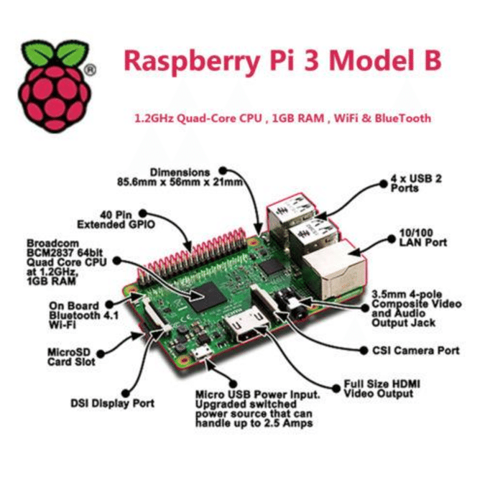
What is Raspberry Pi Board.
2
3

Slide 4
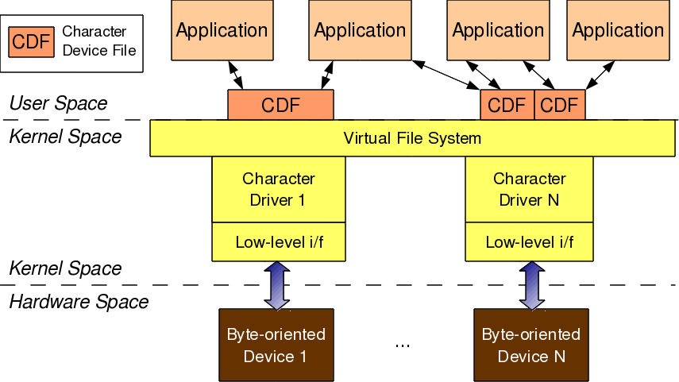
What is Device Driver
4

Slide 5
Design Work
Flow chart :
Start
Building RPI
Creation of oops
Analysing logs
GDB
End
5

Slide 6
Kernel Building for Raspberry Pi
1. Clone the Raspbian source code and Tool chain from Git.
2. Look for system architecture and set the tool chain
3. Set default config for raspberry pi 3.
4. Compile Zimage , Dtbs and Modules using cross compiler
5. Copy kernel image and modules to raspberry pi /boot folder.
6. Reboot Raspberry pi 3
6

Slide 7
Oops Creation and Dmesg
1. Taking one existing Driver from raspbian
source code
2. Creating the Kernel Oops in driver
7

Slide 8
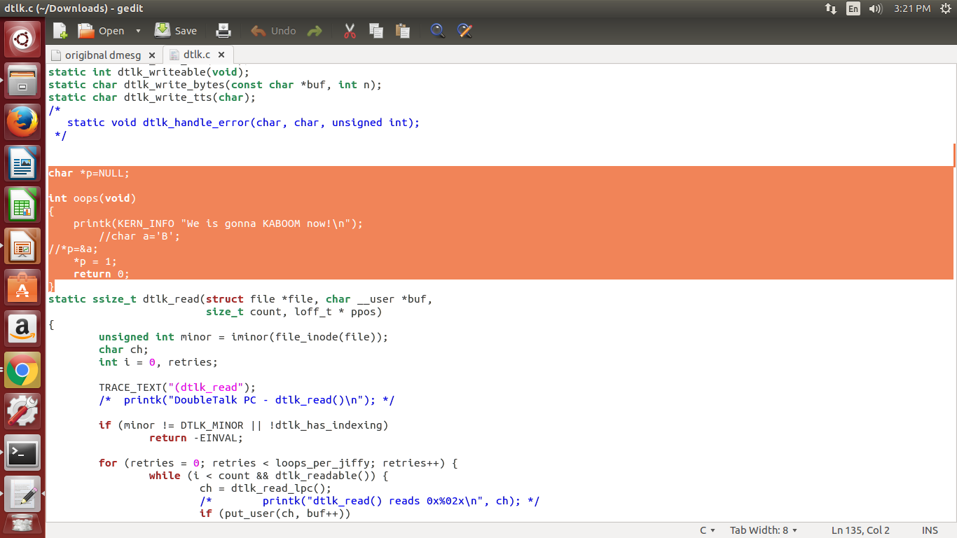
Coding/Implementation
2
8

Slide 9
Testing
1. Tested by module
2.Tested by existing driver
3. Tested by own driver
9

Slide 10
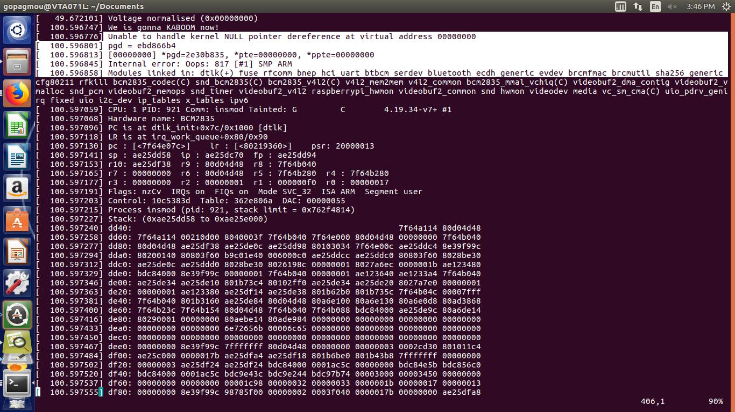
Analysis of Logs from Dmesg
2
10

Slide 11
Debugging by Gdb
Commands are:
> gdb oops.ko
> add-symbol-file oops.ko address
> disassemble function name
> list *address
11

Slide 12
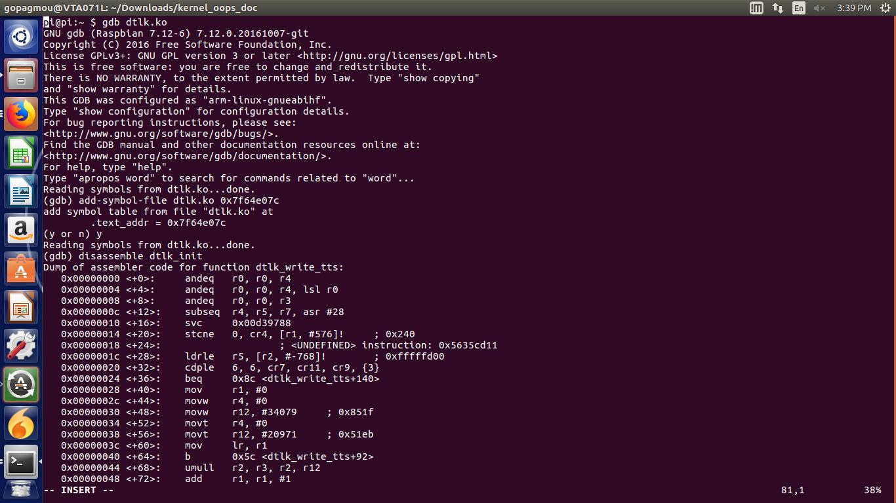
2
12

Slide 13
THANK YOU
13

