Slide 1
API's Supported by Camera Module
Presented by
C Keerthi kumari
T Beeraswamy
1

Slide 2
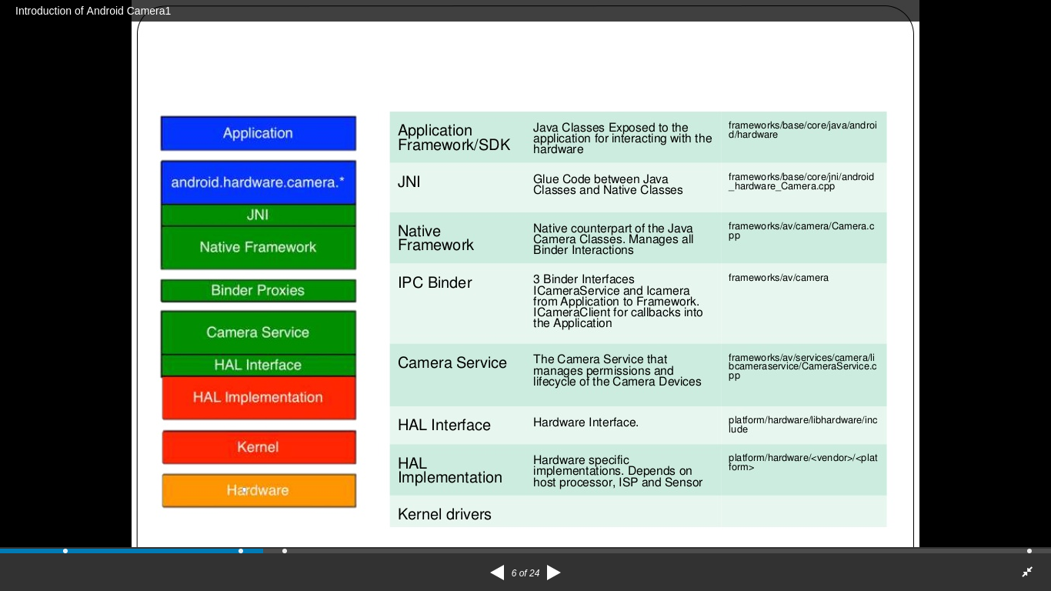
Architecture path of camera driver
2
3

Slide 3
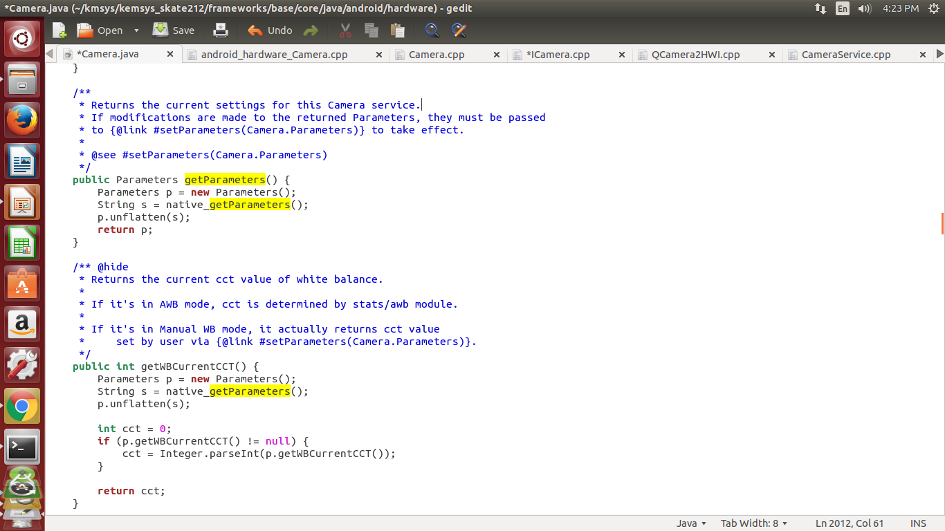
Framwork/base/core/java/android/hardware/camera.java
4

Slide 4
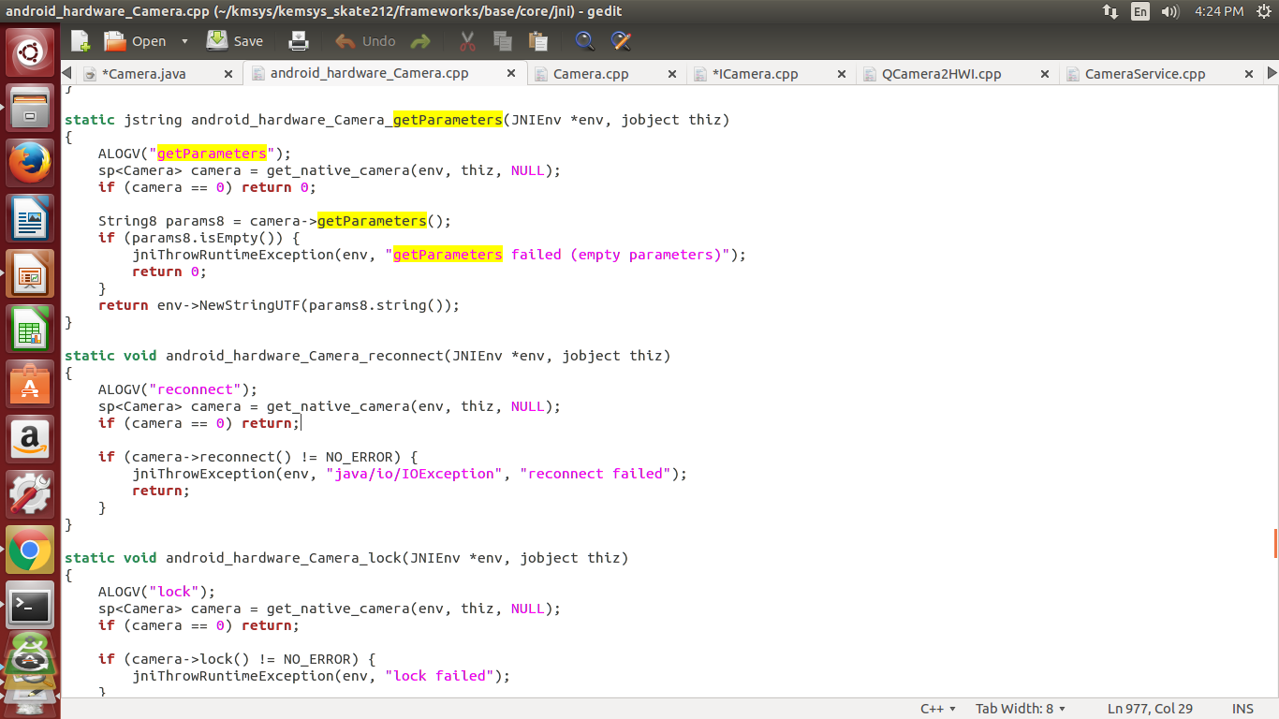
Framwork/base/core/jni/android_hardware_camera.cpp
5

Slide 5
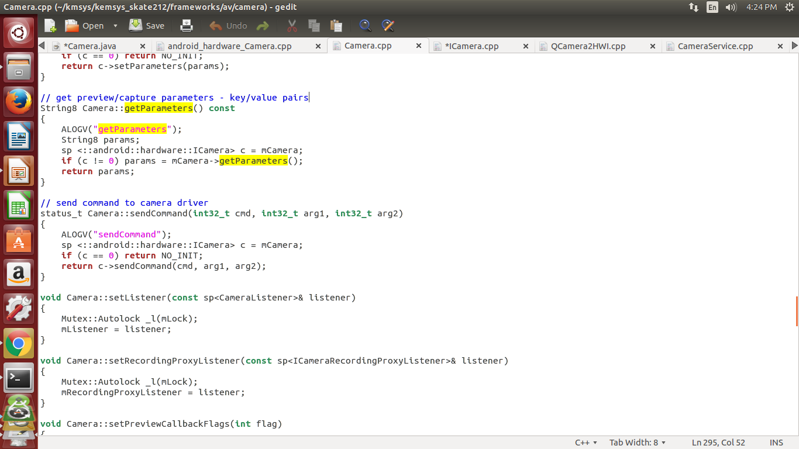
Framework/av/camera/camera.cpp
6

Slide 6
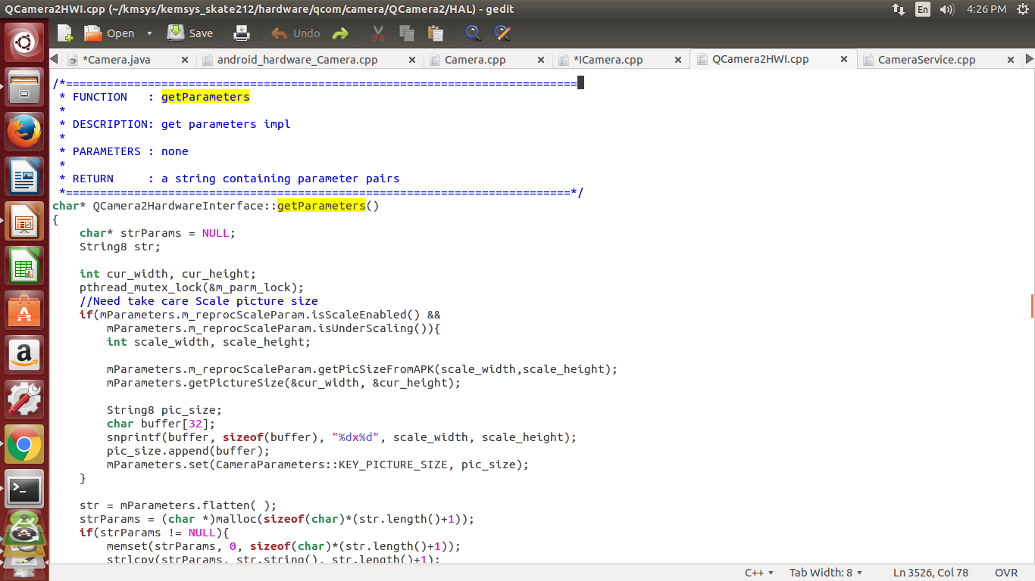
Hardware/<qcom>/camera/Qcamera2/HAL/Qcamera2HWI.cpp
7

Slide 7
THANK YOU
13

