Slide 1
Chapter 4.2
Collision Detection and Resolution

Slide 2
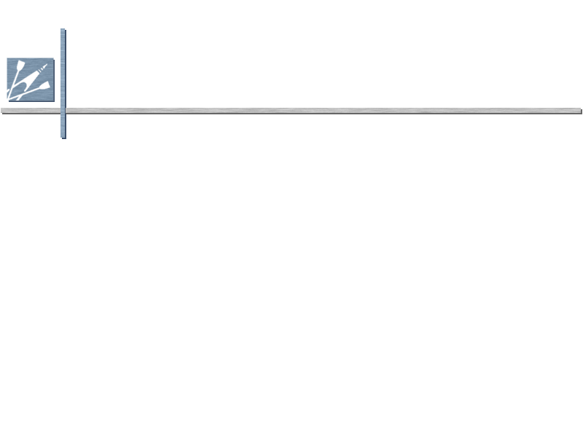
Collision Detection
Complicated for two reasons
  1. Geometry is typically very complex, potentially requiring expensive testing
  2. Naïve solution is O(n²) time complexity, since every object can potentially collide with every other object

Slide 3
Collision Detection
Two basic techniques
  1. Overlap testing
    Detects whether a collision has already occurred
  2. Intersection testing
    Predicts whether a collision will occur in the future

Slide 4
Overlap Testing
Facts
  Most common technique used in games
  Exhibits more error than intersection testing
Concept
  For every simulation step, test every pair of objects to see if they overlap
  Easy for simple volumes like spheres, harder for polygonal models

Slide 5
Overlap Testing:
Useful Results
Useful results of detected collision
  Time collision took place
  Collision normal vector

Slide 6
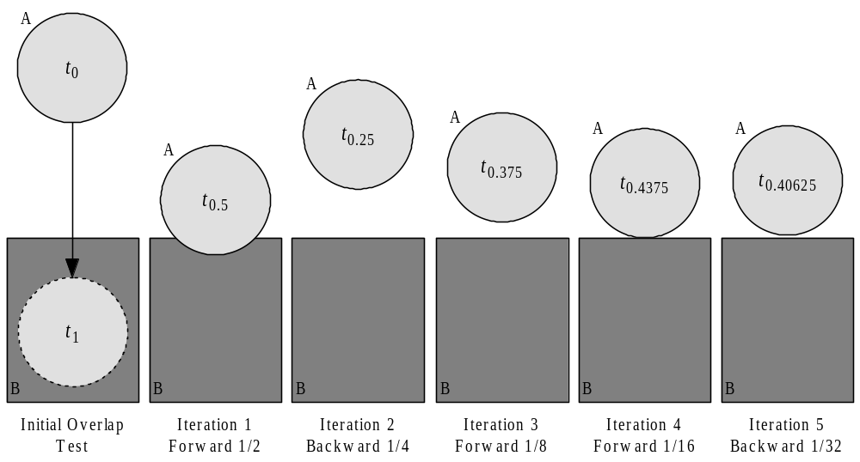
Overlap Testing:
Collision Time
Collision time calculated by moving object back in time until right before collision
  Bisection is an effective technique

Slide 7
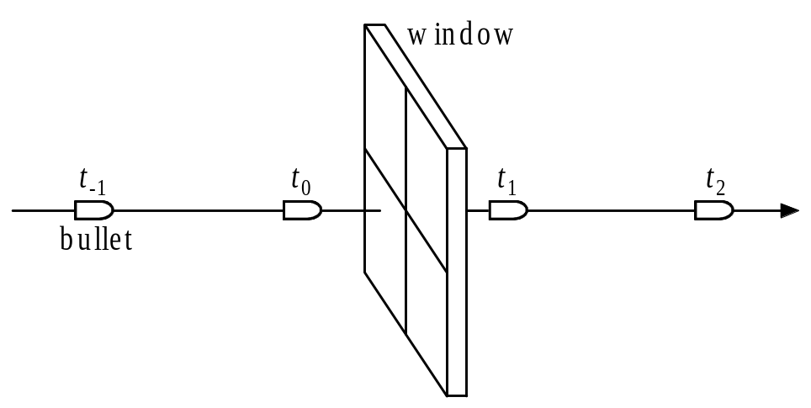
Overlap Testing:
Limitations
Fails with objects that move too fast
  Unlikely to catch time slice during overlap
Possible solutions
  Design constraint on speed of objects
  Reduce simulation step size

Slide 8
Intersection Testing
Predict future collisions
When predicted:
  Move simulation to time of collision
  Resolve collision
  Simulate remaining time step

Slide 9
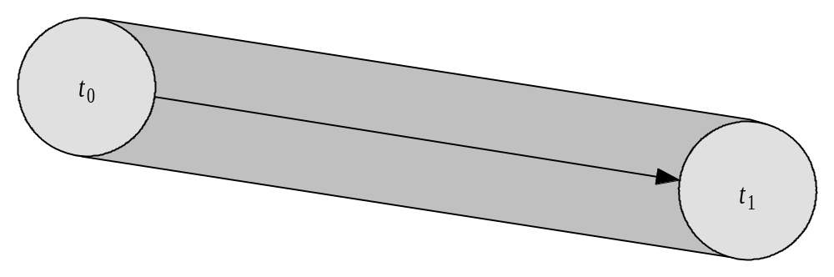
Intersection Testing:
Swept Geometry
Extrude geometry in direction of movement
Swept sphere turns into a “capsule” shape

Slide 10
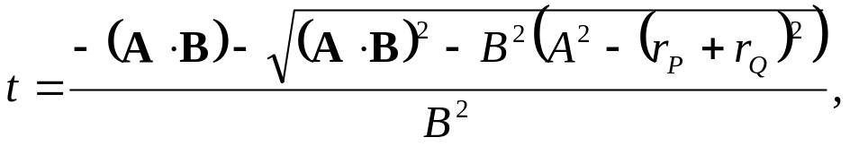
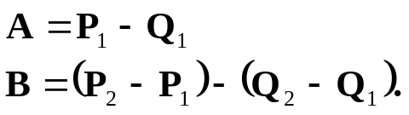
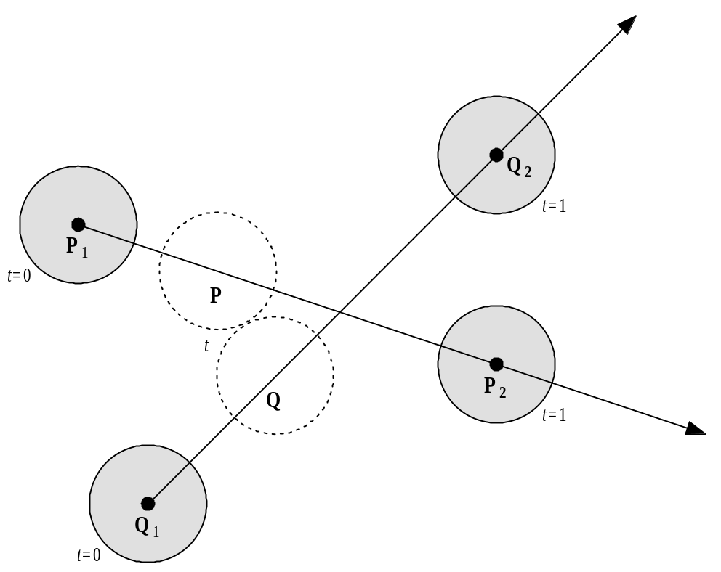
Intersection Testing:
Sphere-Sphere Collision

Slide 11
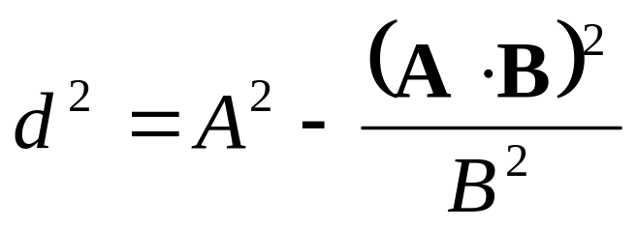
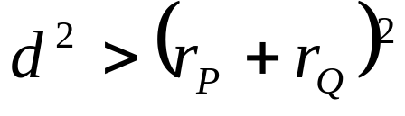
Intersection Testing:
Sphere-Sphere Collision
Smallest distance ever separating two spheres:
If
there is a collision

Slide 12
Intersection Testing:
Limitations
Issue with networked games
  Future predictions rely on exact state of world at present time
  Due to packet latency, current state not always coherent
Assumes constant velocity and zero acceleration over simulation step
  Has implications for physics model and choice of integrator

Slide 13
Dealing with Complexity
Two issues
  1. Complex geometry must be simplified
  2. Reduce number of object pair tests

Slide 14
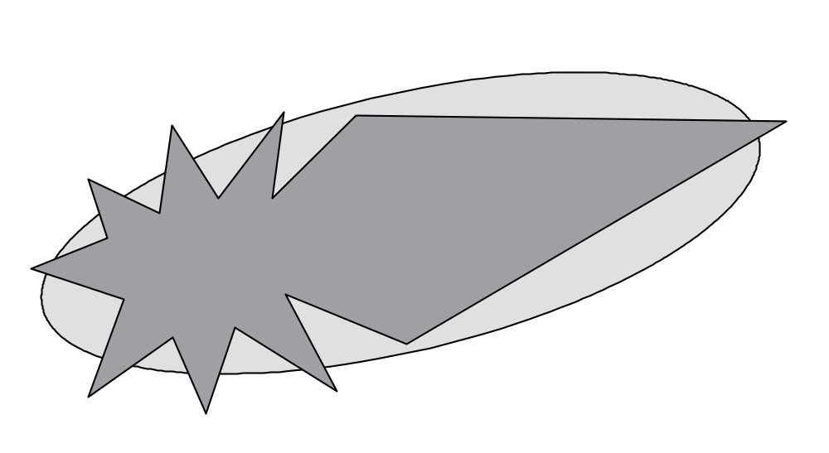
Dealing with Complexity:
Simplified Geometry
Approximate complex objects with simpler geometry, like this ellipsoid

Slide 15
Dealing with Complexity:
Minkowski Sum
By taking the Minkowski Sum of two complex volumes and creating a new volume, overlap can be found by testing if a single point is within the new volume

Slide 16
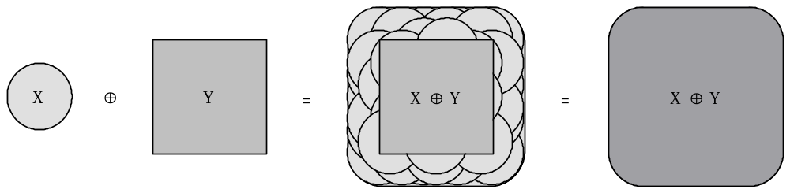
Dealing with Complexity:
Minkowski Sum

Slide 17
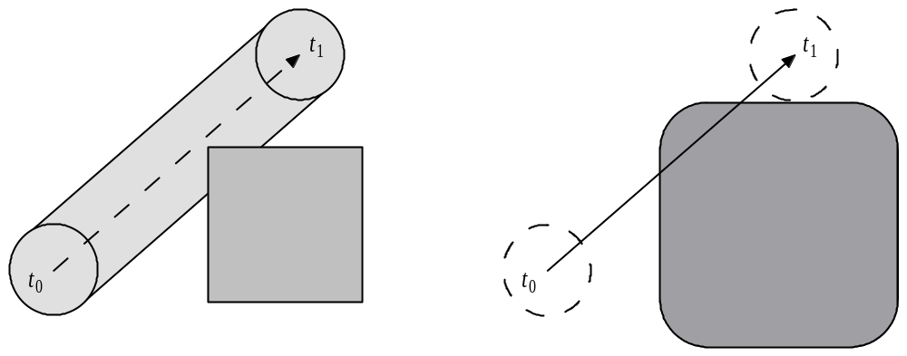
Dealing with Complexity:
Minkowski Sum

Slide 18
Dealing with Complexity:
Bounding Volumes
Bounding volume is a simple geometric shape
  Completely encapsulates object
  If no collision with bounding volume, no more testing is required
Common bounding volumes
  Sphere
  Box

Slide 19
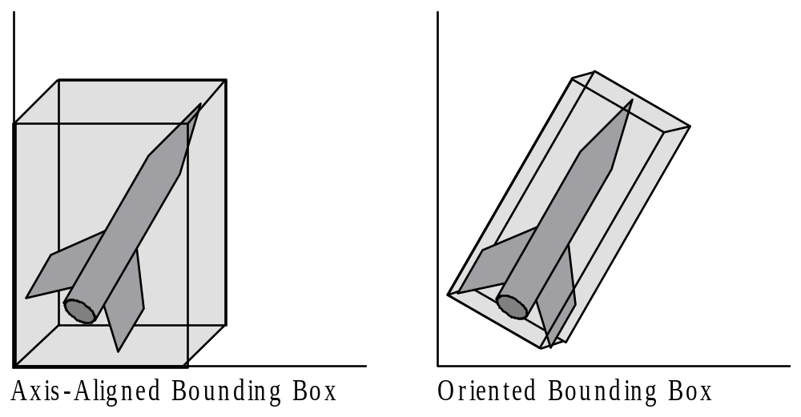
Dealing with Complexity:
Box Bounding Volumes

Slide 20
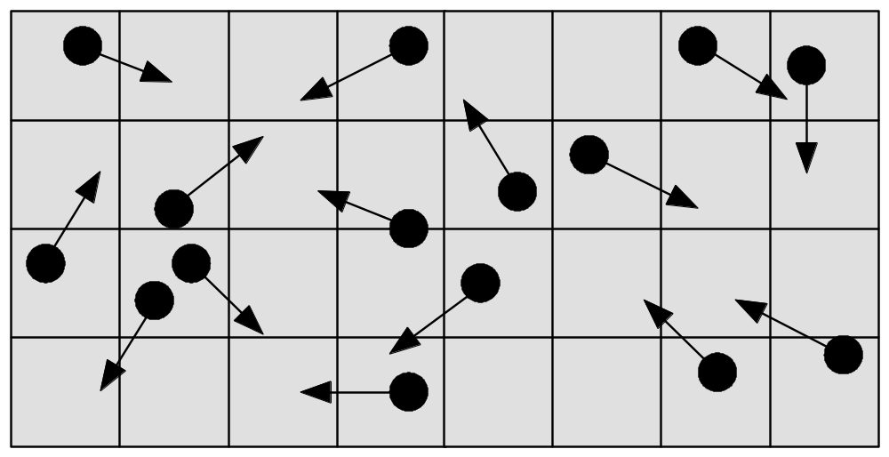
Dealing with Complexity:
Achieving O(n) Time Complexity
One solution is to partition space

Slide 21
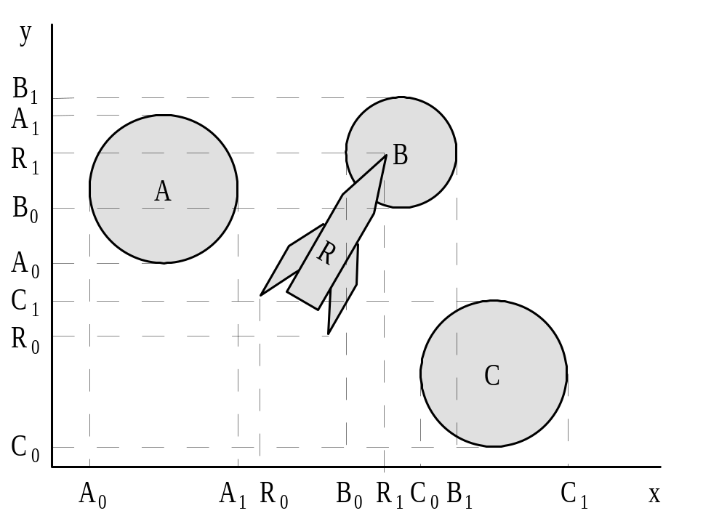
Dealing with Complexity:
Achieving O(n) Time Complexity
Another solution is the plane sweep algorithm

Slide 22
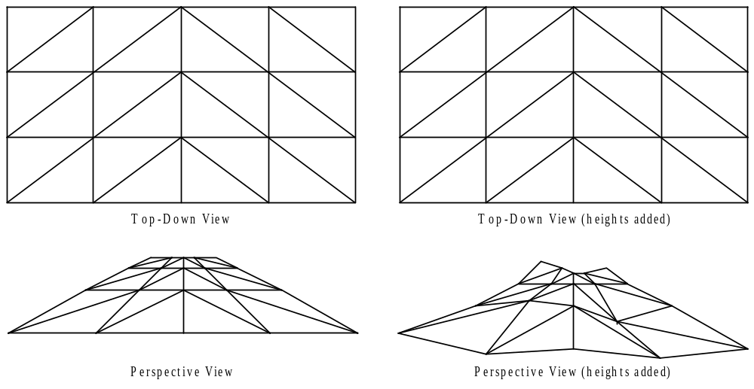
Terrain Collision Detection:
Height Field Landscape

Slide 23
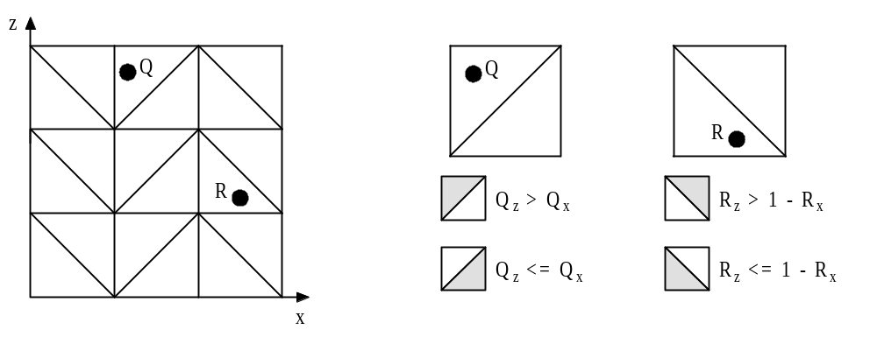
Terrain Collision Detection:
Locate Triangle on Height Field

Slide 24
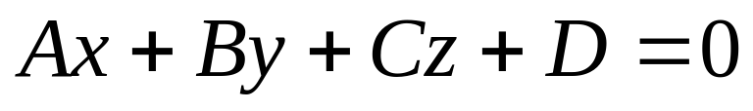
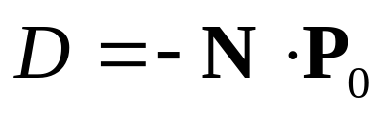

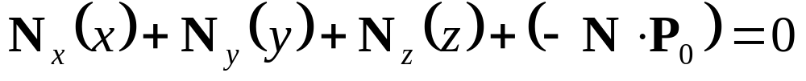
Terrain Collision Detection:
Locate Point on Triangle
Plane equation:
A, B, C are the x, y, z components of the plane’s normal vector
Where
with one of the triangles
vertices being
Giving:

Slide 25
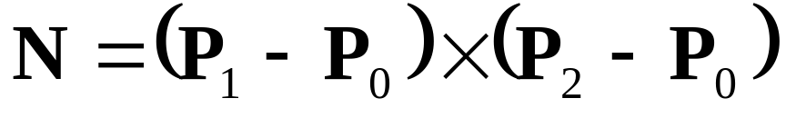
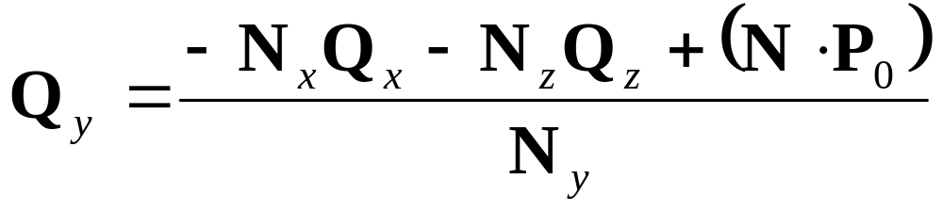
Terrain Collision Detection:
Locate Point on Triangle
The normal can be constructed by taking the cross product of two sides:
Solve for y and insert the x and z components of Q, giving the final equation for point within triangle:

Slide 26
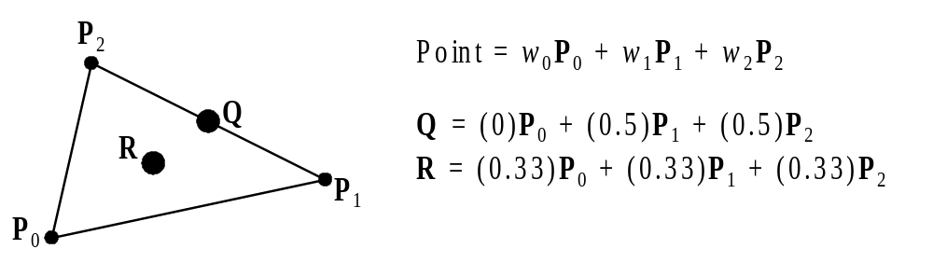
Terrain Collision Detection:
Locate Point on Triangle
Triangulated Irregular Networks (TINs)
  Non-uniform polygonal mesh
Barycentric Coordinates

Slide 27
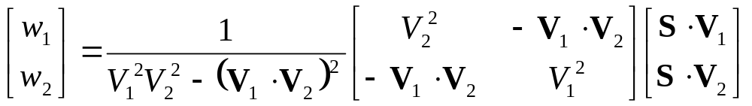
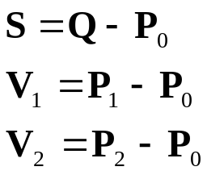
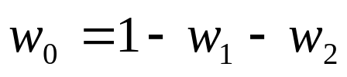
Terrain Collision Detection:
Locate Point on Triangle
Calculate barycentric coordinates for point Q in a triangle’s plane
If any of the weights (w₀, w₁, w₂) are negative, then the point Q does not lie in the triangle

Slide 28
Collision Resolution:
Examples
Two billiard balls strike
  Calculate ball positions at time of impact
  Impart new velocities on balls
  Play “clinking” sound effect
Rocket slams into wall
  Rocket disappears
  Explosion spawned and explosion sound effect
  Wall charred and area damage inflicted on nearby characters
Character walks through wall
  Magical sound effect triggered
  No trajectories or velocities affected

Slide 29
Collision Resolution:
Parts
Resolution has three parts
  1. Prologue
  2. Collision
  3. Epilogue

Slide 30
Collision Resolution:
Prologue
Collision known to have occurred
Check if collision should be ignored
Other events might be triggered
  Sound effects
  Send collision notification messages

Slide 31
Collision Resolution:
Collision
Place objects at point of impact
Assign new velocities
  Using physics or
  Using some other decision logic

Slide 32
Collision Resolution:
Epilogue
Propagate post-collision effects
Possible effects
  Destroy one or both objects
  Play sound effect
  Inflict damage
Many effects can be done either in the prologue or epilogue

Slide 33
Collision Resolution:
Resolving Overlap Testing
1. Extract collision normal
2. Extract penetration depth
3. Move the two objects apart
4. Compute new velocities

Slide 34
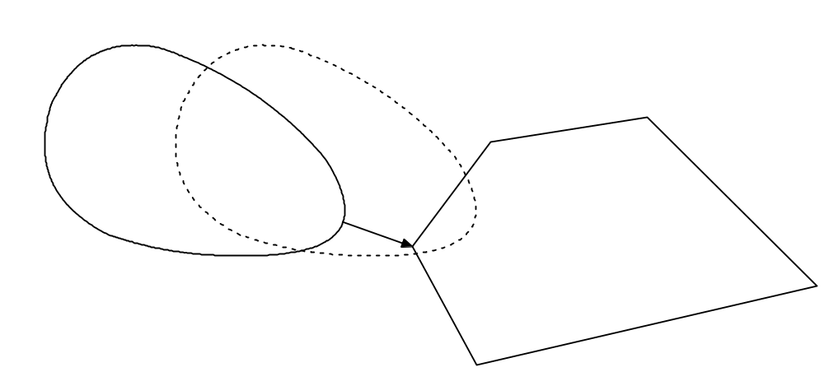
Collision Resolution:
Extract Collision Normal
Find position of objects before impact
Use two closest points to construct the collision normal vector

Slide 35
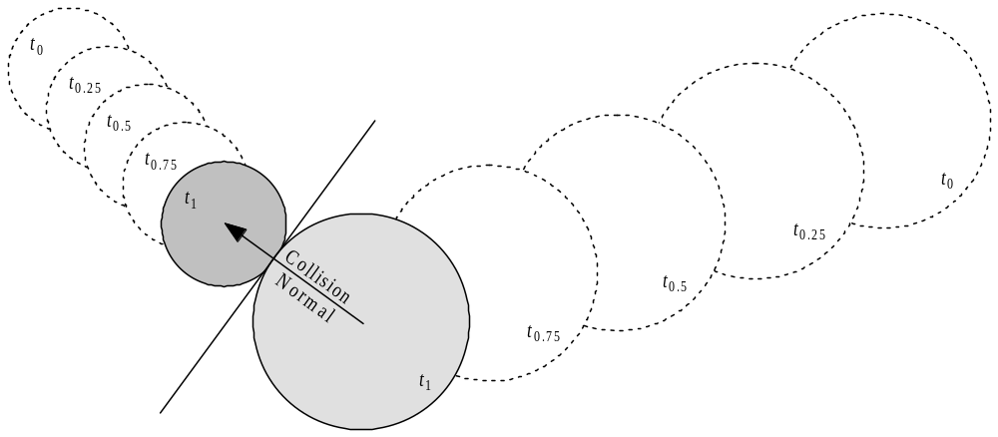
Collision Resolution:
Extract Collision Normal
Sphere collision normal vector
  Difference between centers at point of collision

Slide 36
Collision Resolution:
Resolving Intersection Testing
Simpler than resolving overlap testing
  No need to find penetration depth or move objects apart
Simply
  1. Extract collision normal
  2. Compute new velocities

