Slide 1
The Correlation Between Renewable Energy, Energy Production
and Greenhouse Gas Emissions
Ahmet Enes Topçu 150210310
Alihan Esen 150220338

Slide 2
Problem Definition
Because technology is advancing in a rapid speed while more households get their hands on electric products, there is a constantly increasing need for energy. In order to satisfy this need, more and more energy was generated using non renewable energy sources and this caused significant increases in greenhouse gas emissions. With the growing popularity of renewable energy sources, countries increased their usage of renewable energy sources and this caused an increase in generated energy while not emitting greenhouse gasses. In this project, we will be inspecting how the increase in the usage of renewable energy sources affect the generated energy - greenhouse gas emission ratio.
We will also inspect countries’ (Türkiye and USA) usage of renewable energy and the total amount of energy they generate with how it changes by time and also making predictions to the short future.

Slide 3
Datasets and Sources
For this project, we used datasets from the Turkish Statistical Institute (TÜİK), Organisation for Economic Co-operation and Development (OECD) and U.S Energy Information Administration (EIA).

Slide 4
Research Questions
- How does increasing the percentage of renewable energy sources affect the greenhouse gas emission and the total energy produced?
Hypothesis: Because renewable energy sources don’t emit greenhouse gasses, the increase in renewable energy production will increase the total energy production without increasing the total greenhouse gas emission.
- What would the future of energy production look like and how are these values expected to change?
- What are the differences in electric generation sources between USA and Türkiye?
- Which country between Türkiye and USA is adapting to renewable energy sources quicker than the other country?

Slide 5
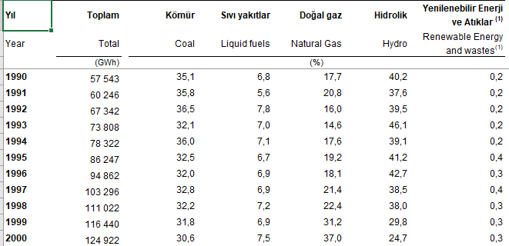
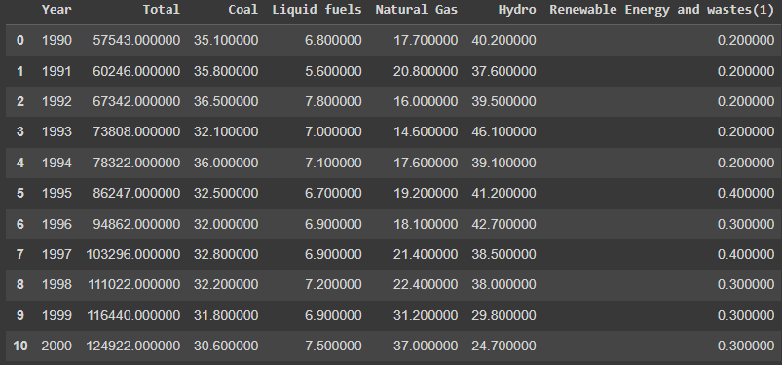
Türkiye Electric Generation by Source in Percentage Through Years (TÜİK)
Our first dataset is about the yearly electric generation percentage by source and the total amount of electric generated in terms of gigawatt-hours (GWh) in Türkiye. The dataset includes data from the year 1990 to 2021. On the left you can see the first 15 rows of the dataset (TUIK).
Raw data
Organized data

Slide 6
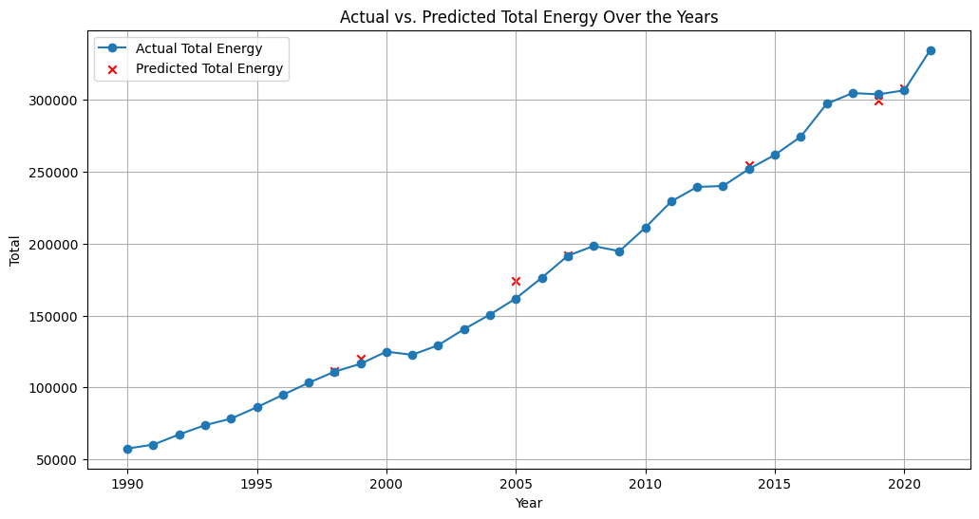
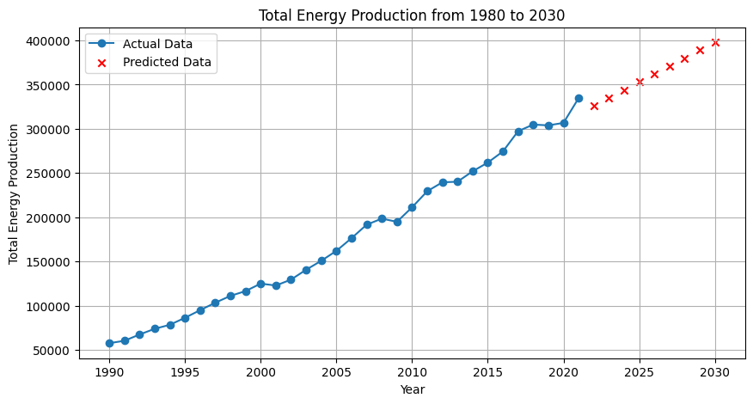
Linear Regression Train/Test - Future Results (Türkiye Total Energy)

Slide 7
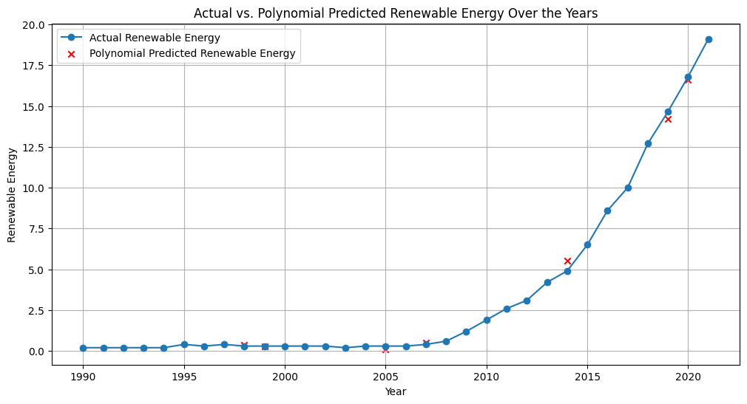
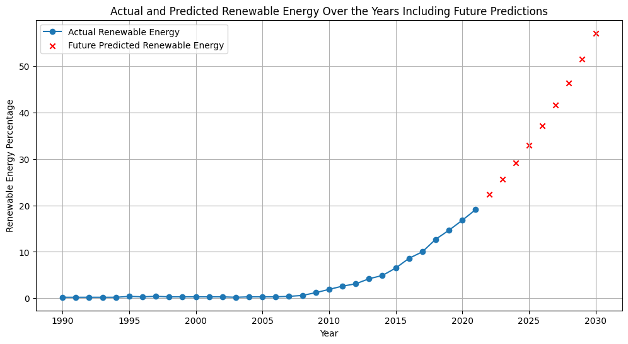
Polynomial Regression Train/Test - Future Results (Türkiye Total Energy)

Slide 8
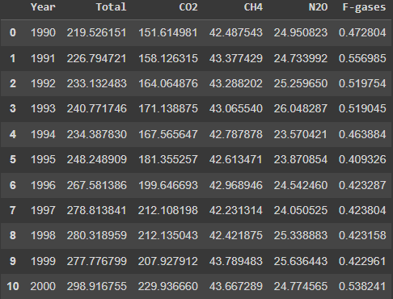
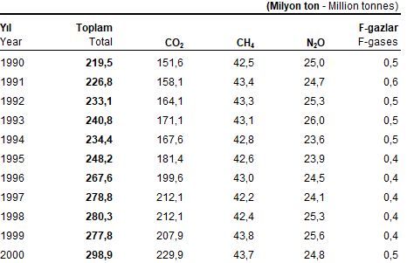
Turkey Greenhouse Gas Emissions (Million Tons of CO2) (TÜİK)
This dataset includes the yearly amount of greenhouse gas emissions throughout the years 1990-2021 in terms of million tons of CO2 (TUIK).
Raw data
Organized data

Slide 9
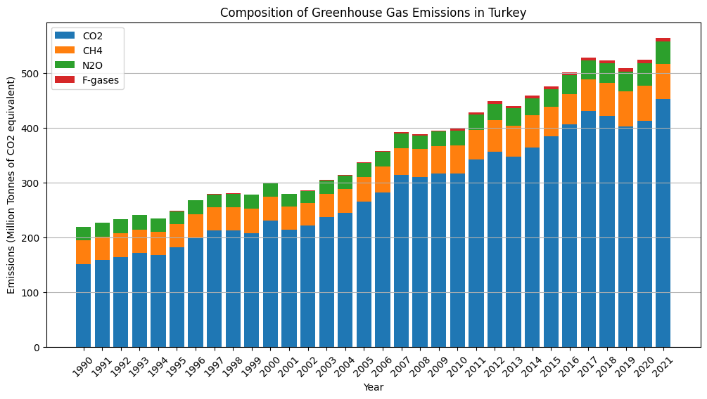

Slide 10
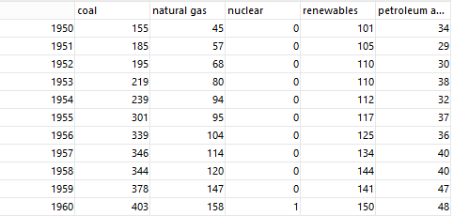
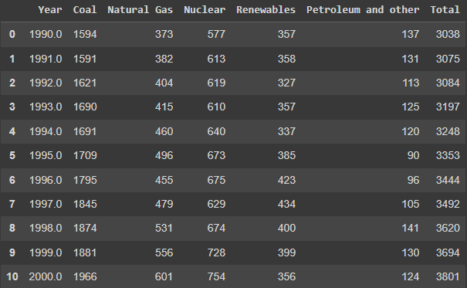
USA Electric Generation by Source in Years (Billion kWh) (EIA)
This dataset includes the yearly amount of electric generated in terms of billion kilowatt-hours (KWh) by the major sources in the United States throughout the years
1990-2021 (EIA).
Raw data
Organized data

Slide 11
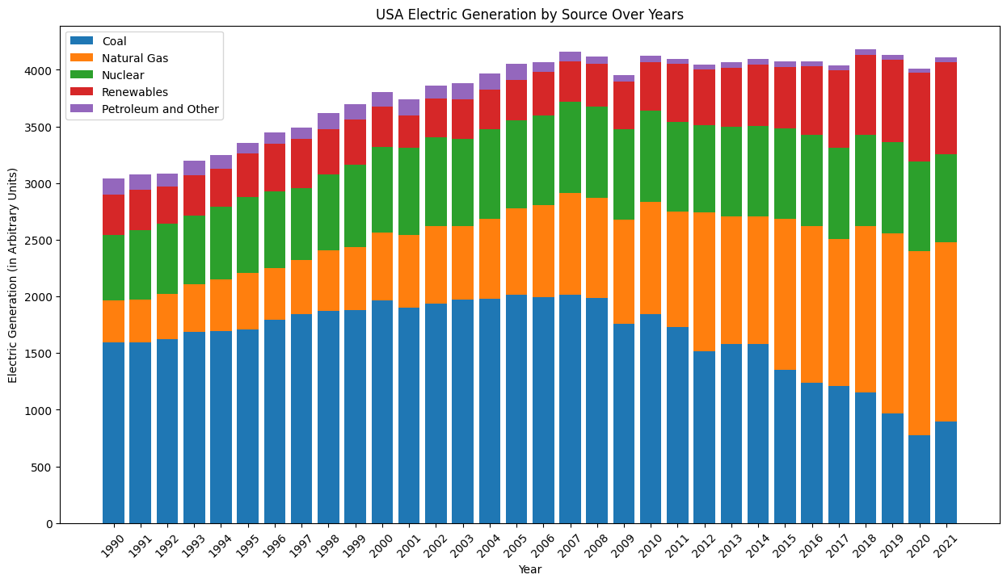

Slide 12
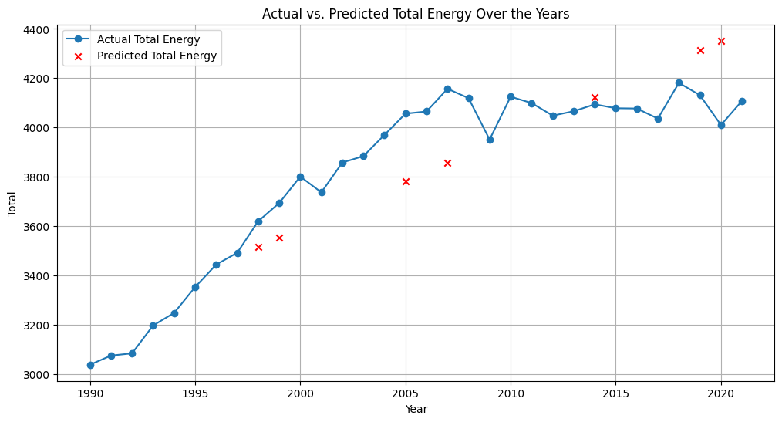

Linear Regression Test on USA Total Energy

Slide 13
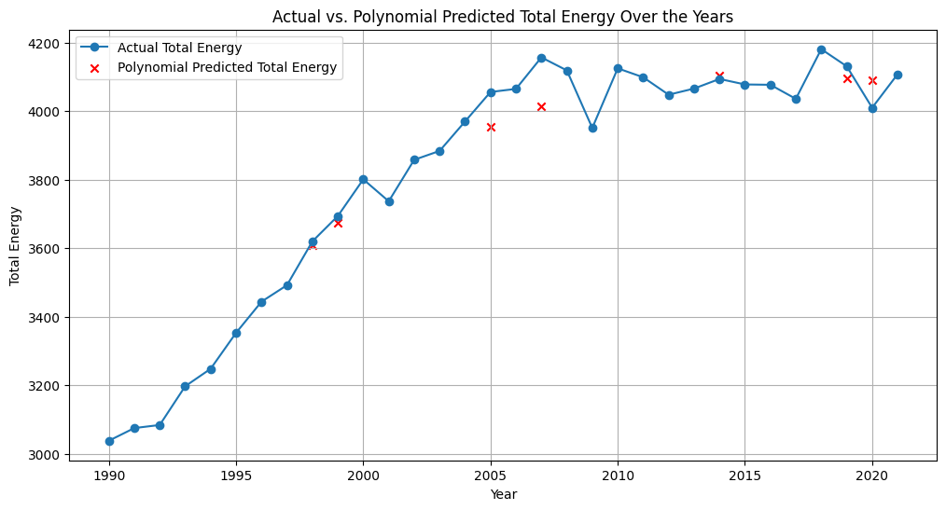
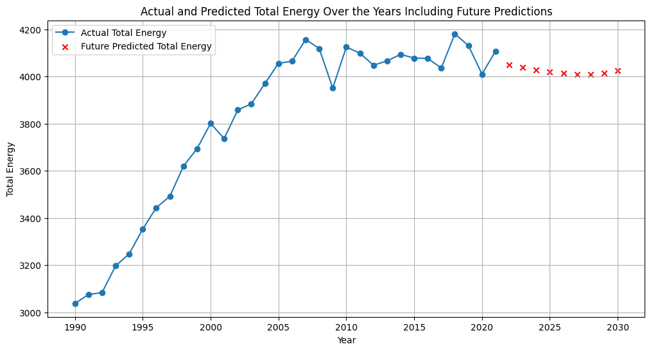

Polynomial Regression Test on USA Total Energy and Future Results

Slide 14
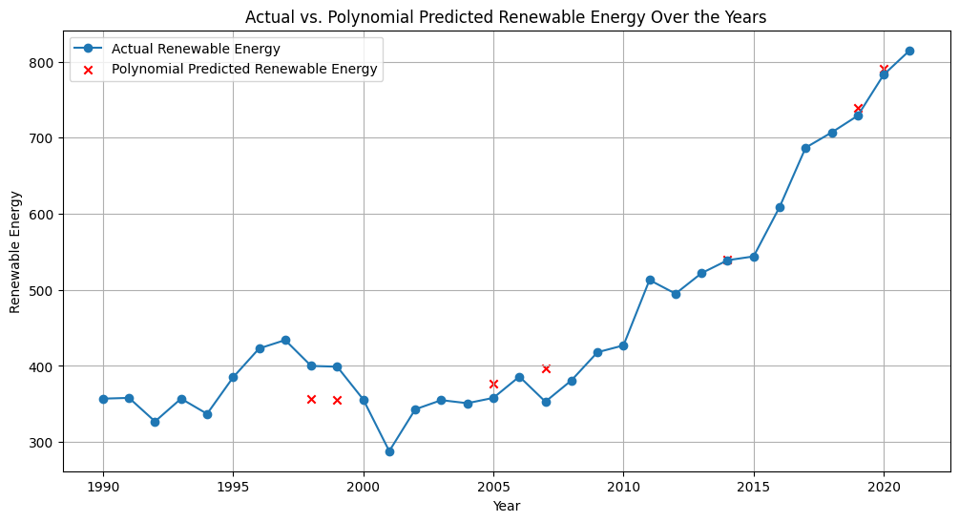
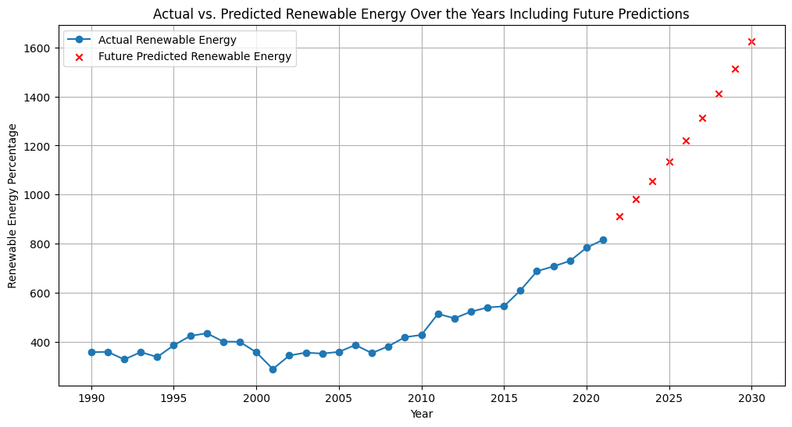
Polynomial Regression Test on USA Renewable Energy and Future Results

Slide 15
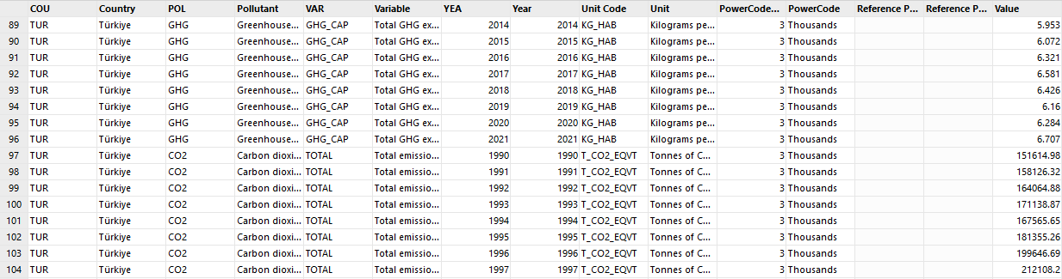
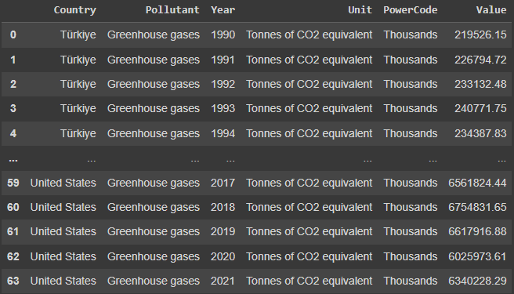
USA and TR Greenhouse Gas Emissions (Tons of CO2) (OECD)
This dataset includes the amount of greenhouse gas emissions of both the USA and
Türkiye in terms of thousand tons of CO2 through the years 1990-2021 (OECD).
Raw data
Organized data

Slide 16
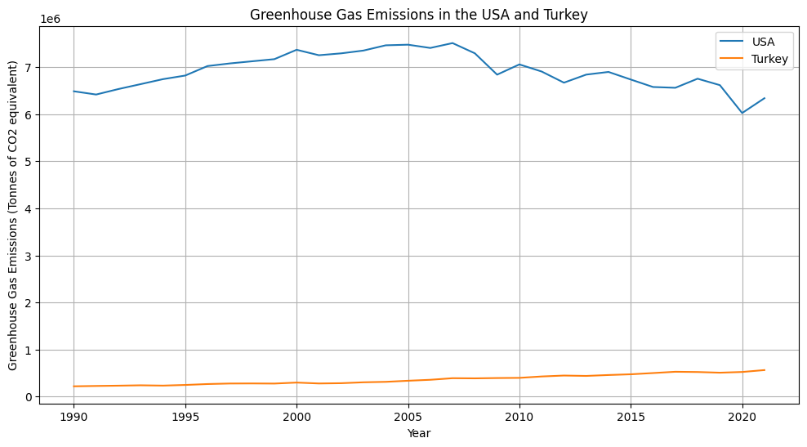
Greenhouse Gas Emissions in the USA and Turkey

Slide 17
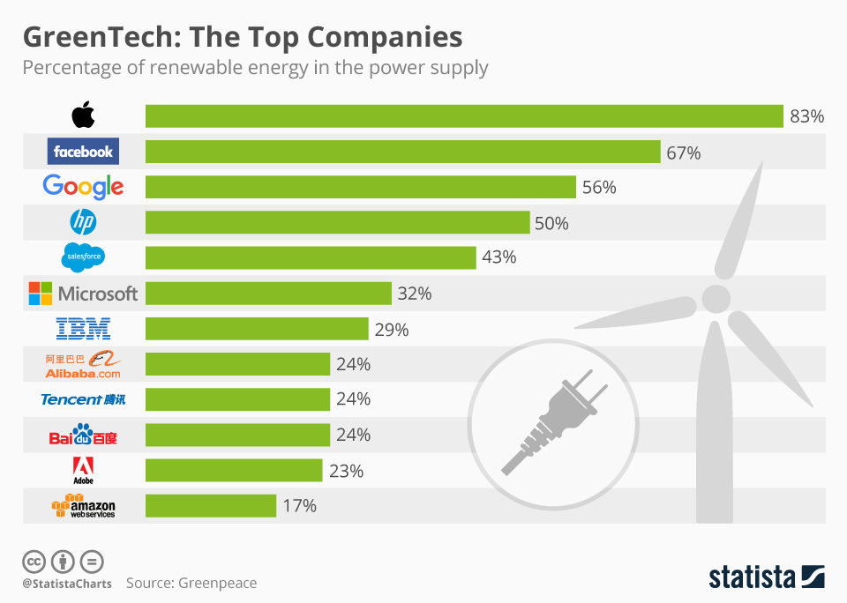
Converting the Project into a Product or Service
-The findings from this analysis could be transformed into a consulting service for governments or companies looking to transition to renewable energy. Many companies that have made the transition to renewable energy and have been successful prove that this can be a useful practice.
-The data and results could also be used to develop a software tool that helps predict future energy needs and the environmental impacts of different energy sources.

Slide 18
Any Issues Related to Data Engineering
Data Collection and Integration:
Gathering data from diverse sources like the Turkish Statistical Institute, OECD, and U.S. Energy Information Administration involves dealing with different formats and standards.
Not being able to find deep data about the topic in the Turkish Statistical Institute.
Advanced Analytics and Machine Learning:
Implementing machine learning models for predictive analytics, and attempting to forecast the future with very few data points. Such as forecasting future trends in energy production and renewable energy.

Slide 19
Any Issues Related Ethics
Data Privacy and Confidentiality:
Even though the data from sources like the Turkish Statistical Institute, OECD, and U.S. Energy Information Administration is largely public, it's crucial to ensure that any data used does not infringe on individual or organizational privacy rights.
If the project expands to include data that could potentially be traced back to individuals or private entities, strict adherence to data privacy laws (like GDPR) is essential.
Bias and Representation:
There's a risk of bias in data collection, analysis, and interpretation. Care must be taken to ensure that the datasets and methodologies used don't accidentally favor certain groups or perspectives, especially in comparative studies between countries.
Checking other sources with data on the same information and date range in order to prevent biased or false data.
Transparency and Accountability:
Maintaining transparency about the methodologies, data sources, and assumptions used in the analysis.
Being accountable for the way findings are presented and used.

Slide 20
Conclusion
In this project, we successfully analyzed data from various sources to understand the impact of renewable energy on greenhouse gas emissions and energy production in Turkey and the USA. Key achievements include comparing energy sources of both countries, forecasting future energy scenarios, and addressing ethical considerations.

Slide 21
Sources
https://www.tuik.gov.tr/
https://www.oecd.org/
https://www.eia.gov/
https://www.statista.com/

