Slide 1
01 / 16
END OF INTERNSHIP PRESENTATION
Weapon-Target Assignment Model
Improvements on
Multi-Target Interception and Attack-Oriented WTA Model
Comparative Optimization with ABC, PSO, and Genetic Algorithm
3
10
5
10K
6
ALGORITHM
MISSILE
DECOY
ITERATIONS
CONSTRAINT TYPE

Slide 2
2 / 29
Contents
Definition of the Problem
Why is it NP-Hard?
Critical Guidance Parameters in WTA Problem
Approaches in the Literature
Results of the Attack Model
Summary
Future Works
Solution Approach Proposed by the Paper
Used Algorithms and Visualization of the Algorithms
Comparisions of the Results with Paper
Attack Model, Constraints and Parameters
Results of the Attack Model
Summary
Future Works

Slide 3
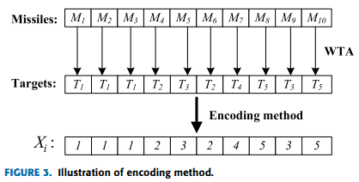
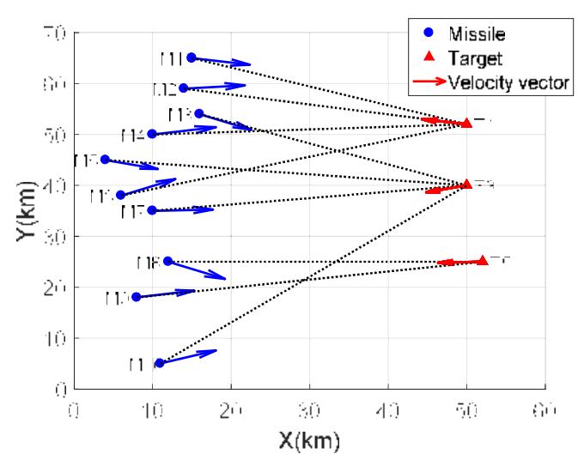
3 / 29
Definition of the Problem
What is Weapon-Target Assignment (WTA)?
● Weapon-Target Assignment (WTA): The optimal assignment of available missiles to threats.
● Original Scenario (Defense): Stopping incoming missiles with our own missiles.
● NP-Hard Complexity: As the number of missiles and targets increase, solution space grows exponentially.
● Kinematic Approach: Assignment is not just numerical; it's done by calculating the positions and vectors of targets in the x-y space.
📊
Assignment Visual on x-y axis from the Paper
Place image here

Slide 4
4 / 29
Why is it NP-Hard?
NP-Hard Structure and Combinatorial Explosion
● Number of possible assignments for 10 missiles and 5 targets: 5¹⁰ = 9,765,625 different combinations.
● When Decoys are added (15-unit vector): 6¹⁵ ≈ 470 billion combinations.
● Traditional methods fail at this scale.
● Therefore, Metaheuristic Algorithms are used.
● They do not guarantee the optimal solution, but they find pretty good solutions within acceptable time.
Scenario | Variable | Solution Space
Old Model (Missiles Only) | 10 | ~10 million
New Model (Missile+Decoy) | 15 | ~470 billion
Large Scenario (50 units) | 50 | ~10³⁸
Comparison: Atoms in the universe | — | ~10⁸⁰

Slide 5
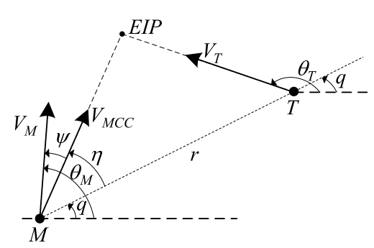
5 / 29
Critical Guidance Parameters: Miss Distance, Time-to-Go, and LOS
Miss Distance (ΔS):
Meaning: Closest distance to the target during flight.
Why Minimize? Closer to zero = Maximum lethality.
2. Time-to-Go (tgo):
Meaning: Estimated time to hit the target
Why Minimize? Gives the target zero time to evade or jam.
3. LOS (Line of Sight):
Meaning: Direct line connecting missile and target. Its change rate is LOS Rate (λ').
Why Minimize? Keep LOS rate at zero. No change in LOS angle = Definite collision course.

Slide 6
6 / 29
Approaches in the Literature
📐 Traditional Methods
🧬 Genetic Algorithms (GA)
Lagrange Relaxation, Exhaustive Search, Branch & Bound. Accurate at small scale, but fails on large problems.
Inspired by natural selection. Explores the search space via Selection, Crossover, and Mutation. It is compatible with integer problems.
🐝 Artificial Bee Colony (ABC)
🌀 Particle Swarm Optimization (PSO)
Simulates the foraging behavior of honey bees. The main algorithm proposed by the paper. It converges to the optimum value, thanks to employee, onlooker and scout bees.
Models the collective movement of bird flocks. Works in continuous space, adapted to integer using floor(). It converges to the optimum value, thanks to speed and location updates.

Slide 7

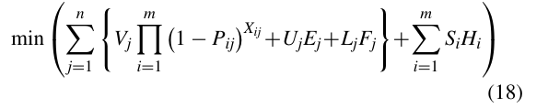
7 / 29
Solution Approach Proposed by the Paper
● Kinematic Phit Calculation: Miss Distance, Time-to-Go, LOS(Line of Sight) are considered to calculate Phit value.
● Grouping Constraints: Prevents excessive accumulation of ammunition on certain targets.
● Penalty Function: Penalties are added to the cost function for solutions that violate constraints.
● Objective Function: Algorithms minimize the expected survival value of targets.
Feature | Fixed | Adaptive
Assignment Rule | Exact number | Min-Max range
Flexibility | Low | High
Example (Target 1) | Exactly 4 missiles | 1–4 missiles
Penalty Formula | Qj · Gj | Uj·Ej + Lj·Fj
Solution Space | Narrow | Wide
For Fixed Grouping
For Adaptive Grouping

Slide 8
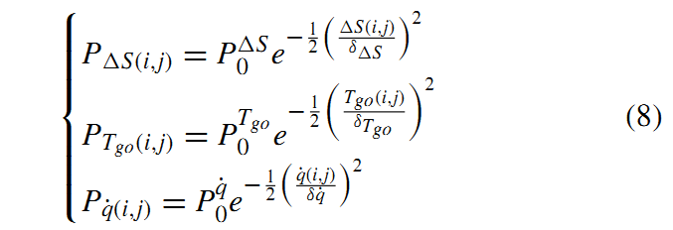
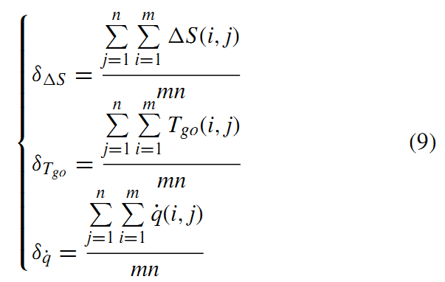

8 / 29
How is Kinematic Hit Probability (Pij) Calculated?
-> Paper's Probability Function (Equations 8, 9, and 10)
Miss Distance:
Time-to-Go:
Line of Sight:
Pij (probability of missile i hitting target j) is modeled by AI as a negative exponential function of three kinematic indicators (Eq. 8).
The average value of these 3 parameters is calculated separately and written as the denominator in the exponent in Equation (8):
The paper combines these three indicators with balancing weights (β) to find the final hit probability:

Slide 9
9 / 29
Working Mechanisms of the Algorithms
Iteration steps and basic formulas of the meta-heuristic algorithms used
🐝 Artificial Bee Colony (ABC)
🌀 Particle Swarm Optimization (PSO)
🧬 Genetic Algorithm (GA)
● 1. Employed Bee Phase
● 2. Onlooker Bee Phase
● 3. Scout Bee Phase
● 1. Velocity Update
● 2. Position Update
● 3. Transformation
● 1. Selection (Tournament)
● 2. Crossover
● 3. Mutation
Position Update:
Velocity / Position Formulas:
Crossover Example (p_c=0.8):
v_ij = x_ij + Φ(x_ij - x_kj)
v_i = w·v_i + c1·r1(pbest) + c2·r2(gbest) x_i = x_i + v_i
P1: [1 1 | 2 3] P2: [0 4 | 5 5] Child: [1 1 | 5 5]

Slide 10
10 / 29
ABC Algorithm: 2-Bee Execution Example

Slide 11
11 / 29
PSO Algorithm: Discrete WTA Execution Example

Slide 12
12 / 29
Genetic Algorithm: Discrete WTA Execution Example

Slide 13
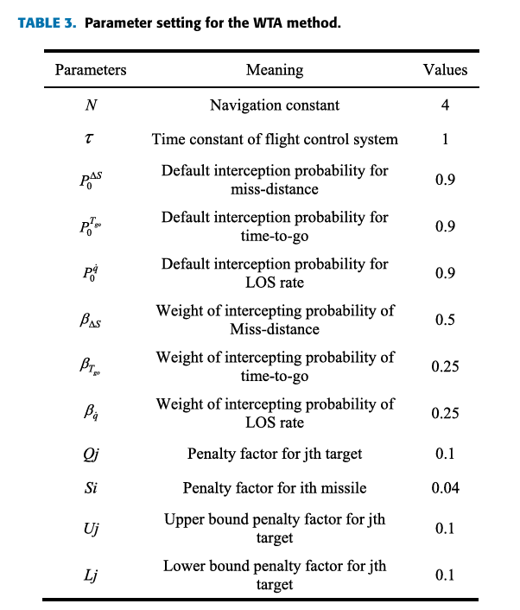
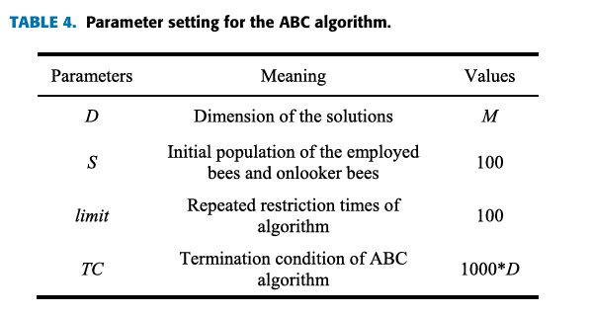
13 / 29
Meaning of Parameters and Constant Values to Apply ABC Algorithm

Slide 14
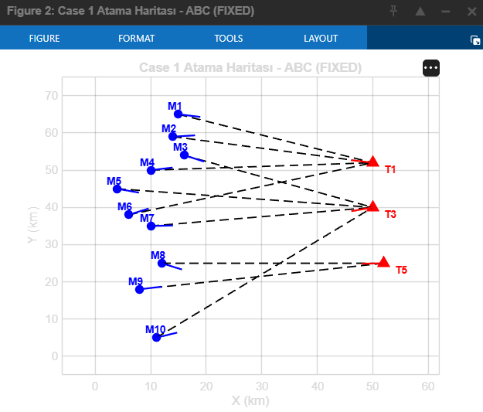
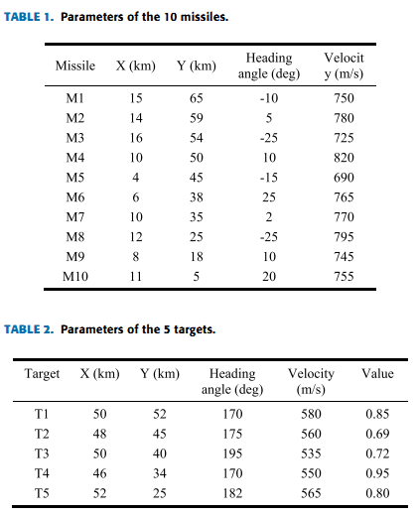
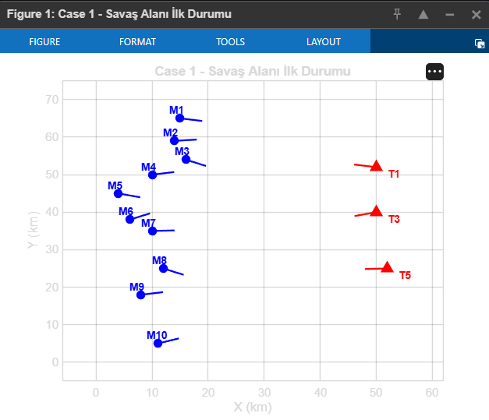
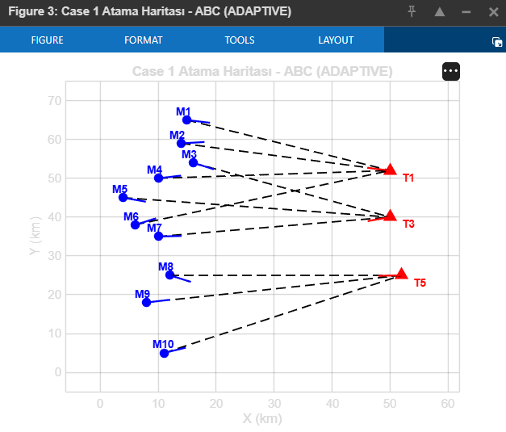
14 / 29
Assignment Results — Case 1 (3 Targets)
Fixed Constraint
T1 -> 4 | T3 -> 4 | T5 ->2
Adaptive Constraint
Min: 1
Max: 4
For each target

Slide 15
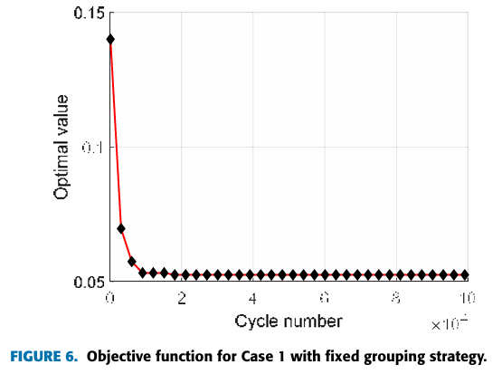
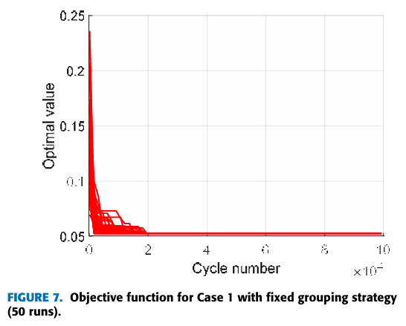
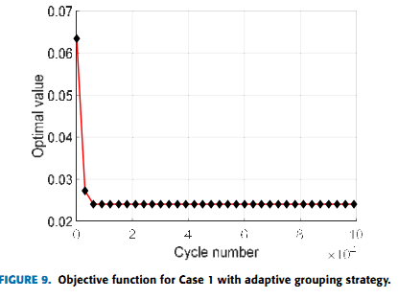
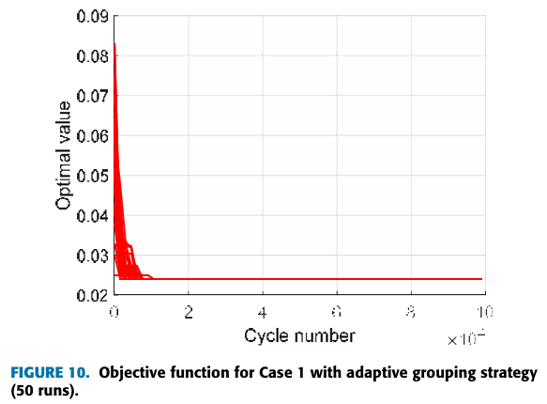
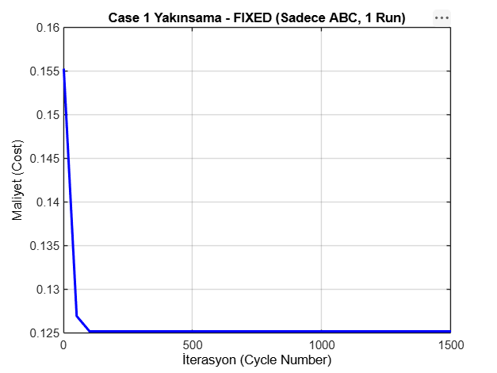
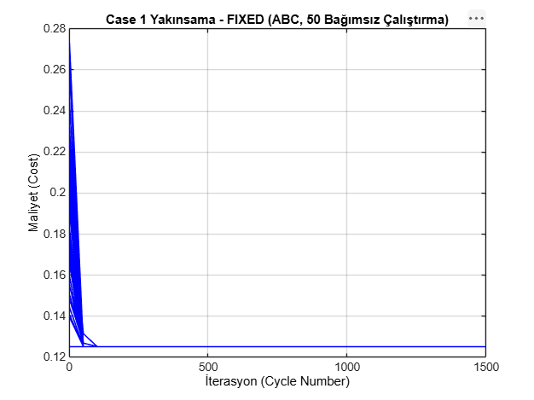
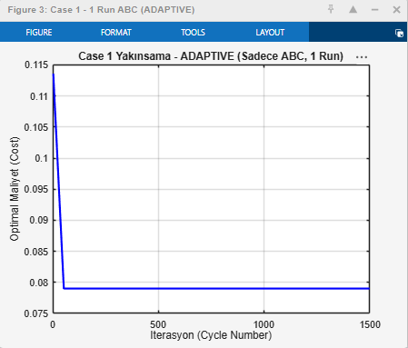
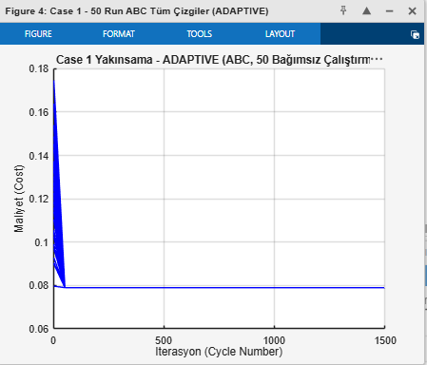
15 / 29
Paper Model (Defense) Verification Case1
The model proposed in the paper was rewritten and verified by me, and GA was added. There are 10 missiles and 3 targets in Case 1.
CASE 1 (3 Targets) - FIXED
CASE 1 (3 Targets) - ADAPTIVE
Algorithm | Cost | Paper Result
🐝 ABC | 0.1252 | 0.0525
Algorithm | Cost | Paper Result
🐝 ABC | 0.0790 | 0.0241

Slide 16
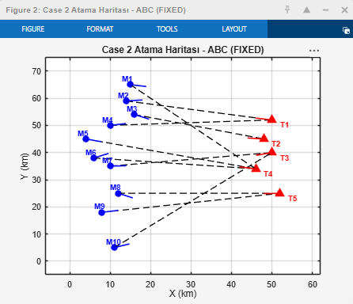
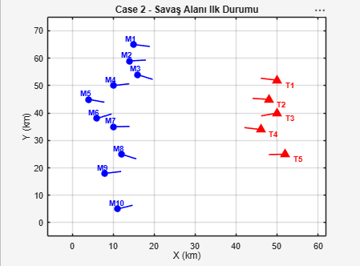

16 / 29
Assignment Results — Case 2 (5 Targets)
Fixed Constraint
T1 -> 2 | T2 -> 1 | T3 ->2 | T4 ->3 | T5 -> 2
Adaptive Constraint
Min: 1
Max: 3
For each target

Slide 17
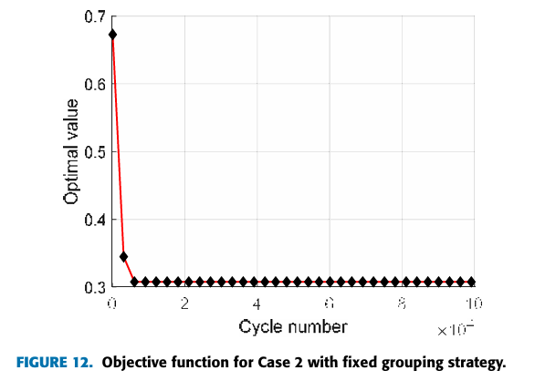
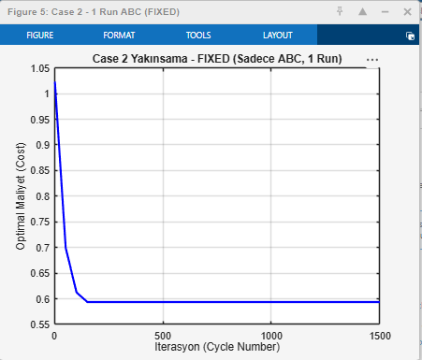
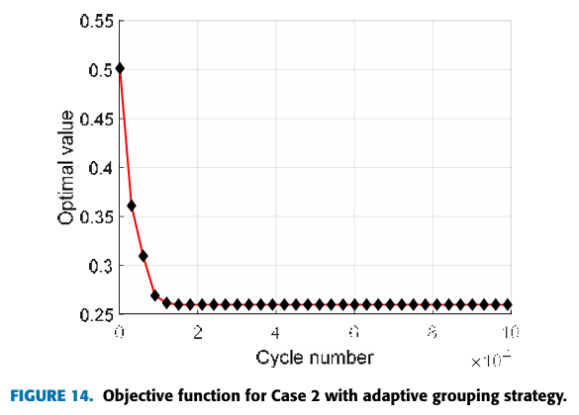
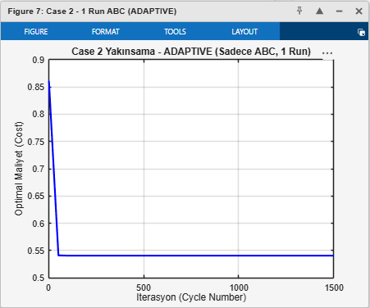
17 / 29
Paper Model (Defense) Verification Case 2
The model proposed in the paper was rewritten and verified by me, and GA was added. There are 10 missiles and 5 targets in Case 2.
CASE 2 (5 Targets) - FIXED
CASE 2 (5 Targets) - ADAPTIVE
Algorithm | Cost | Paper Result
🐝 ABC | 0.5939 | 0.3153
Algorithm | Cost | Paper Result
🐝 ABC | 0.5407 | 0.2672

Slide 18
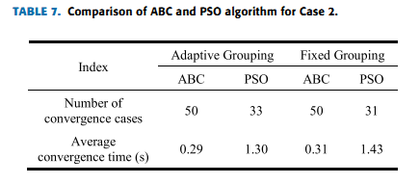
18 / 29
Case 2 50 Iterations ABC and PSO Comparison
Normal(Standard) PSO
Index | Adaptive ABC | Adaptive PSO | Fixed ABC | Fixed PSO
Number of convergence cases | 50 | 19 | 50 | 6
Average convergence time(s) | 0.05 | 0.37 | 0.27 | 0.01
Hybrid PSO
Index | Adaptive ABC | Adaptive PSO | Fixed ABC | Fixed PSO
Number of convergence cases | 50 | 50 | 50 | 34
Average convergence time(s) | 0.05 | 0.06 | 0.31 | 0.61

Slide 19
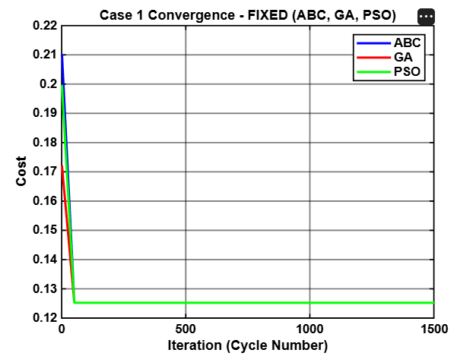
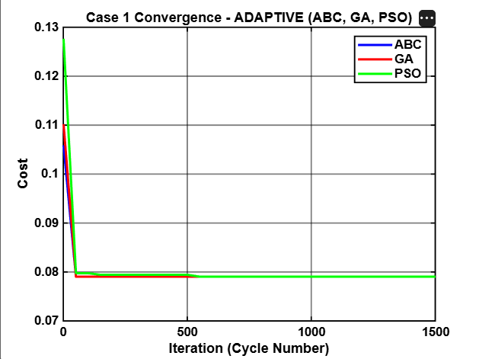
19 / 29
Additional Comparisions for Case 1 (3 targets)
ABC, PSO and also Genetic Algorithm were used to compare whether they reach the optimum cost value.
CASE 1 (3 Targets) - FIXED
Algorithm | Cost | Status
🐝 ABC | 0.1252 | OPTIMUM ✅
🧬 GA | 0.1252 | OPTIMUM ✅
🌀 PSO | 0.1252 | OPTIMUM ✅
CASE 1 (3 Targets) - ADAPTIVE
Algorithm | Cost | Status
🐝 ABC | 0.0790 | OPTIMUM ✅
🧬 GA | 0.0790 | OPTIMUM ✅
🌀 PSO | 0.0790 | OPTIMUM ✅

Slide 20
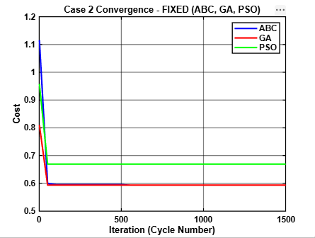
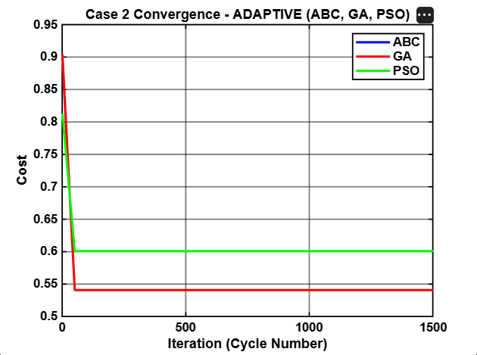
20 / 29
Additional Comparisions for Case 2 (5 targets)
ABC, PSO and also Genetic Algorithm were used to compare whether they reach the optimum cost value.
CASE 2 (5 Targets) - FIXED
Algorithm | Cost | Status
🐝 ABC | 0.5939 | OPTIMUM ✅
🧬 GA | 0.5939 | OPTIMUM ✅
🌀 PSO | 0.6643 | Local Min ⚠️
CASE 2 (5 Targets) - ADAPTIVE
Algorithm | Cost | Status
🐝 ABC | 0.5407 | OPTIMUM ✅
🧬 GA | 0.5407 | OPTIMUM ✅
🌀 PSO | 0.6129 | Local Min ⚠️

Slide 21
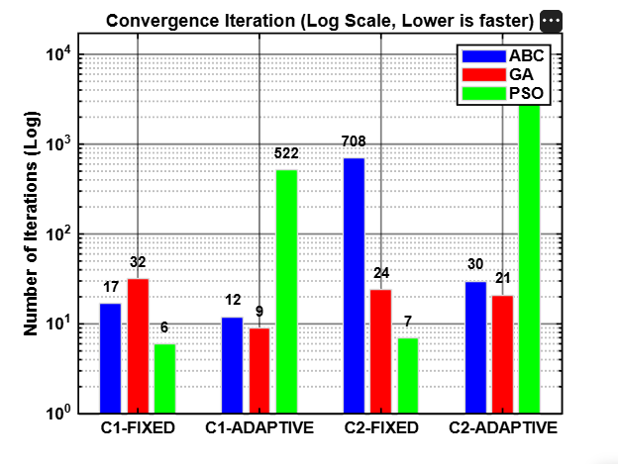
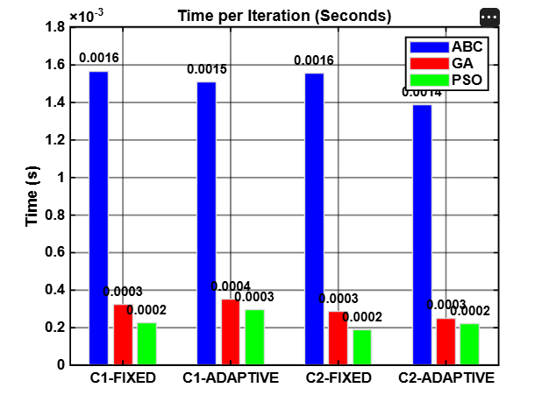
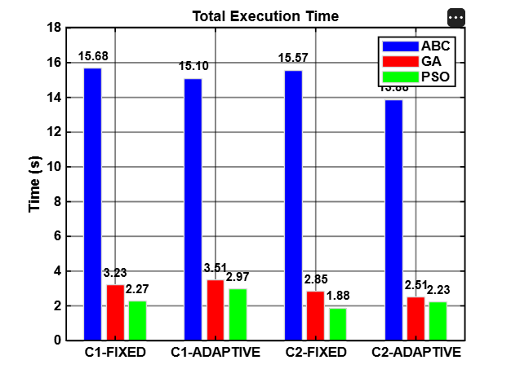
21 / 29
Additional Comparisions for Convergence Times
ABC, PSO and also Genetic Algorithm were used to compare the convergence times/iterations.

Slide 22
22 / 29
Our Another Original Contribution: Transition to the Attack Model
Penetration Probability Formula
● Model Transition: Defense (interception) → Attack scenario.
● Addition of Decoys: 5 decoy targets were added alongside real missiles.
● Saturation: Decoys engage the air defense system, increasing the penetration probability of missiles.
● '0' State: The option of not assigning to a target was added.
Ppen = Pmin + (Pmax − Pmin) × (1 − e^(−λ·Nj))
Symbol | Description
Nj | number of decoys going to j-th target
λ (lambda) | Saturation coefficient = 0.5
Pmin | Penetration without Decoy (base)
Pmax | Penetration at full saturation

Slide 23
23 / 29
Added Operational Constraints
1
Budget Constraint
Penalty Type | Coefficient | Weight
Qj (Fixed Grouping) | 0.1 | Light
Si (Multiple Assignment) | 0.04 | Light
Uj / Lj (Adaptive) | 0.1 | Light
w_heavy (Decoy, Compatibility) | 100 | Heavy
w_light (Salvo, Budget) | 10 | Medium
The total cost of missiles and decoys cannot exceed the operational budget (B=100).
2
Compatibility Constraint
If Ci,j = 0, the i-th missile cannot physically be assigned to the j-th target.
3
Decoy Logic Constraint
Assigning a decoy to a target without assigning a real missile is a waste and is penalized.
4
Salvo Firing Constraint
The Tgo difference of missiles heading to the same target must be less than ε.

Slide 24
24 / 29
Mathematical Model
OBJECTIVE FUNCTION (To be Minimized)
min J = Σ Vj × Π (1 − P_succ(i,j) × Xi,j) + Penalty
Individual Success Probability
P_succ(i,j) = P_pen(j) × P_hit(i,j) × P_kill(i,j)
Symbol | Description | Example Value
Vj | importance/threat value of j-th target | 0.85, 0.72, 0.80
Xi,j | assignment of i-th missile to j-th target (0/1) | Optimized by algorithm
P_hit(i,j) | Kinematic hit probability | Between 0.0 - 1.0
P_kill(i,j) | Kill probability on hit | 0.85 (fixed)
P_pen(j) | Penetration probability | Between Pmin and Pmax (Formule given on the previous page)

Slide 25
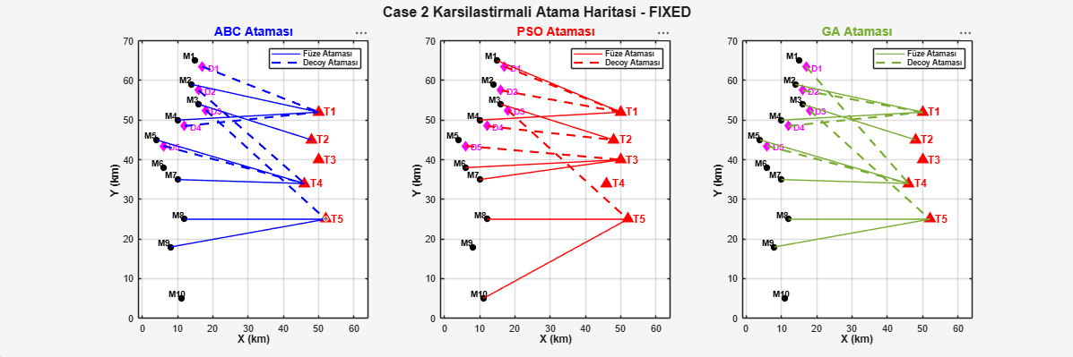
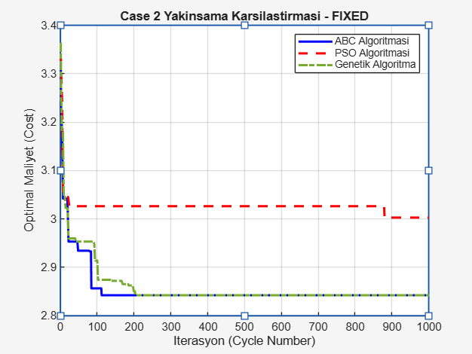
25 / 29
Numerical Results (Attack Model) — Case 2 (5 Targets) - Fixed
FIXED GROUPING
Algorithm | Cost | Status
🐝 ABC | 2.8422 | OPTIMUM ✅
🧬 GA | 2.8422 | OPTIMUM ✅
🌀 PSO | 3.0027 | Local Min ⚠️
📊
Figure 3: Case 2 Fixed Graph
Place image here

Slide 26
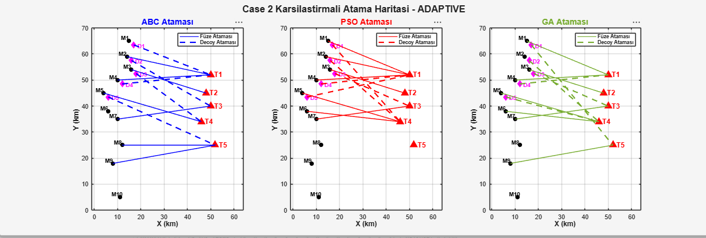
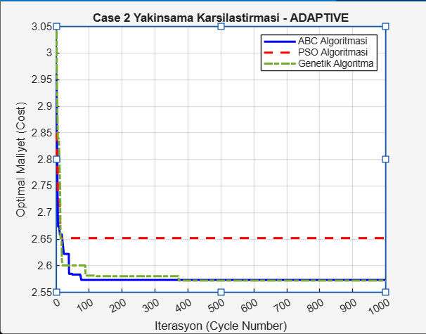
26 / 29
Numerical Results (Attack Model) — Case 2 (5 Targets) - Adaptive
ADAPTIVE GROUPING
📊
Figure 4: Case 2 Adaptive Graph
Place image here
Algorithm | Cost | Status
🐝 ABC | 2.5720 | OPTIMUM ✅
🧬 GA | 2.5720 | OPTIMUM ✅
🌀 PSO | 2.7226 | Local Min ⚠️

Slide 27
27 / 29
Summary of All Results and Performance
Attack Scenario | Grouping | ABC Cost | GA Cost | PSO Cost | PSO Difference (%)
Case 1 (3 Targets) | Fixed | 1.1610 | 1.1610 | 1.3535 | +15.7%
Case 1 (3 Targets) | Adaptive | 0.8610 | 0.8610 | 0.9213 | +7.0%
Case 2 (5 Targets) | Fixed | 2.8422 | 2.8422 | 3.0027 | +5.64%
Case 2 (5 Targets) | Adaptive | 2.5720 | 2.5720 | 2.7226 | +5.85%
✅ Superiority of GA and ABC
GA's Crossover and Mutation operators enabled escaping from the local minimum traps that PSO fell into. Also, ABC uses an avoidance mechanism for local mimimums. They found the unique optimum in both Defense and Attack scenarios.

Slide 28
28 / 29
Future Works
Steps to evolve the system into more realistic warfare environments:
🚀 3-Axis (3D) Engagement Model
🎯 Dynamic (Moving) Target Engagement
● The current model considers targets in a 2D (x-y) plane.
● Including the altitude (z) axis of missiles and targets in the equation.
● Modeling how Pitch and Yaw angles affect the radar and Line of Sight.
● Taking terrain and radar horizon into account.
● Modeling scenarios where targets do not follow fixed routes but continuously maneuver.
● In case the target performs an evasive maneuver after assignment, the algorithm re-assigns during flight (real-time).
● For this, reducing the algorithm's execution time to millisecond levels (GPU parallelization, etc.).

Slide 29
16 / 16
29 / 29
Thank You
Questions?
PROJECT SUMMARY
The defense model in the paper was verified; then expanded to a complex attack optimization model including decoys, budget constraints, and Genetic Algorithm support. GA and ABC outperformed PSO in all scenarios.
0.86
3
6
15
BEST ATTACK COST
ALGORITHM
CONSTRAINT TYPE
MATLAB FILE

