Slide 1
A Quantitative Analysis of Variability
Warnings in Linux

Slide 2
About Presentation
About project
Background
Methodology
Results
Threats to validity

Slide 3
About project
42 bugs paper (Brabrand, Abal et al.)
  Variability bugs were qualitatively analyzed
  Bias in selection
  Nothing can be said quantitatively about the bugs
Objective: Quantify the bugs
  2 different versions of Linux
    Stable
    In-development
  Data on warning types
  Data on warning locations

Slide 4
Background
Variability
Feature models
Linux
Warning types

Slide 5
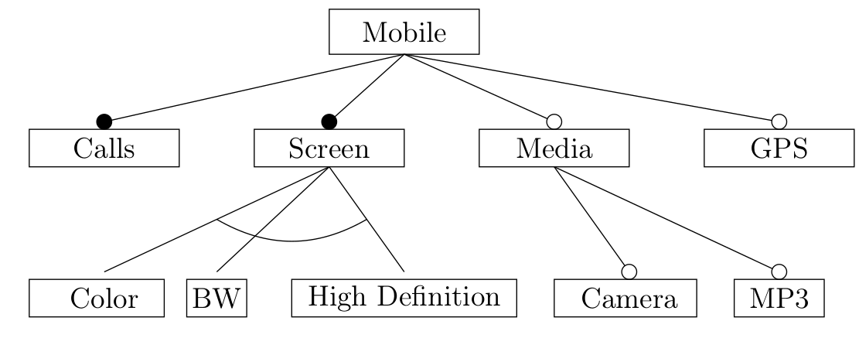
Background - Variability
aka Software Product Lines
One code base – many products
  No need to create many different programs
Example: Mobile phone

Slide 6
Background - Feature Models
A way to represent the different variants
  Features
  Dependencies and restrictions
Many other products use this
  Busybox, Drupal, Eclipse...
Often wide and shallow
The language in Linux is called Kconfig
  Is also used in Busybox amongst others

Slide 7
Background - Linux
Large open source project
  19 million LOC
Large degree of variability
  10,000 to 14,000 features
Easily accessible
  Free online
  Lots of documentation

Slide 8
Background – Warning types
Wrong data
  Stop compilation
  Runtime bugs
Code pollution
  Confuse programmers
  Bad for space limitation
Bad code practice
  Confuse programmers
Irrelevant

Slide 9
Background – Warning types
Array-bounds
Cpp
Deprecated-declarations
frame-larger-than=N
Implicit-function-declaration
Int-to-pointer-cast
Maybe-uninitialized

Slide 10
Background – Warning types
Overflow
Pointer-to-int-cast
Return-type
Uninitialized
Unused-function
Unused-variable
Unused-label

Slide 11
Methodology – Experiment setup
1) Create random variant
2) Test for warnings
3) Save output data for analysis

Slide 12
Methodology – 1) Random variant
Linux' built-in `randconfig` configurator
Fast
  1 second
Easy
  `make randconfig`
Sound
  No invalid configurations
(Not quite representative)

Slide 13
Methodoly – 2) Check for warnings
Testing is done when compiling
  So all we have to do is compile the Linux variant
Linux automatically outputs warnings
  Collect the standard output
Search through the output for warnings
  Unique naming convention [-Wunused-function]
  Easy to differentiate

Slide 14
Methodology – 3) Save the data
Data is saved to a database on ITU

Slide 15
Methodology – Research Questions
RQ1: What warnings are the most common in the stable Linux kernel?
RQ2: Where do most warnings occur?
RQ3: Are there any differences between an in-development version of Linux and a stable version?

Slide 16
Methodology – more on experiment
Was compiled at a HPC at ITU
  And a spare laptop
Ran for 40 days
42,000 configurations were tested
  21,000 were stable version
  21,000 were in-development version

Slide 17
Results
Overview
Warnings in stable
Locations in stable
Stable vs. in-development

Slide 18
Results - Overview
At most 111 warnings were found in one experiment run
On average 4.5 warnings in each experiment run

Slide 19
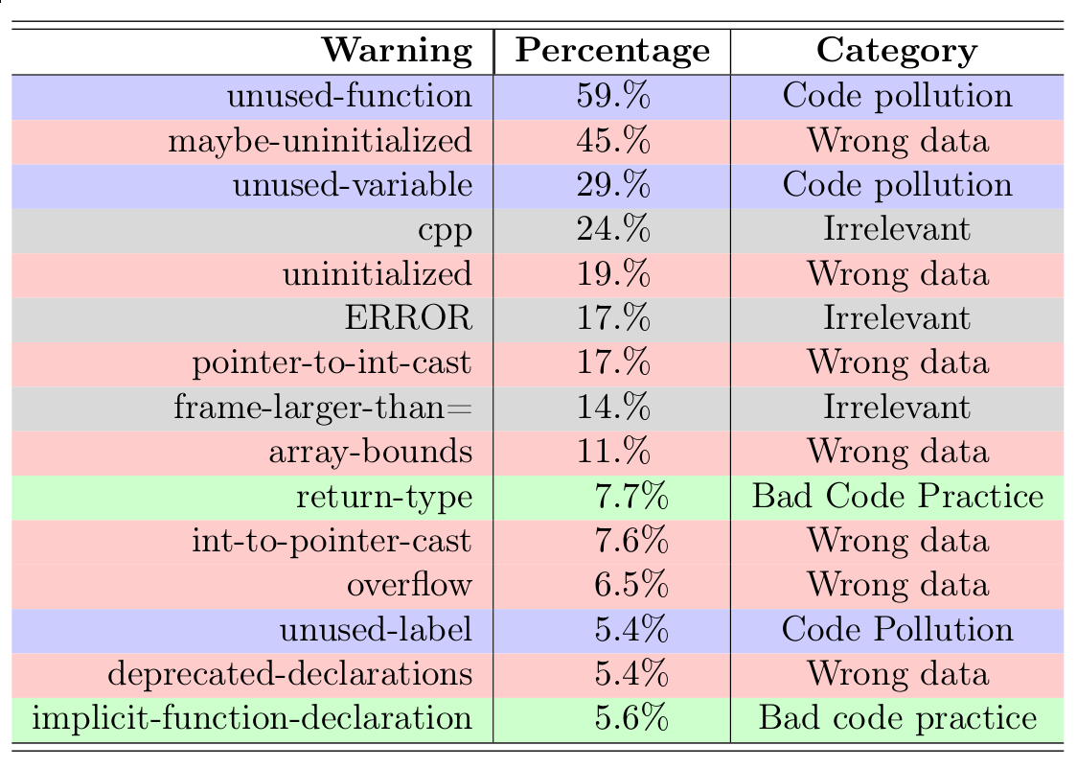
Results – Warnings in stable
Conclusion: Mostly code pollution

Slide 20
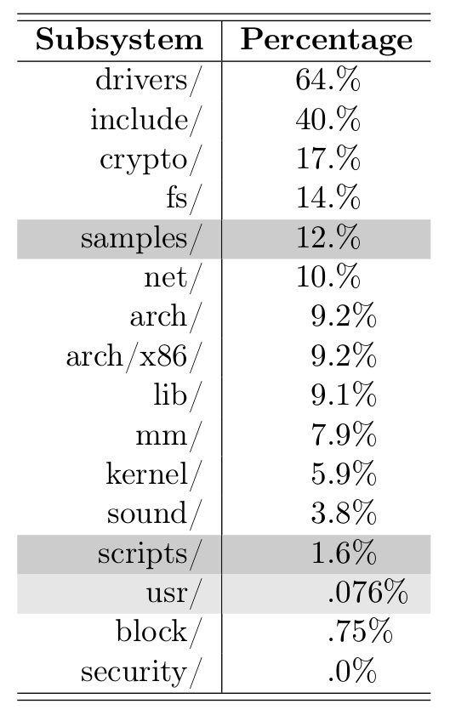
Results – Locations in stable

Slide 21
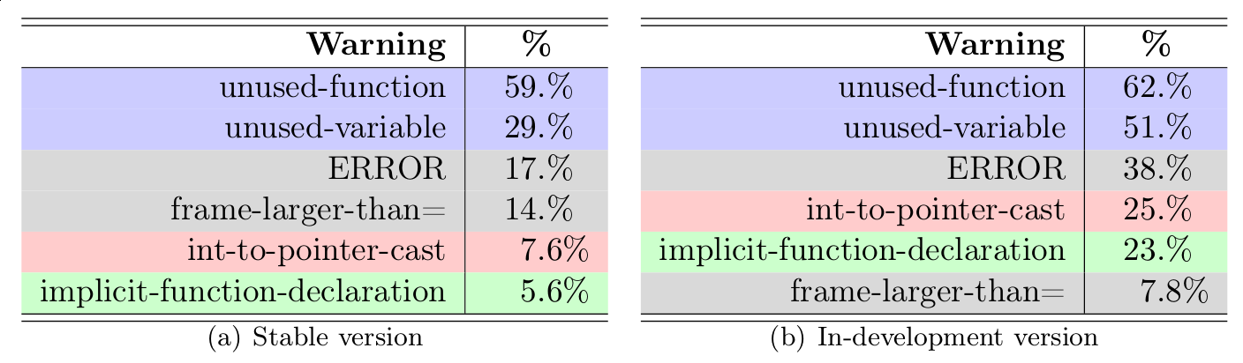
Results – Stable vs. in-development

Slide 22
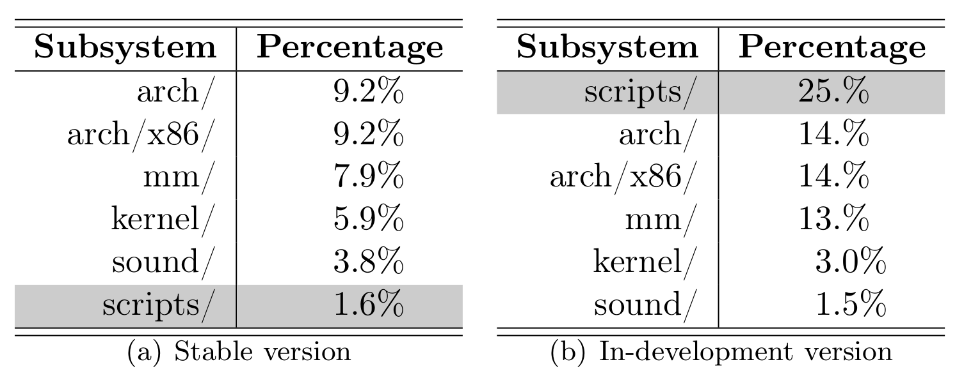
Results – Stable vs. in-development

Slide 23
Threats to Validity
Internal
  Gcc new version might have found more of one type
  Representativeness
External
  Only one architecture
  Not enough in-development versions
  Not compiling with firmware

