Slide 1
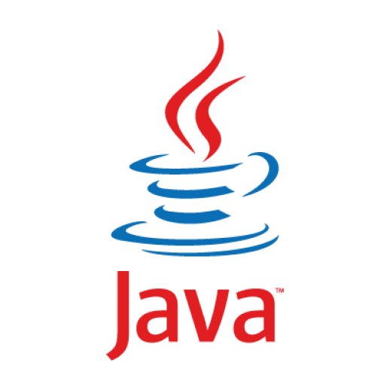
Object orıented programmıng wıth Java
Instructors:
Boran Kahraman
Buse Orak
GitHub Repository

Slide 2

Aım of thıs course
Understanding the concepts of Object Oriented Programming with Java
Classes and Objects
Encapsulation
Inheritance
Polymorphism
Abstraction

Slide 3
What thıs course ıs not about
Not an introduction to programming course
Not a data structures course

Slide 4
references
Java - How to Program, Paul Deitel and Harvey Deitel, Prentice Hall, 2012
Java - An Introduction to Problem Solving and Programming, Walter Savitch, Pearson, 2012
Oğuz Aslantürk Java Notları
Oracle Java Documentation
javaTpoint

Slide 5
Today’s topıcs
Java Programming Language and JVM
Standard Input/Output
Primitive and Non-Primitive Data Types
Declaring and Initializing Variables
Reserved Words
Arrays
Conditions, For Loops and While Loops
Switch-Cases
Methods

Slide 6
Java programmıng language
Java is a programming language and computing platform, developed by James Gosling and first released by Sun Microsystems in 1995.
It has evolved from humble beginnings to power a large share of today’s digital world, by providing the reliable platform upon which many services and applications are built.
New, innovative products and digital services designed for the future continue to rely on Java, as well.

Slide 7
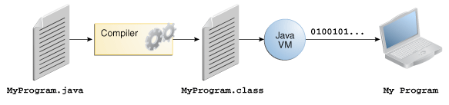
«Wrıte once, run anywhere»
Source code is written in text files with .java extension
These files are compiled into .class files by the javac compiler
.class files contain bytecodes
It is not native to a specific processor
It is the machine language of the Java Virtual Machine
Your code is run by JVM.
It can be run by any machine that has JVM.
Platform-independent
Can be slower than native code

Slide 8
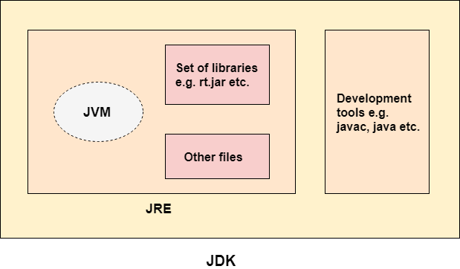

Slide 9
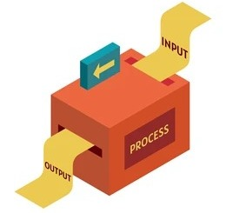
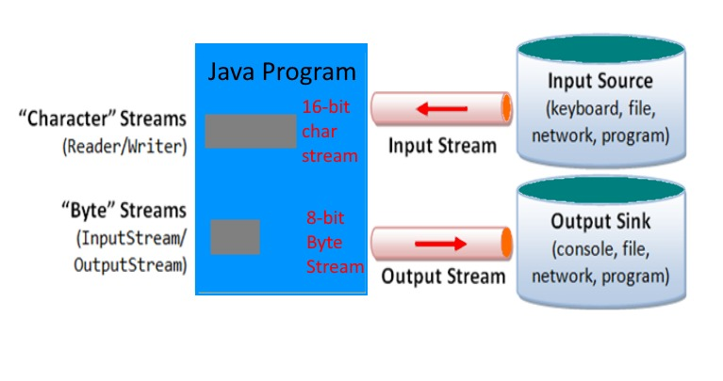
Standard ınput/output
Standard Streams that Java platform supports:
Output Streams:
System.out
System.err
Input Streams:
System.in
They are byte streams.

Slide 10
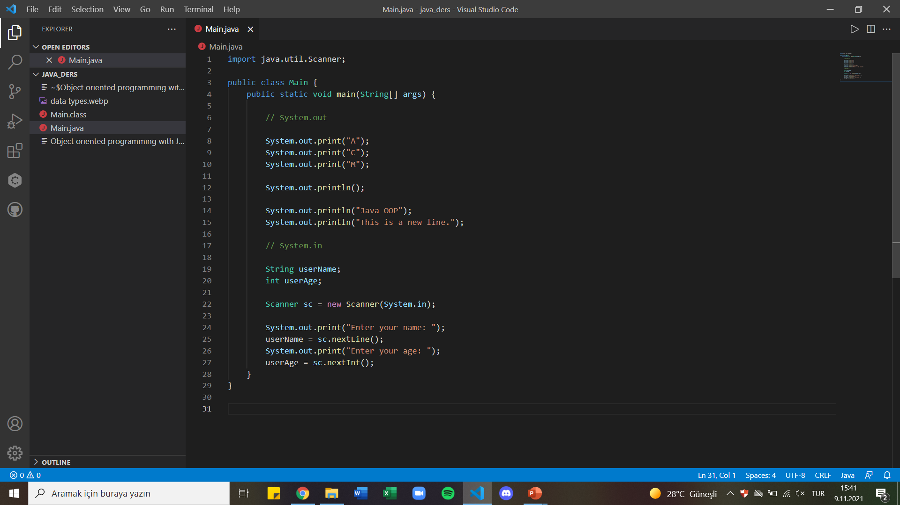


Slide 11
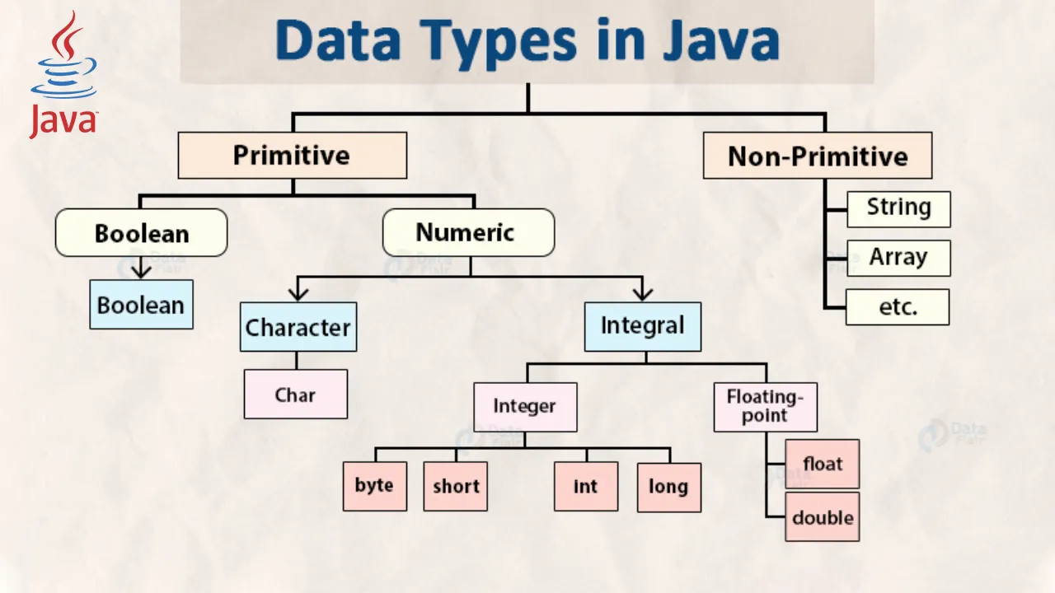

Slide 12
PRImItIVE and non-PRIMITIVE data types
Type Name | Default Values | Memory Used | Range of Values
byte | 0 | 1 byte | -128 to 127
short | 0 | 2 bytes | -32,768 to 32,767
int | 0 | 4 bytes | -2,147,483,648 to 2,147,483,647
long | 0L | 8 bytes | -9,223,372,036,8547,75,808 to 9,223,372,036,854,775,807
float | 0.0f | 4 bytes | ±3.40282347 × 10+38 to ±1.40239846 × 10−45
double | 0.0d | 8 bytes | ±1.79769313486231570 × 10+308 to ±4.94065645841246544 × 10−324
char | '\u0000' | 2 bytes | All Unicode values from 0 to 65,535
boolean | false | 1 bit | true or false

Slide 13
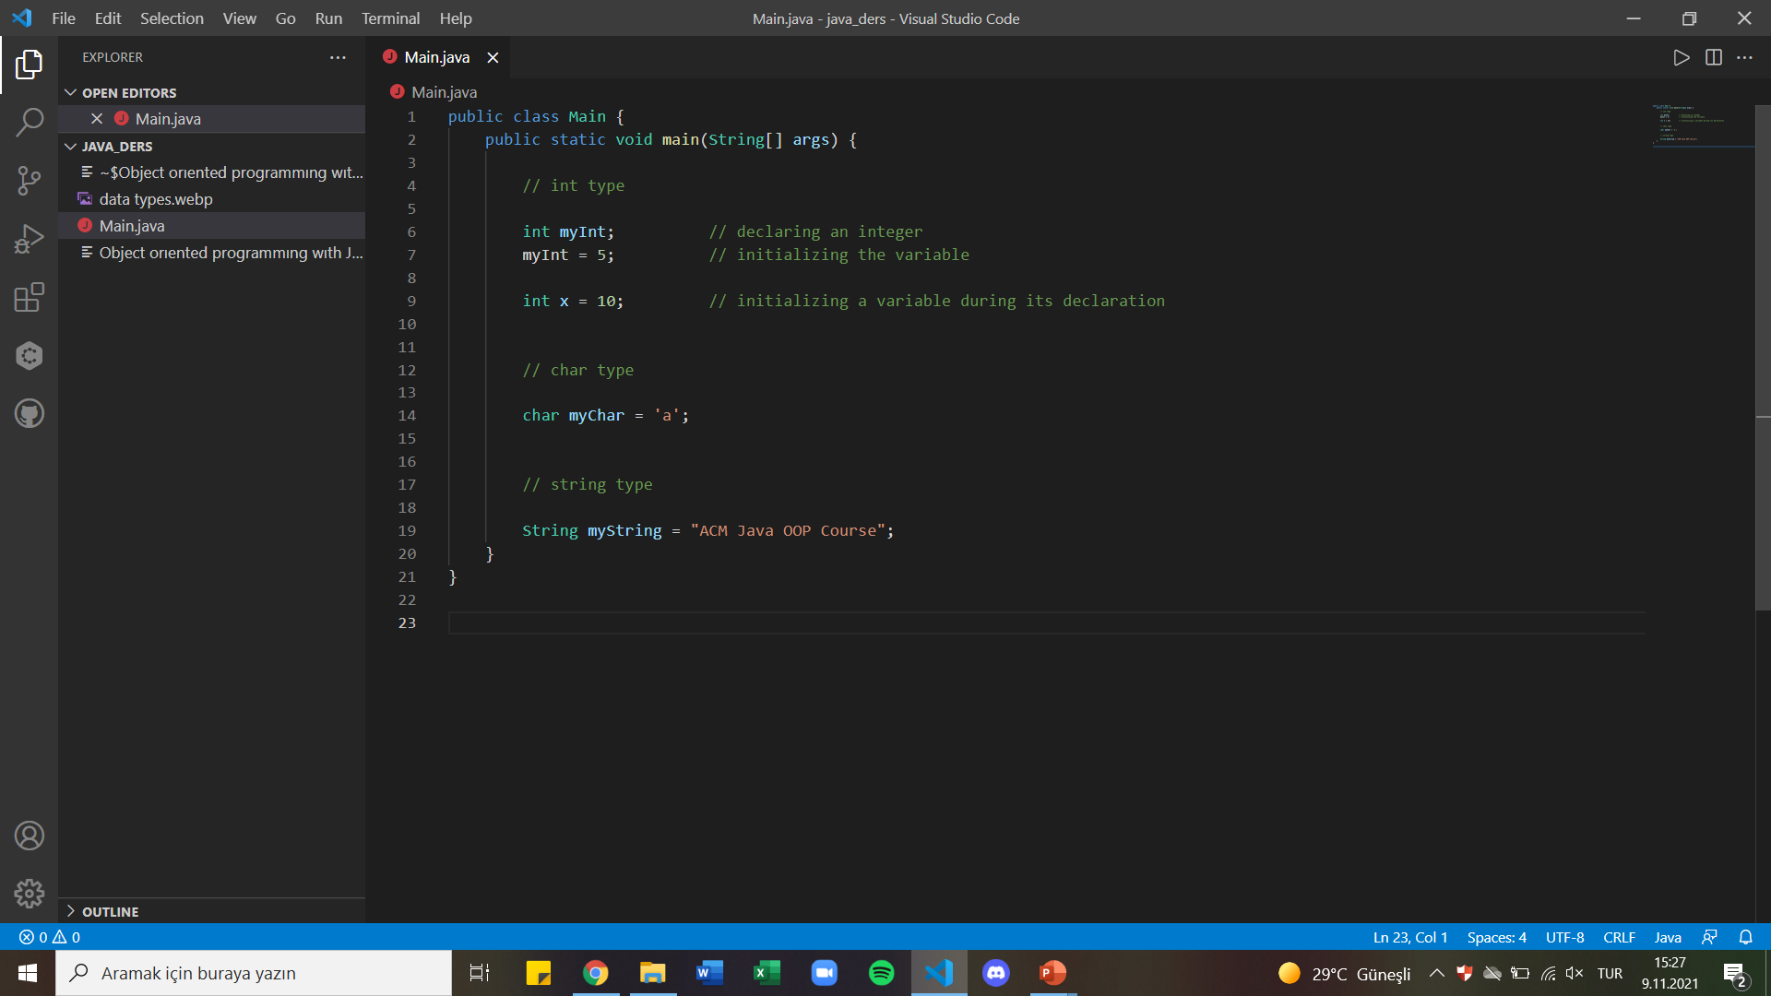
DeCLARING AND INITIALIZING VARIABLES

Slide 14
Type castıng
Type casting is when you assign a value of one primitive data type to another type.
Widening Casting (automatically) - converting a smaller type to a larger type size byte -> short -> char -> int -> long -> float -> double
Narrowing Casting (manually) - converting a larger type to a smaller size type double -> float -> long -> int -> char -> short -> byte

Slide 15
Reserved words
abstract | assert | boolean | break | byte | case
catch | char | class | const | continue | default
double | do | else | enum | extends | FALSE
final | finally | float | for | goto | if
implements | import | instanceof | int | interface | long
native | new | null | package | private | protected
public | return | short | static | strictfp | super
switch | synchronized | this | throw | throws | transient
TRUE | try | void | volatile | while

Slide 16
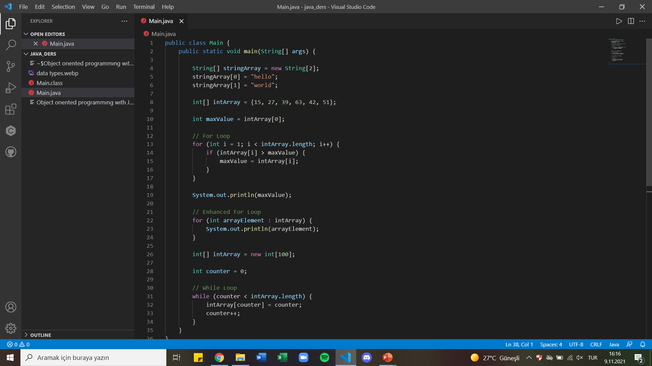
Arrays

Slide 17
For loops and contıdıtons

Slide 18
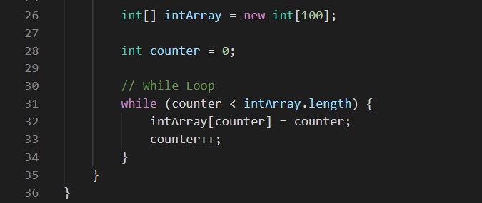
Whıle loop

Slide 19
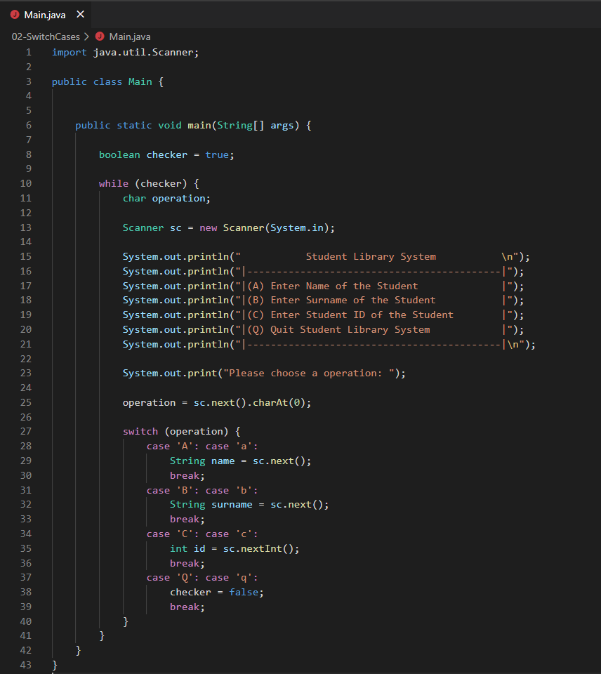
Swıtch-cases

Slide 20
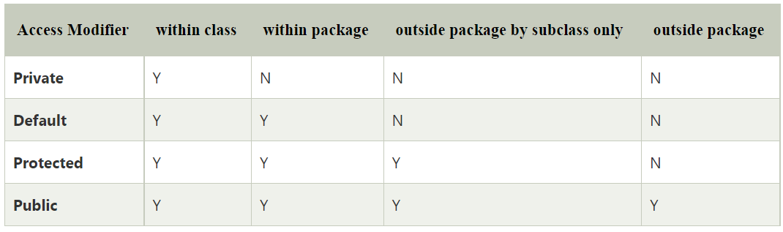
Method keywords access modıfıers

Slide 21
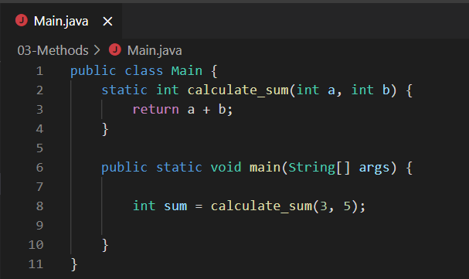
Method keywords return type

Slide 22
call by value
Pass Primitive Type
Pass Reference Type

Slide 23
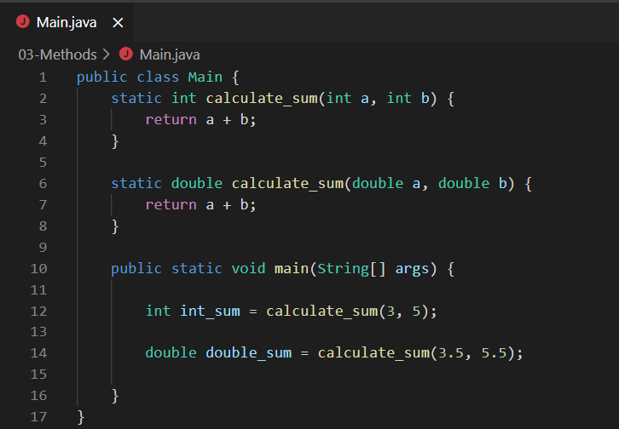
Method overloadıng

