Slide 1
COOKBOOK 2017-18 Fall Database Management Systems Project Kadir Emre OTO Süheyl Emre KARABELA 150140032 150140109

Slide 2

Objective
Cookbook is providing a common area for the recipes that users have already and wonder about.
Users can communicate by messages and follow the user that he/she likes.
Also the recipes can be diversify with the comments of other users.

Slide 3
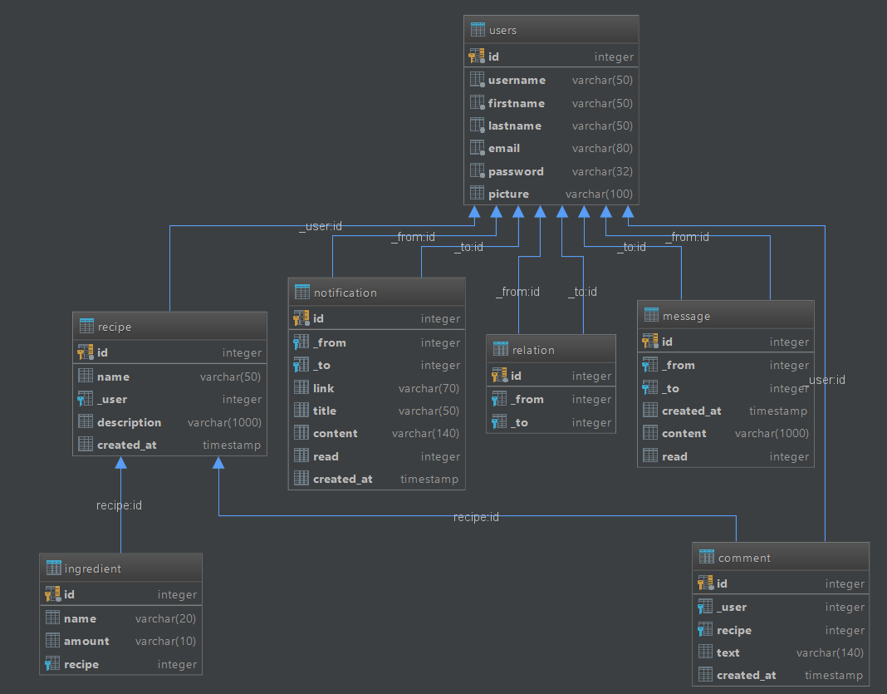
Diagram of the Database

Slide 4
Kadir Emre OTO
User, Message, Notification, Relation Entities

Slide 5

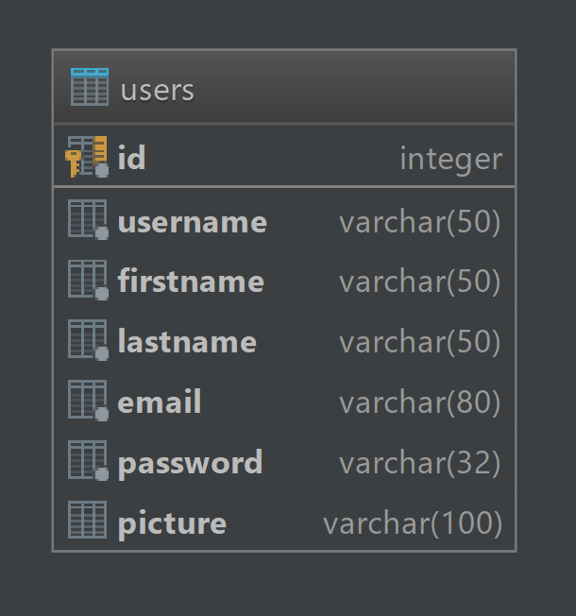
User
User entity keeps the features of the end user.
Cookbook is an end user based web site so the users are important.

Slide 6
Methods
CRUD
create_hash – create a hash of the password
set_password
check_password – check the hash of the password
get_id
follow – follows the user and add it to followings
Unfollow – unfollows the user and remove from followings
get_followers – lists the followers
get_followings – lists the followings

Slide 7

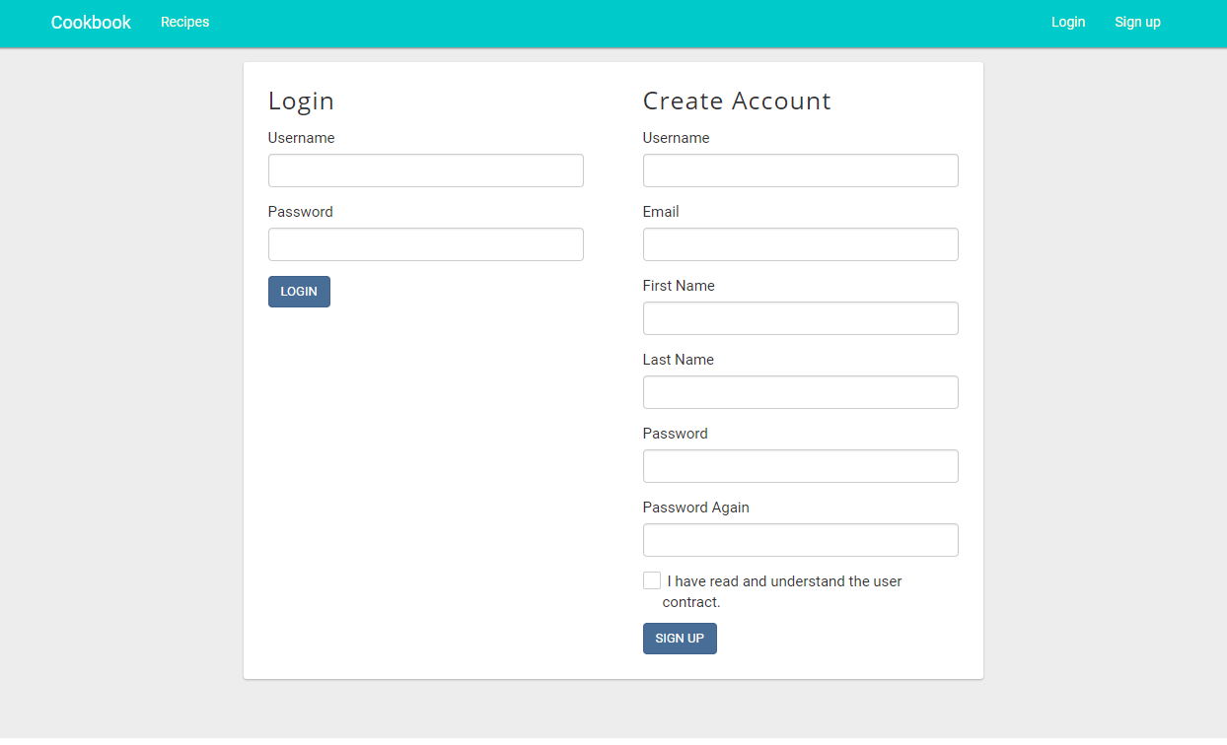
Register and Login Page
When you enter the site the register and login sections loaded and you can create an account or enter the site.

Slide 8
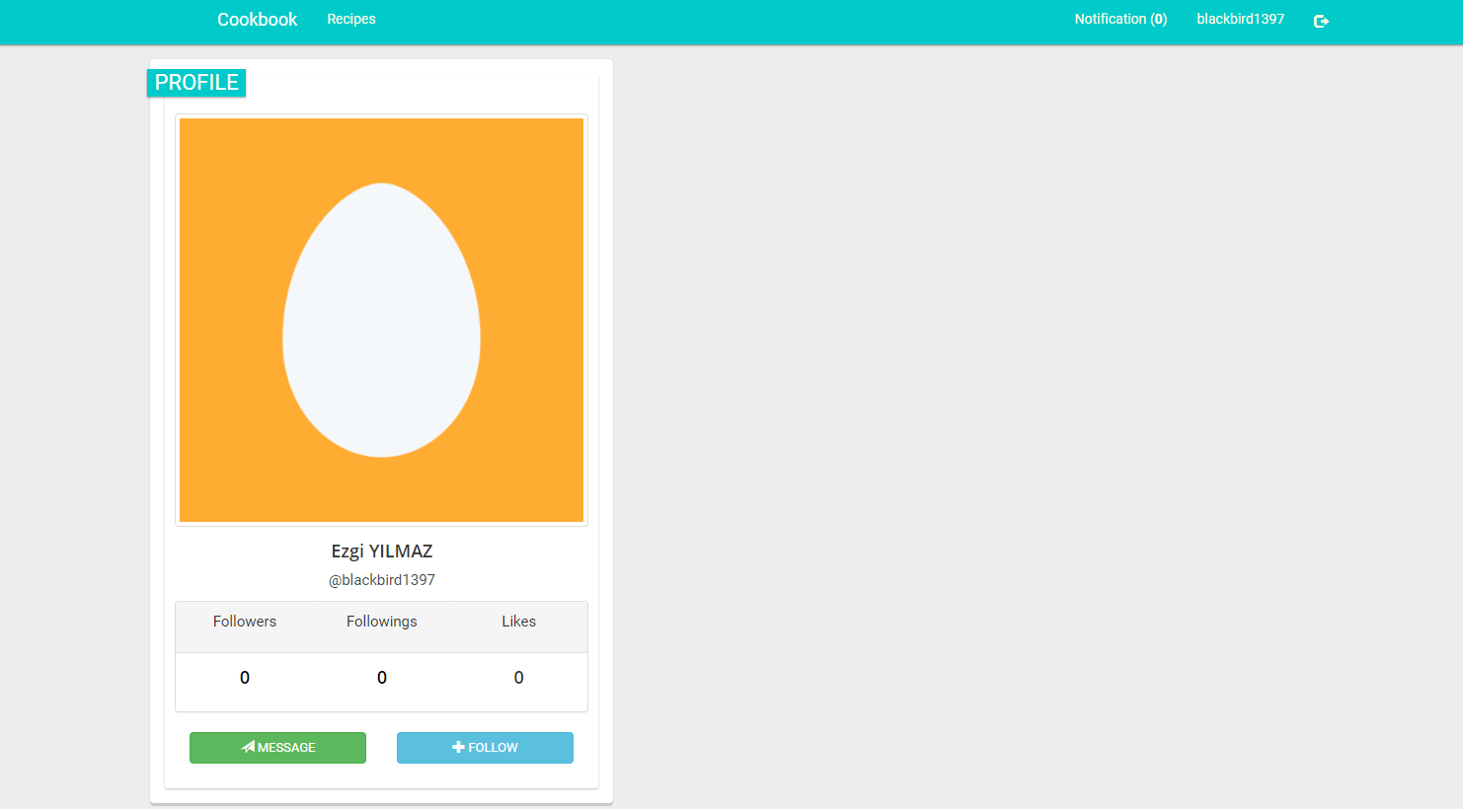
Profile
After registered you automatically directed to your profile.

Slide 9

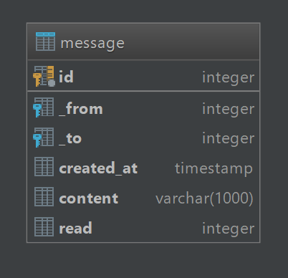
Message
Messages are major way to communicate and sharing information about food.

Slide 10
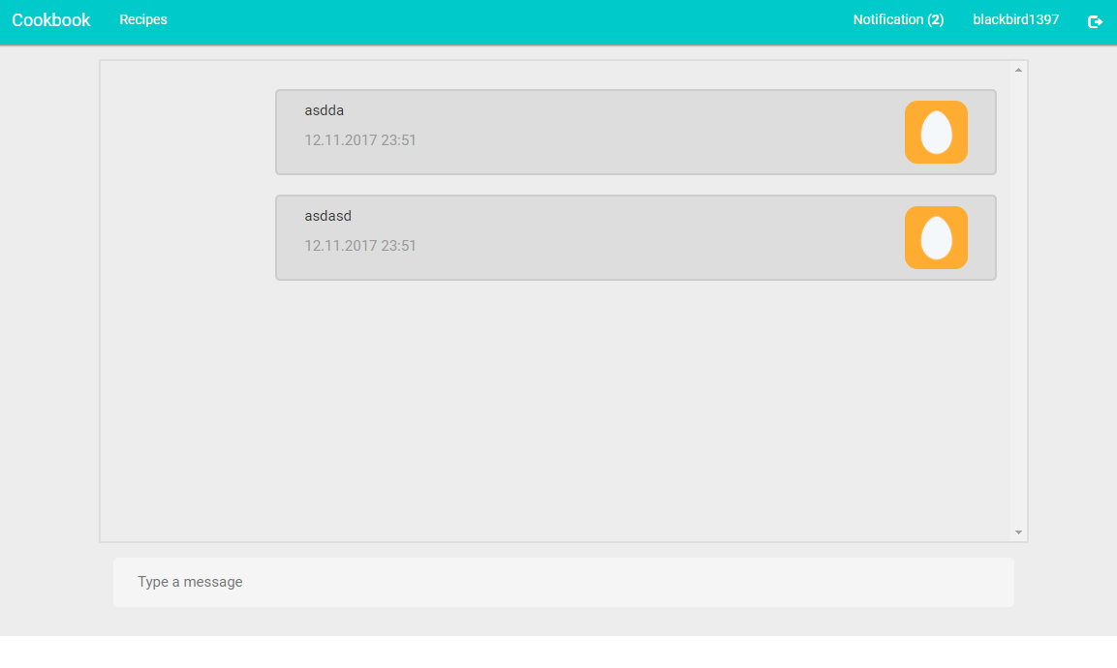
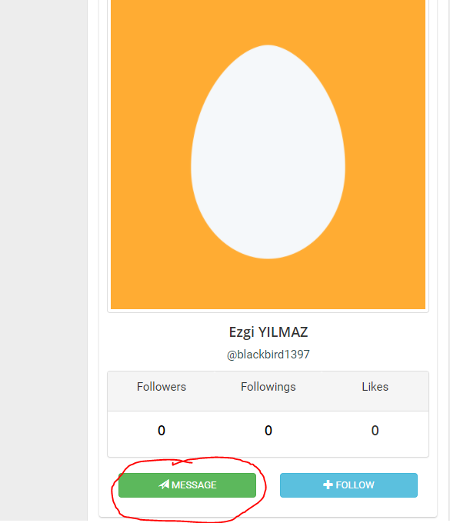
Send Message
To send a message go to the profile of the user that you want to send message and click the message button under the picture. You will be directed a page that you can send your message.

Slide 11

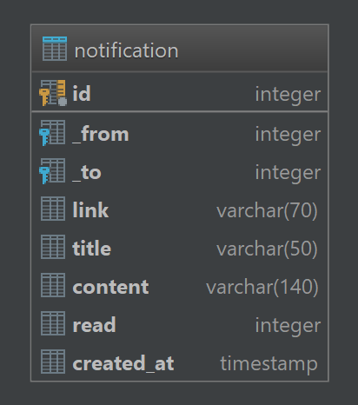
Notification
Notifications draw attention of user to specific and important events like messages.

Slide 12
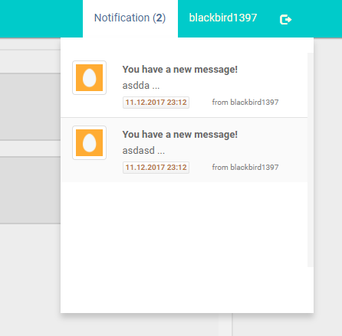
When will you get an notification ?
When you get a new message
When someone comments on your recipes
When someone follows you
Examples at the right side

Slide 13
When will you get an notification ?
When you get a new message
When someone comments on your recipes
When someone follows you
Examples at the right side

Slide 14

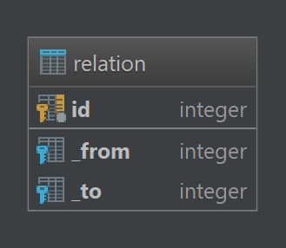
Relation
This is a table to create many to many relations between users.
When a user follows another one to keep that data we need the use this table.

Slide 15
Süheyl Emre KARABELA
Recipe, Ingridient, Comment Entities

Slide 16
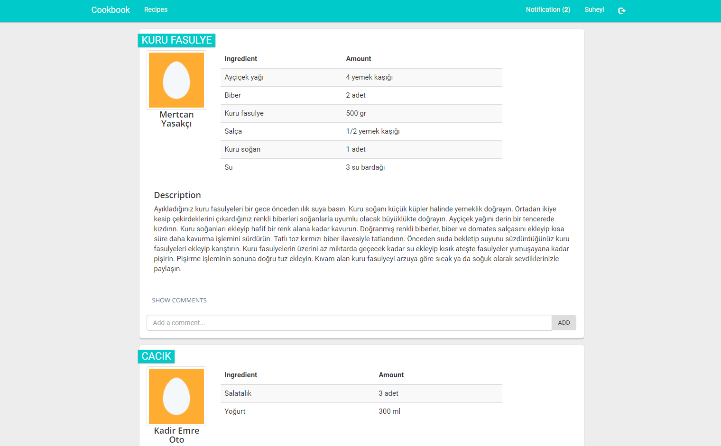
Home Page
The home page of the user will be displayed as this.
As a timeline the recipes of the followings will be listed.

Slide 17
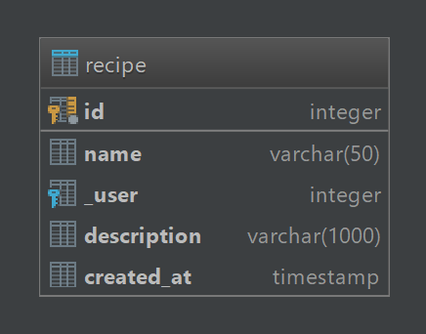
Recipe
Recipes are the posts that user can share their knowledge about that food. Recipes belong to users.

Slide 18
Methods
get_following_posts – Fetchs the user’s following along with its ingredients and comments

Slide 19
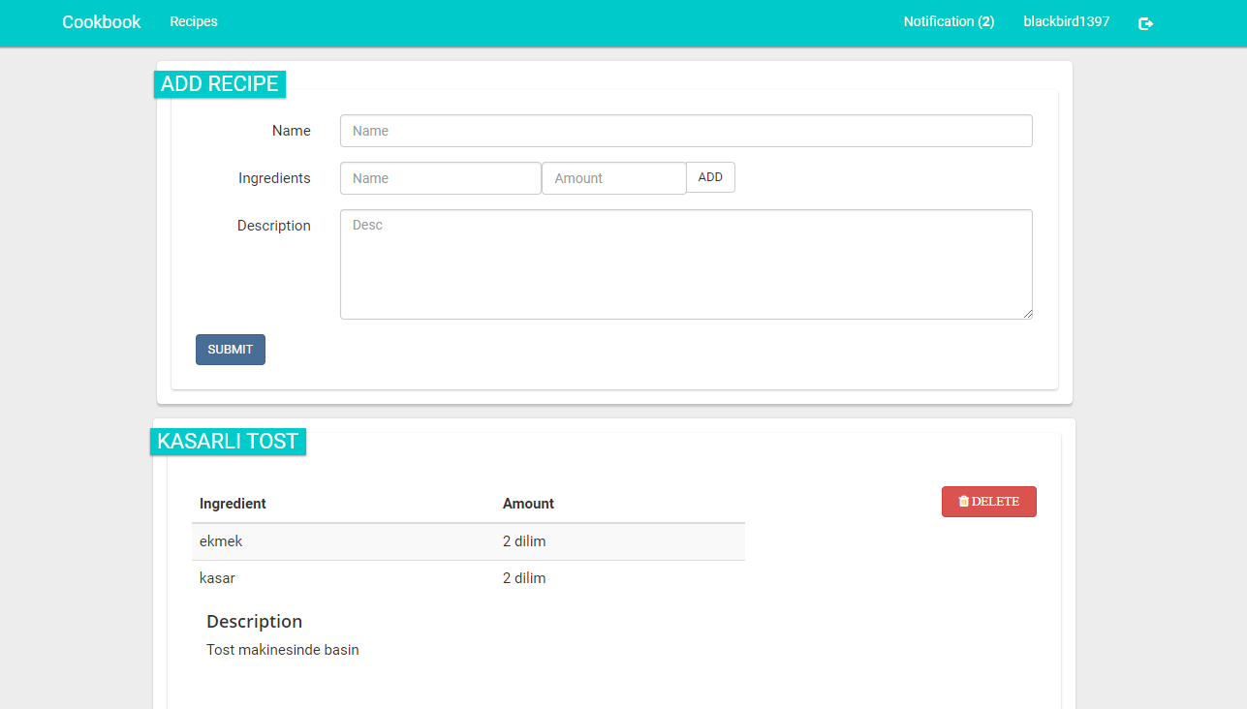
Adding Recipes
When you click recipes it will bring your added recipes list and an area to add a new recipe. You can add more than one ingredient with the add button that activates the JavaScript code.

Slide 20
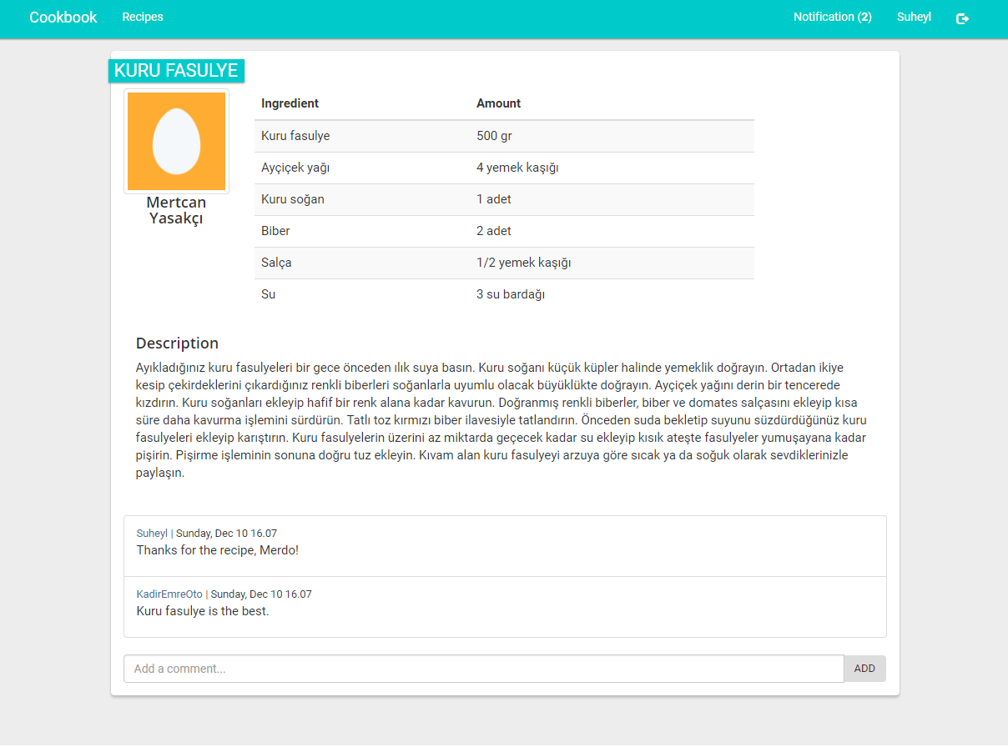
Recipe Page
Shows a single recipe with its comments, the URL of the recipe can be shared.

Slide 21

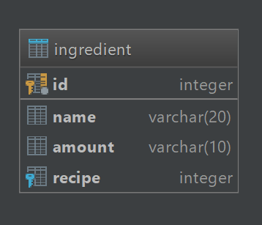
Ingredient
Every recipe has ingredients and amount in them. It is linked to a recipe.

Slide 22

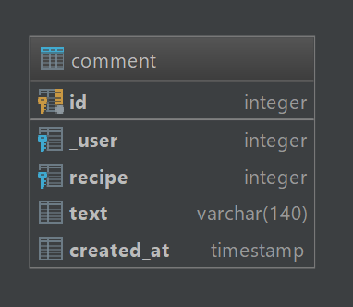
Comment
The users can comment and share their ideas and opinions about the recipe. It is linked to a user and a recipe.

Slide 23
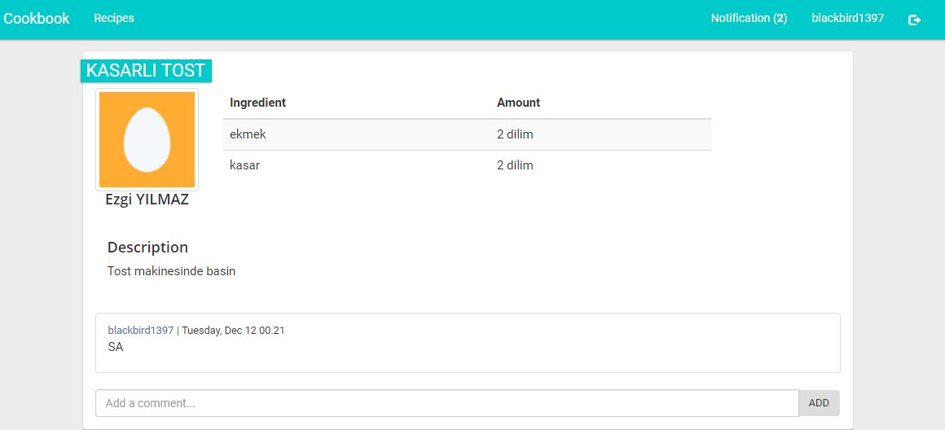
Comment
In the single view of the recipe bottom of it the comment area placed. The owner of the recipe will notified and everybody can see your comment.

