Slide 1
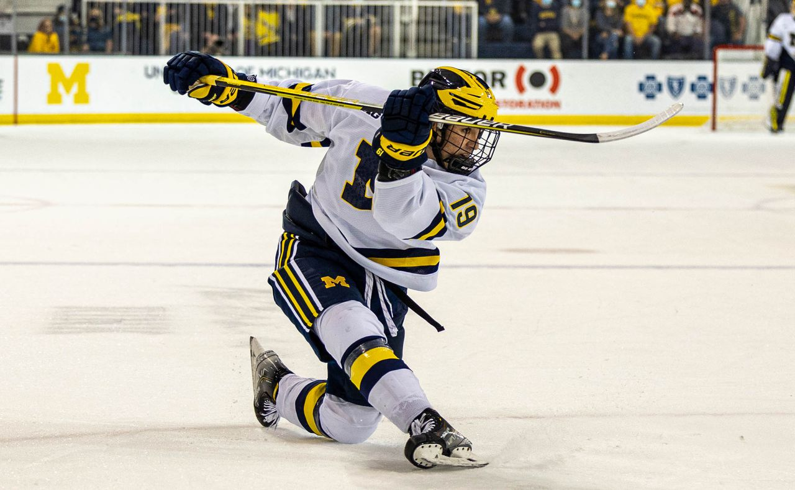

Hockey TrIvIa
Furkan Salık
Eyüpcan Çakır
Berat Dalsuna

Slide 2
What ıs ıt?
A platform that aims to be a vast resource for hockey.
It contains individual and team statistics starting from the 1909-10 season.
Create, Update, Delete operations are performed with admin privileges.
Advanced Search and detailed information for everyone.

Slide 3
Database
SQLite is used
There are 12 tables and 9280 rows in total.

Slide 4
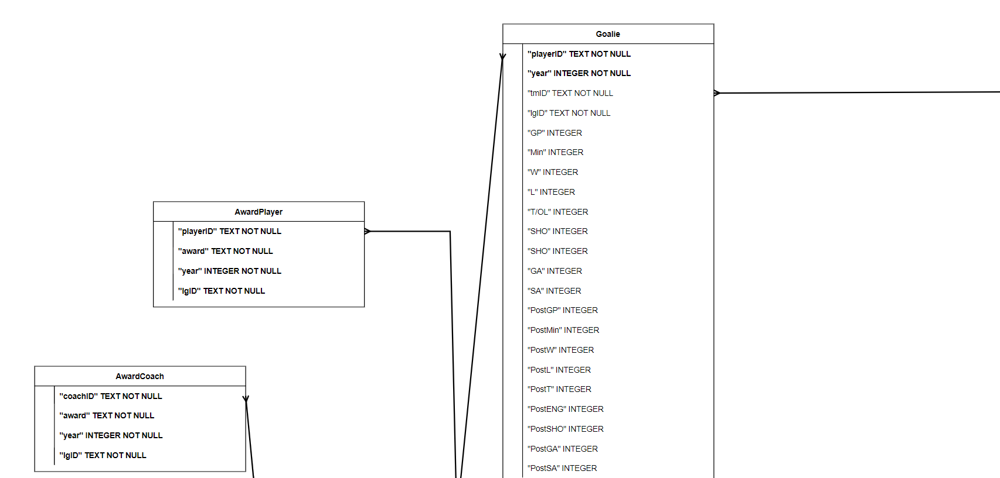
ER Dıagram (Upper left)

Slide 5
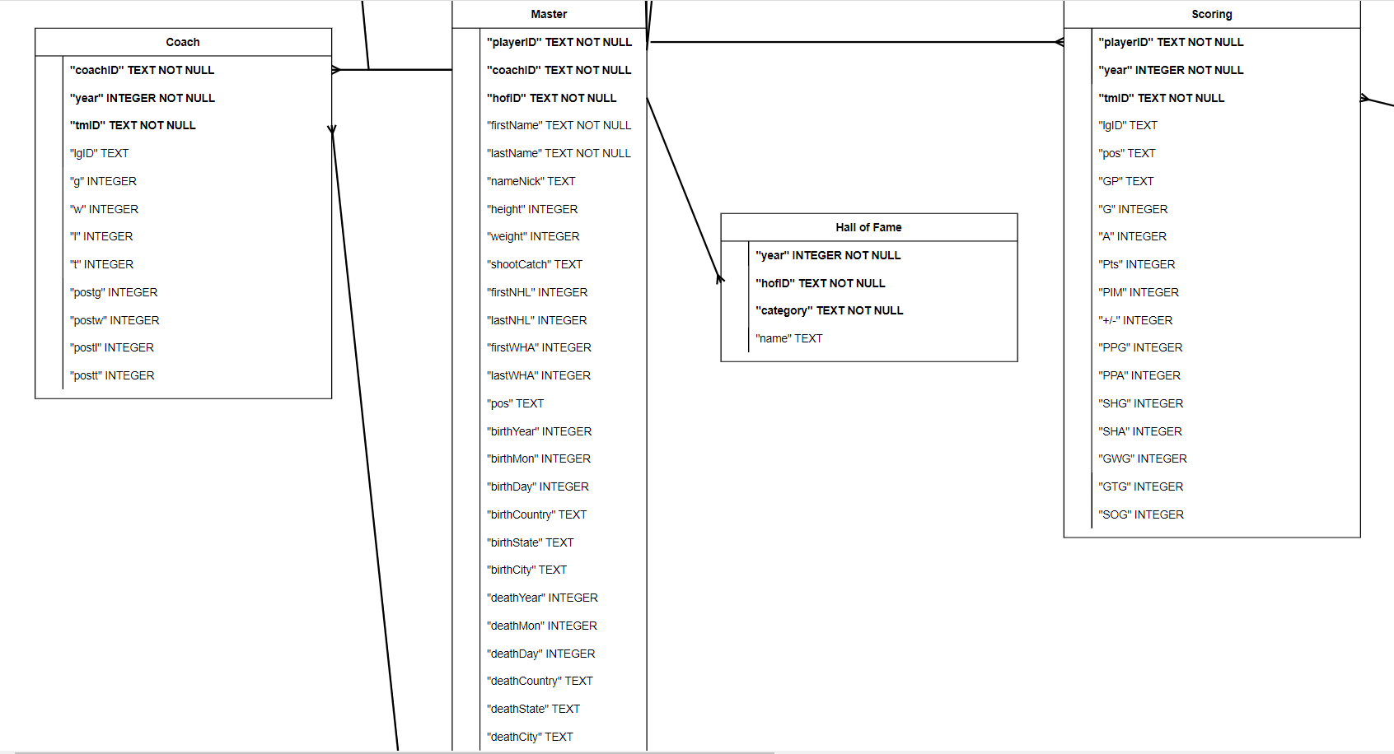
ER Dıagram (Lower Left)

Slide 6
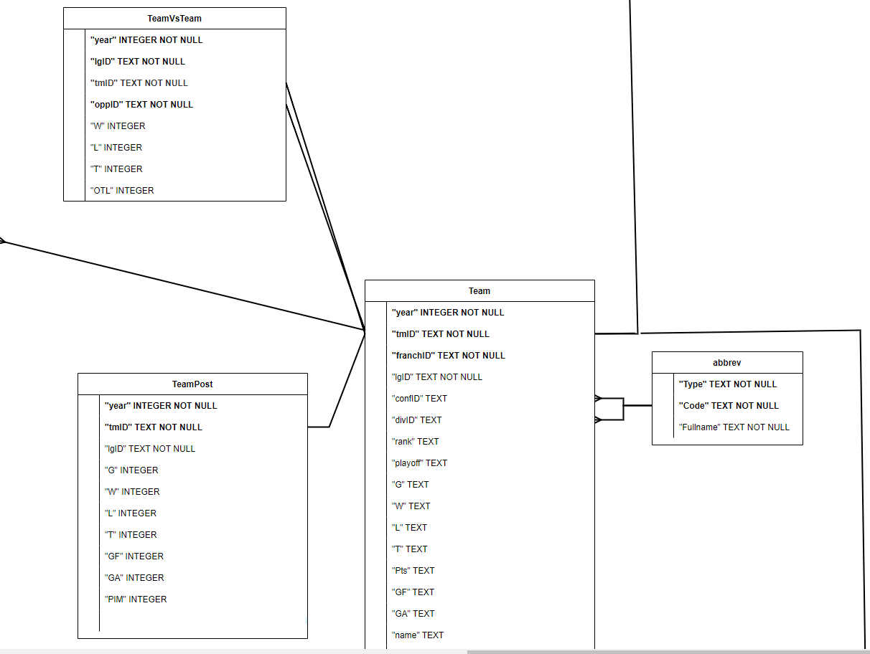
ER Dıagram (Rıght)

Slide 7
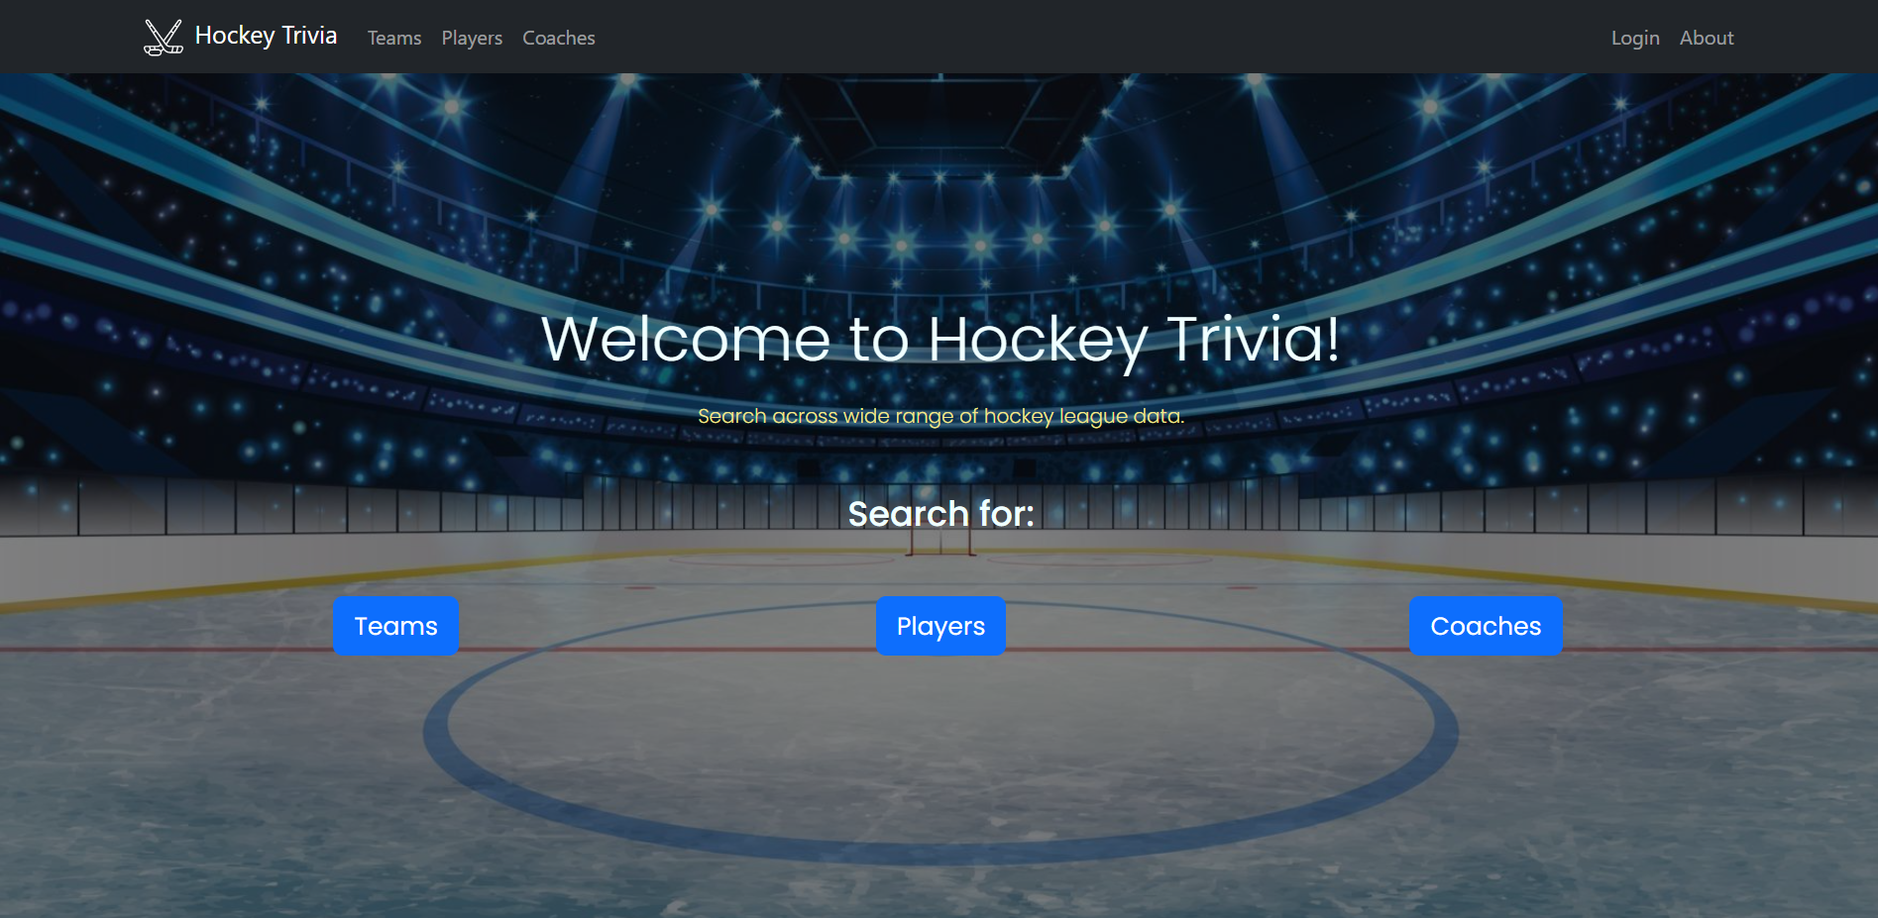
SCREENSHOTS

Slide 8
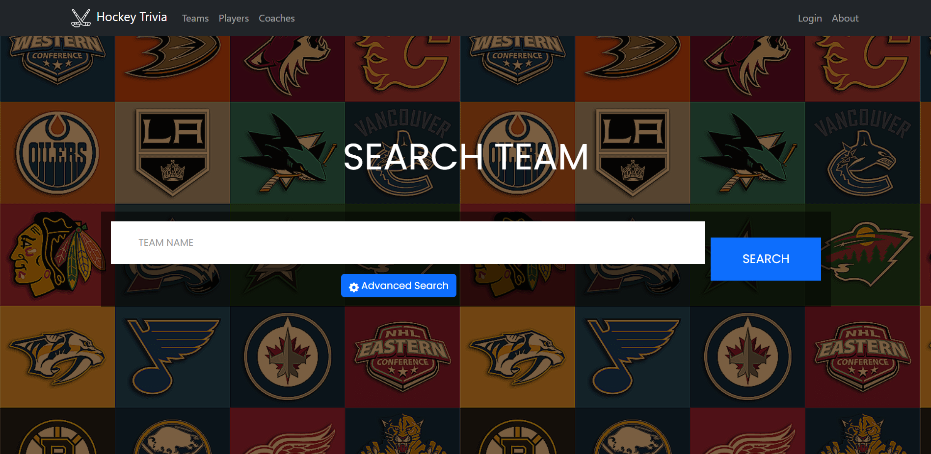
SCREENSHOTS

Slide 9
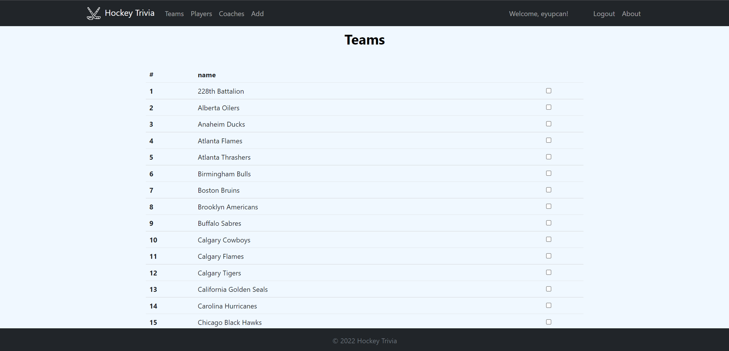
SCREENSHOTS

Slide 10
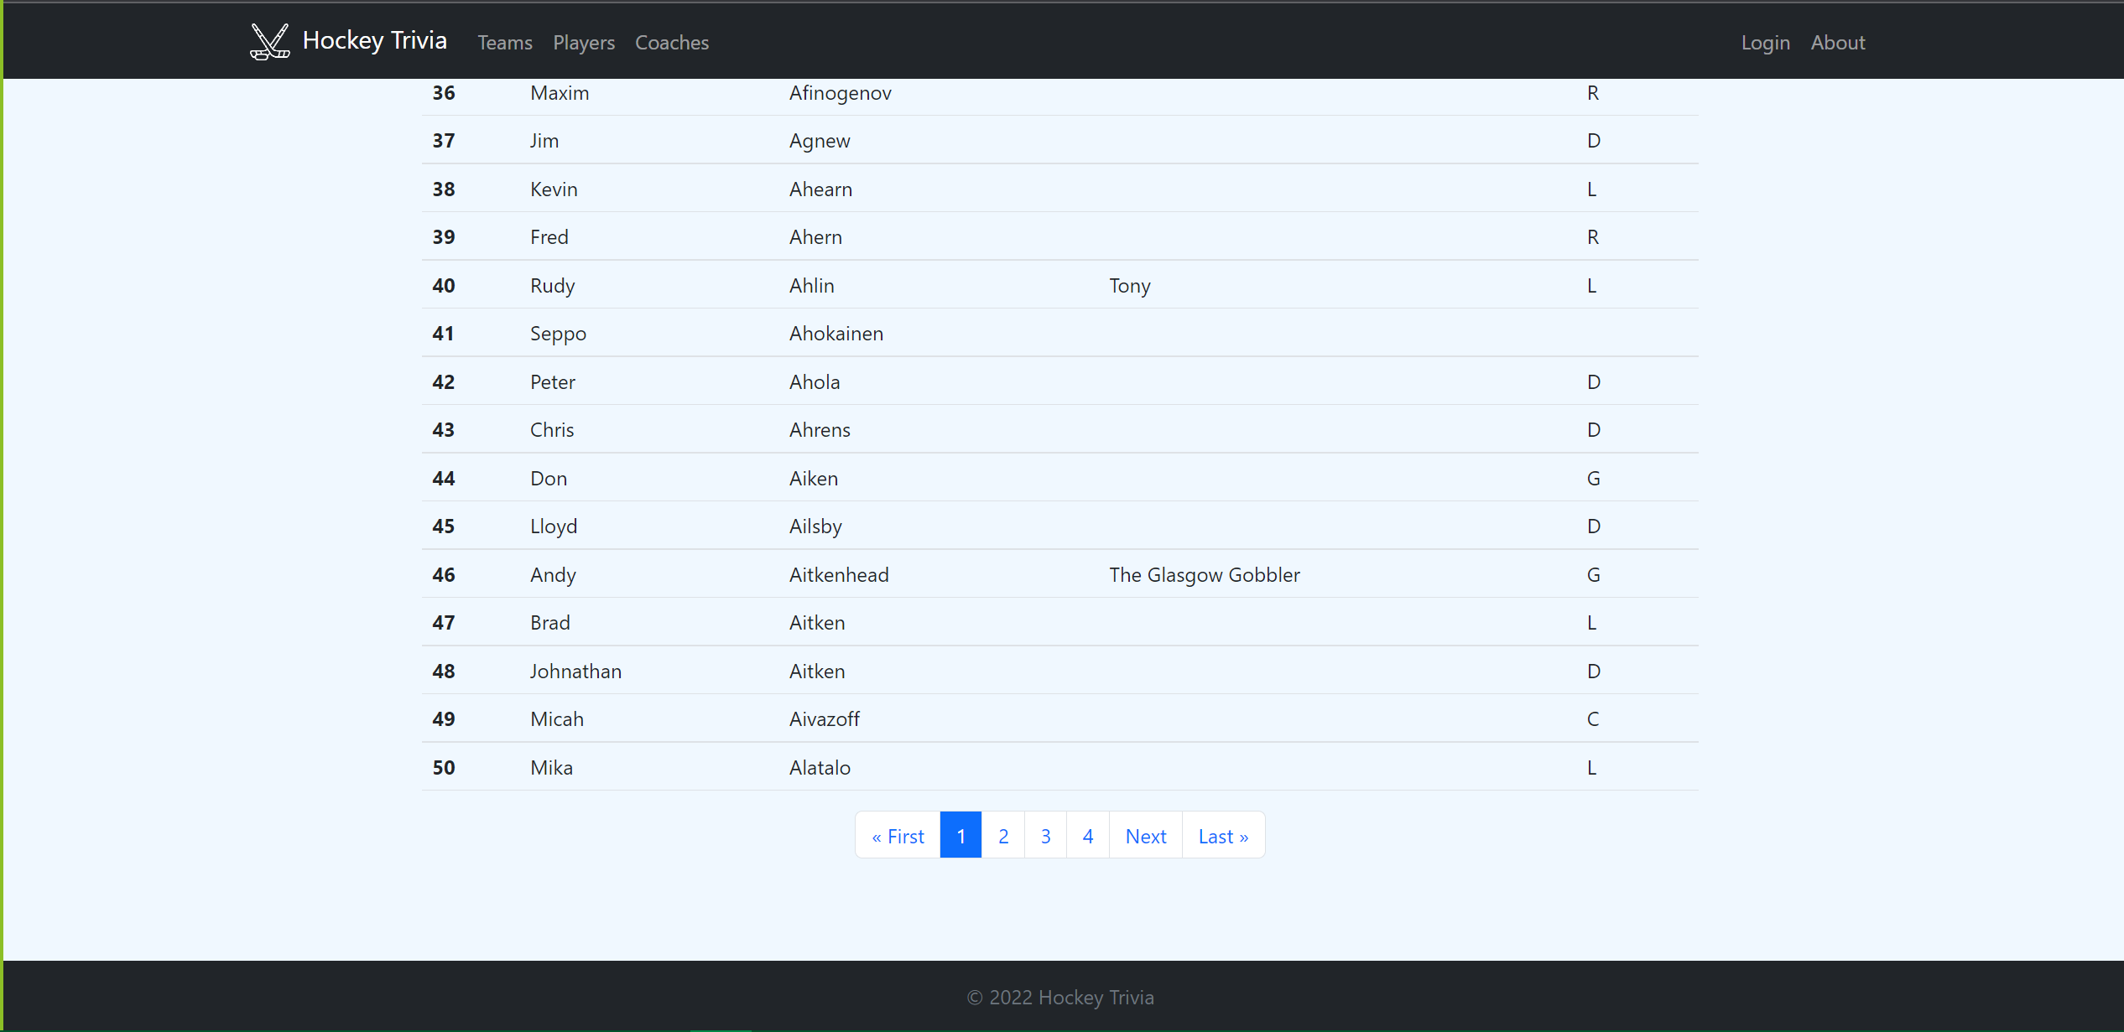
SCREENSHOTS

Slide 11
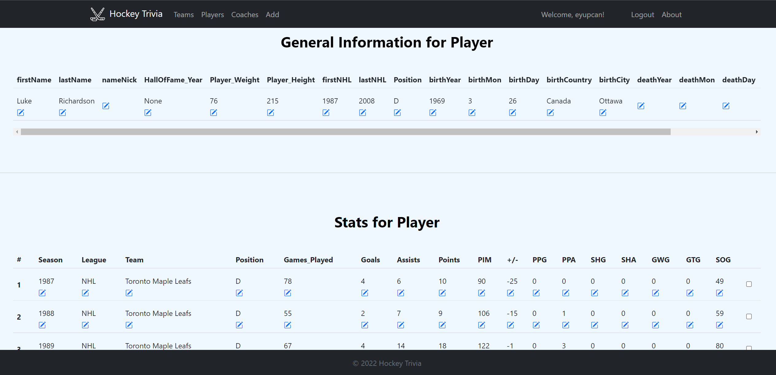
SCREENSHOTS

Slide 12
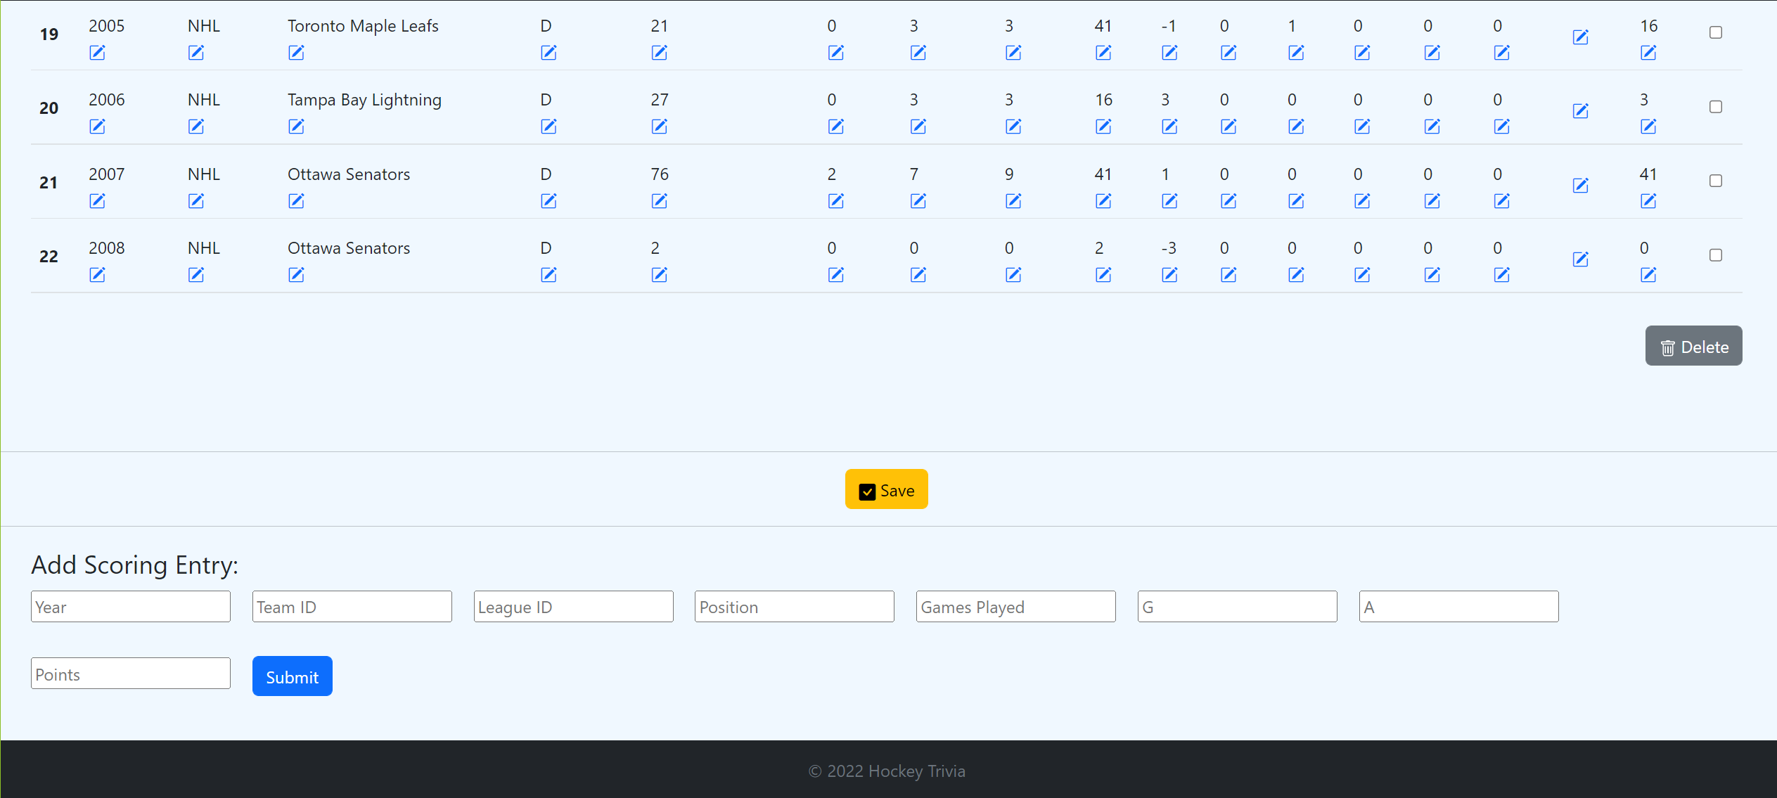
SCREENSHOTS

Slide 13
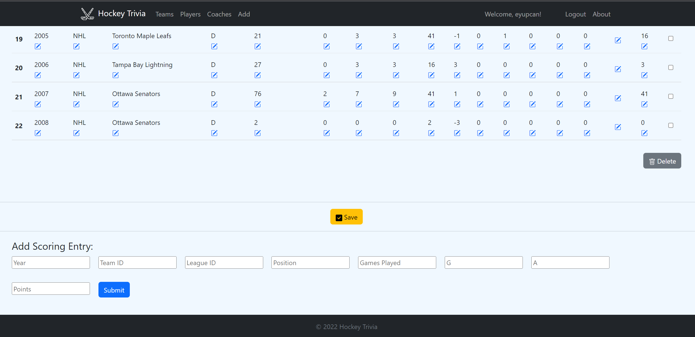
SCREENSHOTS

