Slide 1
Python and R Programming
Ali Furkan Kalay

Slide 2
Why Economists have to learn programming?
Industry 4.0 foresees programming as requirement for blue-collar workers.
Economics is referred as a “Social Science” but it progresses with the tangible data.
So, all economist know at least have minimal knowledge in econometrics.
In recent years, programming is becoming the main tool of econometrics. Actually it becomes a prerequisite for all professions.

Slide 3
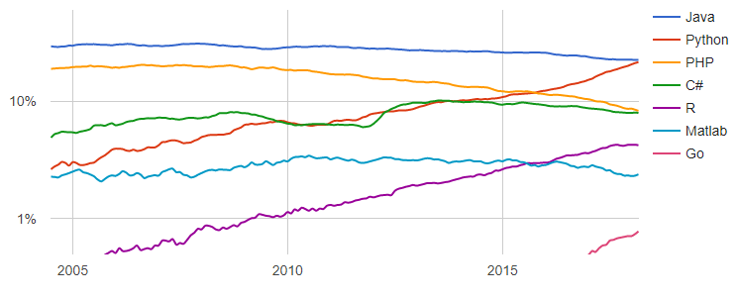
Why Python & R?
Most commonly used programming languages in AI, Big Data Analysis, Machine learning, etc.
Open-source – Free

Slide 4
Philosophy of the course
The course is aiming to teach you «How to learn?» and particularly «How to follow the trends in technology?».
«Programming cannot be taught, but can be learnt.»
Course is mostly self-paced.
You will be utilizing the «notebooks» at the itueconomics.github.io/bil113e/
You should check out the notebooks before attending the lessons. So that, you can ask questions during the lessons.
You should follow the lessons by manipulating the notebooks by yourself.

Slide 5
Philosophy of the course
You should ask your questions regarding the course, homeworks and exams via Ninova so that everyone can see it.
Email me only if it is private: kalaya@itu.edu.tr
Quiz and homework expiration dates are very strict.
Attendence is not very strict. As long as you fulfill the course requirements, it is fine.
Final Project will be on Jupyter Notebook. You will answer the questions on notebooks and then print out it with inputs and outputs.

