Slide 1
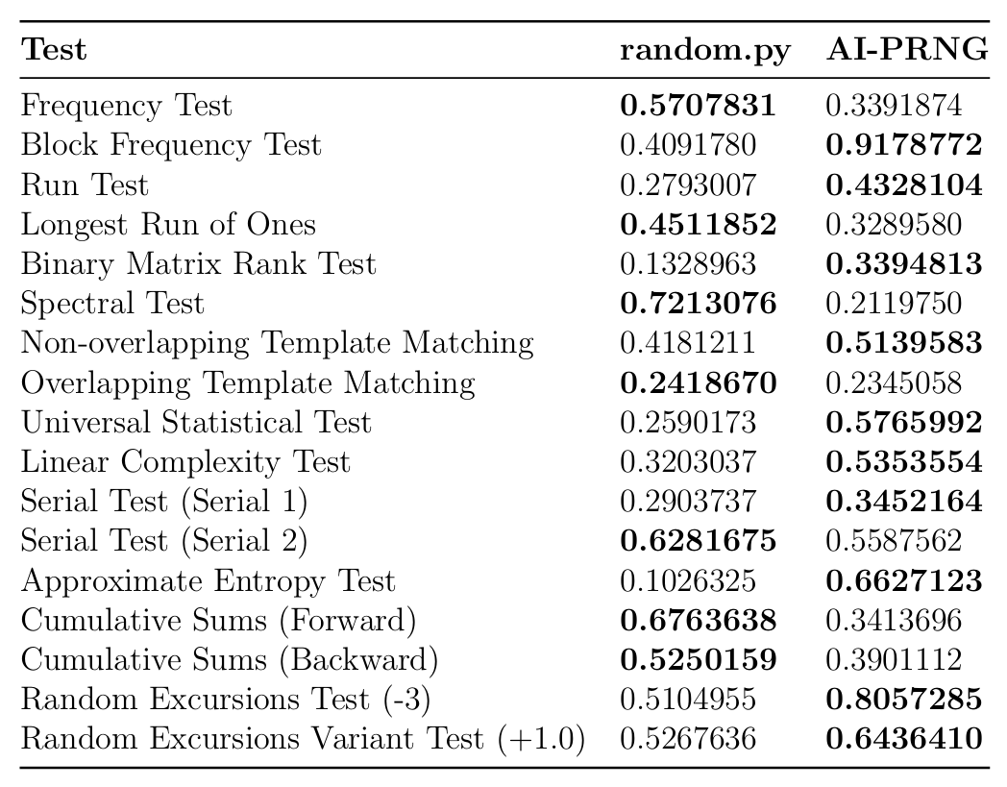
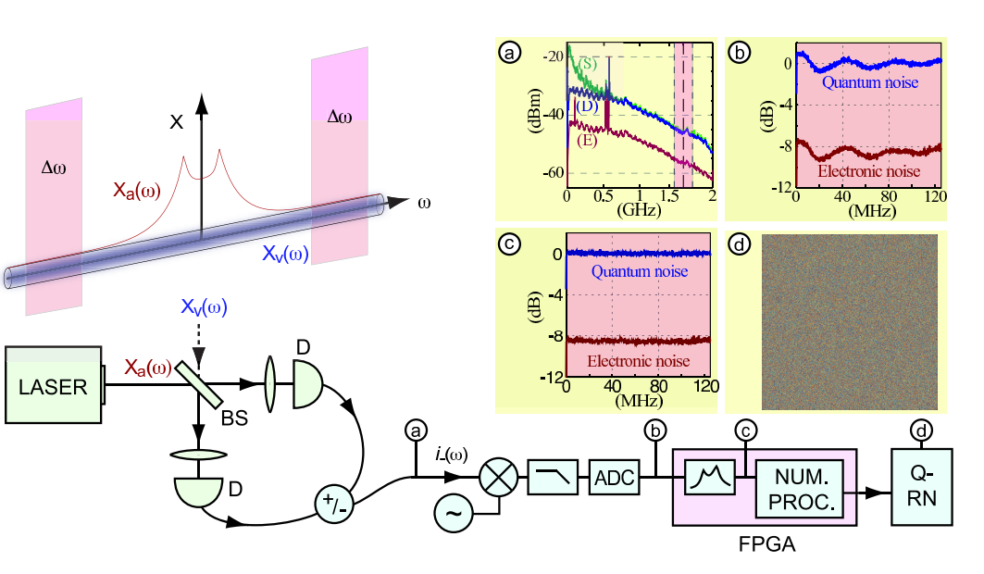
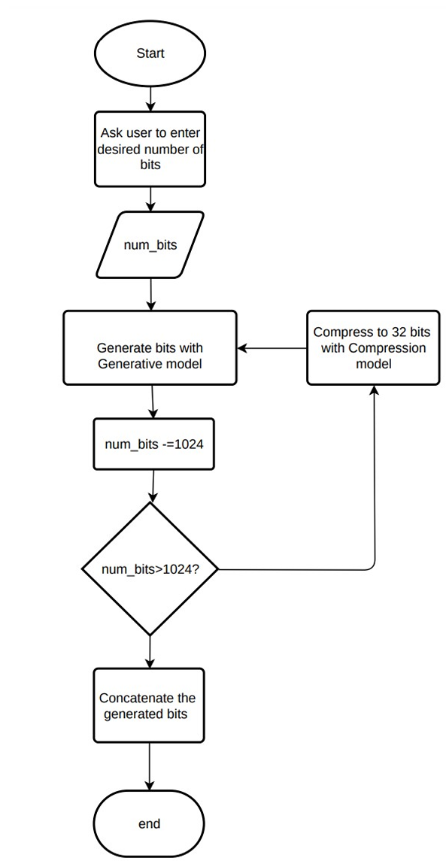
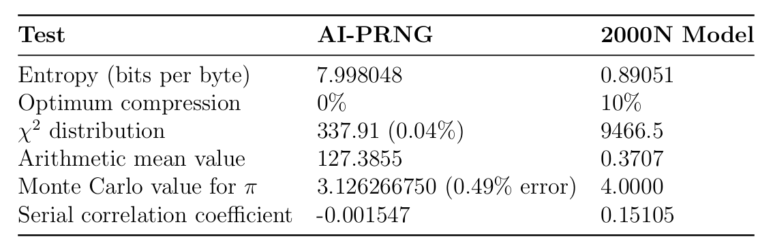
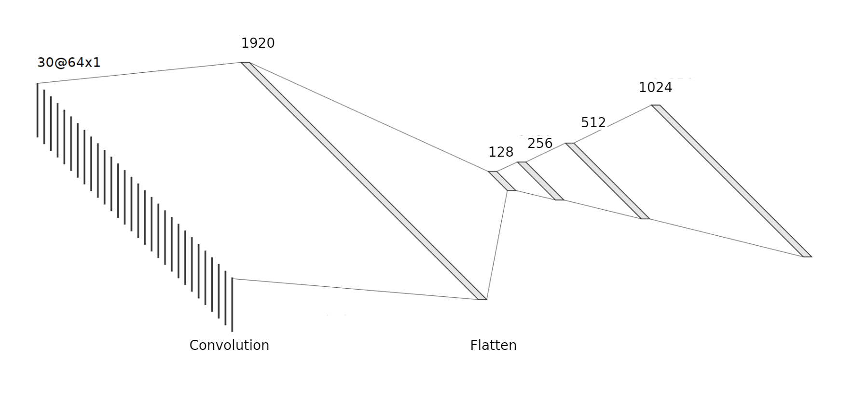
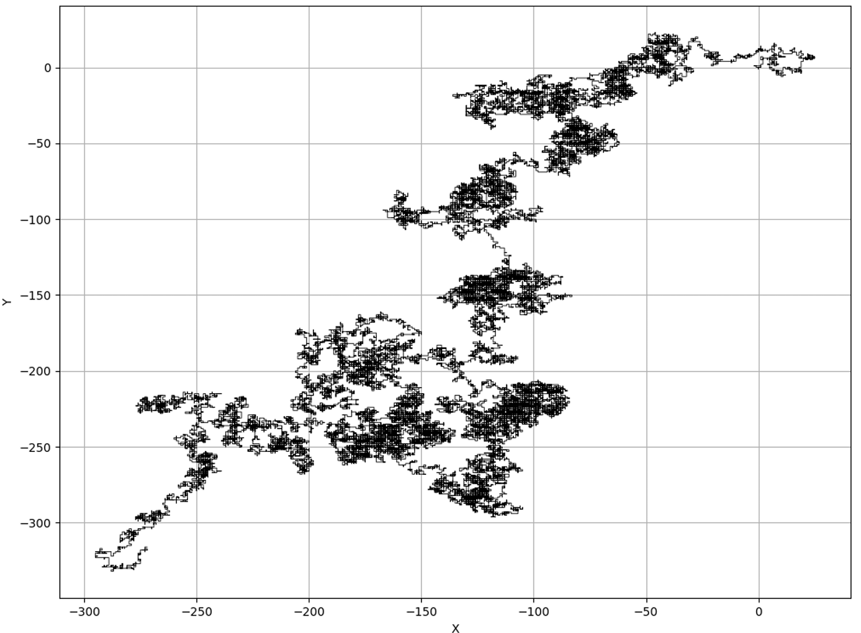
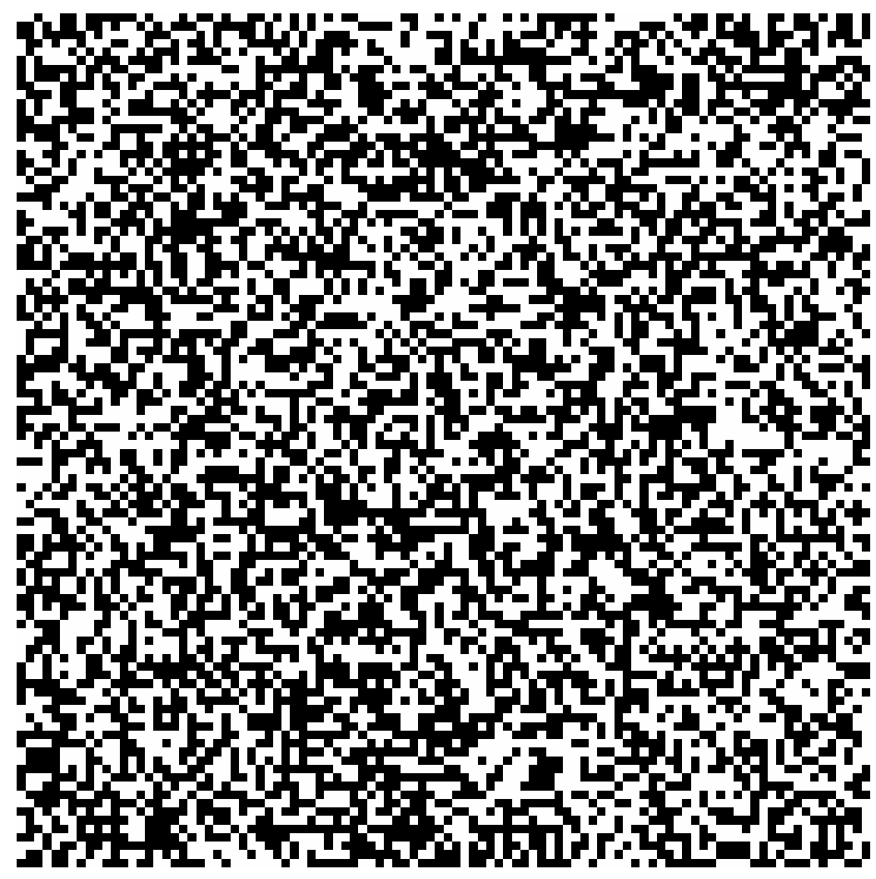
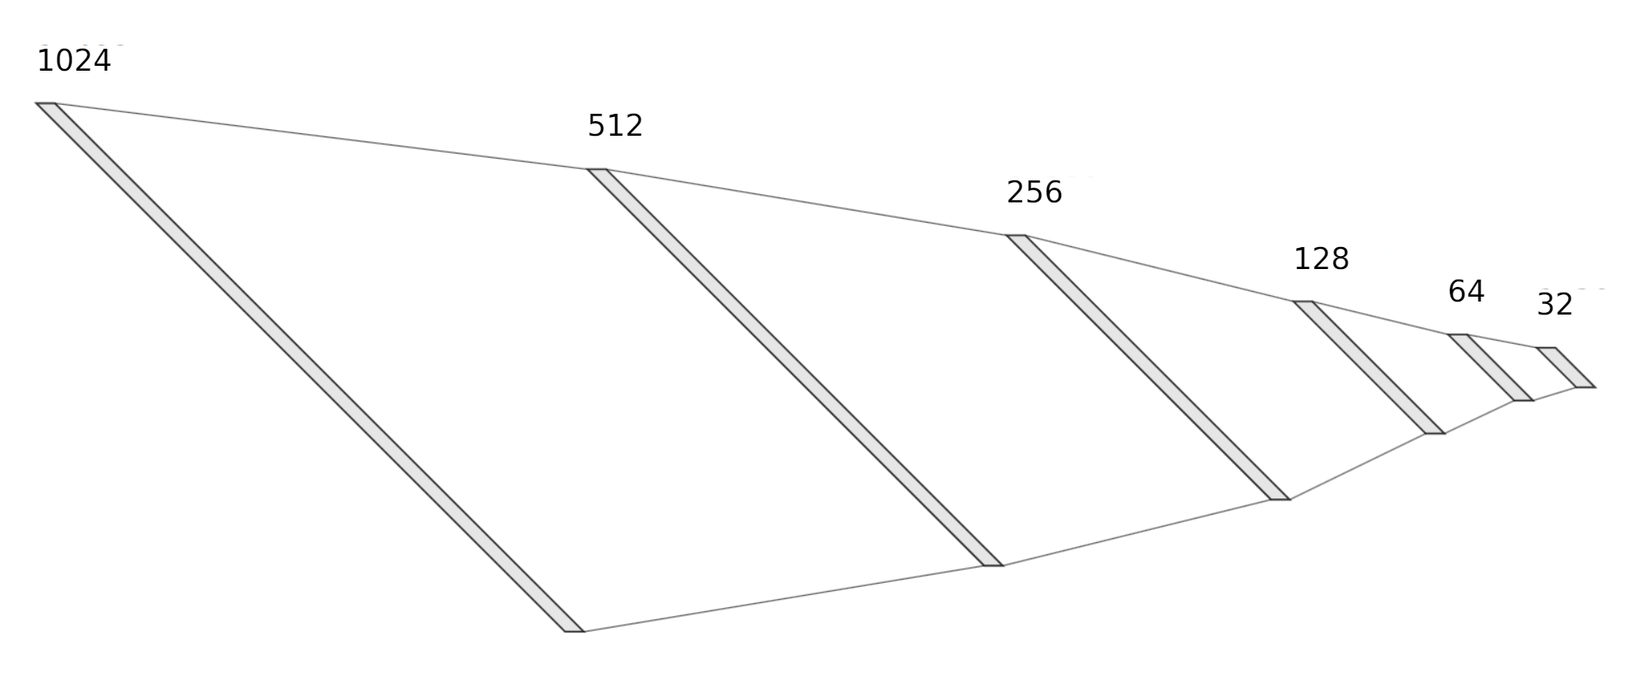
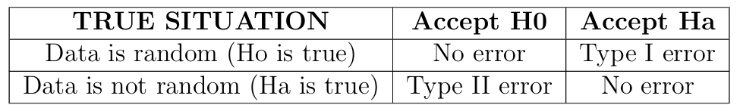
Experimental Pseudo Random Number Generator Using Generative AI
Umutcan Doğan 150200712
Introduction
In today's digital age, where countless messages and data packets traverse the internet every second, encryption has become the backbone of secure communication. At the heart of these encryption mechanisms lies the critical role of random numbers, generated by Pseudo-Random Number Generators (PRNGs). This research explores a novel approach to generating pseudo-random numbers using deep learning models. The goal is to surpass the performance of traditional pseudo-random number generators and balancing quality and computational efficiency.
Dataset
The training data consists of real random bits generated by measuring vacuum fluctuations by The Australian National University labs. In classical physics, vacuum means empty space, but in quantum theory, even in vacuum, particles pop into existence, emitting electromagnetic waves. These waves and fluctuations are measured by advanced lasers, then, can be used as random numbers.
Results
The Table showing NIST test results for random function of python and the implemented AI based PRNG. Better results are in bold.
Methods
In this project, two different models named Generative and Compression models were introduced for generating pseudo-random bits. They were used subsequently to first generate and then compress the generated bits to recursively use them as inputs again.
GENERATIVE MODEL
This model takes 32 bits as input and outputs 1024 bits. It is a generative deep convolutional neural network (DCNN).
The purpose of this model is to generate the pseudo random bits.
COMPRESSION MODEL
This model is a fully connected multi layer neural network.
This model compresses the output of the generative model to 32 bits.
Purpose of this model is to compress the generated bits for feeding them into generative model for multiple runs to create more bits automatically.
As shown in the table, the model was compared with the Python’s native random function which uses the Mersenne Twister Algorithm for generating pseudo random numbers. The model outperforms in most of the results. It should also be noted that the test were done on multiple 1 million bits files and the average of the values were put on the table for more accurate testing.
The process of generating random numbers using quantum fluctuations and electronic noise from a laser source.
Flowchart of the PRNG
The Table showing ENT test results for implemented model and Desai et al.’s 2000 neuron model.
As shown in the table, the model was compared with Desai et al.’s Elman neural network design. Better values for entropy test is as close to 8 bits, compression is zero percent, Chi-square is 10 to 90 percent, Monte Carlo value should be as close to pi as possible, and 0 for serial correlation coefficient.
The figure at the left shows the random walk of the AI PRNG. Left figure is the image representation of the first 10000 bits of the output.
The flowchart of the PRNG model.
Also, an untrained model with randomly assigned weights was made to test whether the training phase improved the model. The results suggest that the untrained model performs poorly, and training is essential for producing high-quality random numbers. The speed was calculated as 0.79 milliseconds per bit. The speed can change according to the hardware used.
Generative model architecture. Convolution operation is applied to 32 bits and concatenated at the flatten layer. Then the dense layers are applied level by level to get to 1024 bits.
The structure of the whole PRNG model consist of using the two model one after another. The algorithm starts by asking the desired number of bits from the user. After the user enters the number of bits. In the loop, the generative model will generate the bits, and the compression model will compress the 1024 bits to 32 bits and feed them into the generative model again for the next iteration. The loop will be over after the desired number of bits were generated. After the loop is over, the generated bits by the generative model will be concatenated and outputted to the user.
In the final output layer, a dense layer with 1024 neurons, sigmoid activation function was used to produce the model's output. The sigmoid activation function compresses the output into a range between 0 and 1, which suits very well for bit generation. At all the other layers, the ReLU (Rectified Linear Unit) activation function was used for better performance in terms of speed.
Conclusion
In this project, it was shown that artificial intelligence can learn the rules of pseudo randomness and mimic it. The implemented model had superior performance in terms of average p-values from one of the most used PRNG, Mersenne Twister. Moreover, each training of the model will yield a different pseudo-random number generator, with different cycle length and properties. This means that each individual can have their own PRNG that can be used in various cryptographic applications.
Testing
Department or Office name goes here School, College or Division name goes here
The pseudo-random number generator was tested using the NIST (National Institute of Standards and Technology) test suite. NIST test suite has 15 distinct tests for determining if a sequence of bits is random or not.
Each test is testing the null hypothesis denoted by H0 which is the sequence being random . Then there is the alternative hypothesis denoted by Ha which is the sequence being not random. The tests return a P-value that summarises the strength of the evidence against the H0. If the P-value of a test is 1, then the sequence is perfectly random, on the other hand, if the P-value is 0, then the data is completely non-random.
References
T. Symul, S. M. Assad, and P. K. Lam, “Real time demonstration of high bitrate quantum random number generation with coherent laser light,” Applied Physics Letters, vol. 98, no. 23, p. 231103, 06 2011. [Online]. Available:https://doi.org/10.1063/1.3597793
L. Bassham, A. Rukhin, J. Soto, J. Nechvatal, M. Smid, S. Leigh, M. Levenson, M. Vangel, N. Heckert, and D. Banks, “A statistical test suite for random and pseudorandom number generators for cryptographic applications,” 2010-09-16 2010. [Online]. Available: https://tsapps.nist.gov/publication/get pdf.cfm?pub id=906762
V. Desai, V. Deshmukh, and D. Rao, “Pseudo random number generator using elman neural network,” 09 2011, pp. 251–254.
Compression model architecture shown layer by layer. The fully connected layers are getting smaller and smaller to compress the data as previously explained. This is a simple fully connected neural network.
The target values of the train data for the compression model was sampled from a uniform distribution of bits. For avoiding collision, distinct sequences were chosen, predicated on the idea that if the model could learn to map data to distinct values, collision might be avoided.

