Slide 1
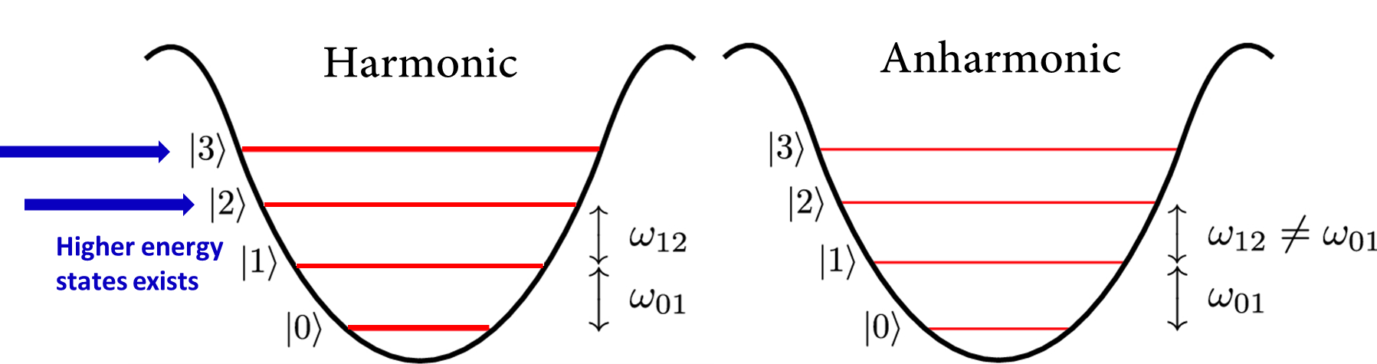
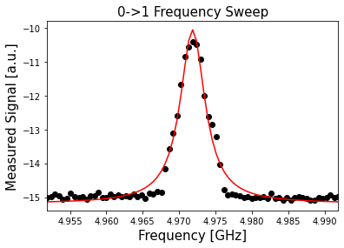
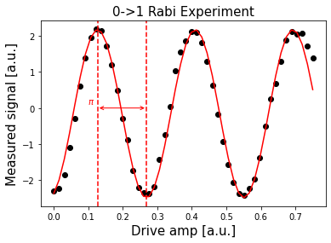
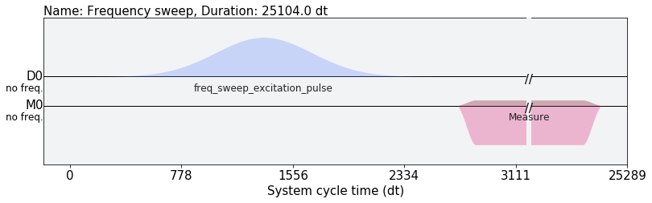
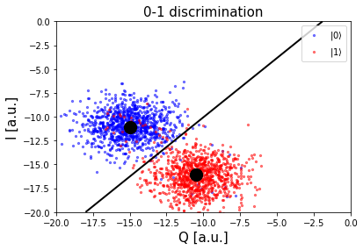
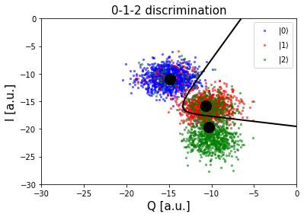
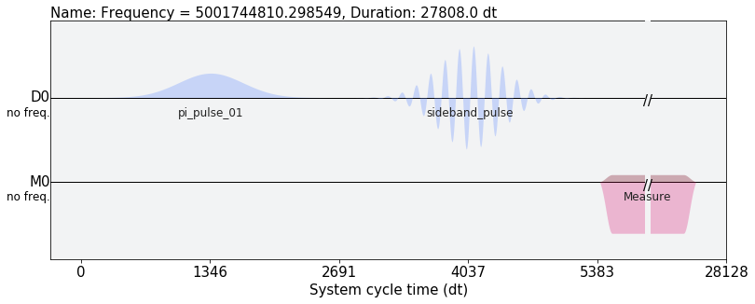
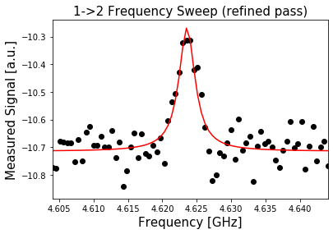
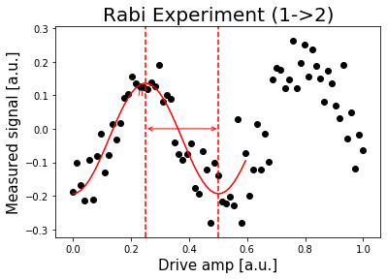
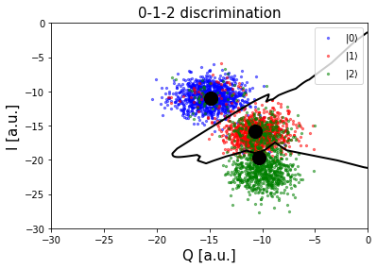
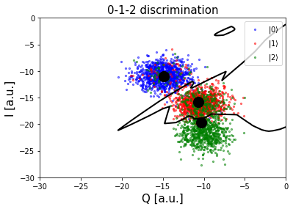



Higher Energy State Classification of IBM Quantum Computer using Machine Learning
I-Tung Chen, Department of Electrical and Computer Engineering, University of Washington.
Abstract: The higher energy state can be potentially used in quantum information processing but to correctly classify different energy state within a qubit is still challenging. This work try to explore the higher energy state and build a classifier to optimize the classification task.
1. Quantum Computer Introduction:
2. QC Access with IBM Quantum (Qiskit)
Superposition
ibmq_Armonk
Qubits
Classical bits
Qubit number: 1
Readout error: 2.77e-2
Anharmonicity: -0.34719GHz
1
and
0
0
or
1
$\left|ψ\right\rangle =α\left|0\right\rangle +β|1⟩$, where $α^{2}+β^{2}=1$
Entanglement(Spooky interaction)
1
0
or
0
1
3. Qubit Caliberation
$$\left|ψ\right\rangle =\frac{1}{\sqrt{2}}\left|01\right\rangle +\frac{1}{\sqrt{2}}|10⟩$$
|0> ->|1> State Calibration
Requirements for Qubits
Two level system
Indistinguishable
1
0
0
1
0
Center frequency: 4.9717GHz
Pi Amplitude: 0.1414GHz
4. Higher Energy State and Classification
|1> ->|2> Discrimination
|1> ->|2> State Calibration
Score: 0.963
Score: 0.808
LDA
Score: 0.840
Score: 0.841
MLP
Hidden layer neurons: 100
Sideband frequency: 4.6235GHz

