Slide 1
Data Visualization Design Exercises Design Exercise 6
Evaluating and communicating the design

Slide 2
Design Exercise 6: Evaluating and communicating the design
14.15-14.25: Introduction to today's exercise (2A52)
14.25-14.40: In your group: Evaluating your work using the heuristics
14.40-15.00: Evaluating your work with another group
15.00-15.15: Break
15.15-16.00: Continue your work with Altair and your exam project

Slide 3
A heuristic
"Heuristic evaluation involves having a small set of evaluators examine the interface and judge its compliance with recognized usability principles"

Slide 4
14.25-14.40: In your group: Evaluating your work using the heuristics
We have chosen 3 heuristics you need to consider:
Confirm hypotheses
Consider Gestalt Laws
Provide multiple levels of detail
Choose 2 additional heuristics (next slide)
Analyze your visualizations using the 5 heuristics
Remember: to take pictures and document your process ––> useful for your hand-in (4/5)!

Slide 5
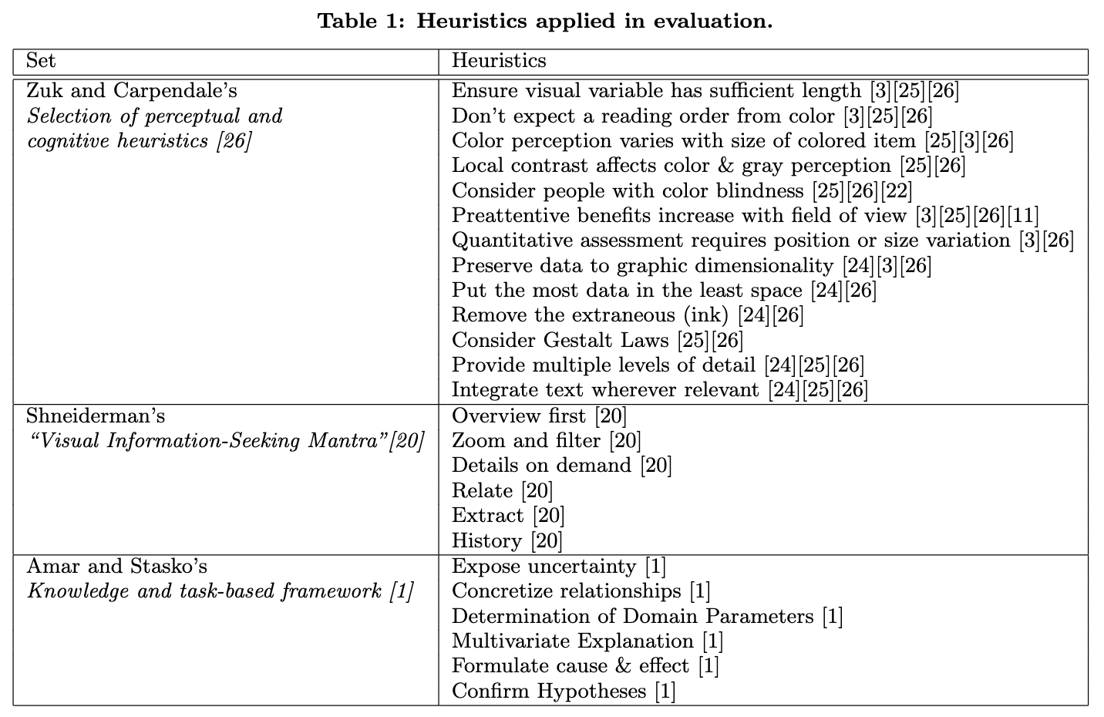
Heuristics a Heuristics applied in evaluation
Consider people with color blindness
Consider Gestalt Laws
Provide multiple levels of detail
Integrate text wherever relevant
https://www.researchgate.net/publication/220945122_Heuristics_for_Information_Visualization_Evaluation

Slide 6
14.40-15.00: Evaluating your work with another group
Present your heuristics to the other group
Discuss the presented heuristics with the other group

Slide 7
Thank you!
HAND-INS
HAND-IN 1: 23/02
HAND-IN 2: 02/03
DESIGN BRIEF: 03/03
HAND-IN 3: 09/03
HAND-IN 4: 16/03
HAND-IN 5: 23/03
HAND-IN 6: 04/05

