Slide 1
Data Visualization Design Exercises Design Exercise 4
Creating the design

Slide 2
Design Exercise 4: Sketching visualizations with the 10+10 approach
14.15-14.25: Introduction to the exercise
14.25-15.00: Use the 10 approach on the appropriateness dataset
15.00-15.15: Break
15.15-15.55: Use the 10+10 approach on your own dataset
15.55-16:00: Round-up and thank you for today!
16.00-: WEEKEND!
Notes:
OBS: It is okay if you don't have collected all of your data yet – then just use the parts you have already collected, or use the appropriateness dataset

Slide 3
Sketch 10 visualizations
Create 10 different visualizations of the "appropriateness dataset" using sketching by hand
Each group member creates 10 sketches of the dataset
If time allows, discuss your sketches in the group
Don't use the computer for this task!
Remember: to take pictures and document your process ––> useful for your hand-in (16/3)!

Slide 4
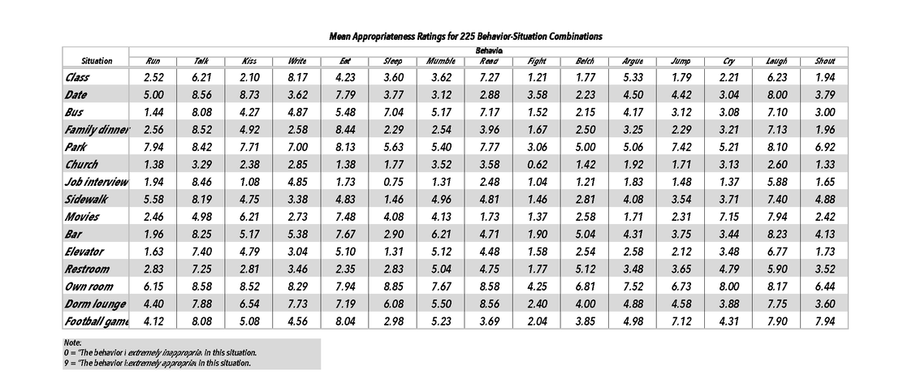

Slide 5
BREAK
15:00-15:15

Slide 6
10+10 approach on your own dataset
Each group member creates 10 sketches of your dataset
Each group member chooses 1 sketch (the best/most interesting sketch)
Each group member creates 10 new versions/sketches of the chosen sketch
Evaluate and discuss the sketches with your group members
Save your sketches! You will need them for the exercise next week!
OBS: It is okay if you don't have collected all of your data yet – then just use the parts you have already collected, or use the dataset from before the break.
Don't use the computer for this task!
Remember: to take pictures and document your process --> useful for your hand-in (16/3)!

Slide 7
Thank you!
HAND-INS
HAND-IN 1: 23/02
HAND-IN 2: 02/03
DESIGN BRIEF: 03/03
HAND-IN 3: 09/03
HAND-IN 4: 16/03
HAND-IN 5: 23/03
HAND-IN 6: 30/03

