Slide 1
REDUX
STATE MANAGEMENT
Notes:
A different way to handle state in web applications. We will use react as examples but could be any other web framework such as Vue or Angular.
We will start by a quick look at React and how state is normally handled. And why this has led to motivation behind Redux. One often here Redux and React in combination. Understand that redux is a separate entity that most be installed used on its own in your web project.

Slide 2
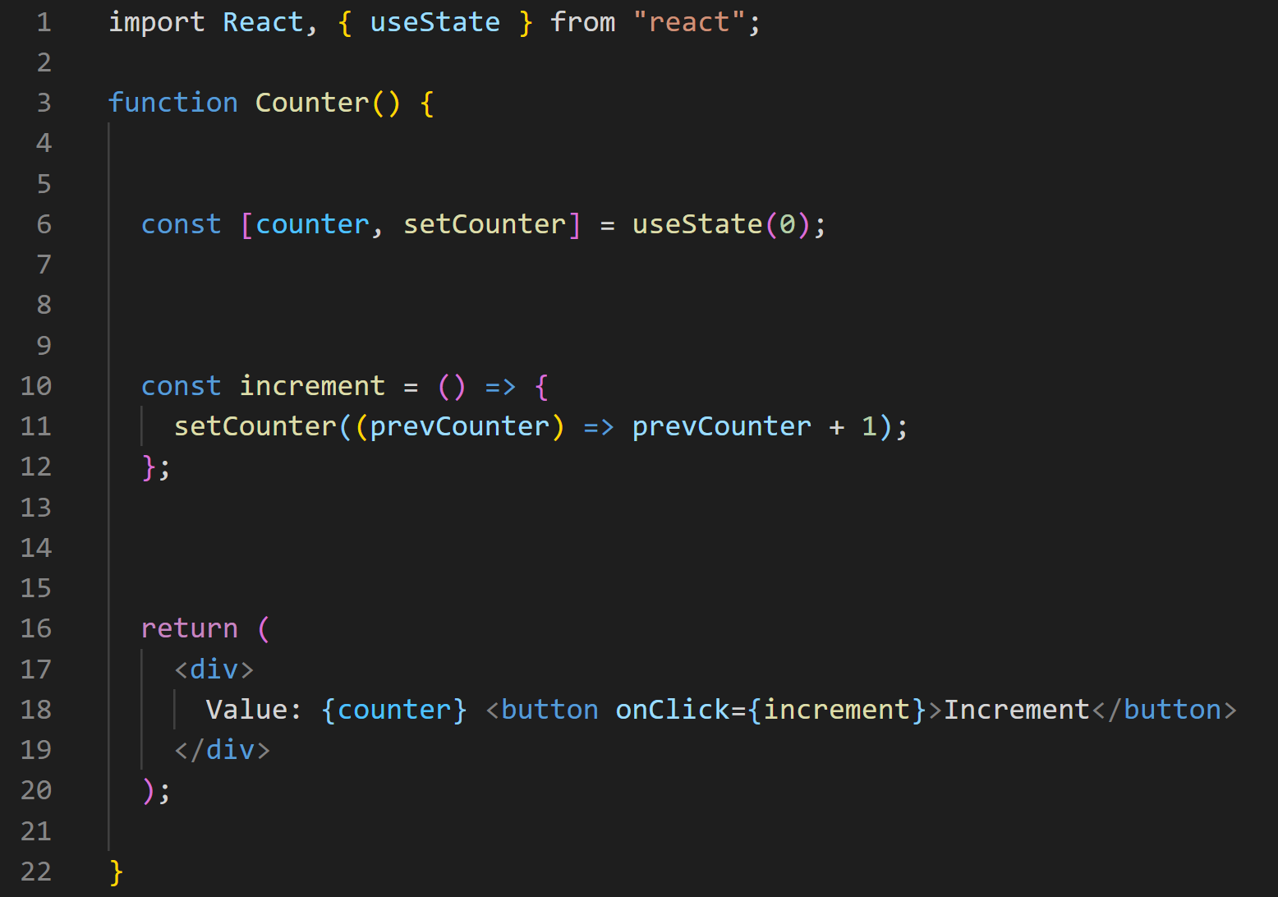
Notes:
A typical react component. Is has state for counter, action to increment and the view part that displays current state on the screen.

Slide 3
Actions
State
View
Notes:
How does React handle updates/re-renders It is a self-contained app with the following parts:
The state, the source of truth that drives our app;
The view, a declarative description of the UI based on the current state
The actions, the events that occur in the app based on user input, and trigger updates in the state
One way data flow
State describes the condition of the app at a specific point in time
The UI is rendered based on that state
When something happens (such as a user clicking a button), the state is updated based on what occurred
The UI re-renders based on the new state

Slide 4
State
Action
View
Notes:
Show parts of the components

Slide 5

Notes:
In React we would want to create reusable components. One of the main ideas of React and other web frameworks for that matter. And pass in properties, property passing. This is a typical page that displays contacts.

Slide 6
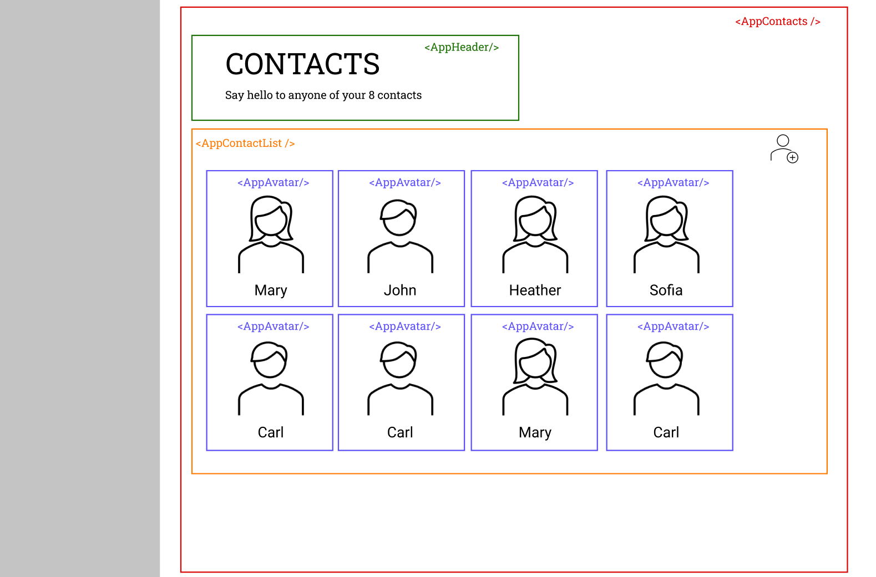
Notes:
It may be divided into the following components. Take extra note that data for length of contact, 8, lies outside the component AppContactsList. At the same time, appContactsList has an AddButton. How to make sure that number of contacts are updated when new contacts are added.

Slide 7
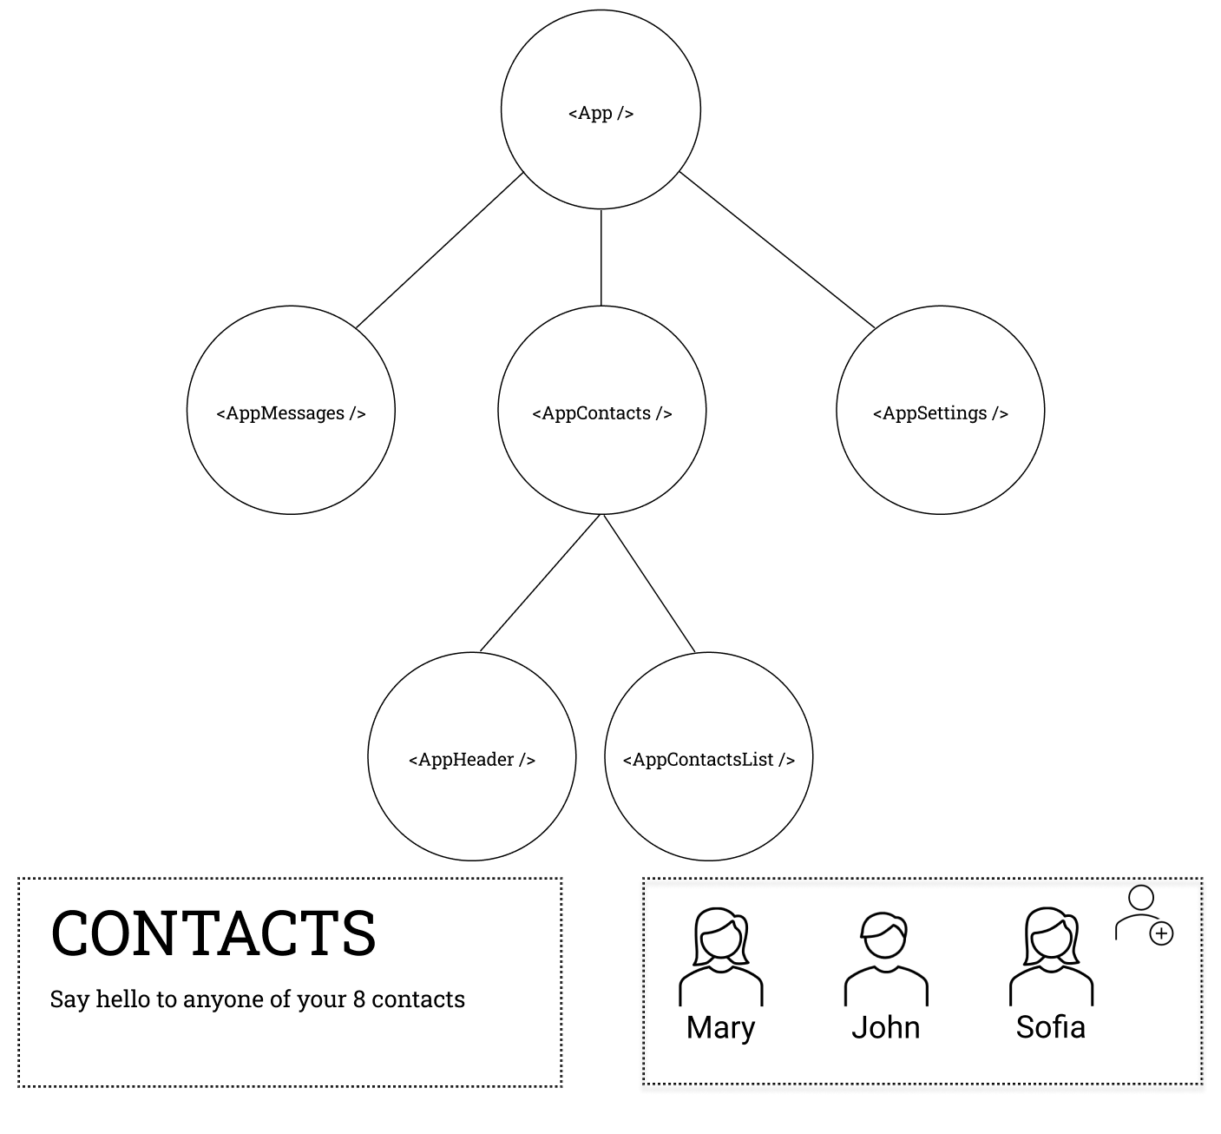
Notes:
Example of how the tree may look.
To solve the problem of data being needed to be synced for two components, will move data to closets parent

Slide 8
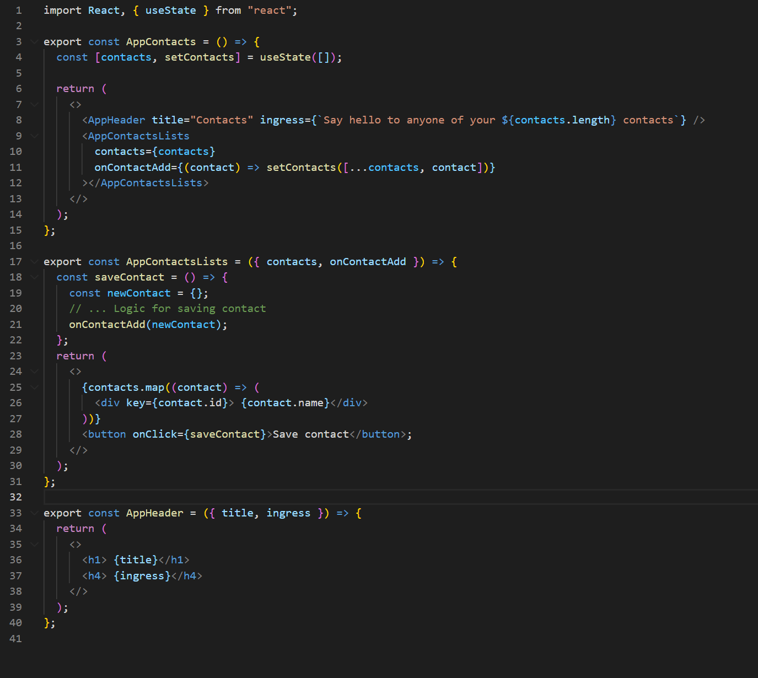
Notes:
Highlight property passing. Ask if they are familiar with this code.

Slide 9
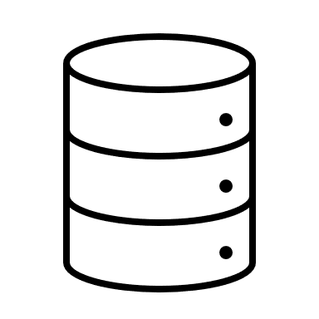
Store
Notes:
This property passing to closest parent is fine for a few levels.
But what happens if we suddenly need to pass all the data into the AppComponent. You would tightly couple the AppContactsList to always be under the AppContatcsComponent.
Among other aspects, this is one of the problems that Redux solves. We will also see other things that Redux is good for.

Slide 10
JavaScript prerequisites

Slide 11
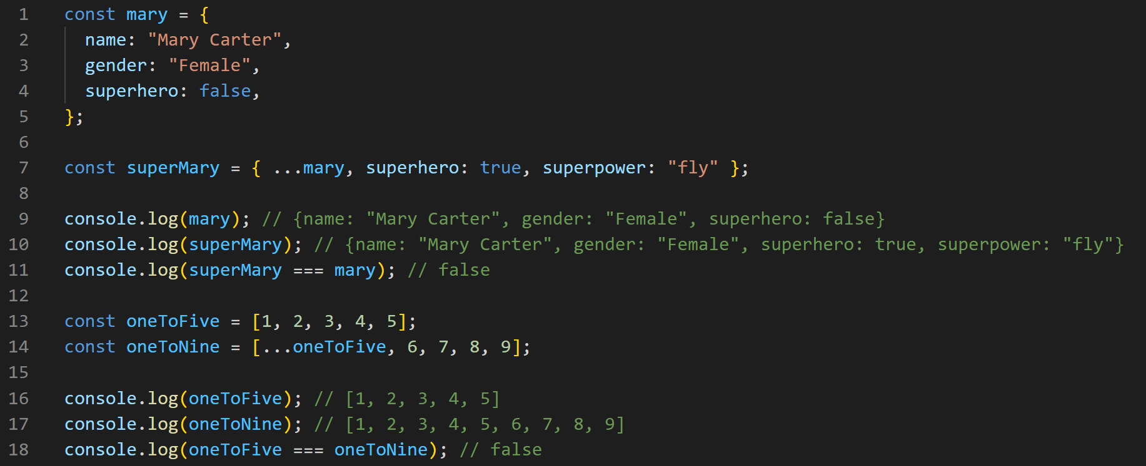
Spread operator
Notes:
Key aspect that objects are copied. Base objects are not changed. Show that the objects are not the same.

Slide 12
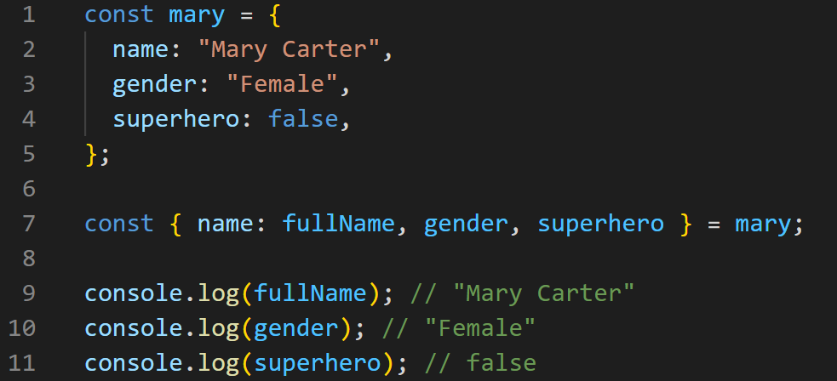
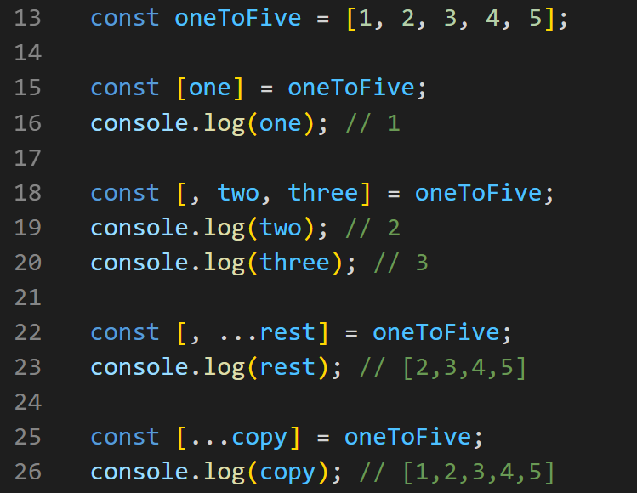
Destructuring assignment
Notes:
Show how one can extract values.

Slide 13
REDUX
Notes:
This talk will focus on Redux, which is an implementation of the FLUX architecture. There are other implementations, e.g. ngrx.

Slide 14
Redux
store

Slide 15
Redux Overview
Global state is stored in an object tree within a single store.
Only way to change the state tree is through actions.
Actions are objects describing what happened.
Actions must be dispatched.
Reducer functions handles the actions and updates the state in an immutable fashion.

Slide 16
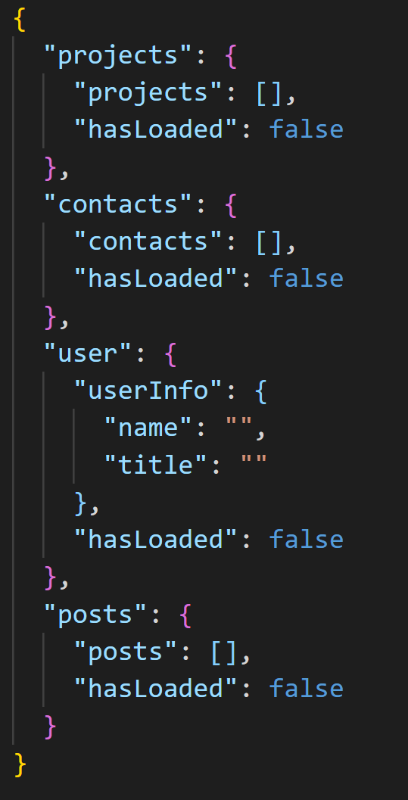
STORE
ACTIONS
DISPATCH
REDUCERS
Notes:
Is a simple object

Slide 17
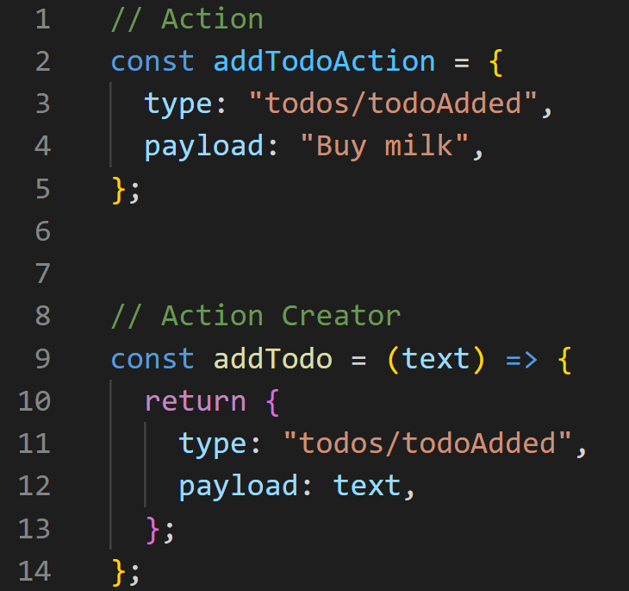
STORE
ACTIONS
DISPATCH
REDUCERS
Notes:
An action is a plain JavaScript object that has a type field and optionally a payload. An actions describes something that happened in the application.
Normally type is written as “domain/eventName”, where domain points to the feature or category and eventName the events that happened.
On the image we see both an action and action creator. Action creators makes sure that you do not have to write the type every time.

Slide 18
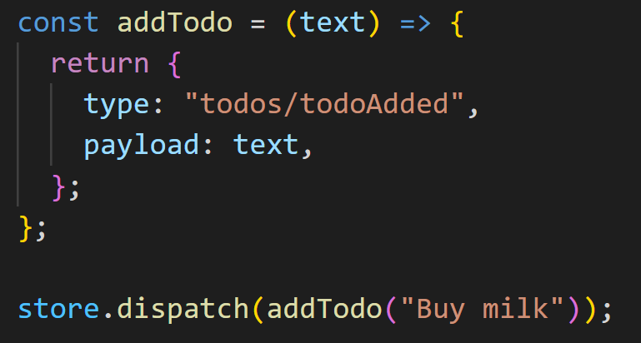
STORE
ACTIONS
DISPATCH
REDUCERS

Slide 19
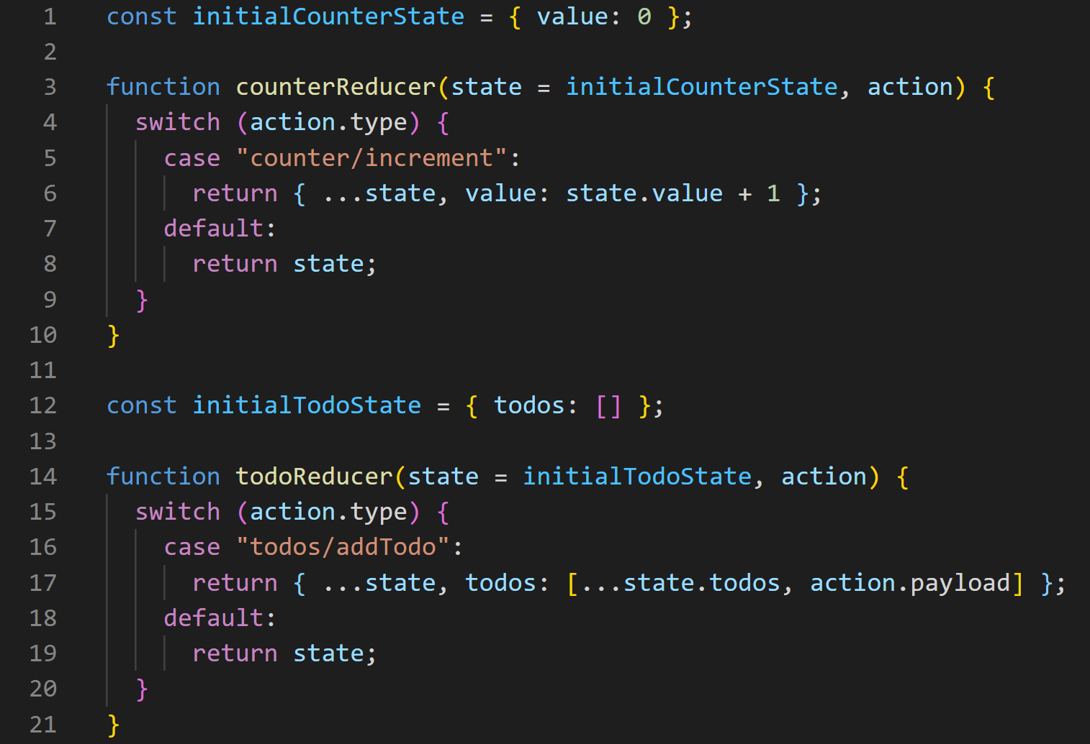
STORE
ACTIONS
DISPATCH
REDUCERS
Notes:
A reducer is a function that receives the current state and an action object, decides how to update the state if necessary, and returns the new state: (state, action) => newState. You can think of a reducer as an event listener which handles events based on the received action (event) type. Reducers must always follow some specific rules:
They should only calculate the new state value based on the state and action arguments
They must make immutable updates, due to shallow equality checking.
They must not do any asynchronous logic, calculate random values, or cause other "side effects"
The logic inside reducer functions typically follows the same series of steps:
Check to see if the reducer cares about this action
If so, make a copy of the state, update the copy with new values, and return it
Otherwise, return the existing state unchanged

Slide 20
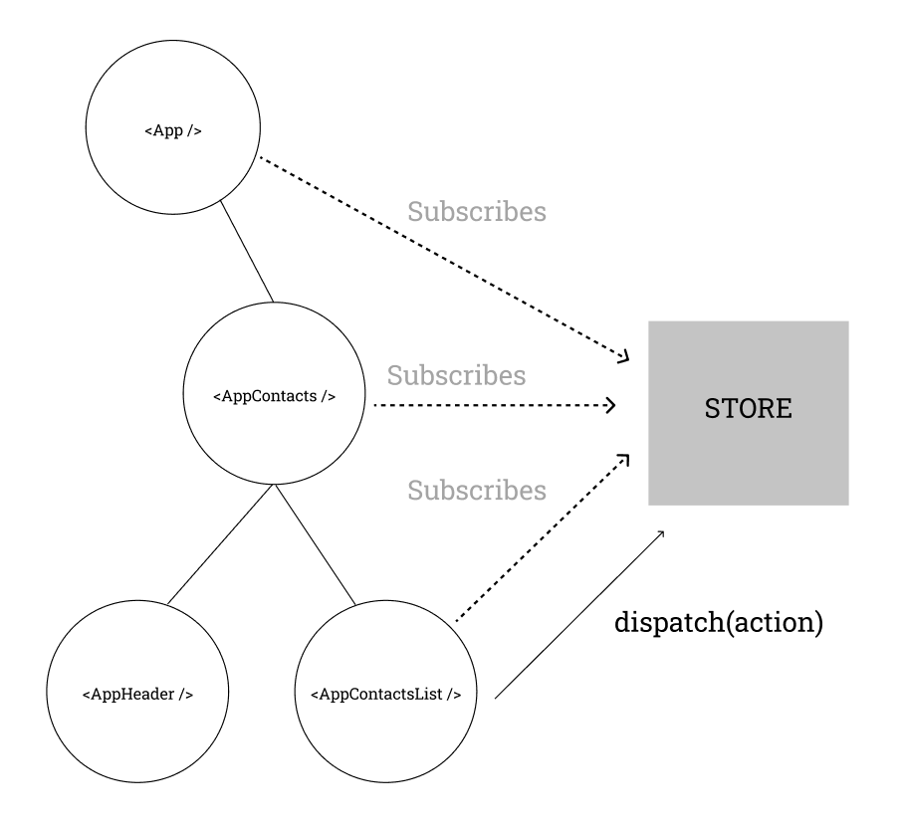
Notes:
Something happens in the app, such as a user clicking a button
The app code dispatches an action to the Redux store, like dispatch({type: 'counter/increment'})
The store runs the reducer function again with the previous state and the current action, and saves the return value as the new state
The store notifies all parts of the UI that are subscribed that the store has been updated
Each UI component that needs data from the store checks to see if the parts of the state they need have changed.
Each component that sees its data has changed forces a re-render with the new data, so it can update what's shown on the screen

Slide 21
Actions
State
View
Notes:
The state part of components is now moved out of the component itself.
The logic behind updating state on action is also moved outside the component. This means that there is one consist way of update the state of that variable
Moving it outside allows for more components to access the exact same data
Removes the updates issue that we saw initially.

Slide 22
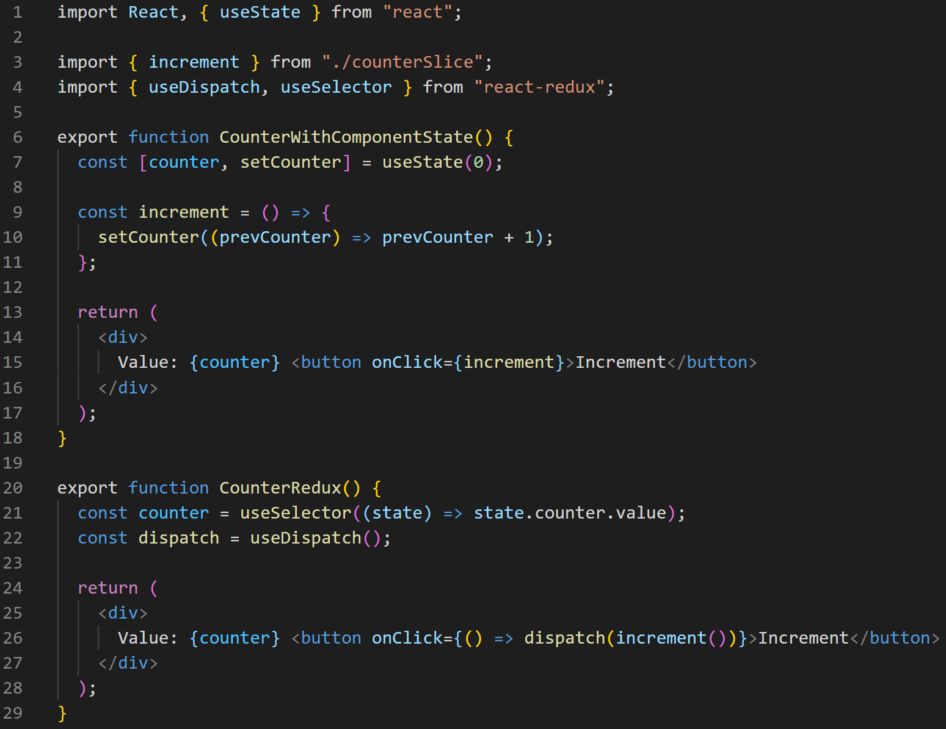
Notes:
Each component can use useSelector to subscribe to values.
Each component can use useDispatch to dispatch actions. Hooks are functions that let you “hook into” React state and lifecycle features from function components.

Slide 23
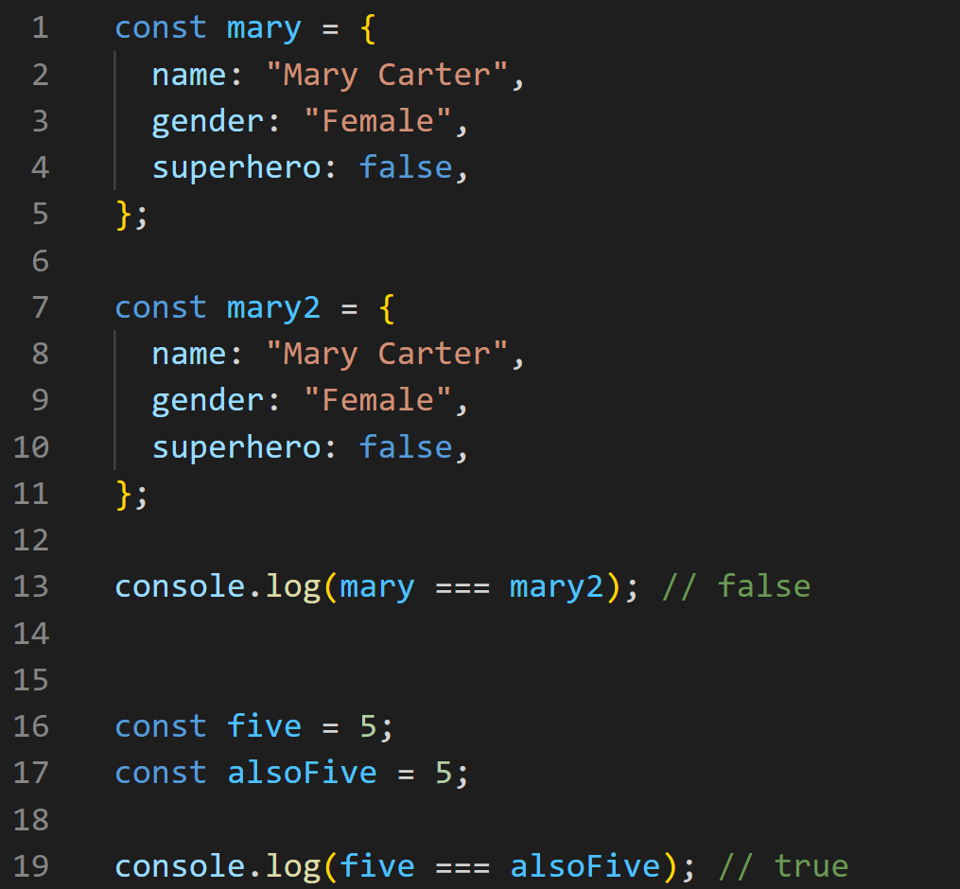
Why immutable?
Notes:
Reference types vs value types

Slide 24
A little breather…
Notes:
Any questions? We have seen that
Redux moved state to store, reducing the need for property passing.
Solve the issue with stale data in other components.
It also made sure that all updates to a variable is at one place.
And all updates happens the same way. It is not possible for another component somewhere in the code base to update the variable in another way than what is done in the reducer.
We must practice immutability due to shallow equality checking (only checks that reference in memory is equal)

Slide 25
SETUP

Slide 26
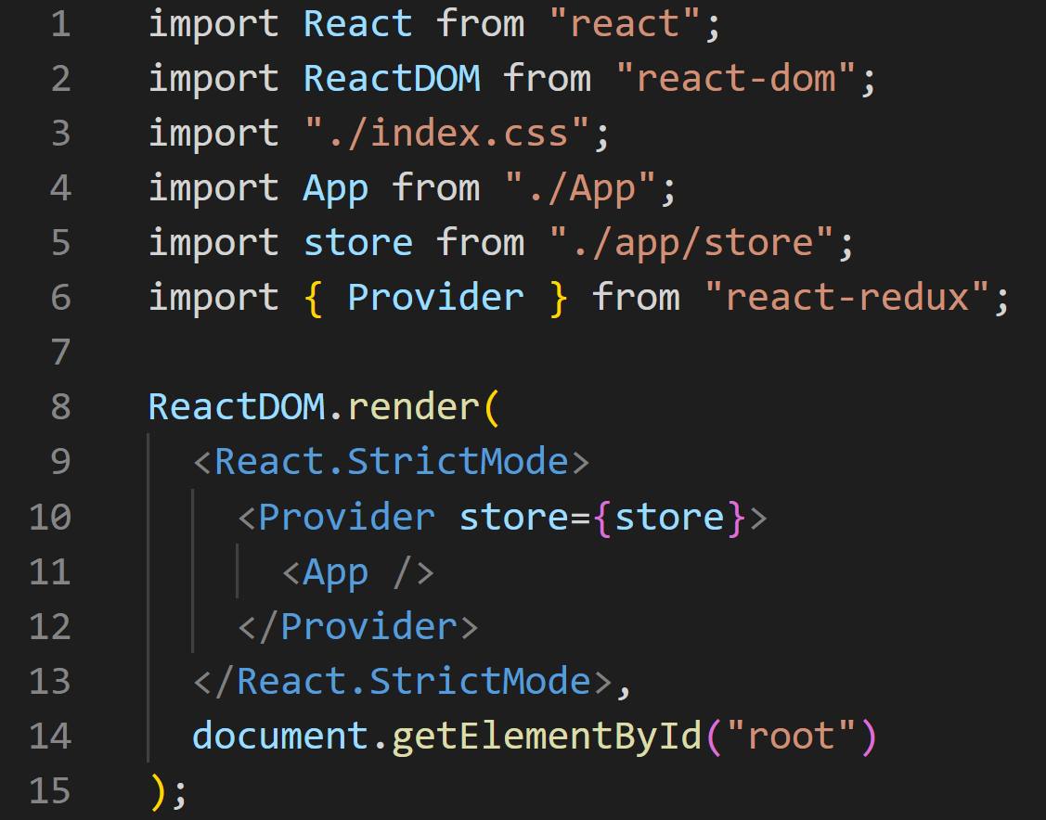
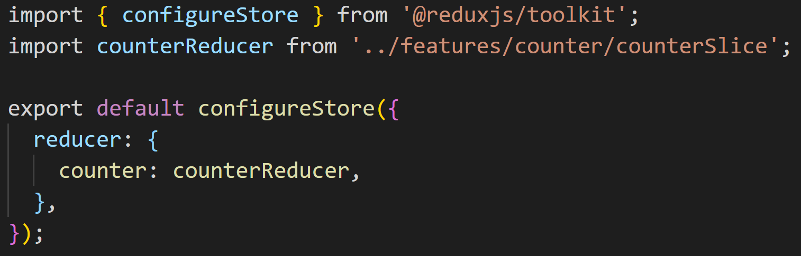
Index.js
store.js
Notes:
We always have to call ReactDOM.render(<App />) to tell React to start rendering our root <App> component.
useSelector and dispatch they need access to store object. We wrap the App in Provider and inject the store we want to use. This makes sure that the store is accessible from every component in the app that is within the Provider. Store.js shows how we create the store. The are other options, but we see that we register the reducers that we want.

Slide 27
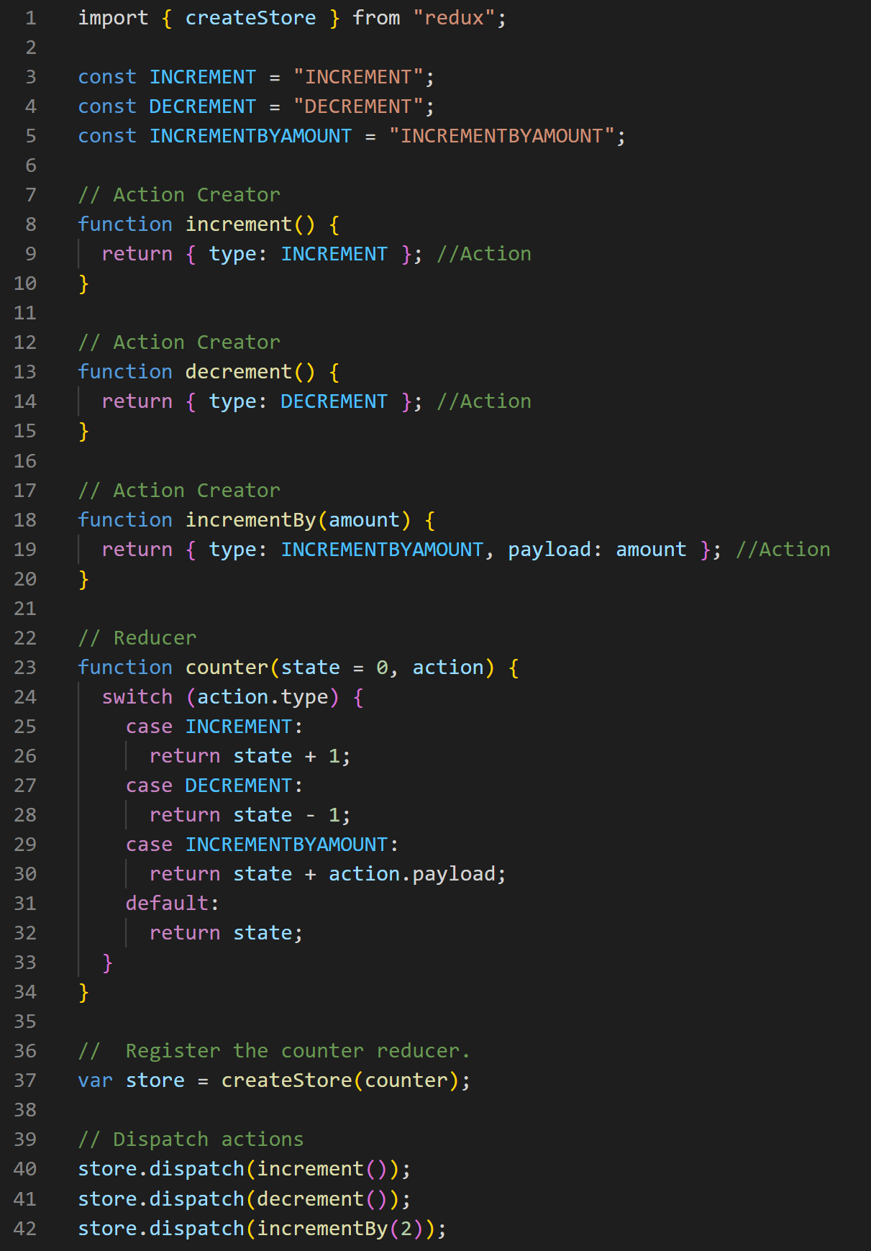
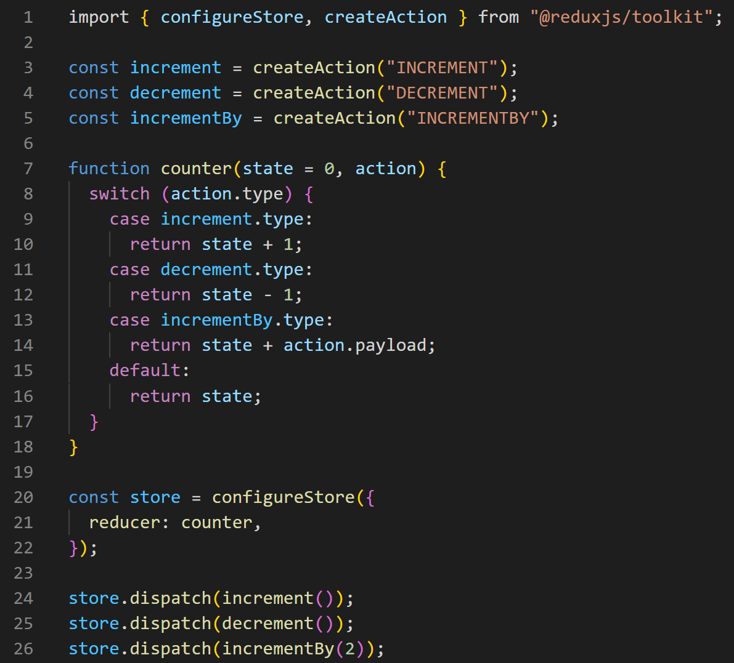
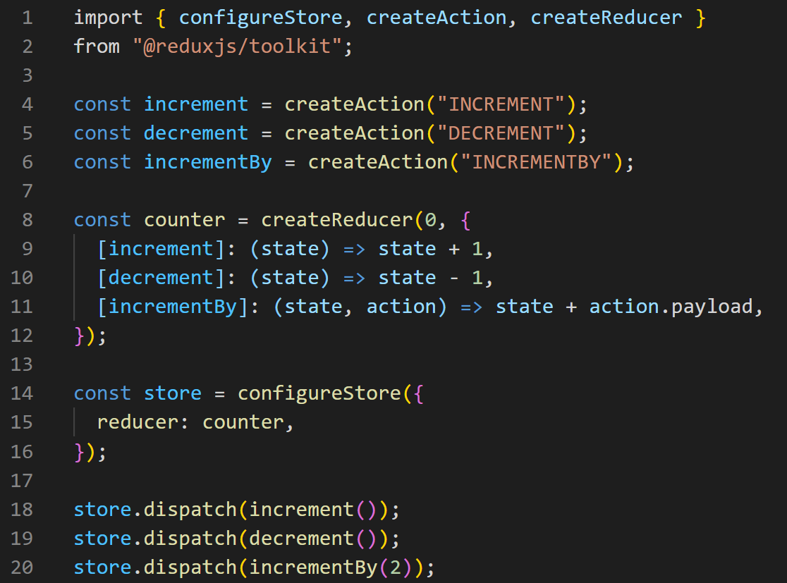
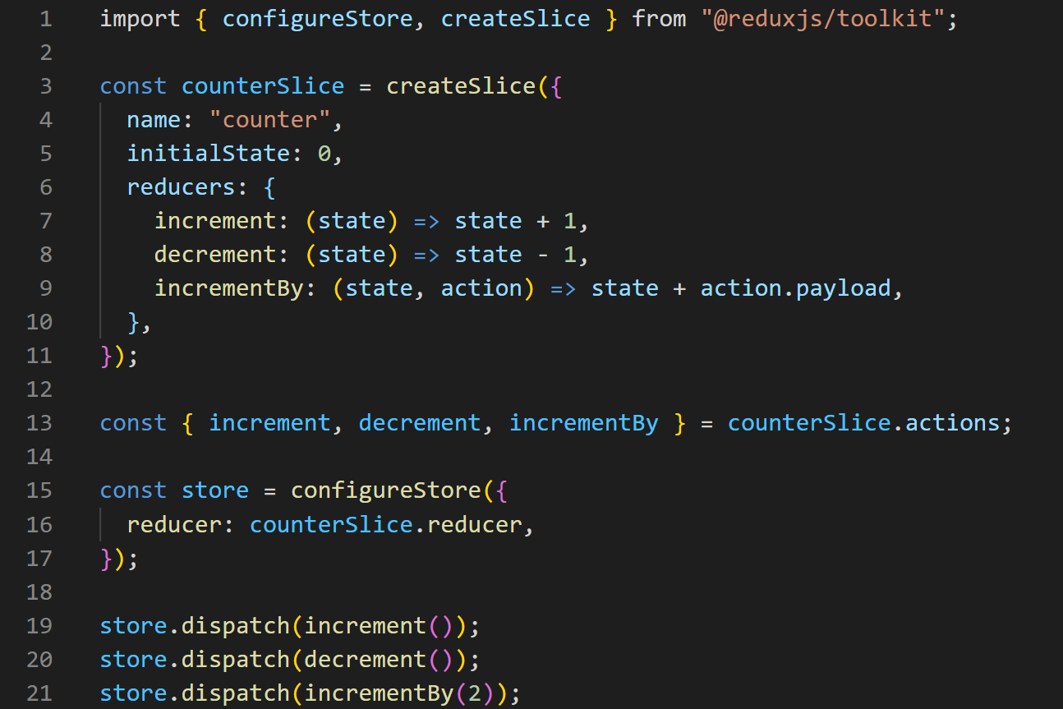
Notes:
Setup of Redux requires creation of actions, action creators, constants and reducers. One of the critics of redux was the amount of code needed to be written for setup, boilerplate code. Redux released reduxjs/toolkit to reduce the amount of code needed to be written.

Slide 28
Redux Toolkit
createSlice() which greatly reduces the amount of boilerplate code.
createSlice uses Immer which allows to do “mutable” updates.
Not really mutable update.
Beware: This cannot be done in reducer without proper setup.
Simplifies Store setup
Redux DevTools
Asynchronous code (Thunks)

Slide 29
Async Redux - Thunks
Actions are objects and cannot perform async operations such as HTTP requests.
In order to dispatch async operations we need to apply middleware.
Redux-Thunk is often used.
Already set up if you use Redux-Toolkit.

Slide 30
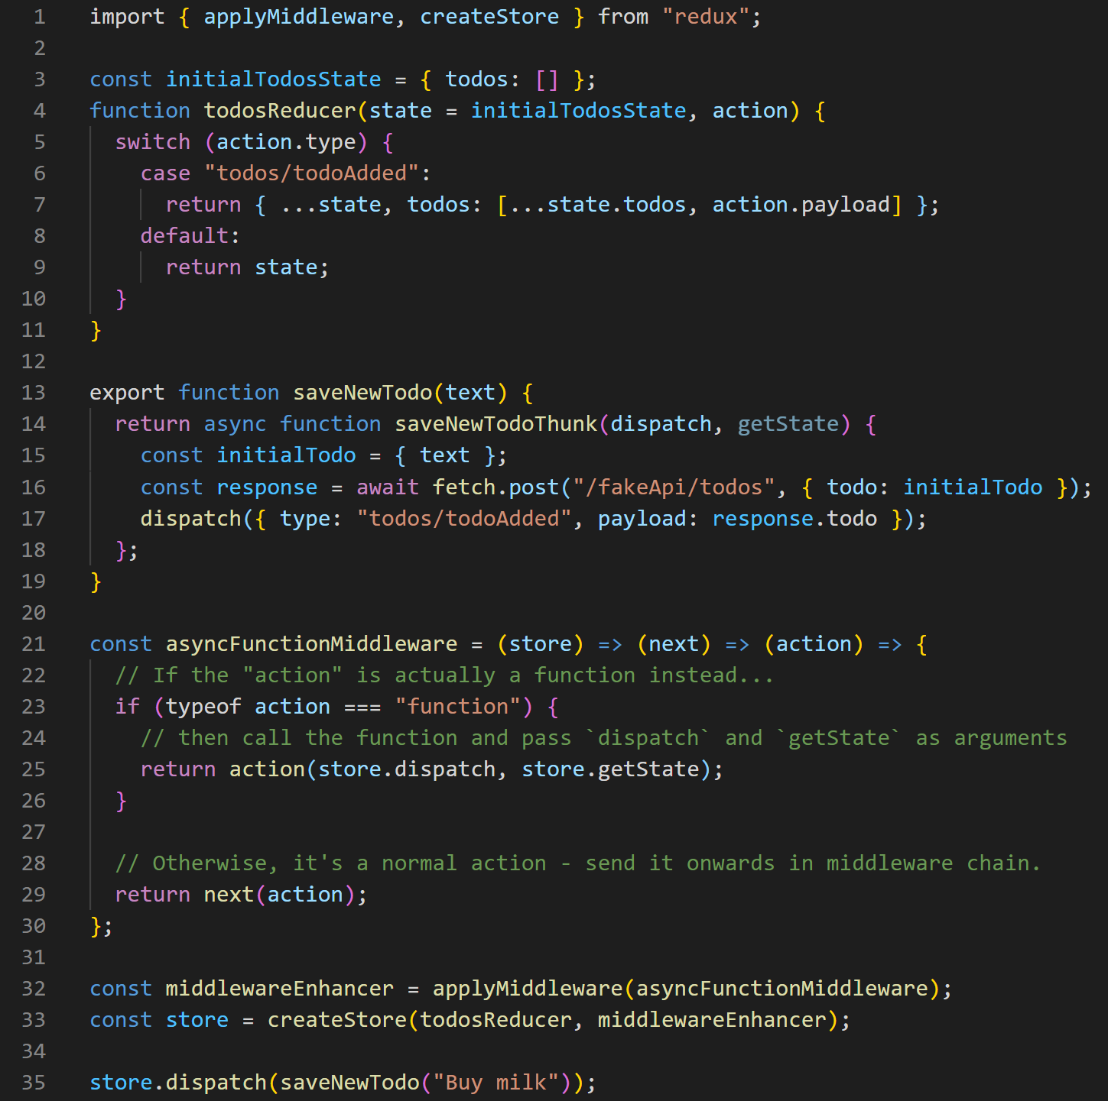
Notes:
A thunk is a specific kind of Redux function that can contain asynchronous logic. Thunks are written using two functions:
An inside thunk function, which gets dispatch and getState as arguments
The outside creator function, which creates and returns the thunk function
However, using thunks requires that the redux-thunk middleware (a type of plugin for Redux) be added to the Redux store when it's created. Fortunately, Redux Toolkit's configureStore function already sets that up for us automatically, so we can go ahead and use thunks here.
Middleware = Middleware is software that's assembled into an app pipeline.
When an action is dispatched, we can insert middleware that will be run each time.

Slide 31
When to use Redux
You have reasonable amounts of data changing over time
You need a single source of truth for your state
Keeping all your state in a top-level component is no longer sufficient.
Global state that is needed across the app should go in the Redux store.
State only relevant to a single component can still be kept in component state.

Slide 32
CODE

