Slide 1

LLM-Vectorizer: LLM-Based Verified Loop Vectorizer
Taneja, Laird, Yan, Musuvathi, Lahiri - 2025
Presented by Kaan YILDIZ

Slide 2
What is vectorization?
Transforming code that performs same operation on individual values into code that operates on multiple values at once using SIMD(Single Instruction, Multiple Data) hardware.
for (int i = 0; i < 8; i++) {
c[i] = a[i] + b[i];
}
a[0] + b[0]
a[1] + b[1]
a[2] + b[2]
...
[a0 a1 a2 a3 a4 a5 a6 a7]
+
[b0 b1 b2 b3 b4 b5 b6 b7]
↓
[c0 c1 c2 c3 c4 c5 c6 c7]
Loop Vectorization

Slide 3
Why is vectorization hard?
Challenge | Core Problem
Dependencies | Iterations may depend on each other
Aliasing | Compiler cannot prove memory accesses are independent
Memory Access | Irregular/gather-scatter access reduces SIMD efficiency
Control Flow | Branches cause divergent SIMD lanes
Data Layout | Production data structures are often SIMD-unfriendly
Language Semantics | Calls, objects, exceptions and side effects obscure parallelism
Vector Overhead | Masks, shuffles, runtime checks and remainder handling
Memory Bandwidth | Faster computation may simply expose a memory bottleneck
Hardware Diversity | SIMD capabilities and costs differ across architectures
Compiler Limitations | Safe/profitable parallelism must be discovered automatically
Parallelism
?
Discoverable
?
Profitable

Slide 4
Why is vectorization still interesting?
Modern compilers are sophisticated...
...but significant opportunities remain
LLVM / GCC / ICX
45–71% synthetic loops vectorized, but only 18–30% of the loops in real applications
Maleki et al., PACT 2011
Source-to-source transformations can expose missed SIMD opportunities.25.9–36.6% of loops gained ≥15% performance from source transformations alone.
36.1–38.1% of beneficial rewrites of initially non-effectively-vectorized loops achieved effective vectorization.
Gong et al., ACM OOPSLA 2018, Tables 3 & 8.
dependence analysis
alias analysis
loop transformations
SLP vectorization
runtime checks
cost models
predication
gather/scatter
Missed vectorization arises from dependencies, compiler limitations, and inaccurate cost models.
Feng et al., 2021.

Slide 5
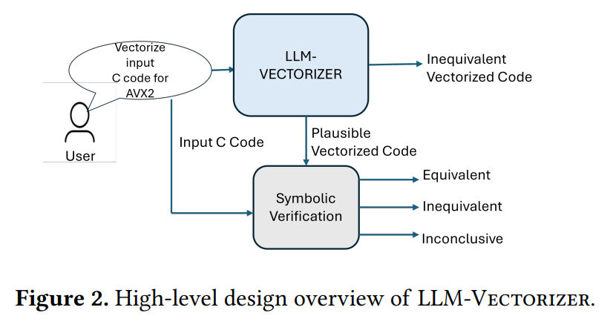
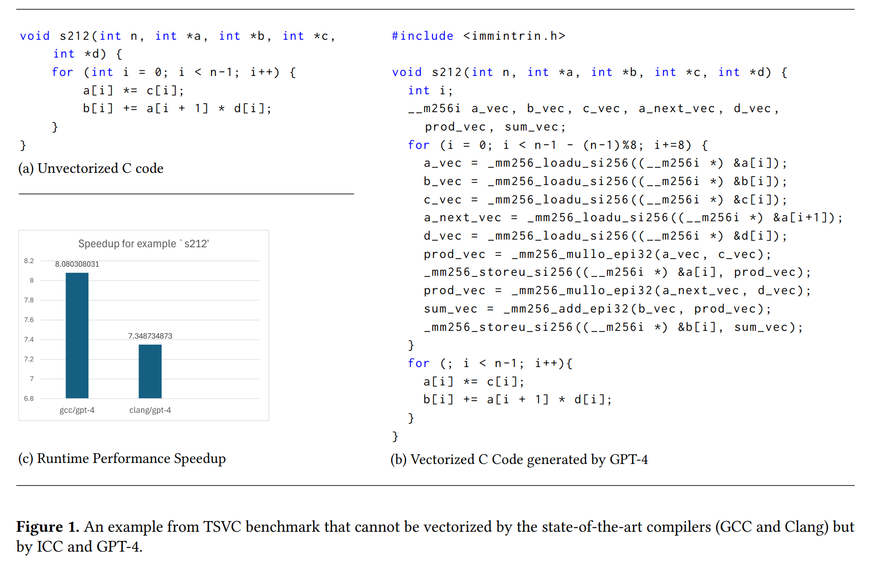
“Can advances in LLMs and formal verification be leveraged to automatically optimize scalar C programs into equivalent vectorized programs using AVX2 intrinsics?”
Source:LLM-Vectorizer: LLM-Based Verified Loop Vectorizer , Fig. 2.
LLM-Based Vectorization: Evaluate LLMs for source-to-source vectorization.
Agentic Feedback: Improve transformations through AI-agent feedback.
Formal Verification: Verify correctness at the LLVM level.
Scalable Verification: Nearly double Alive2's verification and refutation coverage.
Source:LLM-Vectorizer: LLM-Based Verified Loop Vectorizer , Fig. 1.

Slide 6
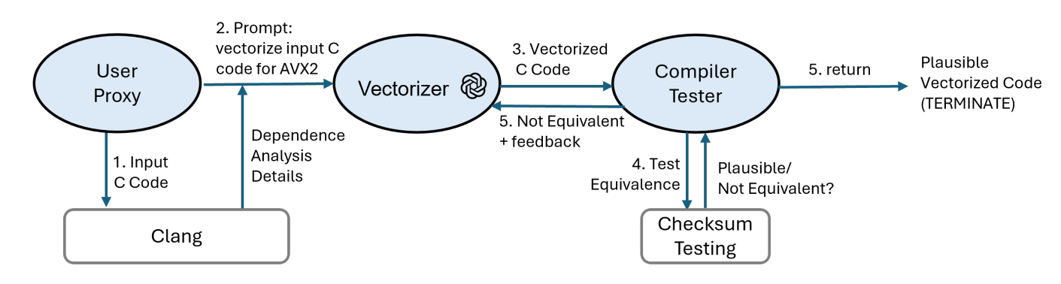
1. reduce the number of LLM invocations required to generate correct vectorized code
2. repair the incorrect vectorized code generated by LLM through a systematic feedback loop
RAW, WAR data dependence
Loop carried dependence
Feedback Loop
Output goes to symbolic verification
`
Source:LLM-Vectorizer: LLM-Based Verified Loop Vectorizer , Fig. 3.
Setting a loop upper bound
Initializing input arrays with random values
Executing both code versions
Comparing output arrays

Slide 7
Symbolic Verification with Alive2
An automatic symbolic translator validation tool for LLVM compilers’ intermediate representation(IR) for checking equivalence.
Alive2 uses a bounded formal verification, where loops are unrolled a fixed number of times

Slide 8
Appendix-1
Data Dependencies
Memory Aliasing
for (int i = 1; i < n; i++)
a[i] = a[i-1] + x[i];
for (int i = 0; i < n; i++)
a[i] = b[i] + 1;
a[i] depends on a[i-1] → iterations cannot simply execute simultaneously.
The compiler may not know whether two pointers refer to overlapping memory.
for (...) {
if (a[i] > 0)
b[i] = f(a[i]);
else
b[i] = g(a[i]);
}
Control-flow Divergence
Different SIMD lanes want to execute different code.
Modern SIMD supports masks/predication, but inactive lanes still reduce efficiency and complicated control flow can prevent vectorization entirely.

Slide 9
Appendix-2
Complex Language Semantics
for (auto &x : objects)
x->compute();
Operations may involve:
function calls
exceptions
virtual calls
pointer-heavy structures
object-oriented abstractions
unpredictable side effects
is dramatically harder to vectorize than:
for (int i = 0; i < n; i++)
y[i] = a[i] * x[i] + b[i];

Slide 10
Appendix-3
Data Layout
SIMD usually prefers:
Structure of Arrays
x: x0 x1 x2 x3
y: y0 y1 y2 y3
z: z0 z1 z2 z3
Production software frequently uses:
Array of Structures
[x0 y0 z0] [x1 y1 z1] [x2 y2 z2] ...
Or even:
pointer → object → pointer → object
The algorithm may be parallel, while its representation is SIMD-unfriendly.

