Slide 1
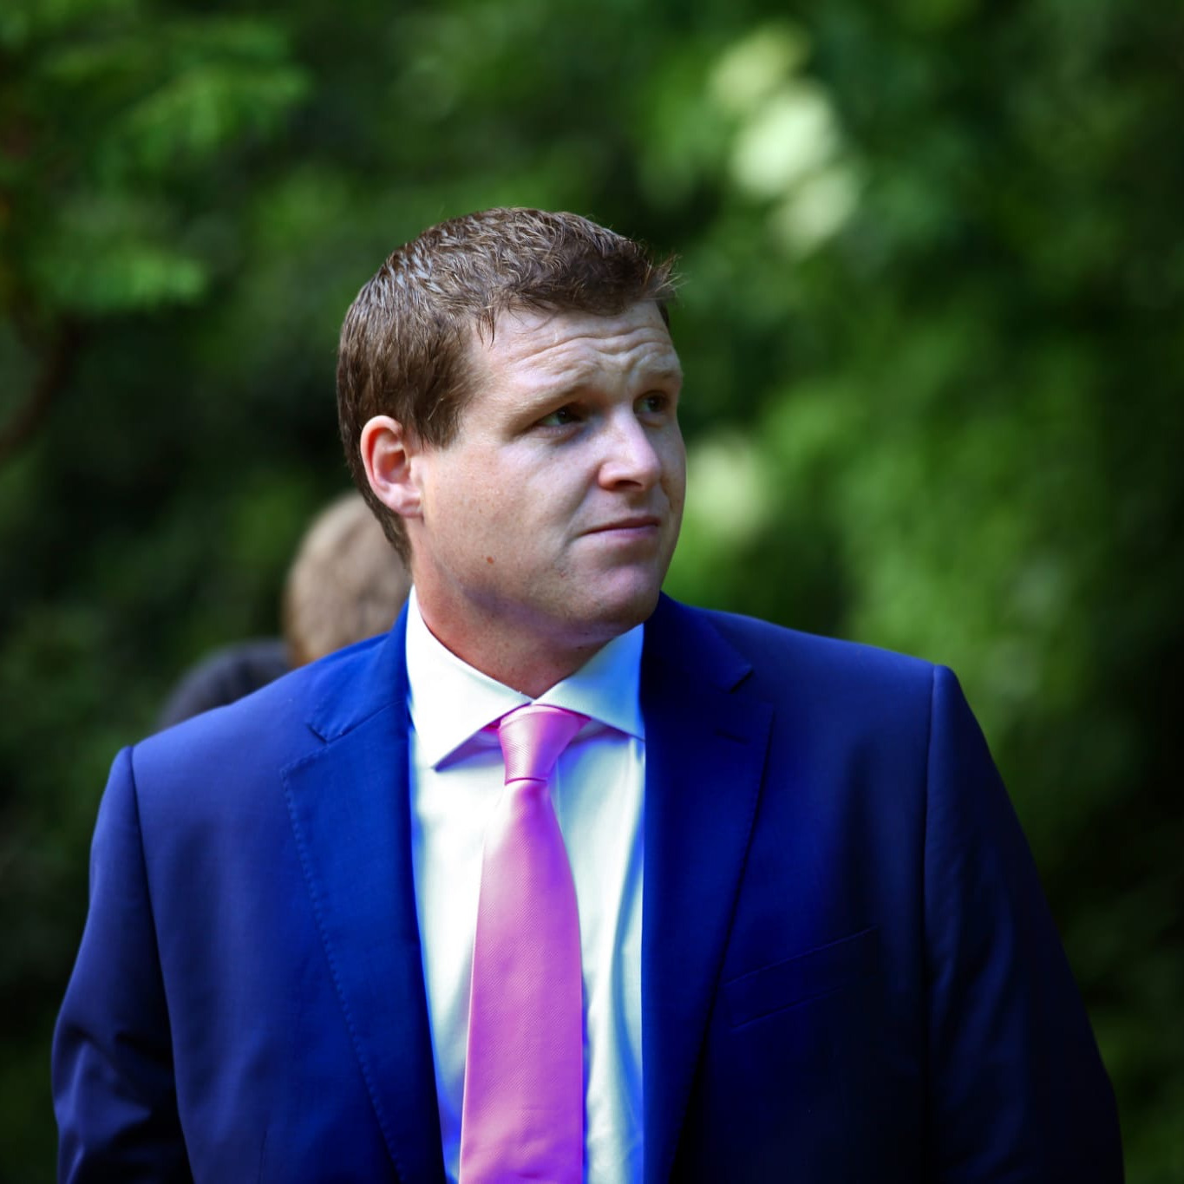

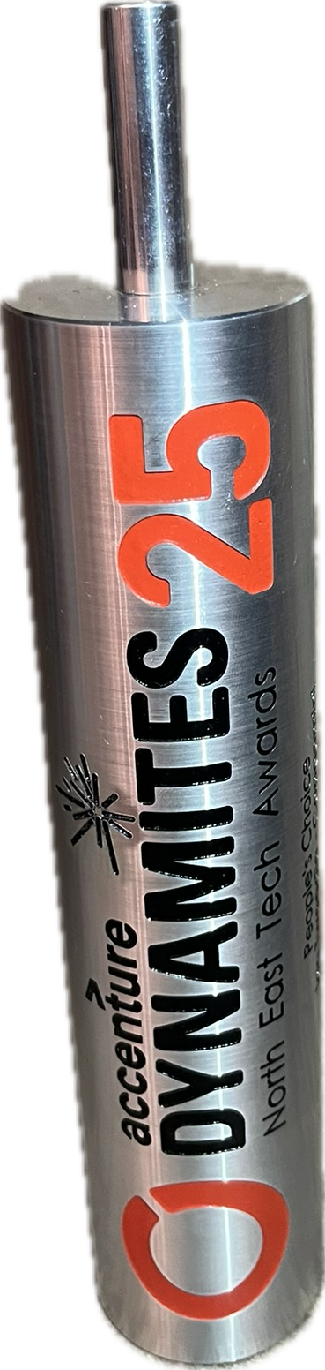
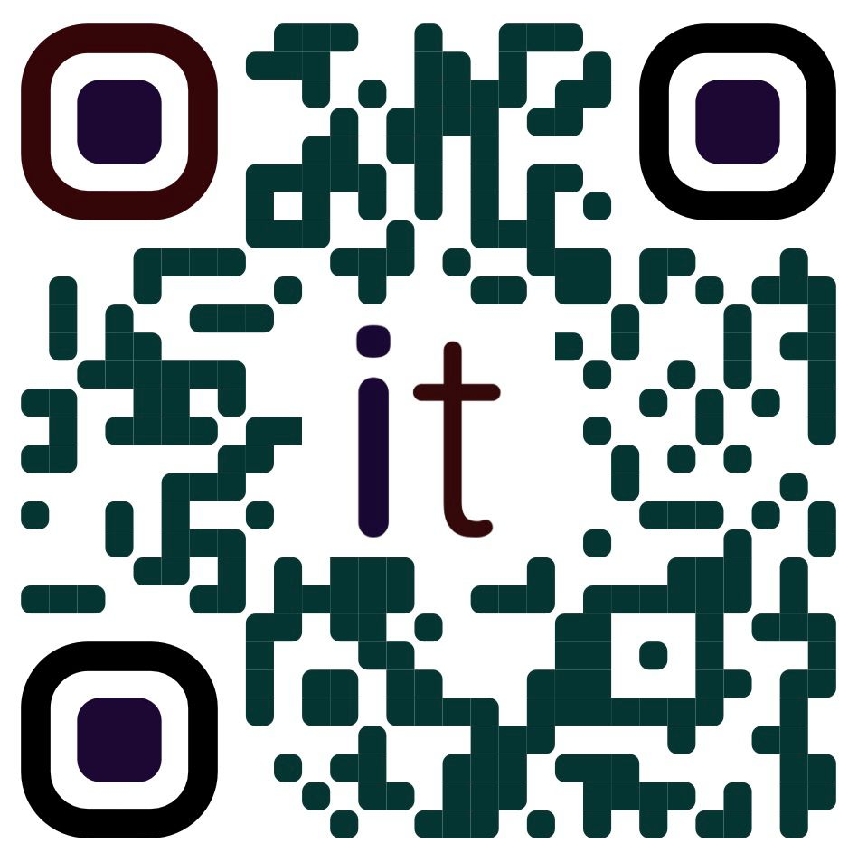







Ian Tweedie
Work
Senior Technical Consultant
Technical Coach
Professional Background
18+ Years in Tech Industry
16+ Microsoft Certifications
35+ Certifications in total
Community Involvement
16+ Community tools, hosted at mightora.io with more than 500k monthly hits
Trustee for Digital Transformation
TechTweedie Blog and YouTube
Power Platform Clinic
Newcastle User Group Leader
Mentoring Hub
Organizing committee of the East of England Summit

