Slide 1

HUMSAATHI AI
Learn. Communicate. Grow.
The Adaptive AI Communication & Learning Platform
CHILD · TEEN · ADULT
HumSaathi AI · Product Pitch Deck · 01 / 15
Notes:
SLIDE 1 — CINEMATIC HERO (HumSaathi AI)
TIME: 25 Seconds
TALKING POINTS:
"Good morning, judges. Over 1 billion people worldwide navigate speech, language, and neurodiverse learning challenges. Yet modern education still treats learning as a one-way street.
This is HumSaathi AI — 'Our Companion'. An adaptive platform designed to bridge the gap between knowing words and communicating with real-world confidence across the human lifespan: Child, Teen, and Adult."
KEY JUDGE TAKEAWAY: Immediate emotional hook, serious AI product demeanor, clear lifespan scope.

Slide 2
LEARNING IS
NOT ONE-SIZE-FITS-ALL.
01
STATIC CONTENT
Traditional apps force every learner through identical linear lessons, ignoring sensory sensitivities and processing pace.
02
PRACTICE GAP
Learners can memorize vocabulary in isolation, but have zero safe, judgment-free space to practice spoken dialogue.
03
FEEDBACK VOID
Standard educational software returns binary pass/fail checks, offering no coaching on tone, social nuance, or clarity.
04
COMMUNICATION ANXIETY
Facing unpredictable social and workplace interactions without simulation causes withdrawal and cognitive fatigue.
HumSaathi AI · Product Pitch Deck · 02 / 15
Notes:
SLIDE 2 — THE PROBLEM (Learning Is Not One-Size-Fits-All)
TIME: 30 Seconds
TALKING POINTS:
"Why does communication learning break down for neurodiverse individuals? Four key failures:
Static content that treats everyone identically.
A gaping practice gap between knowing words and speaking them.
A feedback void where right/wrong checkmarks teach zero conversational nuance.
And communication anxiety that shuts down real-world independence.
We set out to replace this broken model."
KEY JUDGE TAKEAWAY: The problem is communication confidence and sensory adaptation, not simple literacy.

Slide 3
THE CENTRAL INTELLIGENCE
Meet HumSaathi AI
→ LEARNER PROFILE
Baseline sensory & diagnostic thresholds
ADAPTIVE PACING →
Low-sensory calibration matching cognitive load
HUMSAATHI AI
Adaptive Context Engine
Rather than an unguided chatbot, HumSaathi acts as an intelligent mediator. It ingests multi-dimensional contextual signals to dynamically calibrate dialogue pacing, cognitive challenge, and therapeutic reinforcement.
→ PERSONA CONTEXT
Child · Teen · Adult life constraints
DYNAMIC ROLEPLAY →
Empathetic, realistic conversational simulation
→ SCENARIO & ROLE
27 realistic social/workplace contexts
OBJECTIVE SCORING →
Continuous evaluation: Clarity, Relevance, Confidence
HumSaathi AI · Product Pitch Deck · 03 / 15
Notes:
SLIDE 3 — THE BIG IDEA (Meet HumSaathi AI)
TIME: 30 Seconds
TALKING POINTS:
"HumSaathi AI does not simply query a large language model and hope for the best.
It is a centralized Context & Persona Engine. It ingests the learner's developmental stage, sensory preferences, and chosen scenario — whether it's navigating peer conflict or interviewing for a job.
It then generates an adaptive, judgment-free learning experience with real-time conversational calibration."
KEY JUDGE TAKEAWAY: HumSaathi is a full context-aware coaching engine, not a shallow OpenAI wrapper.

Slide 4
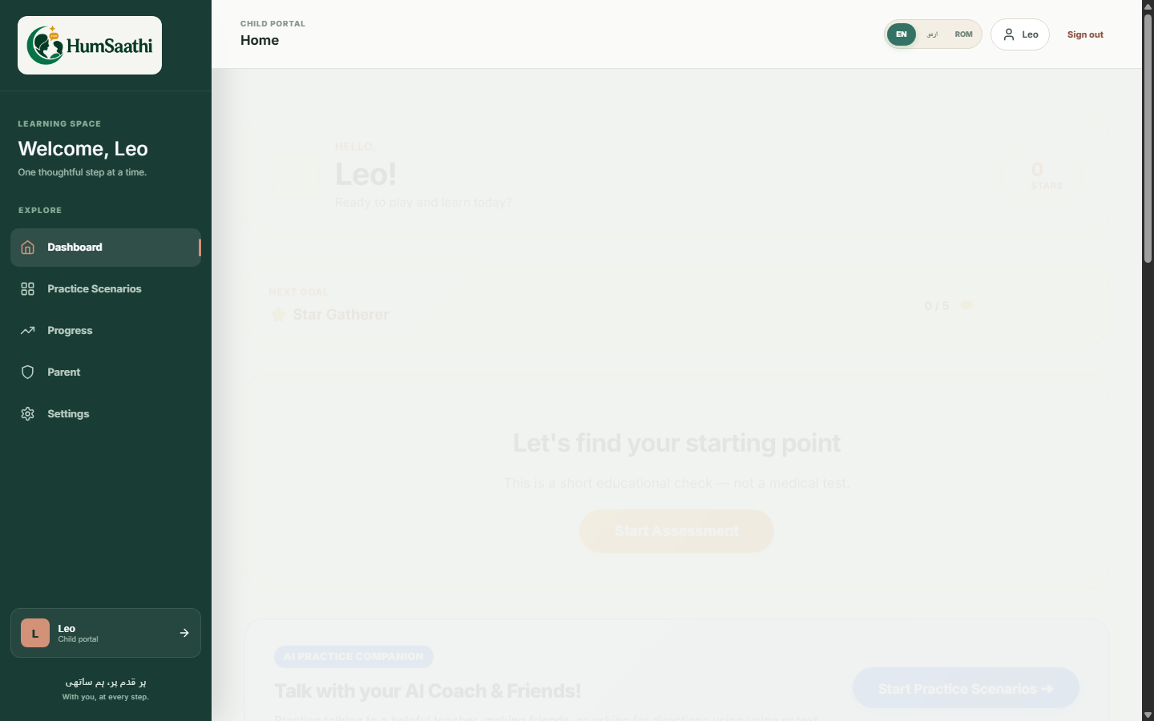
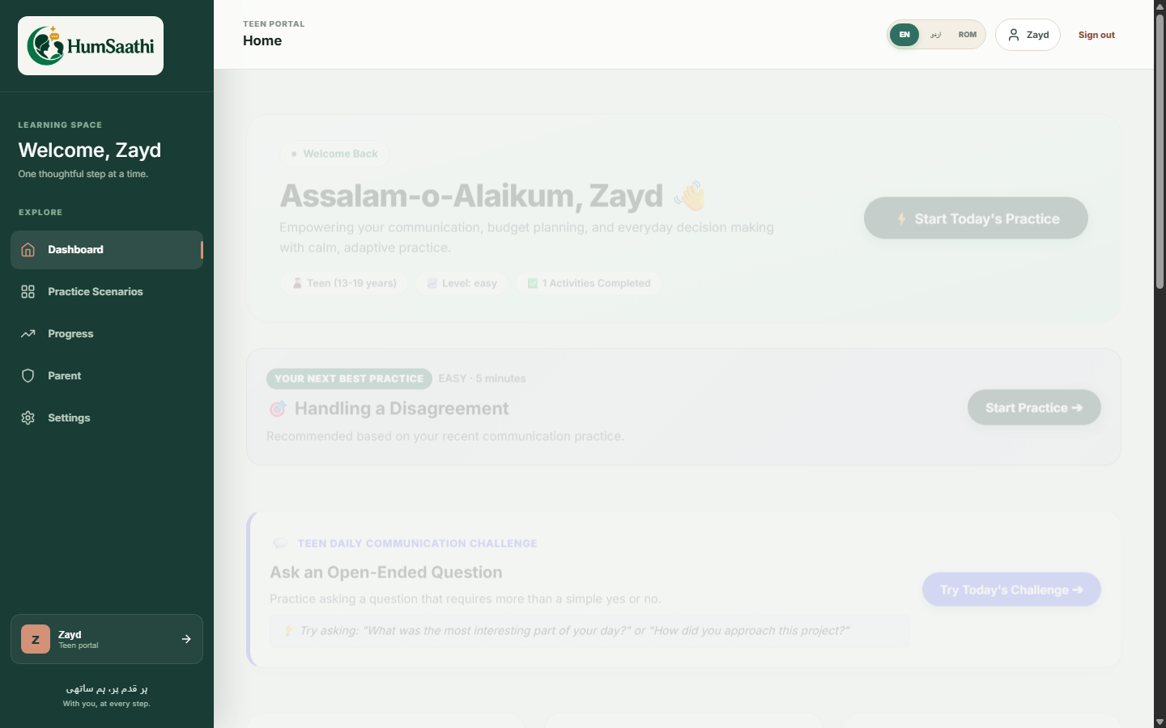
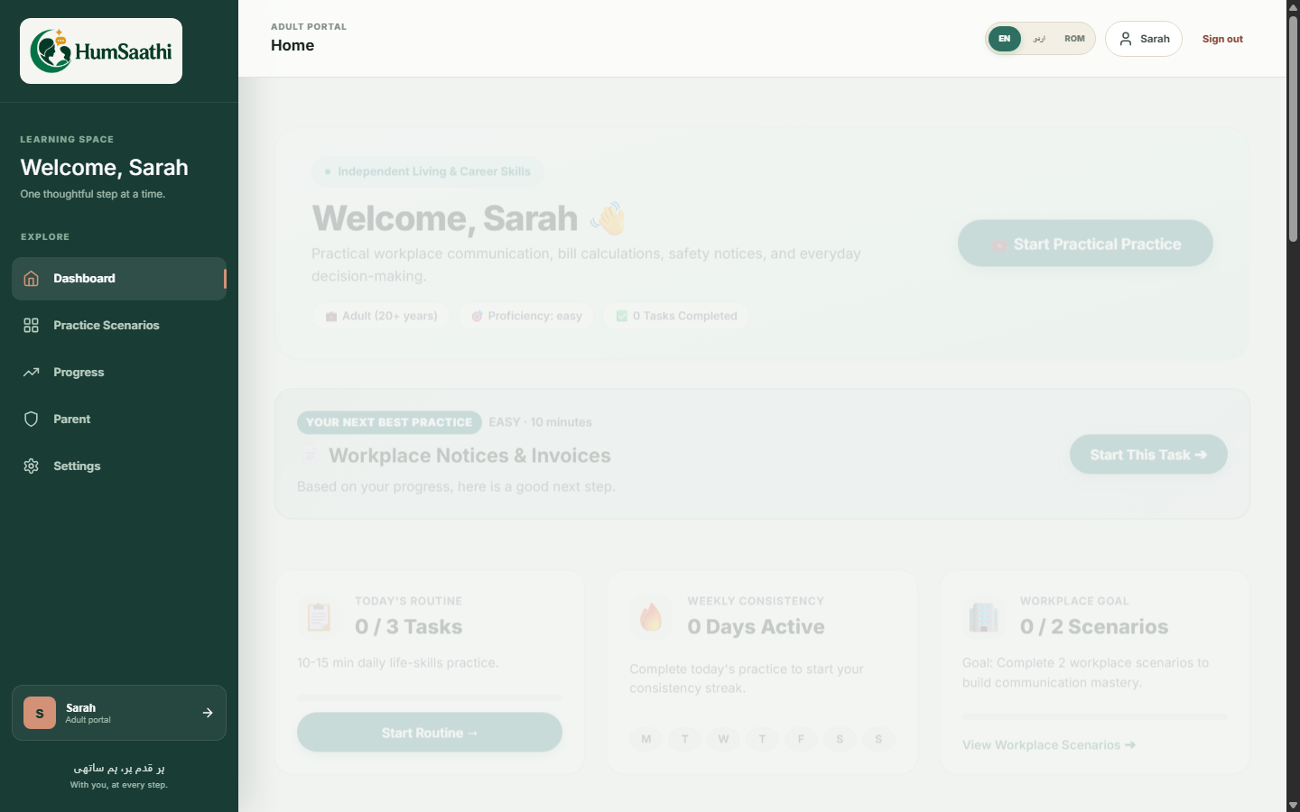
LIFESPAN ADAPTABILITY
Same Intelligence. Different Experience.
https://humsaathi.ai/child
https://humsaathi.ai/teen
https://humsaathi.ai/adult
CHILD EXPERIENCE [Ages 4–11]
Visual learning, high predictability, phonics, numbers, emotions, and zero-anxiety routines.
TEEN EXPERIENCE [Ages 12–17]
Social dynamics, peer disputes, daily communication challenges, and authentic streak metrics.
ADULT EXPERIENCE [Ages 18+]
Career readiness, workplace goal tracking, doctor & bank navigation, and contingency problem-solving.
HumSaathi AI · Product Pitch Deck · 04 / 15
Notes:
SLIDE 4 — THREE EXPERIENCES (Same Intelligence. Different Experience.)
TIME: 30 Seconds
TALKING POINTS:
"Here you see our actual, live platform adapting across life stages.
For children: calm, sensory-safe exploration.
For teens: peer dynamics, social challenges, and vocabulary.
For adults: workplace meetings, job interviews, banking, and transit autonomy.
One unified architecture; three deeply respectful, age-tailored user interfaces."
KEY JUDGE TAKEAWAY: The platform solves the entire lifespan, preventing users from aging out of support.

Slide 5
EARLY FOUNDATIONS
Child Portal: Calm, Structured Exploration
https://humsaathi.ai/child/dashboard
VISUAL LEARNING
High-contrast visual cues with bilingual English & Urdu audio pronunciation for letters, numbers, and animals.
LOW SENSORY LOAD
Zero flashing animations, zero countdown clocks, and zero punishing fail buzzers. Pure cognitive safety.
PREDICTABLE INTERACTION
Structured daily routines and emotion identification matching occupational therapy standards.
HumSaathi AI · Product Pitch Deck · 05 / 15
Notes:
SLIDE 5 — CHILD EXPERIENCE (Calm, Structured Exploration)
TIME: 25 Seconds
TALKING POINTS:
"Look at the actual Child Portal screen on the left.
Notice the intentional whitespace and calm color system. Neurodiverse children easily experience sensory overload. We implemented 7 foundational categories: Letters, Numbers, Shapes, Colors, Animals, Emotions, and Daily Routines.
Every interaction is predictable, bilingual, and positive."
KEY JUDGE TAKEAWAY: Designed strictly with occupational therapy ergonomics in mind.

Slide 6
MATURITY PROGRESSION
Teen + Adult: Social Dynamics & Career Autonomy
https://humsaathi.ai/teen
https://humsaathi.ai/adult
TEEN: ACADEMIC & PEER DYNAMICS
Features rotating Daily Communication Challenges (asking for help, expressing opinions) with real database-calculated contiguous streaks.
ADULT: CAREER READINESS & INDEPENDENCE
Workplace Goal tracking ('Complete 2 workplace scenarios'), manager check-ins, job interviews, banking, and transit delay problem-solving.
HumSaathi AI · Product Pitch Deck · 06 / 15
Notes:
SLIDE 6 — TEEN + ADULT (Social Dynamics & Career Autonomy)
TIME: 35 Seconds
TALKING POINTS:
"Here is our side-by-side progression.
On the left, the Teen Portal addresses social nuance: resolving group project disagreements, reading context clues, and building daily habits with genuine streak metrics.
On the right, the Adult Portal transforms into a sleek, professional career hub. Adults prepare for job interviews, clarify ambiguous emails, and practice high-stress autonomy tasks like resolving bank debit card issues. Real tools for real independence."
KEY JUDGE TAKEAWAY: Age-appropriate respect and dignity built into every pixel.

Slide 7
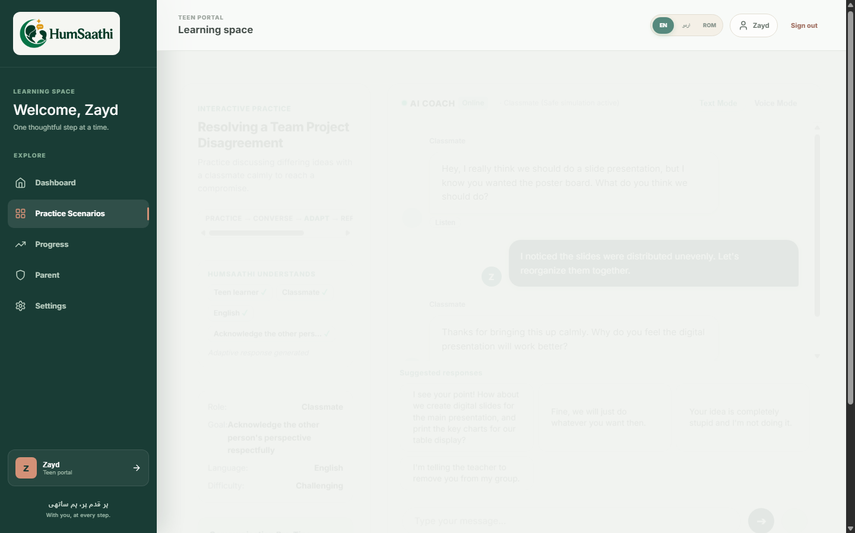
HERO CAPABILITY
AI That Doesn't Just Answer — It Practices With You
https://humsaathi.ai/conversation/session-live
MULTI-DIMENSIONAL DIAGNOSTIC
CLARITY SCORE — 85%
Vocabulary precision and grammatical coherence
RELEVANCE SCORE — 90%
Directness in addressing situational prompt
CONFIDENCE INDEX — 80%
Conversational flow and reduced hesitation
SUGGESTED ALTERNATIVE PHRASING
“I understand your concern. The slides I took have the technical diagrams, but let's rebalance them right now so we both have an equal count.”
HumSaathi AI · Product Pitch Deck · 07 / 15
Notes:
SLIDE 7 — AI COMMUNICATION COACH (Practices With You)
TIME: 45 Seconds
TALKING POINTS:
"This is our core breakthrough.
Generic chatbots write essays for you. HumSaathi AI roleplays *with* you.
When a user says: 'I noticed the slides were distributed unevenly,' the AI acts as the teammate or manager, responding in character.
At the end of the exchange, our engine scores Clarity, Relevance, and Confidence. And look at the bottom right: it models a 'Suggested Alternative Response' — showing the learner exactly how to rephrase their thought more constructively. That is real communication coaching."
KEY JUDGE TAKEAWAY: Turn-by-turn simulation + structured evaluation + alternative phrasing model.

Slide 8
ENGINEERING DEPTH
Production AI Architecture & Data Flow
01. CLIENT LAYER
React 18 + Vite SPA
Web Speech API audio capture & I18n trilingual translation runtime
02. GATEWAY
FastAPI ASGI
Python 3.11 serverless routing with JWT bearer authentication
03. CONTEXT ENGINE
context_builder.py
Referent anchor tracking & intent classification across dialogue turns
04. LLM & FALLBACK
Gemini 2.0 / OpenAI
Temperature-calibrated persona prompting with deterministic rule fallback
05. EVALUATION
evaluation_service.py
Clarity, relevance, confidence scoring + alternative phrasing generation
06. PERSISTENCE
SQLAlchemy + DB
Persona-isolated schema, streak computation & parent digest aggregation
ENGINEERING HIGHLIGHT: Referent anchor tracking in context_builder.py resolves pronoun antecedents across 4+ turns, preventing topic drift.
HumSaathi AI · Product Pitch Deck · 08 / 15
Notes:
SLIDE 8 — PRODUCTION AI ARCHITECTURE (How The AI Works)
TIME: 40 Seconds
TALKING POINTS:
"For our technical judges: how does HumSaathi actually work?
From the React client, requests pass through our FastAPI ASGI gateway. Before calling any LLM, our Context and Persona Engine in context_builder.py resolves pronouns like 'what next?' or 'how so?', grounding the conversation to prevent topic drift.
We prompt Gemini 2.0 or OpenAI under strict temperature calibration. If an API rate limit or outage occurs, our deterministic rules engine steps in automatically with zero downtime."
KEY JUDGE TAKEAWAY: Proof of architectural sophistication, multi-turn statefulness, and production resilience.

Slide 9
ADAPTIVE INTELLIGENCE
Continuous Calibration: Every Interaction Makes the Next Smarter
01. ASSESS
Lightweight baseline diagnostic evaluating strengths and sensory preferences.
02. PRACTICE
Engaging in interactive voice/text scenarios and foundational skill modules.
03. OBSERVE
Tracking response latency, sentence complexity, and vocabulary retention in real time.
04. EVALUATE
Scoring Clarity, Relevance, and Confidence immediately post-session.
05. ADAPT
Recalibrating scenario difficulty thresholds and sensory stimulation levels.
06. RECOMMEND
Generating the 'Next Best Practice' card directly on the learner's dashboard.
HumSaathi AI · Product Pitch Deck · 09 / 15
Notes:
SLIDE 9 — ADAPTIVE LEARNING LOOP
TIME: 25 Seconds
TALKING POINTS:
"The core intelligence of HumSaathi is continuous calibration.
Assess, Practice, Observe, Evaluate, Adapt, and Recommend.
When an adult learner struggles with expressing a disagreement constructively, the engine detects hesitation and adapts: it lowers the difficulty tier and recommends an intermediate roleplay on active listening. The system grows with the learner."
KEY JUDGE TAKEAWAY: Demonstrates the recommendation algorithm and personalized adaptation logic.

Slide 10
MULTIMODAL ACCESSIBILITY
Speak. Listen. Practice in Your Language.
SPEAK. LISTEN. PRACTICE.
ENGLISH [en]
Standard international terminology for academic and professional workplace mastery.
URDU (اردو) [ur]
Full native Right-to-Left (RTL) typography with culturally grounded phrasing.
Web Speech API integration powers authentic real-world phone calls and conversational speech recognition without third-party vendor latency.
ROMAN URDU [ur_rm]
Phonetic conversational vernacular widely spoken across South Asian diaspora communities.
HumSaathi AI · Product Pitch Deck · 10 / 15
Notes:
SLIDE 10 — VOICE + LANGUAGE (Speak. Listen. Practice.)
TIME: 25 Seconds
TALKING POINTS:
"Real communication is spoken. Using the browser's Web Speech API, learners practice phone calls and face-to-face dialogue.
And we are natively trilingual: English, native Urdu with full RTL typography, and Roman Urdu. By supporting Roman Urdu, we break down the literacy barrier for hundreds of millions in South Asia and global diasporas."
KEY JUDGE TAKEAWAY: True multimodal speech recognition + cultural localization.

Slide 11

FAMILY ECOSYSTEM
Parent Companion: Understand Progress — Not Control It
https://humsaathi.ai/parent/communication
4 CORE COMMUNICATION DIMENSIONS
GREETING & INITIATION
Measures the learner's ability to initiate conversations comfortably.
ANSWERING QUESTIONS
Evaluates directness, relevance, and response accuracy.
ASKING QUESTIONS
Tracks proactive inquiry, requesting help, and conversational curiosity.
CONFIDENCE INDEX
Monitors conversational flow, pacing, and reduced hesitation.
🔒 PRIVACY-FIRST: Parents receive AI weekly digests and home practice guidance without reading private transcripts.
HumSaathi AI · Product Pitch Deck · 11 / 15
Notes:
SLIDE 11 — PARENT COMPANION (Understand Progress — Not Control It)
TIME: 30 Seconds
TALKING POINTS:
"Look at the actual Parent Portal screen.
Instead of leaving parents wondering how their child is doing, we track four core communication dimensions: Greeting, Answering, Asking, and Confidence.
And we respect learner dignity: parents do not read private chat transcripts. Our AI synthesizes home guidance, like 'Encourage Zayd to order dinner tonight to reinforce his progress in asking questions.' Protected behind a 4-digit PIN."
KEY JUDGE TAKEAWAY: Actionable caregiver insights without invasive surveillance.

Slide 12
PRODUCTION ENGINEERING
Full-Stack AI Ecosystem
FRONTEND
React 18 · Vite · React Router v7 · Native CSS Design Tokens
Sub-second initial paint, zero bloated component libraries, full accessibility contrast.
BACKEND API
Python 3.11 · FastAPI · Pydantic v2 · Uvicorn ASGI
Asynchronous serverless endpoints with microsecond request validation and rate limiting.
AI ENGINE
Google Gemini 2.0 · OpenAI GPT-4o · Deterministic Rule Engine
Referent anchor resolution, intent classification, and instant offline fallback resiliency.
PERSISTENCE
SQLAlchemy ORM · SQLite (Local) · PostgreSQL (Cloud)
Relational data schema with strict persona isolation filters and real-time streak computation.
INFRASTRUCTURE
Vercel Serverless Functions · Global Edge CDN · GitHub CI/CD
Automated deployment pipeline with 100% production uptime at hum-saathi-ai.vercel.app.
HumSaathi AI · Product Pitch Deck · 12 / 15
Notes:
SLIDE 12 — ENGINEERING / TECHNOLOGY
TIME: 25 Seconds
TALKING POINTS:
"Here is our actual production stack.
React 18 and Vite for instant load times.
Python 3.11 with FastAPI for serverless ASGI performance.
Google Gemini 2.0 paired with our deterministic offline fallback engine.
Everything is version-controlled and deployed live on Vercel's edge network right now."
KEY JUDGE TAKEAWAY: Modern, production-ready, clean engineering.

Slide 13
DATA PROTECTION
Security & Privacy Built Into the Architecture
01. IDENTITY
JWT & Google OAuth 2.0
Cryptographically verified authentication with passwordless login support.
02. ROLE CONTROL
Enterprise RBAC
Strict separation of Learner, Parent, and System Administrator privileges.
03. PERSONA ISOLATION
Database Partitioning
Adult and Child progress metrics are query-isolated, preventing data leakage.
04. CAREGIVER GATE
Encrypted 4-Digit PIN
Parent portal access locked locally, preventing accidental profile edits.
HumSaathi AI · Product Pitch Deck · 13 / 15
Notes:
SLIDE 13 — SECURITY (Privacy Built Into the Architecture)
TIME: 25 Seconds
TALKING POINTS:
"When dealing with neurodiverse and younger learners, security is non-negotiable.
We enforce database-level persona data isolation — child records and adult workplace scenarios cannot cross-contaminate.
Parent access is protected by an encrypted PIN, and our admin panel provides full audit logging and AI monitoring."
KEY JUDGE TAKEAWAY: Enterprise-grade compliance and ethical AI safeguards.

Slide 14
THE VALUE PROPOSITION
Why HumSaathi AI? More Than an AI Chatbot
TRADITIONAL PARADIGMS
✕ Generic LLM Prompt Box
Overwhelming for neurodiverse learners; causes executive dysfunction and cognitive shutdown.
✕ Static Flashcards & Quizzes
Teaches passive vocabulary memorization with zero conversational agility.
✕ Binary Right / Wrong Marks
Provides pass/fail scores with no actionable guidance on tone, social nuance, or clarity.
✕ One Audience Assumption
Patronizes adults with child cartoons or overwhelms children with dense menus.
HUMSAATHI AI INNOVATION
✓ Scaffolded Scenario Roleplay
27 goal-oriented real-world situations with empathetic turn-by-turn guidance.
✓ Multidimensional Evaluation
Objective scoring of Clarity, Relevance, and Confidence post-session.
✓ Suggested Alternative Phrasing
Teaches learners how to rephrase thoughts more constructively next time.
✓ Lifespan Personalization
Deeply tailored Child, Teen, and Adult portals with parent observation insights.
HumSaathi AI · Product Pitch Deck · 14 / 15
Notes:
SLIDE 14 — WHY HUMSAATHI? (The Value Proposition)
TIME: 30 Seconds
TALKING POINTS:
"Judges often ask: 'Why not just use ChatGPT?'
Here is the answer: an open text box is paralyzing for a neurodiverse learner.
HumSaathi provides scaffolded structure. It evaluates Clarity and Confidence. It offers direct alternative phrasing. And it adapts to the learner's developmental stage.
It is a specialized communication health intervention, not a text toy."
KEY JUDGE TAKEAWAY: Clear competitive moat established.

Slide 15
LEARNING IS PERSONAL.
COMMUNICATION IS PRACTICE.
GROWTH IS CONTINUOUS.
HUMSAATHI AI
Learn. Communicate. Grow.
“HumSaathi AI doesn't just teach users what to learn — it helps them learn how to communicate, practice, and grow.”
HumSaathi AI · Product Pitch Deck · 15 / 15
Notes:
SLIDE 15 — CINEMATIC ENDING (Learn. Communicate. Grow.)
TIME: 25 Seconds
TALKING POINTS:
"To conclude:
Learning is personal.
Communication is practice.
Growth is continuous.
HumSaathi AI doesn't just teach users what to learn — it helps them learn how to communicate, practice, and grow.
The platform is deployed live at hum-saathi-ai.vercel.app. We invite you to experience it, and we welcome your questions!"
KEY JUDGE TAKEAWAY: A cinematic, confident, and unforgettable finish.

