Slide 1
Frames

Slide 2
Frames
Provide a way to display more than 1 XHTML document at a time in the same window
Introduced by Netscape, now part of HTML 4 and XHTML
Good for:
Common content like header and footer
Keeping navigation visible
Form verification
Problems:
Present indexing problems for search engines
Old browsers, text-only browsers will have trouble displaying
Printing information can be difficult
May “chop up” already too small window

Slide 3
Frames (con’t)
Frameset – group of frames in a browser window where frame is a partition
Frameset declaration specifies:
How to partition the browser window
What to load into each partition initially
Use <frameset> tag to replace <body> tag
To view source for frameset declaration, go to View in browser window, select View Source
To view source for individual frames, right mouse click while mousing over frame content, select View Source

Slide 4
Frames – frameset declaration
<?xml version="1.0" encoding="UTF-8"?>
<!DOCTYPE html PUBLIC "-//W3C//DTD XHTML 1.0 Frameset//EN"
"http://www.w3.org/TR/xhtml1/DTD/xhtml1-frameset.dtd">
<html xmlns="http://www.w3.org/1999/xhtml">
<head>
<title>XHTML Frame Example</title>
</head>
<frameset rows = "20%,80%">
<frame src = "top.html" />
<frame src = "bottom.html" name = "main" />
<noframes>This is best viewed with Netscape version 2.0 or higher.
<a href = “noframes.html”>View</a> version of the material without frames.
</noframes>
</frameset>
</html>
Notes:
Frameset declaration – 1)how to partition window and 2) what to load into each partition

Slide 5
Frames – frameset tag
rows attribute – used to divide window into rows
cols attribute – used to divide window into columns
Each can take different types of values (Think PPP):
percent (30%, 70%)
pixel amount (100, 400)
proportion (*, 2*) (also used to represent remainder)
Values can be combined:
<frameset rows = “15%, 20%,*">
3 values mean 3 rows, the first row is 15% the height of the window, the second one is 20% the height of the window, the third is the remainder
<frameset cols = “*, 50%, 80”>
3 values mean 3 columns, the first column is ½ the width of the window minus 80 pixels, the second is ½ the width of the window, the third is 80 pixels (a fixed pixel value is useful for displaying an image)
Notes:
If values add to more than 100%, browser will make it fit.
Proportion – if asterisk is preceded by an integer value, the corresponding row or column gets proportionally more of the available space. Example: <frameset cols = “10%, 3*, *, *”>
creates four columns: the first column occupies 10% of the overall width of the frameset,
the browser gives the second frame 3/5 of the remaining space,
the third and fourth columns are each given 1/5 of the remaining space.
* = wildcard

Slide 6
Frames – frame tag
Tells the browser what to load into each partition
src attribute specifies url of file to load
Frames are loaded in a top-to-bottom, left-to-right manner
id or name attribute identifies a particular frame by naming it (no spaces allowed in name)
<frame src = "top.html" />
<frame src = "bottom.html" name = "main" />
Notice there is no </frame> tag – use /> instead

Slide 7
Frames – combining cols and rows
Can use column (cols) and rows (rows) together in frameset:
<frameset cols = “*, *, *” rows = “33%, 33%, *”>
<frame src = “a.html” />
<frame src = “b.html” />
<frame src = “c.html” />
<frame src = “d.html” />
...
<frame src = “j.html” />
</frameset>
The partitioning will look like a tic-tac-toe board with the files loaded top-to-bottom, left-to-right:
a.html
b.html
c.html
d.html
e.html
f.html
g.html
i.html
j.html

Slide 8
Frames – nesting cols and rows
Nested framesets produce output like:
...
</head>
<frameset rows = “30%, 70%”>
<frame src = “header.html”>
<frameset cols = “*, 2*”>
<frame src = “toc.html”>
<frame src = “display.html” id = “display-area”>
</frameset>
</frameset>
</html>
Header info here
Table of contents
Display area

Slide 9
Frames – noframes tag
Used in case a browser does not support frames (e.g., lynx)
Content between <noframes> and </noframes> is displayed if browser does not support frames; content is ignored if browser does support frames.
<noframes>This is best viewed with Netscape version 2.0 or higher.
<a href = “noframes.html”>View</a> version of the material without frames.
</noframes>
Notes:
Notice that we offer a non-frames version with a hyperlink – this is the only xhtml allowed in this document

Slide 10
Frames – other frame tag attributes
Frame borders can be resized by user; when noresize is present, the frame’s edges can not be manually resized by the user.
By default content within a frame will determine if a scroll bar is necessary and the browser will supply it; the scrolling attribute can be set to always provide a scroll bar, or never provide a scroll bar, or to only provide it when it is necessary (the default).
<frame src = “display.html” name = “display-area” noresize = “noresize” scrolling = “yes” />
Or scrolling = “no”
Or scrolling = “auto” (default)

Slide 11
Frames – other frameset tag attributes
To eliminate dividers in the frameset, use frameborder = “no” or “0” (default is yes or 1) and specify border = “0”
<frameset cols = “*, 2*, *” frameborder = “no” border = “0”>
Notice that without the frameborder, user can not resize the frame
Notes:
Border is outside border; value is pixel count
Netscape supports values of yes/no for frameborder
IE4 supports yes/no and 1/0

Slide 12
Frames – targeted hyperlinks
By default, a hyperlink contained within the contents of a frame will load the new page into the same frame; the new page can be directed to another frame by using the target attribute in the anchor tag:
...
</head>
<frameset cols = “*,2*”>
<frame src = “toc.html” />
<frame src = “display.html” name = “display-area” />
</frameset>
</html>
File toc.html contains the following:
...
</head>
<body>
<h1>Table of Contents</h1>
<a href = “assign1.html” target = “display-area”>Assignment 1</a>
<a href = “assign2.html” target = “display-area”>Assignment 2</a>
<a href = “assign3.html” target = “display-area”>Assignment 3</a>
...
</body>
</html>

Slide 13
Frames – targeted hyperlinks (con’t)
File toc.html contains the following:
...
</head>
<body>
<h1>Table of Contents</h1>
<a href = “assign1.html” target = “display-area”>Assignment 1</a>
<a href = “assign2.html” target = “display-area”>Assignment 2</a>
<a href = “assign3.html” target = “display-area”>Assignment 3</a>
</body></html>
When many links are targeted to the same frame, use the base tag with the target attribute; file toc.html now contains the following:
...
<base target = “display-area” />
</head>
<body>
<h1>Table of Contents</h1>
<a href = “assign1.html”>Assignment 1</a>
<a href = “assign2.html”>Assignment 2</a>
<a href = “assign3.html”>Assignment 3</a>
</body></html>
Notes:
Base target can be over-ridden

Slide 14
Frames – targeted hyperlinks (con’t)
Special (or magic) targets are reserved names for targeting windows
Can be used with or without frames:
_blank - causes document specified in href attribute to be loaded into a new, unnamed browser window (forward and back buttons do not work)
_top – causes document specified in href attribute to be loaded into the entire browser window containing the link (forward and back buttons do work)
_self – causes document specified in href attribute to be loaded into same window OR frame (default)
_parent – causes document specified in href attribute to be loaded into the parent frameset (useful for nested frames)
Examples:
<a href = “project.html” target = “_top”>My Project</a>
<a href = “assign1.html” target = “window_1”>Assignment 1</a>

Slide 15
Frames – inline frames
Uses the <iframe> tag to generate a “floating frame.”
<iframe> tag is not used within frameset tag.
Use anywhere within your document that an <img /> tag might appear.
The inline area is 150 pixels high and 300 pixels wide (but those values can be changed).
The inline area is useful for displaying another document that contains information related to the current document being viewed:

Slide 16
Frames – inline frames (con’t)
<iframe> tag is a container – if the browser does not support inline frames, any content placed between the beginning and ending tags will be displayed
Title attribute is for improved accessibility
Align attribute is used to position the frame on page (like <img /> tag)
Name attribute is used so links can be targeted to the frame
Height and width attributes determine size of frame (default is 150 X 300)
<iframe src = "iframe-example.html"
title = "Iframe Example"
align = "right"
name = "small-window"
height = "200"
width = "450">
This is an example of an inline frame. If your browser does not display
inline frames, you can <a href = "iframe-example.html">view the content
here</a>.
</iframe>

Slide 17
Frames
Divides a browser window into number of panes.
• Each frame may contain a different document.
• <FRAMESET> element defines a set of frames.
– Should preclude the <BODY> element.
– <FRAMESET> </FRAMESET>
• ROWS
• COLS
• <FRAME > element defines an individual frame
– NAME = “frame name”
– SRC=“url”
– SCROLLING = auto / yes / no
– NORESIZE

Slide 18
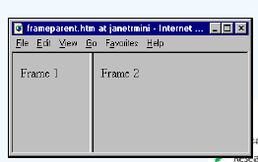
Frame Example
<HTML>
<FRAMESET COLS="*, 2*">
<FRAME SRC=“Frame1.htm">
<FRAME SRC=“Frame2.htm">
</FRAMESET>
<HTML>
example

Slide 19
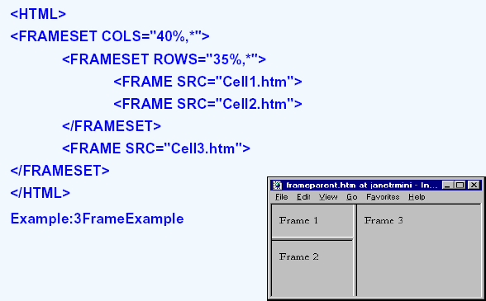
Nesting Frames
example

Slide 20
Targeting Frames
• Ensure frame naming
• <FRAMESET COLS="*, 20%">
<FRAME NAME="Frame1” SRC="Cell_1.htm">
<FRAME NAME="Frame2” SRC="Cell_2.htm">
</FRAMESET>
• Set the TARGET attribute for one hyperlink
– <A HREF="file.htm" TARGET="Frame1">Link Text</A>
– <A HREF="file.htm" TARGET="_top">Link Text</A>
• Set the TARGET attribute for all hyperlinks
– <BASE TARGET="Frame2">
– <BASE TARGET="_top">

Slide 21
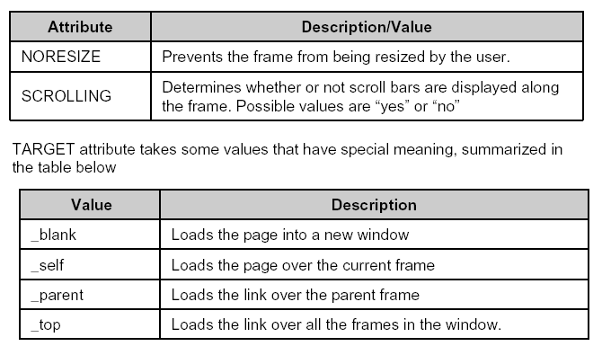
Attributes Of Frames Tag

Slide 22
NOFRAMES
• <NOFRAMES> </NOFRAMES> tag
– Encloses text to be displayed when the browser does not support frames.
<HTML>
<FRAMESET COLS="*, 2*">
<FRAME SRC=“Frame1.htm">
<FRAME SRC=“Frame2.htm">
<NOFRAMES> <P>This document uses frames. Please follow this link for the
<A HREF=“noframes.htm”></A> version <NOFRAMES>
</FRAMESET>
<HTML>

