Slide 1
Introduction to Markup Languages

Slide 2
Markup
Markup is text that is added to the data of a document in order to convey information about it.
Markup indicates which part of document is heading, which parts are paragraphs, what belongs in a table and so on. This markup in turn allows a web browser to display your document properly.
A marked up document contains
Data
Information about the data.

Slide 3
Types of Markup
Procedural Markup
Specifies how to process text
Instructs agent what to do with the text
Is concerned with formatting, presentation
Is “efficient” because requires little further interpretation.
Procedural Markup Drawbacks
Is often specific to one proprietary processing system
Provides no semantic information

Slide 4
Types of Markup (contd…)
Descriptive Markup
Identifies the logical components of a document
Is generally concerned with what text is
Does not specify what procedures are to be applied to text
Descriptive Markup Benefits
Is usually human and machine readable
Identifies information content
Is non-proprietary
Descriptive Markup specifies either structural information about the
document or the semantic information about the content.

Slide 5
Markup Languages
A markup Language is a formalized way of providing markup.
Example HTML, XML,WML etc
The definition of markup language must specify:
What markup is allowed
What markup is required
How markup is distinguished from text
What markup means

Slide 6
SGML
SGML is a meta language.
It does not define a language but defines how to create a good descriptive
markup language.
For instance, using SGML you can define
How to write tags
Beginning and ending characters
Fonts of the tags
How to define the structure of the document
Parent/child structures
Nested structures
DTD: Document Type Definition: It is a file required to declare the structure of
a document i.e. its tags, atrributes etc.

Slide 7
SGML Example
<!DOCTYPE message [
<!ELEMENT message (to,from,heading,body)>
<!ELEMENT to (#PCDATA)>
<!ELEMENT from (#PCDATA)>
<!ELEMENT heading (#PCDATA)>
<!ELEMENT body (#PCDATA)>
]>
<message>
<to>Sir</to>
<from>Anu</from>
<heading>Reminder</heading>
<body>Weekend Holiday</body>
</message>

Slide 8
SGML Benefits
Documents can be held in non-proprietary format
Documents can be validated against a DTD
Portability, interoperability and exchange.

Slide 9
HTML
example
<html>
<head>
<title>My page</title>
</head>
<body>
<h1> heading</h1>
<p> a paragraph</p>
</body>
</html>
Hypertext Markup Language
An SGML compliant markup language
Advantages
Simple to learn and use
Easy to parse
Disadvantages
No standardization
Much more of a presentation language than a structural language
Too limited

Slide 10
XML: Extensible Markup Language
Simplification of SGML
It is also a meta language
It is a subset of SGML
Out of date features are eliminated
Validation against a DTD become necessary
Definition of two level mechanism for documents
Well- formed documents
Valid

Slide 11
HTML as Markup Language-is a language for describing how pages of text, graphics and other information are organized, formatted and linked together.

Slide 12
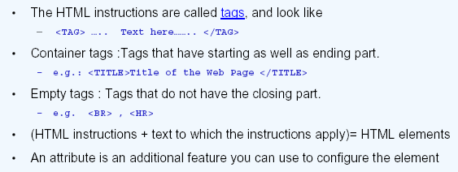
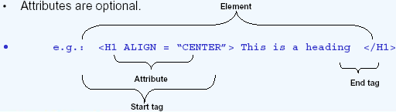
HTML Tags and Attributes

Slide 13
Document type (required) defines HTML version
1 <!DOCTYPE HTML PUBLIC "-//W3C//DTD HTML 4.01//EN"
2 "http://www.w3.org/TR/html4/strict.dtd">
3 <html>
html tag identifies page as HTML
4
Comments are ignored by browser but increase HTML readability.
5 <!-- Fig. 2.1: main.html -->
6 <!-- Our first Web page -->
7
head tag specifies page information
8 <head>
title tag assigns name to page; title generally displayed at top of browser.
9 <title>XML How to Program - Welcome</title>
10 </head>
11
body tag contains page contents.
12 <body>
13
14 <p>Welcome to Our Web Site!</p>
Paragraph element formats paragraph text
15
16 </body>
17 </html>

Slide 14
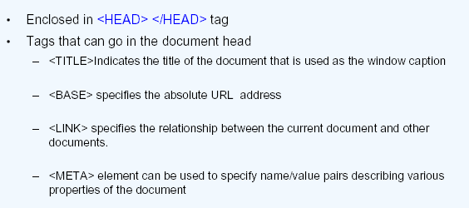
HTML Document HEAD

Slide 15
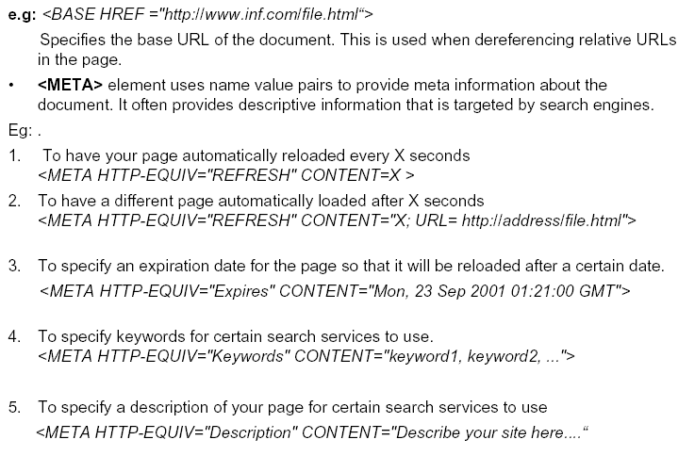
EXAMPLE
EXAMPLE

Slide 16
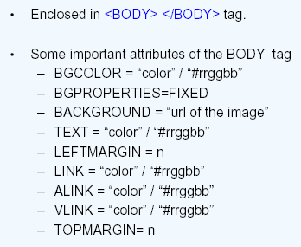
HTML Document- BODY

Slide 17
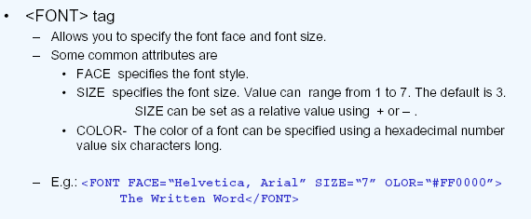
Formatting The Web Page
<FONT> tag describes the display attributes
of the text inside

Slide 18
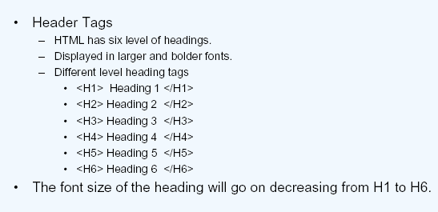
Text Formatting Tags

Slide 19
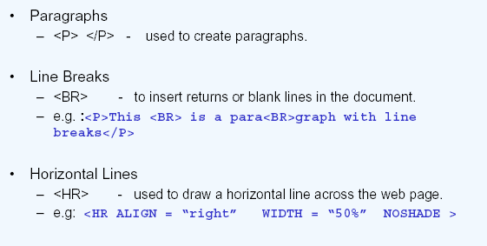
Text Formatting Tags
It has ALIGN attribute—allowed values
LEFT, RIGHT, CENTER, JUSTIFY
Attributes—size, width, align, noshade

Slide 20
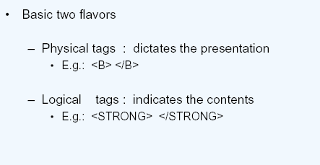
Text Level Elements
Logical tags give some kind of indication about the content but does not
dictate the presentation
For example <H1!> indicates the highest level of heading but does not
Specify whether it should be arial or times new roman

Slide 21
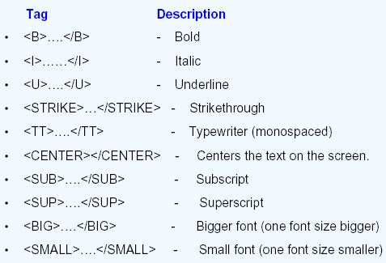
Text Formatting Tags

Slide 22
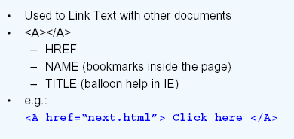
Linking The Pages
Additional attributes
ALINK -- specifies the color of the activated link
VLINK – specifies the color of visited link
LINK – specifies color of links

Slide 23
mailto: tells Web browser to load default email client with given address
1 <!DOCTYPE HTML PUBLIC "-//W3C//DTD HTML 4.01//EN"
2 "http://www.w3.org/TR/html4/strict.dtd">
3 <html>
4
5 <!-- Fig. 2.4: contact.html -->
6 <!-- Adding email hyperlinks -->
7
8 <head>
9 <title>XML How to Program - Contact Page</title>
10 </head>
11
12 <body>
13
14 <p>My email address is <a href = "mailto:deitel@deitel.com">
15 deitel@deitel.com</a>. Click on the address and your browser
example
16 will open an email message and address it to me.</p>
17
18 </body>
19 </html>

Slide 24
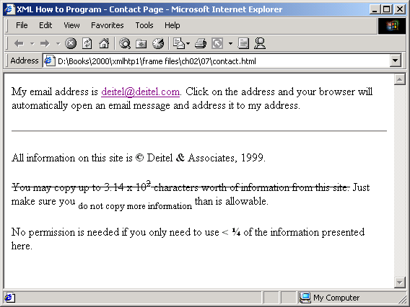
Output

Slide 25
<!DOCTYPE html PUBLIC "-//W3C//DTD XHTML 1.0 Transitional//EN" "http://www.w3.org/TR/xhtml1/DTD/xhtml1-transitional.dtd">
<html xmlns="http://www.w3.org/1999/xhtml">
<head>
<meta http-equiv="Content-Type" content="text/html; charset=iso-8859-1" />
<title>Untitled Document</title>
</head>
<body>
<a href="mailto:info@example.org?subject=HTML&cc=sales@example.org">Do mail from this link</a>
</body>
</html>

Slide 26
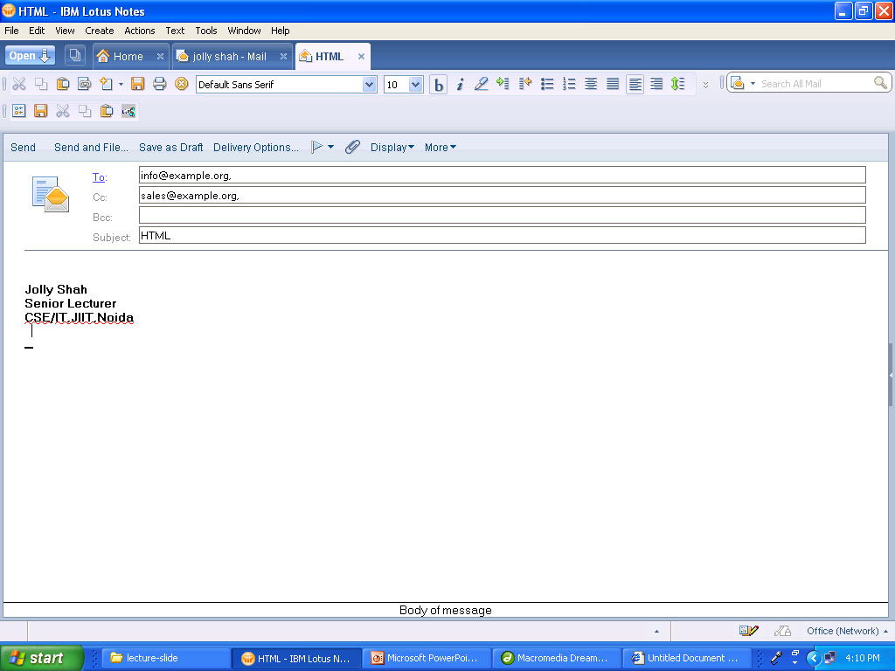

Slide 27
Unordered Lists
Unordered Lists
Element ul
Creates unordered list
Each line begins with bullet mark
Attributes
TYPE –specifies type of bullet
example FILLROUND, SQUARE
Element li
defines each List Entry

Slide 28
1 <!DOCTYPE HTML PUBLIC "-//W3C//DTD HTML 4.01//EN"
2 "http://www.w3.org/TR/html4/strict.dtd">
3 <html>
4
5 <!-- Fig. 2.8: links.html -->
6 <!-- Unordered list containing hyperlinks -->
7
8 <head>
9 <title>XML How to Program - Links</title>
10 </head>
11
12 <body>
13
14 <h1>Here are my favorite Internet Search Engines</h1>
15

Slide 29
16
17 <p><strong>Click on the Search Engine address to go to that
18 page.</strong></p>
Element ul begins the list, and element li separates each list
19
20 <ul TYPE=“FILLROUND”>
21 <li><a href = "http://www.yahoo.com">Yahoo</a></li>
22
23 <li><a href = "http://www.altavista.com">AltaVista</a></li>
24
25 <li><a href = "http://www.askjeeves.com">Ask Jeeves</a></li>
26
27 <li><a href = "http://www.webcrawler.com">WebCrawler</a></li>
28 </ul>
29
30 </body>
31 </html>

Slide 30
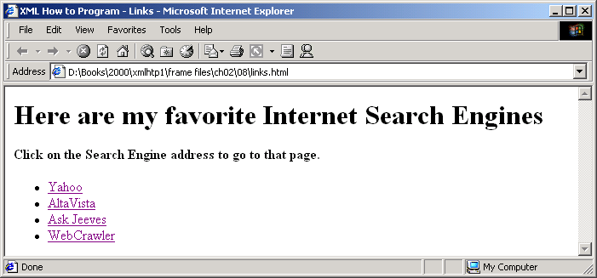
Output

Slide 31
Special Characters
Special Characters
Format: &code;
code is abbreviated name or hex code
Examples:
&amp; = &
&copy; = ©

Slide 32
Nested and Ordered Lists
Nested Lists
Improve Document structure
Display outline information
Ordered Lists
Automatically assign rank to each element

Slide 33

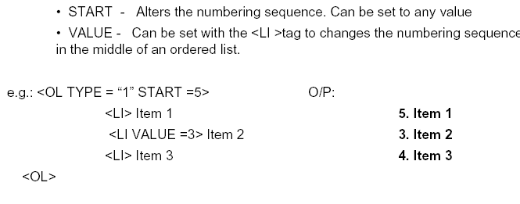
Attributes Of Ordered Lists

Slide 34
1 <!DOCTYPE HTML PUBLIC "-//W3C//DTD HTML 4.01//EN"
2 "http://www.w3.org/TR/html4/strict.dtd">
3 <html>
4
5 <!-- Fig. 2.9: list.html -->
6 <!-- Advanced Lists: nested and ordered -->
7
8 <head>
9 <title>XML How to Program - Lists</title>
10 </head>
11
Start nested list, where each li tag designates top-level element
12 <body>
13
14 <h1>The Best Features of the Internet</h1>
15
16 <ul>
17 <li>You can meet new people from countries around
18 the world.</li>
19 <li>You have access to new media as it becomes public:
20
21 <!-- This starts a nested list, which uses a modified -->
22 <!-- bullet. The list ends when you close the <ul> tag -->
Add another level to nested list
23 <ul>
24 <li>New games</li>
25 <li>New applications

Slide 35
26
27 <!-- Another nested list -->
28 <ul>
29 <li>For business</li>
30 <li>For pleasure</li>
31 </ul> <!-- This ends the double nested list -->
32 </li>
33
34 <li>Around the clock news</li>
35 <li>Search engines</li>
36 <li>Shopping</li>
37 <li>Programming
38
39 <ul>
40 <li>XML</li>
41 <li>Java</li>
42 <li>HTML</li>
43 <li>Scripts</li>
44 <li>New languages</li>
45 </ul>
46
47 </li>
48
49 </ul> <!-- This ends the first level nested list -->
50 </li>

Slide 36
51
52 <li>Links</li>
53 <li>Keeping in touch with old friends</li>
54 <li>It is the technology of the future!</li>
55
56 </ul> <!-- This ends the primary unordered list -->
57
58 <h1>My 3 Favorite <em>CEOs</em></h1>
59
60 <!-- Ordered lists are constructed in the same way as -->
61 <!-- unordered lists, except their starting tag is <ol> -->
62 <ol>
Begins ordered list (most browsers assign decimal numbers to top-level elements)
63 <li>Bill Gates</li>
64 <li>Steve Jobs</li>
65 <li>Michael Dell</li>
EXAMPLE
66 </ol>
67
68 </body>
69 </html>

Slide 37
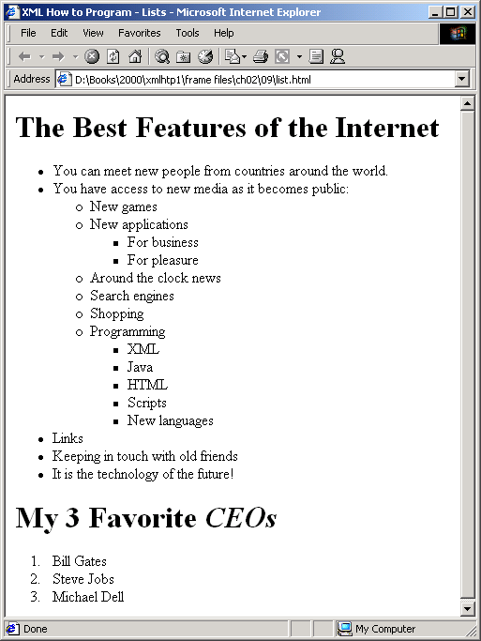
Output

Slide 38
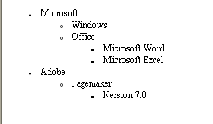
Exercise

Slide 39
Definition lists
The definition list is a special kind of list for providing terms followed by a short text definition of description for them. Definition lists are contained inside the <dl> element. The <dl> elements contains alternating <dt> and <dd> element. The contents of the <dd> element is the term you will be defining and <dt> element contains the definition of the previous <dd> element.

Slide 40
<!DOCTYPE html PUBLIC "-//W3C//DTD XHTML 1.0 Transitional//EN" "http://www.w3.org/TR/xhtml1/DTD/xhtml1-transitional.dtd">
<html xmlns="http://www.w3.org/1999/xhtml">
<head>
<meta http-equiv="Content-Type" content="text/html; charset=iso-8859-1" />
<title>Untitled Document</title>
</head>
<body>
<dl>
<dt>Unordered List</dt>
<dd> A list of bullet points.</dd>
<dt> Ordered List</dt>
<dd>An ordered list of ponits, such as a numbered set of steps </dd>
<dt> Definition lists</dt>
<dd>A list of terms and definitions</dd>
</dl>
</body>
</html>

Slide 41
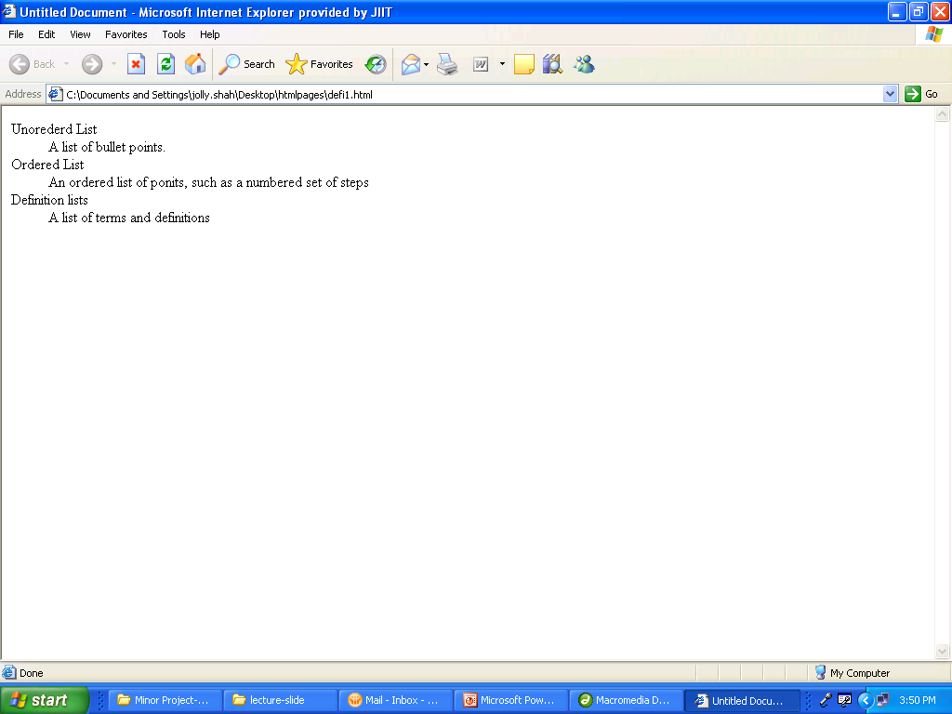

Slide 42
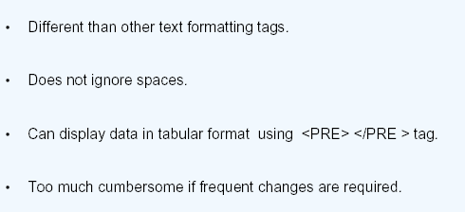
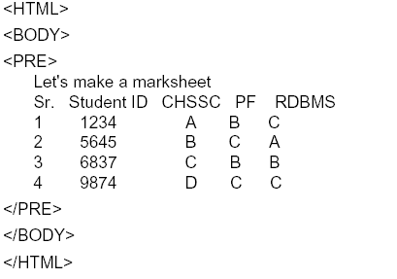
<PRE> Preformatted

Slide 43
Complex HTML elements
Structures
Tables
Clear data presentation
Forms
Obtain input from user
Navigation aids
Image maps
Internal linking
Frames

Slide 44
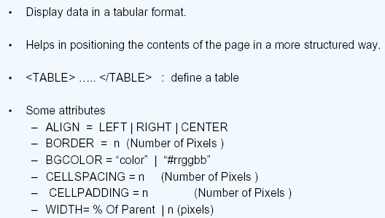
Tables

Slide 45
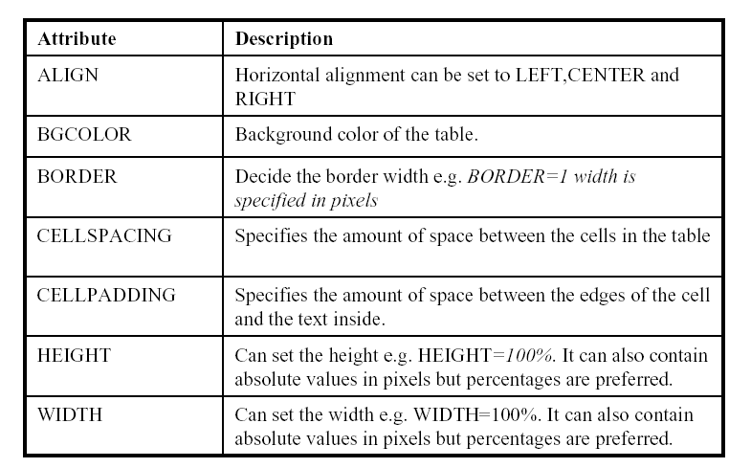

Slide 46
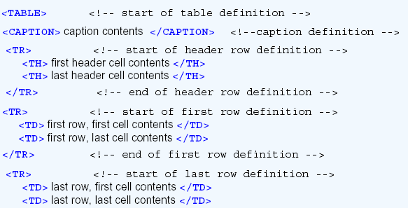

Structure of the Table
Notes:
CAPTION attribute---Align=“BOTTOM”

Slide 47
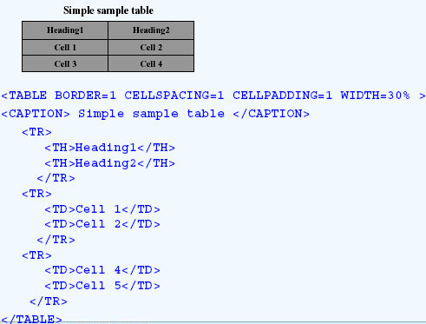
Creating Tables

Slide 48
Attributes of Cell
Attribute rowspan of element th and td
Specifies row size
Attribute colspan of element th and td
Specifies column size
Attribute valign of element th, td and tr
Specifies vertical alignment of text
Attribute nowrap th, td and tr
Deactivates automatic text wrap in the cell

Slide 49

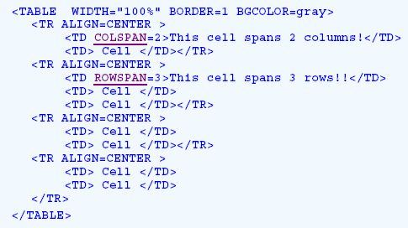
Creating Tables

Slide 50
Internal Linking
Internal Linking
Define anchors within a page
Allows hyperlinks to anchors

Slide 51
1 <!DOCTYPE HTML PUBLIC "-//W3C//DTD HTML 4.01//EN"
2 "http://www.w3.org/TR/html4/strict.dtd">
3 <html>
4
5 <!-- Fig. 3.6: links.html -->
6 <!-- Internal Linking -->
7
8 <head>
9 <title>XML How to Program - List</title>
10 </head>
11
12 <body>
13
14 <!-- <a name = ".."></a> makes an internal hyperlink -->
15 <p><a name = "features"></a></p>
Hyperlink causes browser to jump directly to #ceos anchor (at bottom of page)
16 <h1>The Best Features of the Internet</h1>
17
18 <!-- An internal link's address is "xx.html#linkname" -->
19 <p><a href = "#ceos">Go to <em>Favorite CEOs</em></a></p>
20
21 <ul>
22 <li>You can meet people from countries around the world.</li>
23

Slide 52
24 <li>You have access to new media as it becomes public:
25 <ul>
26 <li>New games</li>
27 <li>New applications
28 <ul>
29 <li>For Business</li>
30 <li>For Pleasure</li>
31 </ul>
32 </li>
33
34 <li>Around the Clock news</li>
35 <li>Search Engines</li>
36 <li>Shopping</li>
37 <li>Programming
38 <ul>
39 <li>HTML</li>
40 <li>Java</li>
41 <li>Dynamic HTML</li>
42 <li>Scripts</li>
43 <li>New languages</li>
44 </ul>
45 </li>
46 </ul>
47 </li>
48
49 <li>Links</li>
50 <li>Keeping In touch with old friends</li>
51 <li>It is the technology of the future!</li>
52 </ul>
53

Slide 53
Anchored position of #ceos
54
55 <p><a name = "ceos"></a></p>
56 <h1>My 3 Favorite <em>CEOs</em></h1>
57
58 <p>
59 <a href = "#features">Go to <em>Favorite Features</em></a>
60 </p>
61
62 <ol>
63 <li>Bill Gates</li>
64 <li>Steve Jobs</li>
65 <li>Michael Dell</li>
66 </ol>
example
67
68 </body>
69 </html>

Slide 54
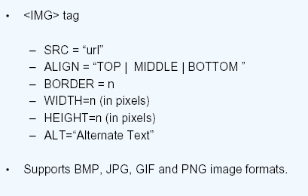
Embedding Images

Slide 55
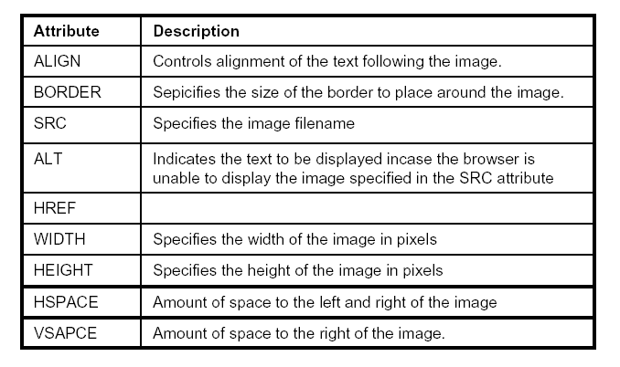
Attributes Of Image Tag

Slide 56
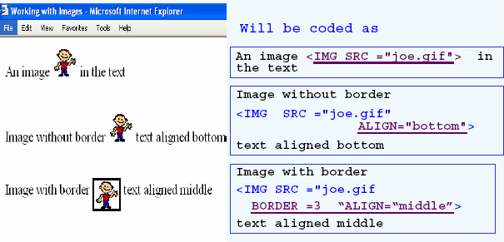

Example

Slide 57
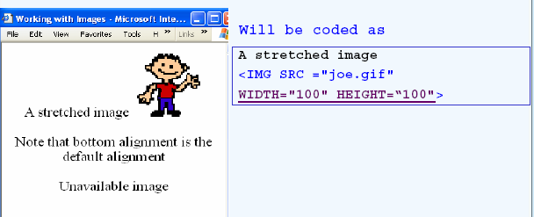
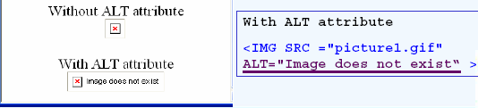
Example
Notes:
Besides, for every image on your page, a new request is sent out by the client to the server. So if you have two images on your page, there will be totally three requests -the first one for the actual page and the next two for the images. This causes three round trips (request + response = round trip) to happen -this could also jam the network with the additional data.

Slide 58
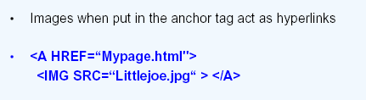
Image As Link
EXAMPLE
The image will be displayed with a border
If you don't like the border, add BORDER=0 to the IMG tag.

Slide 59
Creating and using Image Maps
Image mapping
Define image hotspots
Used as hyperlink anchors
Element map
Contains all image map elements
Attribute name
Defines map identifier

Slide 60
Creating and using Image Maps (cont.)
Image Mapping
Element area
Defines hotspot
Attribute href
Assigns hyperlink URL
Attribute shape
Specifies shape of area
Attribute cords
Specifies hotspot location

Slide 61
1 <!DOCTYPE HTML PUBLIC "-//W3C//DTD HTML 4.01//EN"
2 "http://www.w3.org/TR/html4/strict.dtd">
3 <html>
4
5 <!-- Fig. 3.7: picture.html -->
6 <!-- Creating and Using Image Maps -->
7
8 <head>
9 <title>XML How to Program - Image Map</title>
10 </head>
11
Define rectangles in each corner of image as links
12 <body>
13
14 <p>
15 <!-- <map> opens and names an image map formatting area -->
16 <!-- and to be referenced later -->
17 <map name = "picture">
18
19 <!-- The "shape = rect" indicates a rectangular area, with -->
20 <!-- coordinates of the upper-left and lower-right corners -->
21 <area href = "form.html" shape = "rect"
22 coords = "3, 122, 73, 143" alt = "Go to the feedback form">
23 <area href = "contact.html" shape = "rect"
24 coords = "109, 123, 199, 142" alt = "Go to the contact page">
25 <area href = "main.html" shape = "rect"
26 coords = "1, 2, 72, 17" alt = "Go to the homepage">
27 <area href = "links.html" shape = "rect"
28 coords = "155, 0, 199, 18" alt = "Go to the links page">
29

Slide 62
30 <!-- The "shape = polygon" indicates an area of cusotmizable -->
Create hexagon-shaped hotspot
31 <!-- shape, with the coordinates of every vertex listed -->
32 <area href = "mailto:deitel@deitel.com" shape = "poly"
33 coords = "28, 22, 24, 68, 46, 114, 84, 111, 99, 56, 86, 13"
34 alt = "Email the Deitels">
35
36 <!-- The "shape = circle" indicates a circular area with -->
37 <!-- center and radius listed -->
38 <area href = "mailto:deitel@deitel.com" shape = "circle"
39 coords = "146, 66, 42" alt = "Email the Deitels">
40 </map>
Create circle-shaped hotspot
41
42 <!-- <img src=... usemap = "#name"> says that the indicated -->
43 <!-- image map will be used with this image -->
example
44 <img src = "deitel.gif" width = "200" height = "144"
45 alt = "Harvey and Paul Deitel" usemap = "#picture">
46 </p>
47
48 </body>
49 </html>

Slide 63
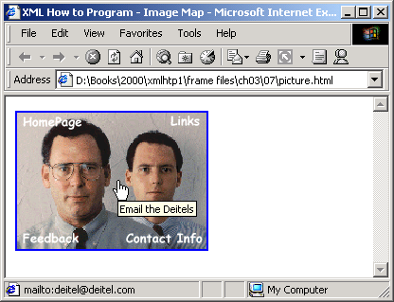
Output
example

Slide 64
Forms
Set of fields that can record information
To interact with the client (like text fields, textarea fields,
dropdown, menus, radio buttons, checkboxes, etc.)
FORM by itself really cannot do anything
Forms become powerful when connected to a server
application
A single HTML page can have multiple forms.

Slide 65
Forms
• Can be designed using <FORM></FORM> tag
NAME is used for future manipulation of data by
scripting language
ACTION indicates a program on the server that will be
executed when this form is submitted. Mostly it will be an
ASP or a CGI script.
METHOD indicates the way the form is submitted to the server
popular options are GET/POST -->
<FORM NAME=“form1” ACTION="abc.asp" METHOD=GET>
(form elements go here)
</FORM>

Slide 66
Form Elements
• <INPUT> tag is used to add elements to the form.
– NAME = “controlname”
– TYPE = text / password / checkbox / radio/ submit / reset / button /
hidden
– VALUE
– MAXLENGTH
– SIZE

Slide 67
Text/Password
• A text field can be added to the form by typing
– <INPUT TYPE=“TEXT" NAME=“txtcompany" VALUE=”INFOSYS”
SIZE="10" MAXLENGTH="15">
• A password field can be added to the form by typing
– <INPUT TYPE=PASSWORD NAME=pwdLogin SIZE=50
MAXLENGTH=12>
– Input to the field will not be reveled.
• Attributes are
– VALUE is the default value loaded
– SIZE sets the size of the field in no. of characters.
– MAXLENGTH specifies max # of chars

Slide 68
Text Area
• Multiline text input
– <TEXTAREA NAME=“feedback” ROWS=3 COLS=40> Default
text goes here
</TEXTAREA>
• ROWS is the number of rows desired.
• COLS is the no of characters per line.
• Default text is optional
• It is not possible to set the default text using the VALUE attribute
• The default text is to be put into
<TEXTAREA> </TEXTAREA> tags

Slide 69
In addition to these attributes Netscape supports WRAP attributes for the <TEXTAREA> element.
The values for
WRAP are OFF,HARD and SOFT.
• OFF disables word wrapping.
• HARD allows word wrapping and the actual breakpoints are
included when the form is submitted.
• SOFT allows word wrapping but the line breaks are not sent with
the form contents.

Slide 70
List Box
<SELECT NAME=“Hobbies” MULTIPLE SIZE=“3”>
<OPTION VALUE=“TR”>Travel
<OPTION SELECTED>Reading
<OPTION>Sleeping
<OPTION>Walking
</SELECT>
• SIZE # of lines to display
• VALUE indicates what will be sent to the server
• SELECTED sets the default selected item

Slide 71
List Box
The boolean MULTIPLE attribute allows the user to select multiple options, which are submitted as
separate name/value pairs.
The boolean DISABLED attribute, new in HTML 4.0 and poorly supported by current
browsers, makes the SELECT element unavailable.

Slide 72
Check Box
<INPUT TYPE="checkbox" NAME=”contact" VALUE=“email”
CHECKED>Notify by email<P>
• Can have multiple checkbox where checked is true
• VALUE indicates the value to be transmitted to the server.
– e.g: contact=email will be sent to the server.
• CHECKED sets the text box to be selected by default.
<INPUT TYPE="checkbox" NAME=”InternetBanking“ > Internet Banking

Slide 73
Radio Button
<INPUT TYPE="radio" NAME="output" VALUE="screen“ SELECTED>Screen
<INPUT TYPE="radio" NAME="output" VALUE="printer">Printer
• Radio buttons with the same NAME are grouped together.
• Only one button can be selected in a group.
• VALUE data to be sent to the server.
• SELECTED will preselect the button.

Slide 74
Radio Button
The second mechanism for selection is a set of radio buttons. In a set of radio
buttons only one can be selected at a time - to do this all the buttons should be given the same value for the NAME attribute.
e.g.
<INPUT TYPE=RADIO NAME=rdbAgeGroup VALUE=1>
<INPUT TYPE=RADIO NAME=rdbAgeGroup VALUE=2>.

Slide 75
Hidden Text Fields
<INPUT TYPE=“hidden” NAME=“useinformation” VALUE =“form1”>
• Can be used to transmit default or previously specified data.
• Can be used to pass data from one form to another.
• Cannot be modified by the user
• So it must have a VALUE attribute set
• VALUE data to be sent to the server.

Slide 76
Buttons
The Submit button
– Sends the form contents to the server when clicked
– <INPUT TYPE=submit NAME=cmdsubmit VALUE =“Submit”>
The Reset button
– Resets all the form controls to the default state.
– <INPUT TYPE=Reset NAME=cmdReset VALUE="Reset">.
A button
– No predetermined action like submit or reset.
– Script should be written to make it work. (this will be covered in later
chapters)
– <INPUT TYPE=Button NAME=cmdAdd VALUE=“Click Me">.

Slide 77
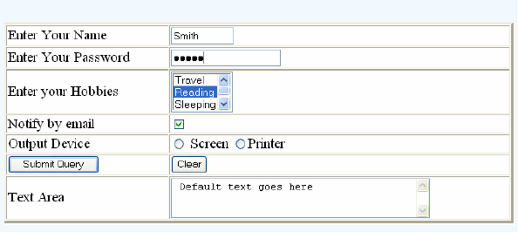
Form Example
example
example

Slide 78
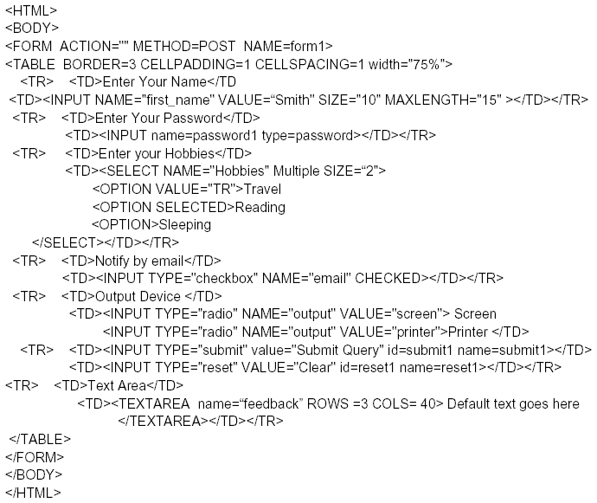

Slide 79
Frames
Divides a browser window into number of panes.
• Each frame may contain a different document.
• <FRAMESET> element defines a set of frames.
– Should preclude the <BODY> element.
– <FRAMESET> </FRAMESET>
• ROWS
• COLS
• <FRAME > element defines an individual frame
– NAME = “frame name”
– SRC=“url”
– SCROLLING = auto / yes / no
– NORESIZE

Slide 80
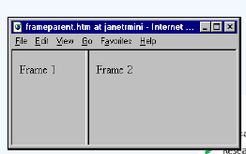
Frame Example
<HTML>
<FRAMESET COLS="*, 2*">
<FRAME SRC=“Frame1.htm">
<FRAME SRC=“Frame2.htm">
</FRAMESET>
<HTML>
example

Slide 81
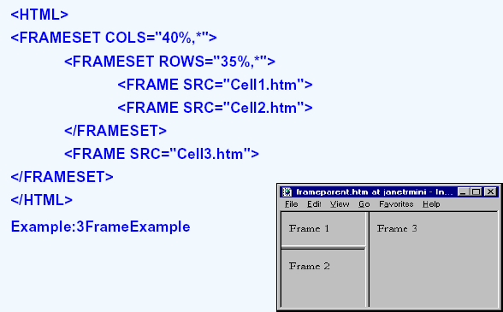
Nesting Frames
example

Slide 82
Targeting Frames
• Ensure frame naming
• <FRAMESET COLS="*, 20%">
<FRAME NAME="Frame1” SRC="Cell_1.htm">
<FRAME NAME="Frame2” SRC="Cell_2.htm">
</FRAMESET>
• Set the TARGET attribute for one hyperlink
– <A HREF="file.htm" TARGET="Frame1">Link Text</A>
– <A HREF="file.htm" TARGET="_top">Link Text</A>
• Set the TARGET attribute for all hyperlinks
– <BASE TARGET="Frame2">
– <BASE TARGET="_top">

Slide 83
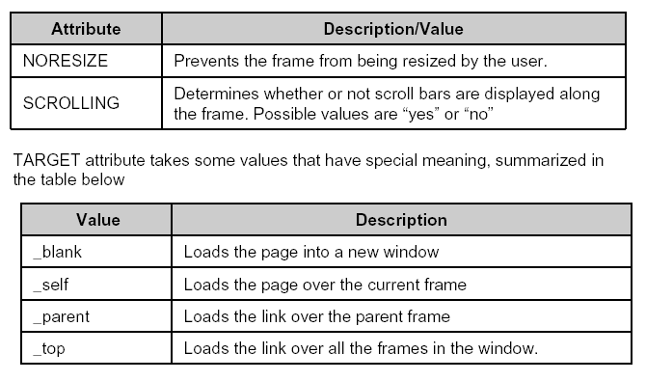
Attributes Of Frames Tag

Slide 84
NOFRAMES
• <NOFRAMES> </NOFRAMES> tag
– Encloses text to be displayed when the browser does not support frames.
<HTML>
<FRAMESET COLS="*, 2*">
<FRAME SRC=“Frame1.htm">
<FRAME SRC=“Frame2.htm">
<NOFRAMES> <P>This document uses frames. Please follow this link for the
<A HREF=“noframes.htm”></A> version <NOFRAMES>
</FRAMESET>
<HTML>

