Slide 1






8981838547
Blinkit Sales Data Analysis
https://classroomtech.in
https://www.linkedin.com/in/satyaki-das-25593714a/
3 Months
1st April 2025– 30th June 2025
A PowerBI Dashboard Report
Presented By:
AYUSHEE SHAW

Slide 2




Name: Ayushee Shaw College Name: Narula Institute of Technology Department: Information Technology
📞 Contact Us
📱 Phone: 8981838547
🌐 Website: https://classroomtech.in
🔗 LinkedIn: https://www.linkedin.com/company/classroom-tech/

Slide 3
Objectives:
The objective of this project is to analyze Blinkit’s sales data using Power BI to uncover key business insights. By designing interactive dashboards and meaningful visualizations, the project aims to help understand customer purchase behavior, product-wise sales performance, regional order trends, and overall business growth. This will assist in making informed, data-driven decisions and improving operational efficiency.

Slide 4
Tools Used:
Power BI – For data visualization and creating interactive dashboards
Microsoft Excel – For initial data cleaning and formatting
DAX (Data Analysis Expressions) – For writing custom measures and calculations in Power BI
Power Query Editor – For data transformation and preprocessing within Power BI

Slide 5
Methodology:
Data Collection: Sales data of Blinkit was obtained in Excel/CSV format with relevant fields like product name, customer ID, quantity, date, and amount.
Data Cleaning: Power Query Editor was used to remove duplicates, fix data types, and prepare the dataset for analysis.
Data Modeling: Relationships between tables (customer, product, orders) were established for a structured data model.
Analysis & Calculations: DAX was used to create measures like total sales, average quantity, and monthly trends.
Visualization: Dashboards were created using charts, slicers, and filters to represent key insights interactively.

Slide 6
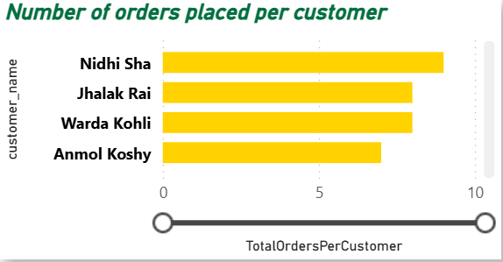



blinkit
India's Last Minute App
Number of Orders Placed per Customer
Purpose: To display which customers have placed the highest number of orders.
Visual: Horizontal bar chart (X-axis: order count, Y-axis: customer names)
Insights:
Nidhi Sha has the highest orders (9).
Multiple customers have 7–8 orders, showing repeat buying behavior.
Useful to target loyal customers with offers and retention campaigns.

Slide 7
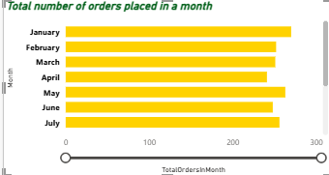
blinkit
India's Last Minute App
Total Number of Orders Placed in a Month
Purpose: To track order volume trends by month.
Visual: Vertical bar chart (X-axis: Month-Year, Y-axis: total orders)
Insights:
Peak orders in August 2023 (285) and May 2023 (276).
Order volume stays consistent month to month.
Helps plan campaigns, manpower, and stock for busy periods.

Slide 8
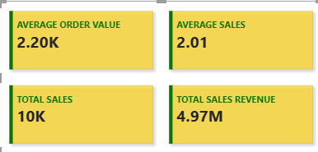
blinkit
India's Last Minute App
Total sales
Purpose:
To display the overall sales distribution by product category.
Visual:
Pie chart showing categories like Beverages, Snacks, Dairy, Pet Care, etc.
Insights:
Beverages and Snacks are the top-selling categories. Pet Care has the smallest share, suggesting growth potential.

Slide 9
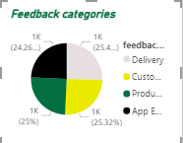
blinkit
India's Last Minute App
Distribution of Feedback Categories
Purpose: To understand which areas customers give the most feedback about.
Visual: Pie chart with slices for Delivery, Customer Service, Product Quality, App Experience.
Insights:
Feedback is evenly spread across all 4 categories (~24–25% each).
No single area dominates, so multiple teams need to improve together.
Confirms the need for holistic service improvement.

Slide 10
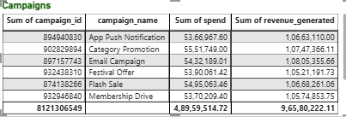
blinkit
India's Last Minute App
Campaign Table
Purpose: To list and compare individual marketing campaigns by spend and revenue.
Insights:
Shows spend ranges from ~1K to ~5K per campaign.
Revenue generated is higher than spend for most campaigns.
Provides a clear ROI view for each campaign, enabling better budget allocation.

Slide 11
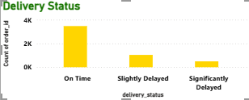
blinkit
India's Last Minute App
Orders Based on Delivery Status
Purpose: To show how many orders were on time, slightly delayed, or significantly delayed.
Visual: Vertical bar chart (X-axis: Delivery Status, Y-axis: order count)
Insights:
3.5K orders delivered on time, 1K slightly delayed, 0.5K significantly delayed.
Over 70% orders meet delivery promises.
Highlights where process improvements can cut delays further.

Slide 12
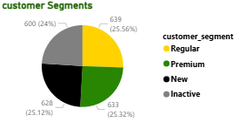
blinkit
India's Last Minute App
Customer Segment
Purpose: To show the proportion of customers in each segment.
Visual: Pie chart with segments: Regular, Premium, New, Inactive.
Insights:
Segments are evenly spread (24–25% each).
Indicates a balanced mix of loyal, new, and inactive customers.
Helps tailor offers to re-engage inactive users.

Slide 13
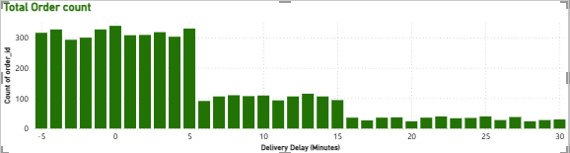
blinkit
India's Last Minute App
Total order count
Purpose:
To analyze sales trends over days of the week.
Visual:
Line chart (X-axis: Days, Y-axis: Total Orders).
Insights:
Weekends show a spike in orders, indicating higher demand during leisure days. Can be leveraged for weekend-specific promotions.

Slide 14
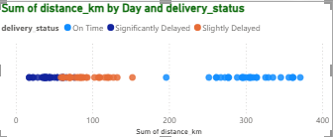
blinkit
India's Last Minute App
Delivery status
Purpose:
To view the geographic distribution of orders.
Visual:
Map visualization highlighting order density by city/region.
Insights:
Metro cities like Delhi, Mumbai, and Bangalore have the highest order volumes, confirming strong urban demand.

Slide 15
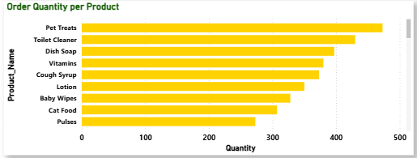
blinkit
India's Last Minute App
Order quantity per product
Purpose:
To show average delivery times per category.
Visual:
Horizontal bar chart (X-axis: Average Delivery Time, Y-axis: Category).
Insights:
Most categories are delivered within 30 minutes, but Frozen Foods take longer due to special handling.

Slide 16
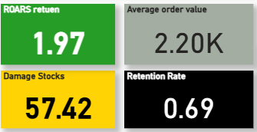
blinkit
India's Last Minute App
Average order values
Purpose:
To analyze customer acquisition trends.
Visual:
Line/Area chart showing number of new customers acquired per month.
Insights:
New customer sign-ups peak in festive months, possibly due to targeted marketing campaigns.

Slide 17
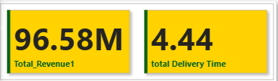
blinkit
India's Last Minute App
Total delivery time
Purpose:
To compare order quantities across customer segments.
Visual:
Clustered bar chart (X-axis: Customer Segments, Y-axis: Quantity).
Insights:
Premium customers purchase higher quantities per order compared to other segments.

Slide 18
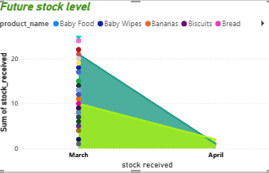
blinkit
India's Last Minute App
Future stock level
Purpose:
To display top-selling products.
Visual:
Table with Product Name, Quantity Sold, and Revenue.
Insights:
Top 5 products contribute over 40% of total revenue, highlighting their importance in inventory planning.

Slide 19
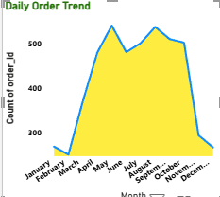
blinkit
India's Last Minute App
Daily order
Purpose:
To examine repeat purchase frequency.
Visual:
Histogram showing number of orders vs number of customers.
Insights:
A significant proportion of customers make more than 5 purchases, indicating strong customer loyalty.

Slide 20
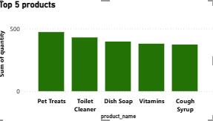
blinkit
India's Last Minute App
Top 5 products
Purpose:
To analyze discount impact on sales.
Visual:
Scatter plot (X-axis: Discount %, Y-axis: Sales).
Insights:
Moderate discounts (10–20%) generate the highest sales boost without significantly reducing margins.

Slide 21
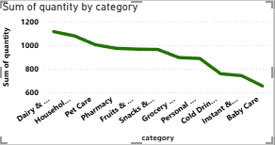
blinkit
India's Last Minute App
Sum of quantity by category
Purpose:
To identify products with declining sales.
Visual:
Line chart showing sales over months for specific products.
Insights:
Some seasonal products see dips post-festival periods, suggesting need for targeted clearance sales.

Slide 22
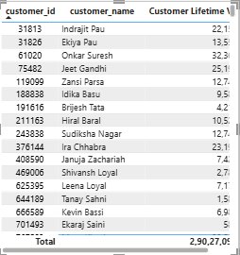
blinkit
India's Last Minute App
Customer Details
Purpose: To view basic details about individual customers.
Visual: Table with customer ID, name, and address.
Insights:
Supports address validation for deliveries.
Useful for store or zone-level order tracking.
Can be used for personalized service and communication.

Slide 23
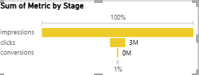
blinkit
India's Last Minute App
Sum of metric by stage
Purpose:
To show the proportion of payment methods used.
Visual:
Pie chart (UPI, Credit Card, Cash on Delivery, Wallets).
Insights:
UPI is the most preferred payment method (~50%), followed by Cash on Delivery.

Slide 24
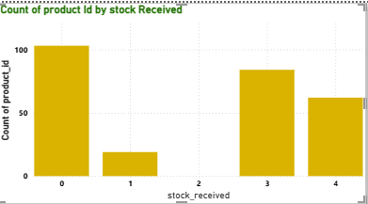
blinkit
India's Last Minute App
Count of product id by stock recieved
Purpose:
To track revenue growth over time.
Visual:
Line chart (X-axis: Months, Y-axis: Revenue).
Insights:
Steady upward trend with spikes during festive sales, indicating effective seasonal promotions.

Slide 25
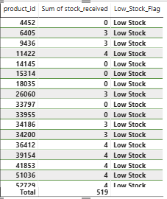
blinkit
India's Last Minute App
Sum of Stocks received
Purpose: To track products with critically low stock levels, helping Blinkit identify items that need urgent replenishment.
Visual:
Shows Product ID, Stock Received, and Low Stock Flag.
All products listed are marked “Low Stock,” with quantities between 0–4 units.
Total stock for these items is 519 units.
Insight:
Several products (e.g., 4452, 14145, 18035) have 0 stock, meaning they are completely unavailable.
Items with only 3–4 units in stock require immediate restocking.
Continuous monitoring is essential to avoid stockouts and lost sales.

Slide 26
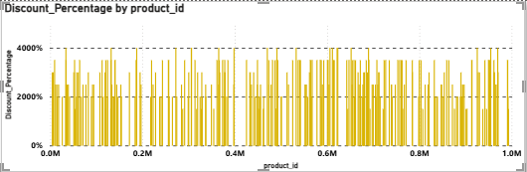
blinkit
India's Last Minute App
Discount Product
Purpose: This visual shows the Discount Percentage by Product ID to understand discount distribution patterns across different products. It helps in identifying products with unusually high or low discounts.
Visual Description:
X-axis: Product IDs (ranging from 0M to 1.0M).
Y-axis: Discount percentage (0% to over 4000%).
Each yellow bar represents a product’s discount level.
Insight:
Discounts vary significantly, with many products showing extremely high values (above 2000%), which may indicate data anomalies or promotional pricing errors.
Discount distribution is not concentrated in one range—high discounts are scattered across the entire product range.

Slide 27
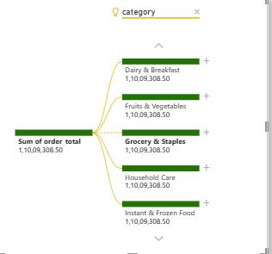
blinkit
India's Last Minute App
Tree Visualization of Product Sales
Purpose: To break down product sales by category, customer segment, year, month, and day.
Visual: Tree or Sankey diagram with multiple levels.
Insights:
Pet Care shows 398 total orders, split by segments and dates.
New segment contributes the most.
Gives a clear drill-down path for deep analysis.

Slide 28
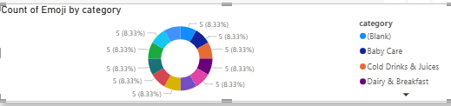
blinkit
India's Last Minute App
Emoji-Based Ratings
Purpose: To show customer product/service ratings using emoji stars.
Insights:
Pet Care category shows average ratings of 3–5 stars.
Indicates high satisfaction for Pet Care items.
Supports maintaining product/service standards.

Slide 29
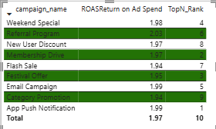
blinkit
India's Last Minute App
ROAS Return
Purpose: This table compares different marketing campaigns based on Return on Ad Spend (ROAS) and their Top N Rank performance. Visual Description:
The campaign_name column lists 9 marketing initiatives.
ROAS shows the efficiency of each campaign in generating returns.
TopN_Rank ranks campaigns based on performance metrics (1 = highest performing).
Insight:
Referral Program achieved the highest ROAS (2.03), making it the most cost-effective campaign despite ranking 6th overall.
App Push Notification ranked 1st overall but had a slightly lower ROAS (1.99) than Referral Program.
Membership Drive ranked 2nd with ROAS of 1.97, showing strong efficiency.
Category Promotion had the lowest ROAS (1.94) among Top N campaigns, indicating scope for optimization.

Slide 30
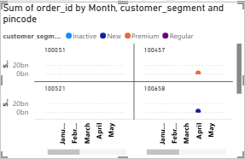
blinkit
India's Last Minute App
Sum of orders
Purpose: This visual displays the sum of order IDs segmented by month, customer segment, and pincode. It helps identify which customer segments are placing orders in specific pincodes over time.
Visual Description:
The chart is split by pincode (100051, 100457, 100521, 100658).
The x-axis shows months from January to May.
Insight:
Orders are concentrated in only a few customer segments for specific pincodes.
Pincode 100457 shows Premium customer activity in March.
Pincode 100658 shows Inactive customers placing orders in April.
Pincode 100051 and 100521 have minimal visible customer activity, suggesting potential markets for engagement or targeted promotions.

Slide 31
Thank You!

