Slide 1
GIT SESSION

Slide 2
What is GIT?
Git is an open-source distributed version control system. It is designed to handle minor to major projects with high speed and efficiency. It is developed to co-ordinate the work among the developers. The version control allows us to track and work together with our team members at the same workspace.

Slide 3
SCALABILITY
Features of GIT
OPEN SOURCE
SECURITY
SPEED

Slide 4
Benefits OF GIT
Save Timing.
Offline Working.
Undo Mistakes.
Track Changes.

Slide 5
Version Control System
A version control system is a software that tracks changes to a file or set of files over time so that you can recall specific versions later. It also allows you to work together with other programmers.
Benefits of Version Control:
Complete change history of the file
Simultaneously working
Branching and merging
Traceability

Slide 6
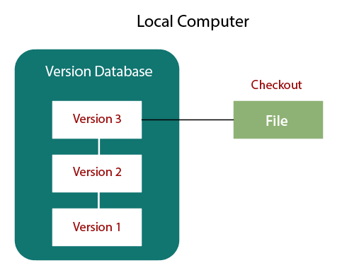
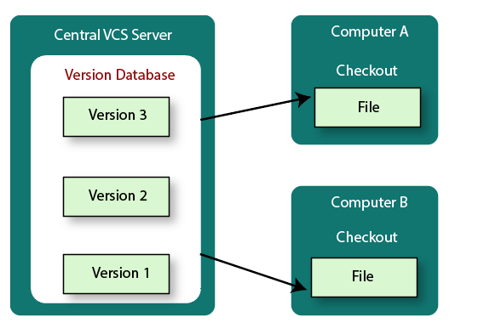
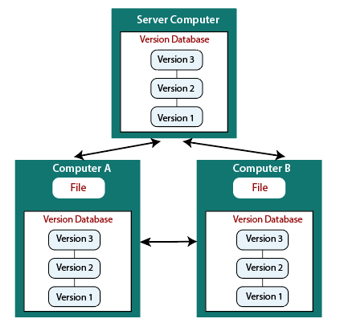
Types of Version Control System
Localized version Control System
Centralized version control systems
Distributed version control systems
Localized
Centralized
Distributed

Slide 7
BASICS COMMANDS :-
Git init
Git clone
Git config
Git add
Git commit
Git status
Git stash
Git push
Git pull
Git branch
Git merge
Git log
Git remote
Git checkout

