Slide 1

Log Data File
MDF – Master Data File – actual data
LDF – Log Data File –
CRUD, indexes, alert etc.,
SELECT *
CREATE TABLE
CREATE TABLE
ALTER TABLE
DROP INDEX DROP TABLE
UPDATE
BACKUP
Database
3MB
LogFile
1MB
Database
100MB
LogFile
10GB

Slide 2
Backup
Full DB BackUp
INSERT INTO
UPDATE
ALTER
CREATE
INSERT INTO
INSERT INTO
INSERT INTO
UPDATE
ALTER
CREATE
INSERT INTO
INSERT INTO
INSERT INTO
INSERT INTO
INSERT INTO
INSERT INTO
MDF Backup
Full
Differential
TLog Backup
Full Backup
Differential Backup
Full Backup
Differential Backup
Monday 00:00
Thursday 00:00
Monday 00:00
Thursday 00:00
Time

Slide 3
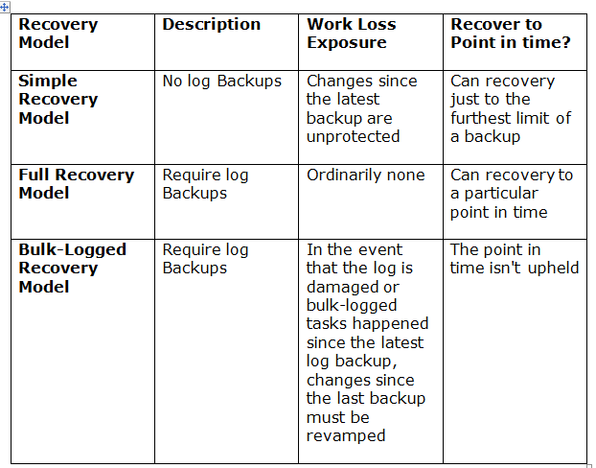
LoGFIle
Full DB BackUp
INSERT INTO
INSERT INTO
INSERT INTO
INSERT INTO
INSERT INTO
INSERT INTO - Tuesday
INSERT INTO
INSERT INTO
INSERT INTO
INSERT INTO
INSERT INTO
INSERT INTO - Wedne
Recovery Models
Simple
Full
Bulk_Logged

Slide 4
DATABASE
MDF
LDF

Slide 5
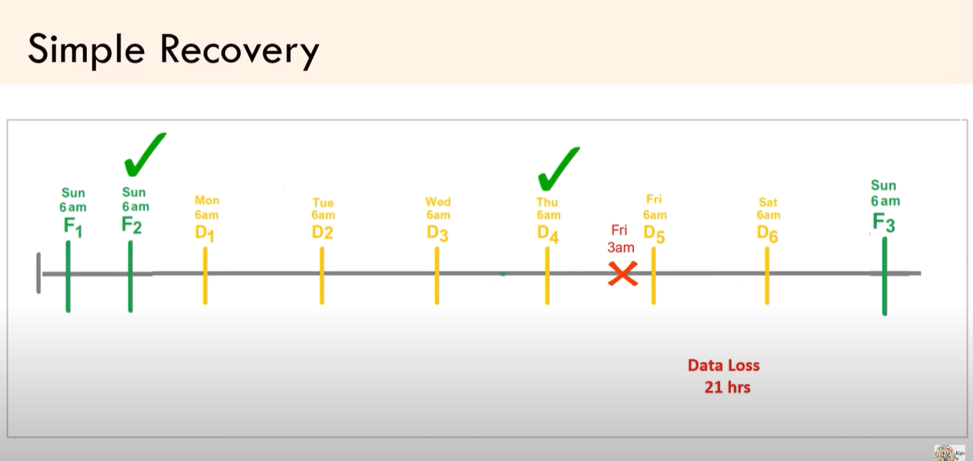

Slide 6
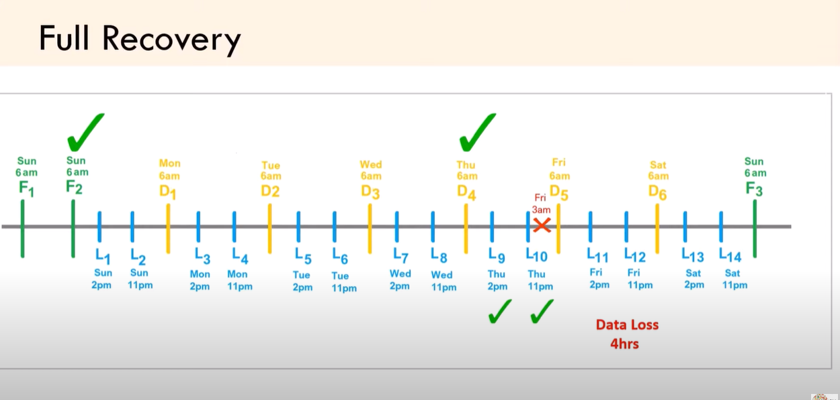

Slide 7
Emp no | Emp Name | Designation | Address | Mobile no
01 | Gopi | Developer | Chennai | 123
02 | Venkat | Manager | Chennai | 456
03 | Johnson | Senior | Ponnamalle | 789
Database 10 mb
Log file 11 mb

