Slide 1

Facial Recognition Attendance: A Modern Solution
Submitted by:
Rohit Yadav(12206751)
Raj Singh Bisht(12208897)

Slide 2
Facial Recognition Attendance: A Modern Solution
Traditional attendance methods are inefficient. But facial recognition offers an automated, accurate, and efficient solution.
It provides an automated, accurate, and efficient way to track attendance in real-time.

Slide 3

How It Works: The Technology Behind It
Facial recognition uses AI, Machine Learning, and Computer Vision.
Image Capture
Feature Extraction
Matching
A webcam or device camera captures your image.
The system identifies unique facial features.
Features are compared to a stored database.

Slide 4
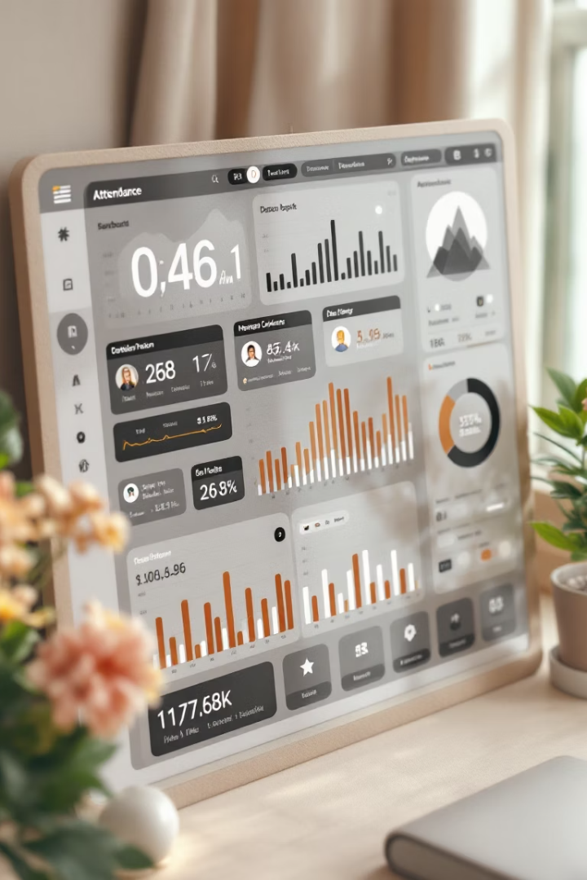




Benefits: Accuracy and Efficiency
This system eliminates errors, speeds up attendance, and cuts costs.
Improved Accuracy
Increased Efficiency
Real-time Data
Cost Savings

Slide 5
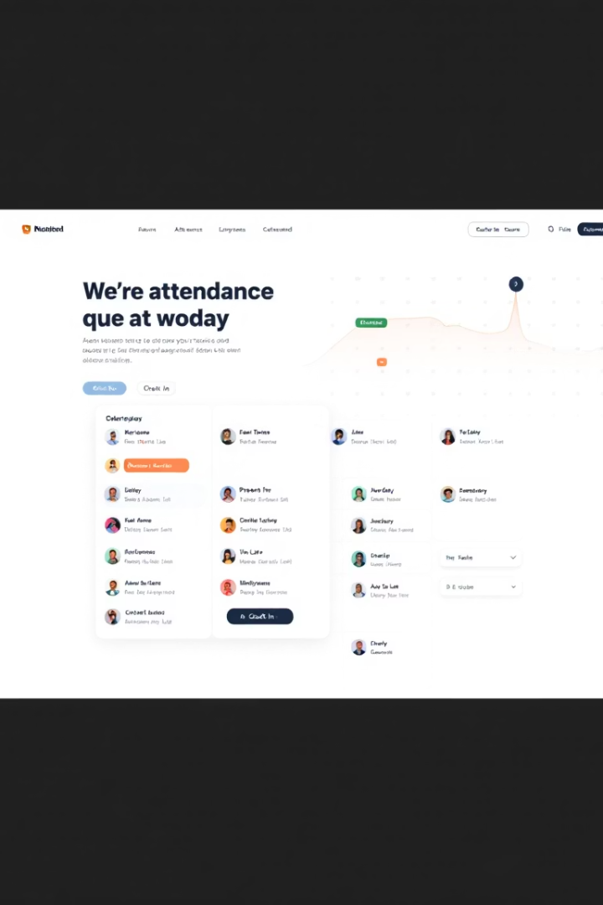
Webpage Features: A User-Friendly Interface
Our webpage offers user registration, a dashboard, reports, and account management.
User Registration
Attendance Dashboard
Easy enrollment with facial capture.
Real-time status view.
Reporting
Customizable analysis reports.

Slide 6




Security and Privacy: Addressing Concerns
We use encryption, comply with regulations, and obtain user consent.
Data Encryption
Compliance
Protecting sensitive facial data.
Adhering to privacy regulations.
Consent
Informed consent from users.

Slide 7

Conclusion: The Future of Attendance
Facial recognition is the future of secure, efficient attendance tracking.
Summarize Benefits
Efficient attendance tracking
Future Growth
Potential for Innovation

