Slide 1
BANK LOAN DEFAULT RISK ANALYSIS
Presented By – Power Booster Team

Slide 2


Our TEAM members
Roshan Kumar
Swaranjal Sharma
Omveer Gangwar
Priyanshi Johari
Om Kumar
Raghav Gupta
Ritesh Kumar
Akash Kumar
Rajat Pratap Singh
Ananya Singh

Slide 3

INTRODUCTION
Helps banks predict whether a customer will repay or default on a loan.
Uses data like age, employment, income, property, and past defaults.
Supports safe and data-driven lending decisions.
Reduces financial losses by identifying high-risk customers early.
Improves loan approval accuracy and overall credit management.

Slide 4






RAW DATA COLLECTION
64.4%
30k- 2M
1m – 10BN
15,000+
60-80%
Bank loan Risk dataset
Income
Age(18,70)
Loan Amount Range
Total Records
Credit Score
Success

Slide 5





PROJECT OVERVIEW
Loan Default Risk Analysis uses historical loan data
It helps understand factors influencing loan repayment
Analytical insights assist in better loan approval decisions
Analyzes key factors like credit score, income, loan amount, and repayment history.
Helps banks predict the likelihood of loan defaults using data-driven models.
Evaluates how a borrower’s credit history affects repayment behavior.
Measures financial burden and repayment capacity.
Identify potential defaulters using predictive analytics.
Enhance accuracy in evaluating borrower creditworthiness.
Improved decision-making process for loan approvals and risk management
To analyze borrower data and identify factors influencing loan default risk
Uses machine learning to forecast the likelihood of loan defaults.
Considers multiple borrower attributes for accurate risk assessment.
Gather and clean historical borrower and loan data.
Use analytical models to forecast and minimize future loan defaults.

Slide 6






TOOLS & LIBRARIES USED
WEBSITE
(Raw Data)
Python (NumPy & Pandas)
Excel Data filtering
Real customer information including age, income, and employment details used for analysis
Helps perform fast numerical computations and handle large arrays efficient.
Provides advanced and attractive statistical visualizations to identify patterns and correlations.
Removed duplicates and irrelevant records to ensure data accuracy.
Used Excel filters to view specific loan categories and borrower segments.
Pivot tables - Charts
Power BI Dashboard
Summarized large loan datasets to analyze trends by category, region, or credit score.
Allowed quick comparisons of approved vs. defaulted loans.
Integrated cleaned Excel loan datasets into Power BI.
For creating interactive dashboards to visualize loan risk factors and final insights..

Slide 7
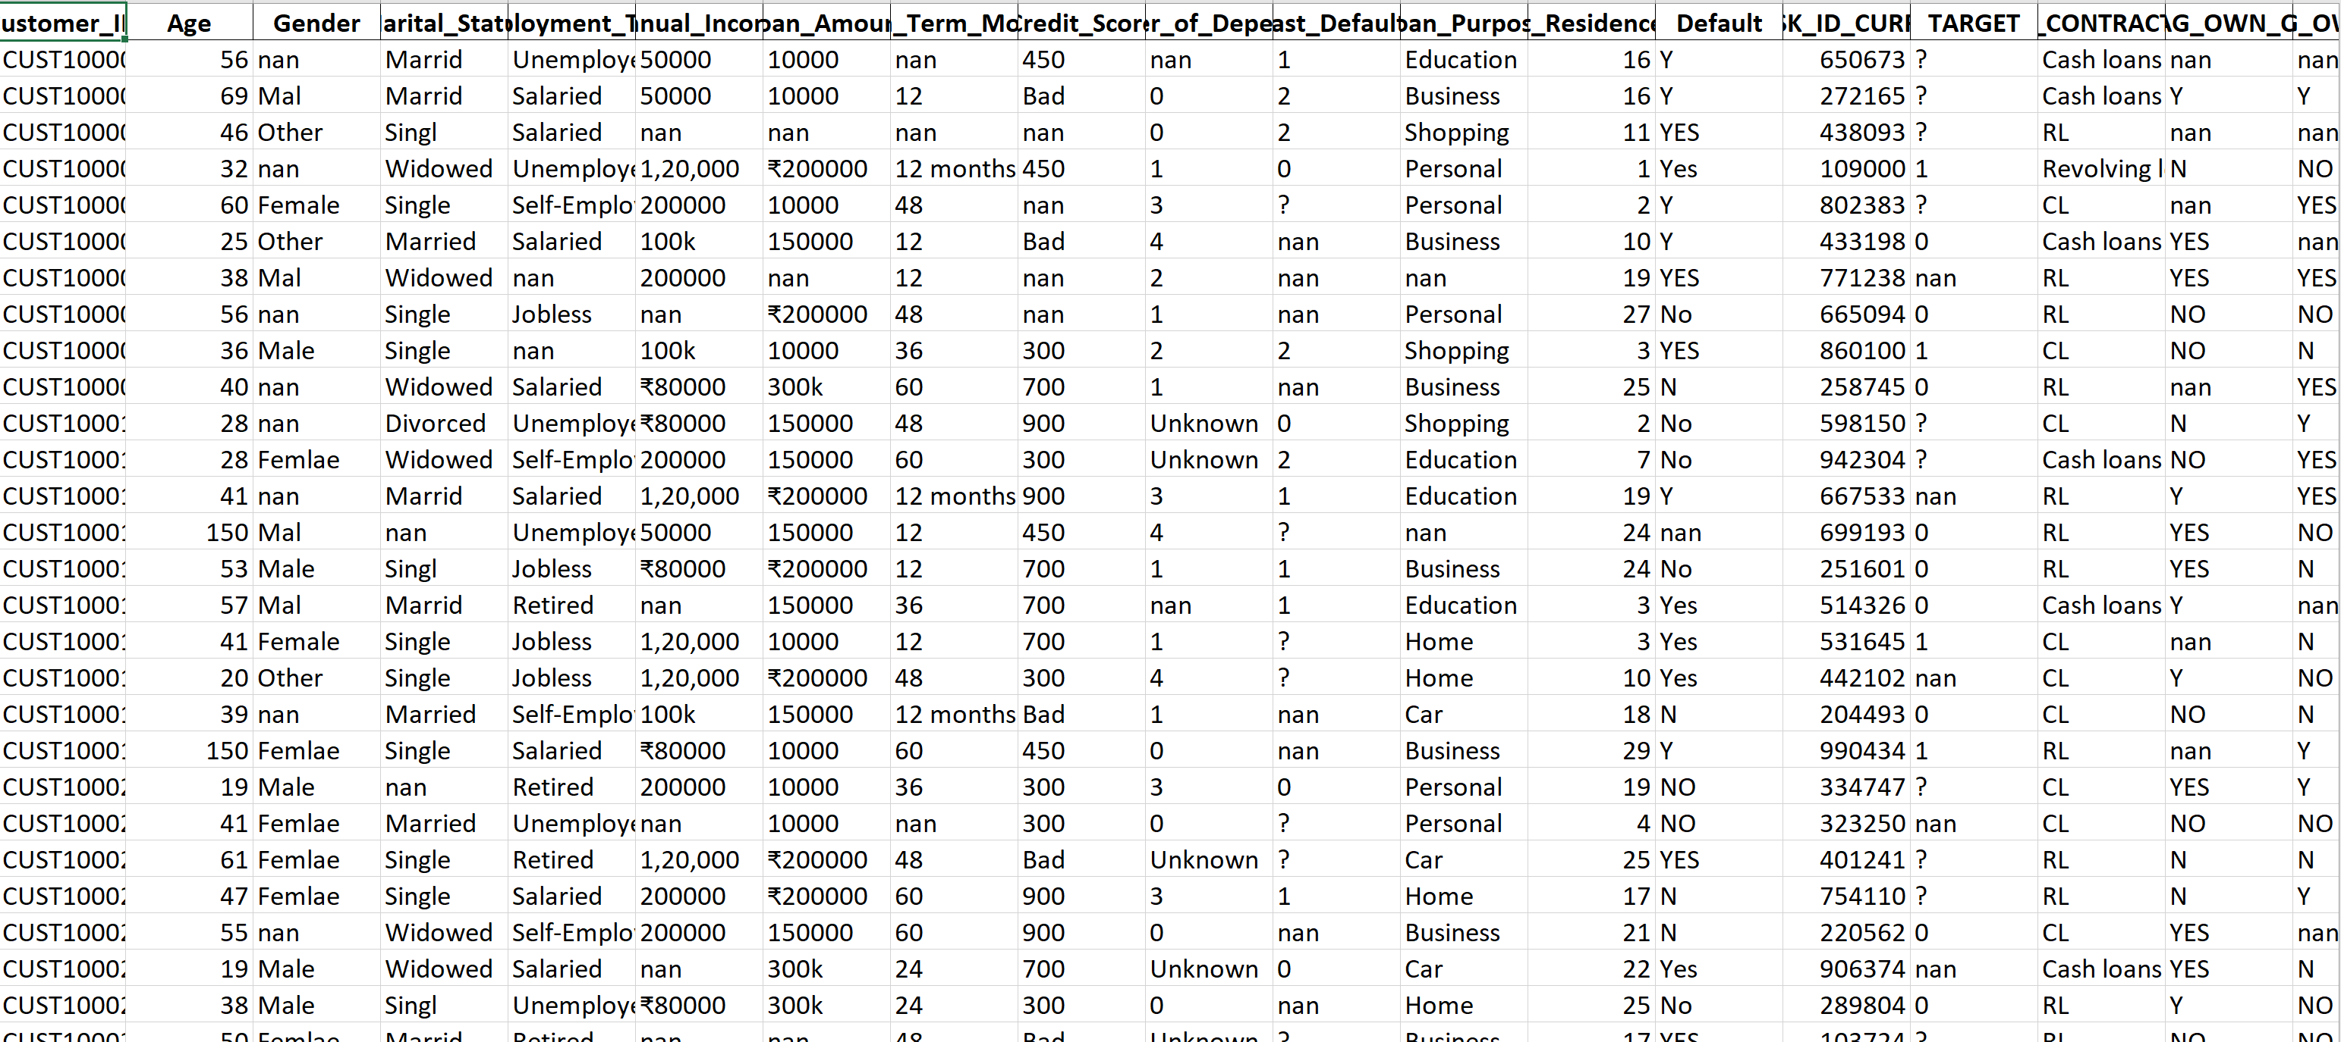

Slide 8



DATA CLEANING ( Numpy & Pandas )
Null values handled using imputation
Duplicate data removed
Standardized date and numeric formats
Filling missing values
Numerical columns
Categorical columns
Accuracy
Consistency
Uniqueness
Uniformity
Readability
Comparability

Slide 9
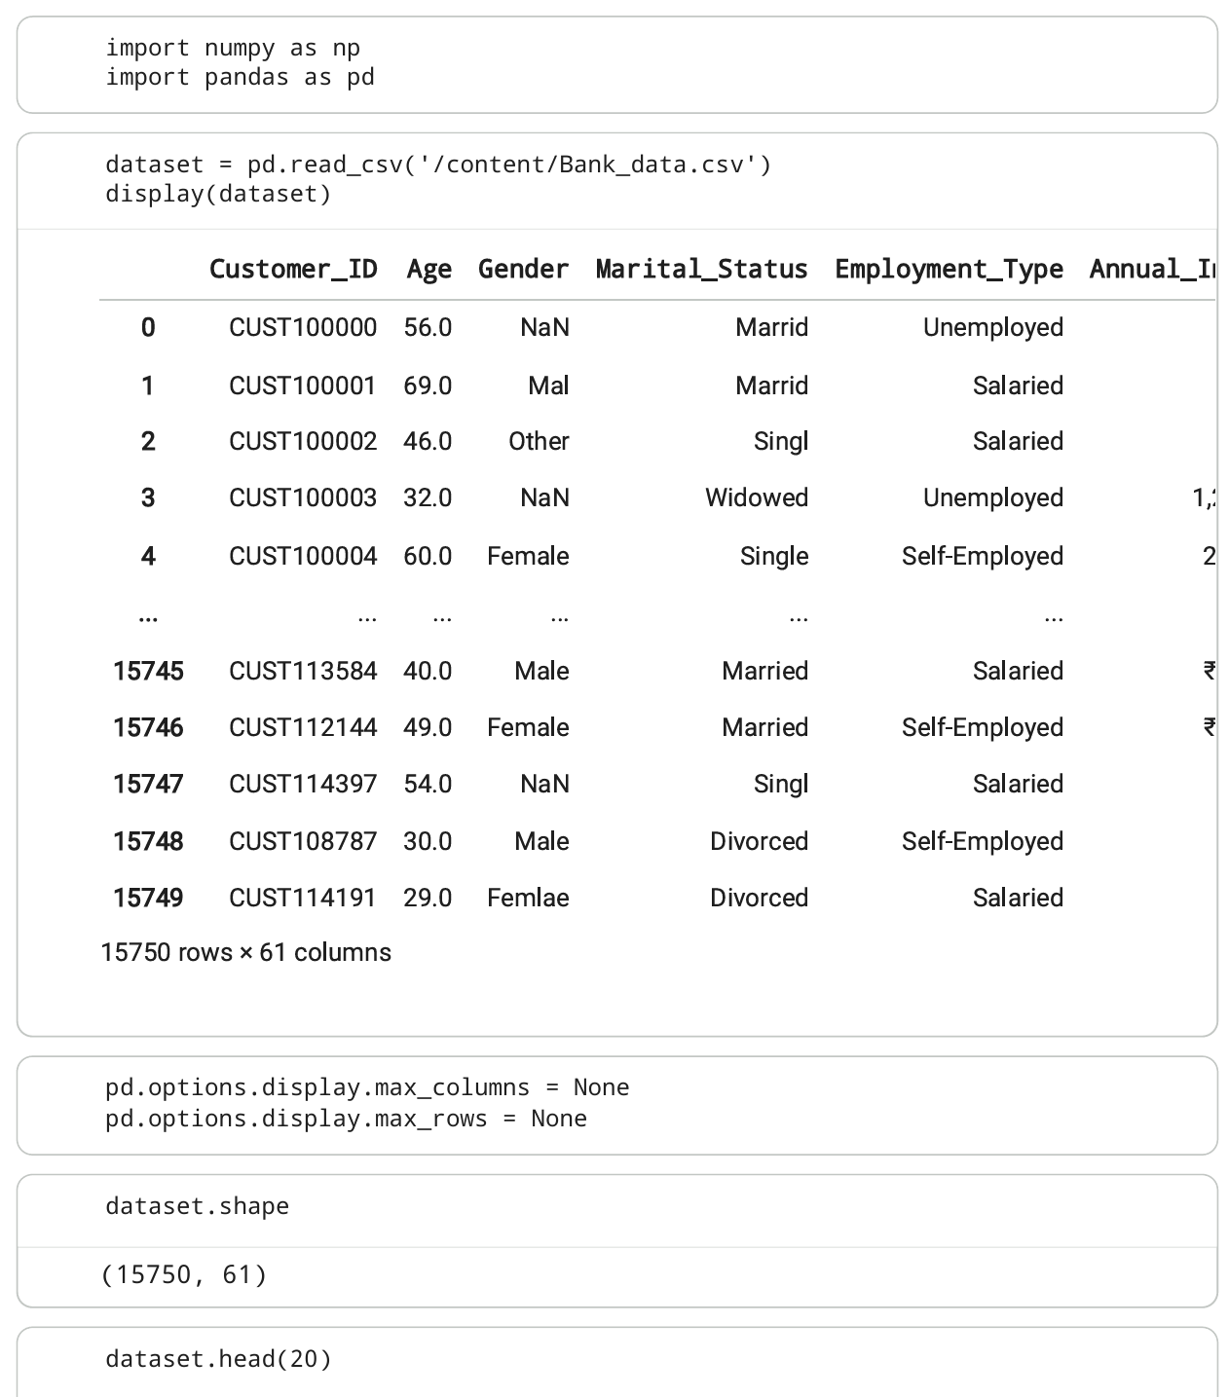
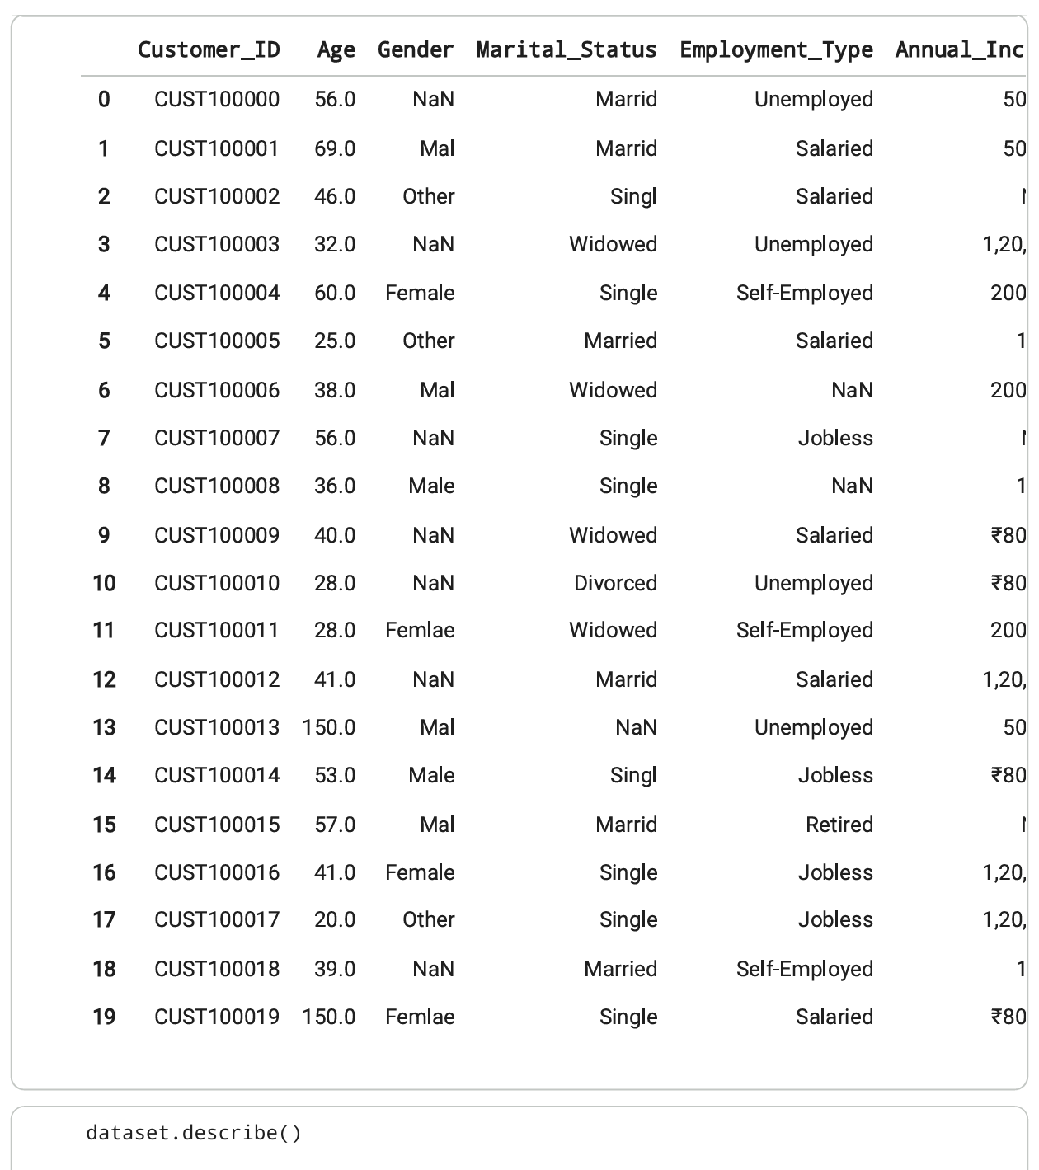

Slide 10
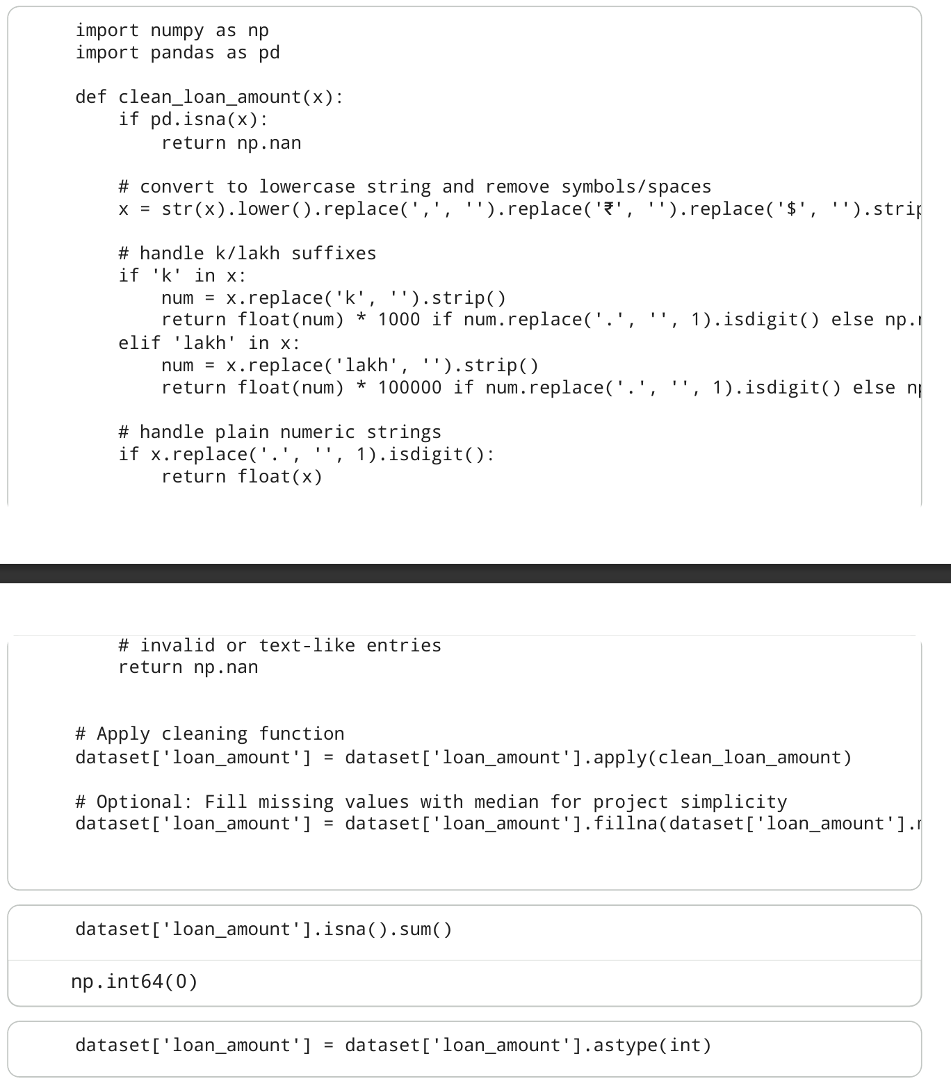
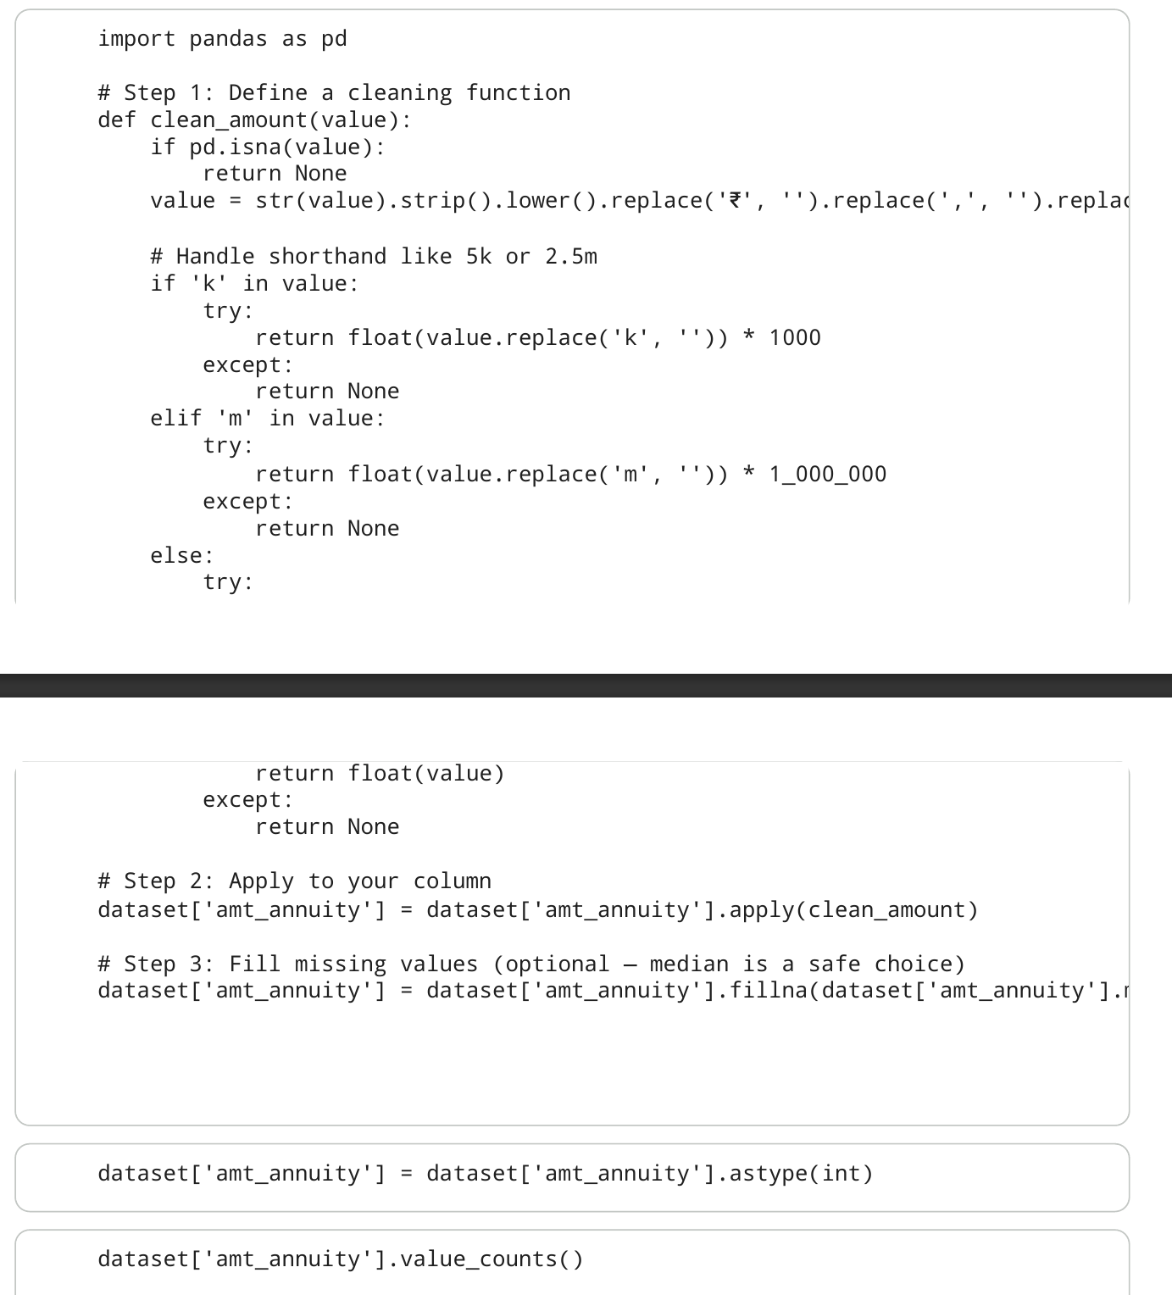

Slide 11


DATA CLEANING Summary
Converted categorical data into numerical format
Created new columns like ‘Flag Own Car'
Normalized data for better comparative analysis
Transformation
Conversion
Representation
Feature-Engineering
Insights
Optimization
Scaling
Uniformity
Balance

Slide 12
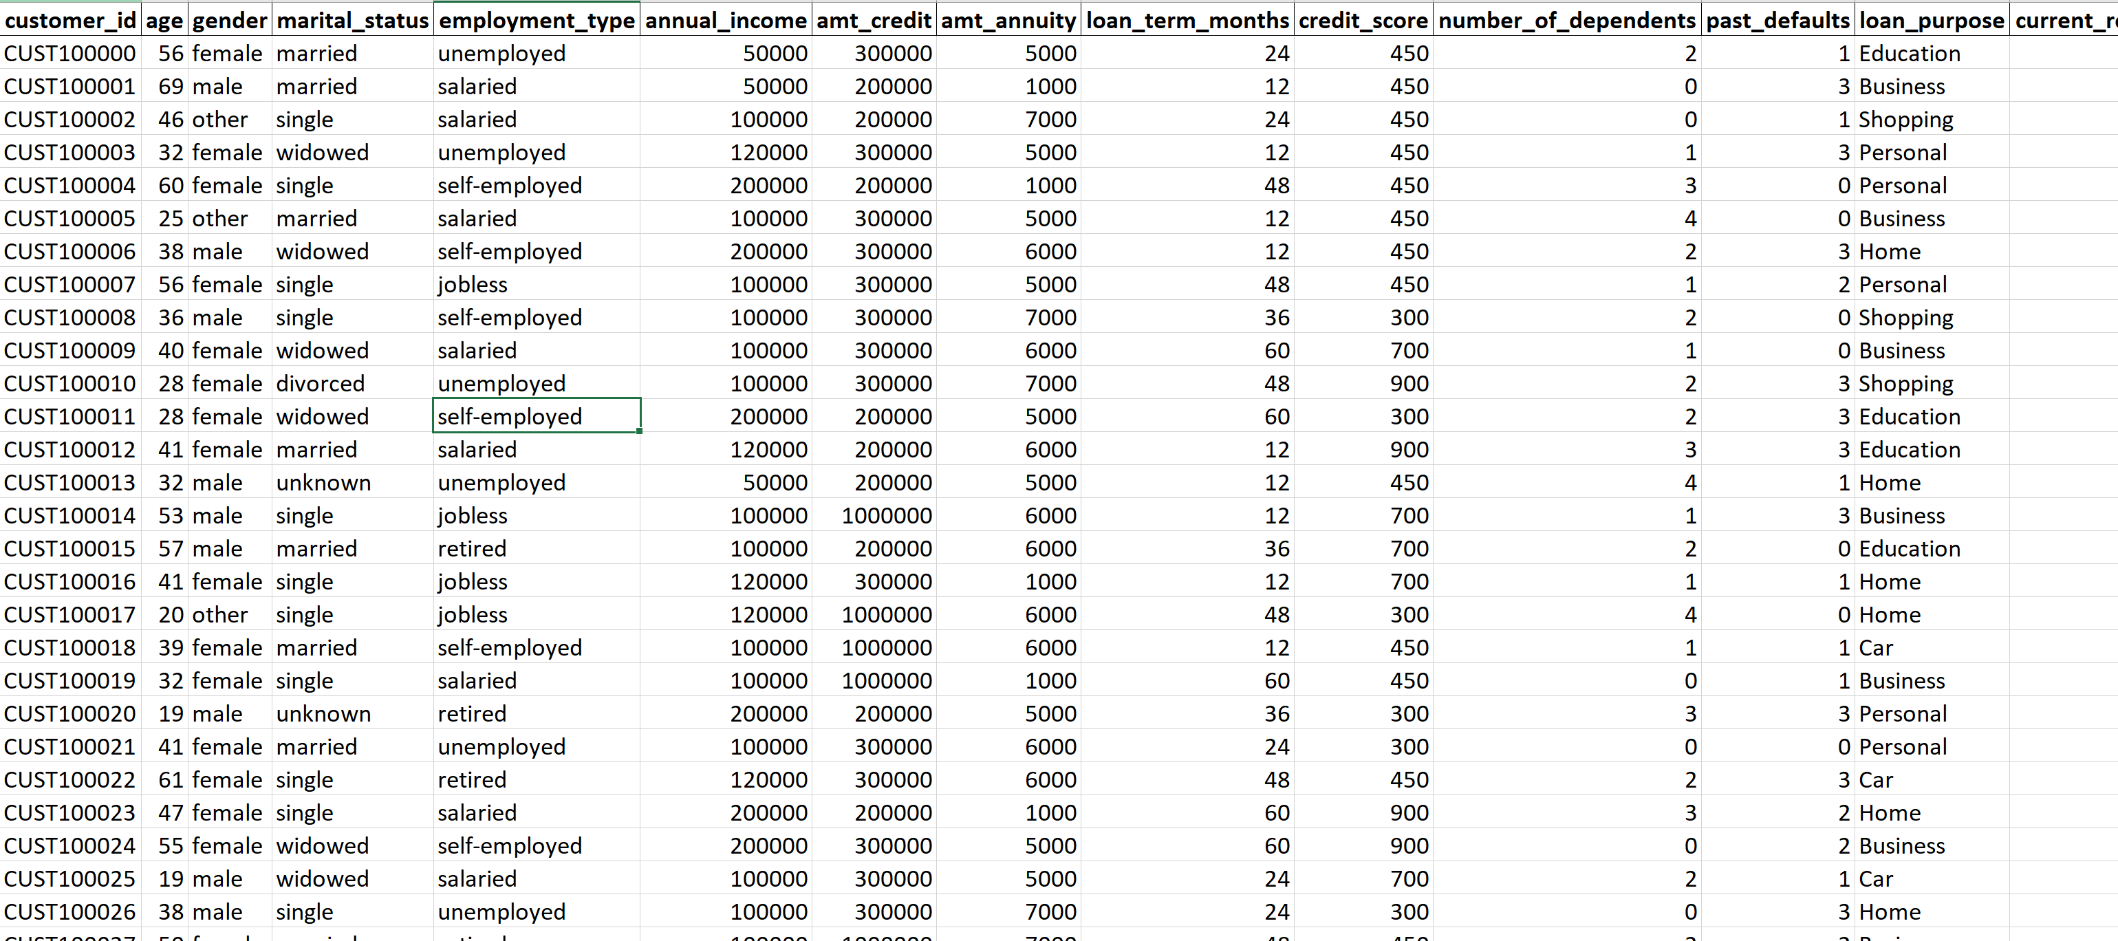

Slide 13



EXCEL DATA CLEANING & Formatting
Imported cleaned CSV file into Excel
Performed additional data checks using Excel formulas
Used Conditional Formatting to identify outliers
Export
Accessibility
Reporting
Validation
Verification
Accuracy
Highlighting
Detection
Analysis

Slide 14
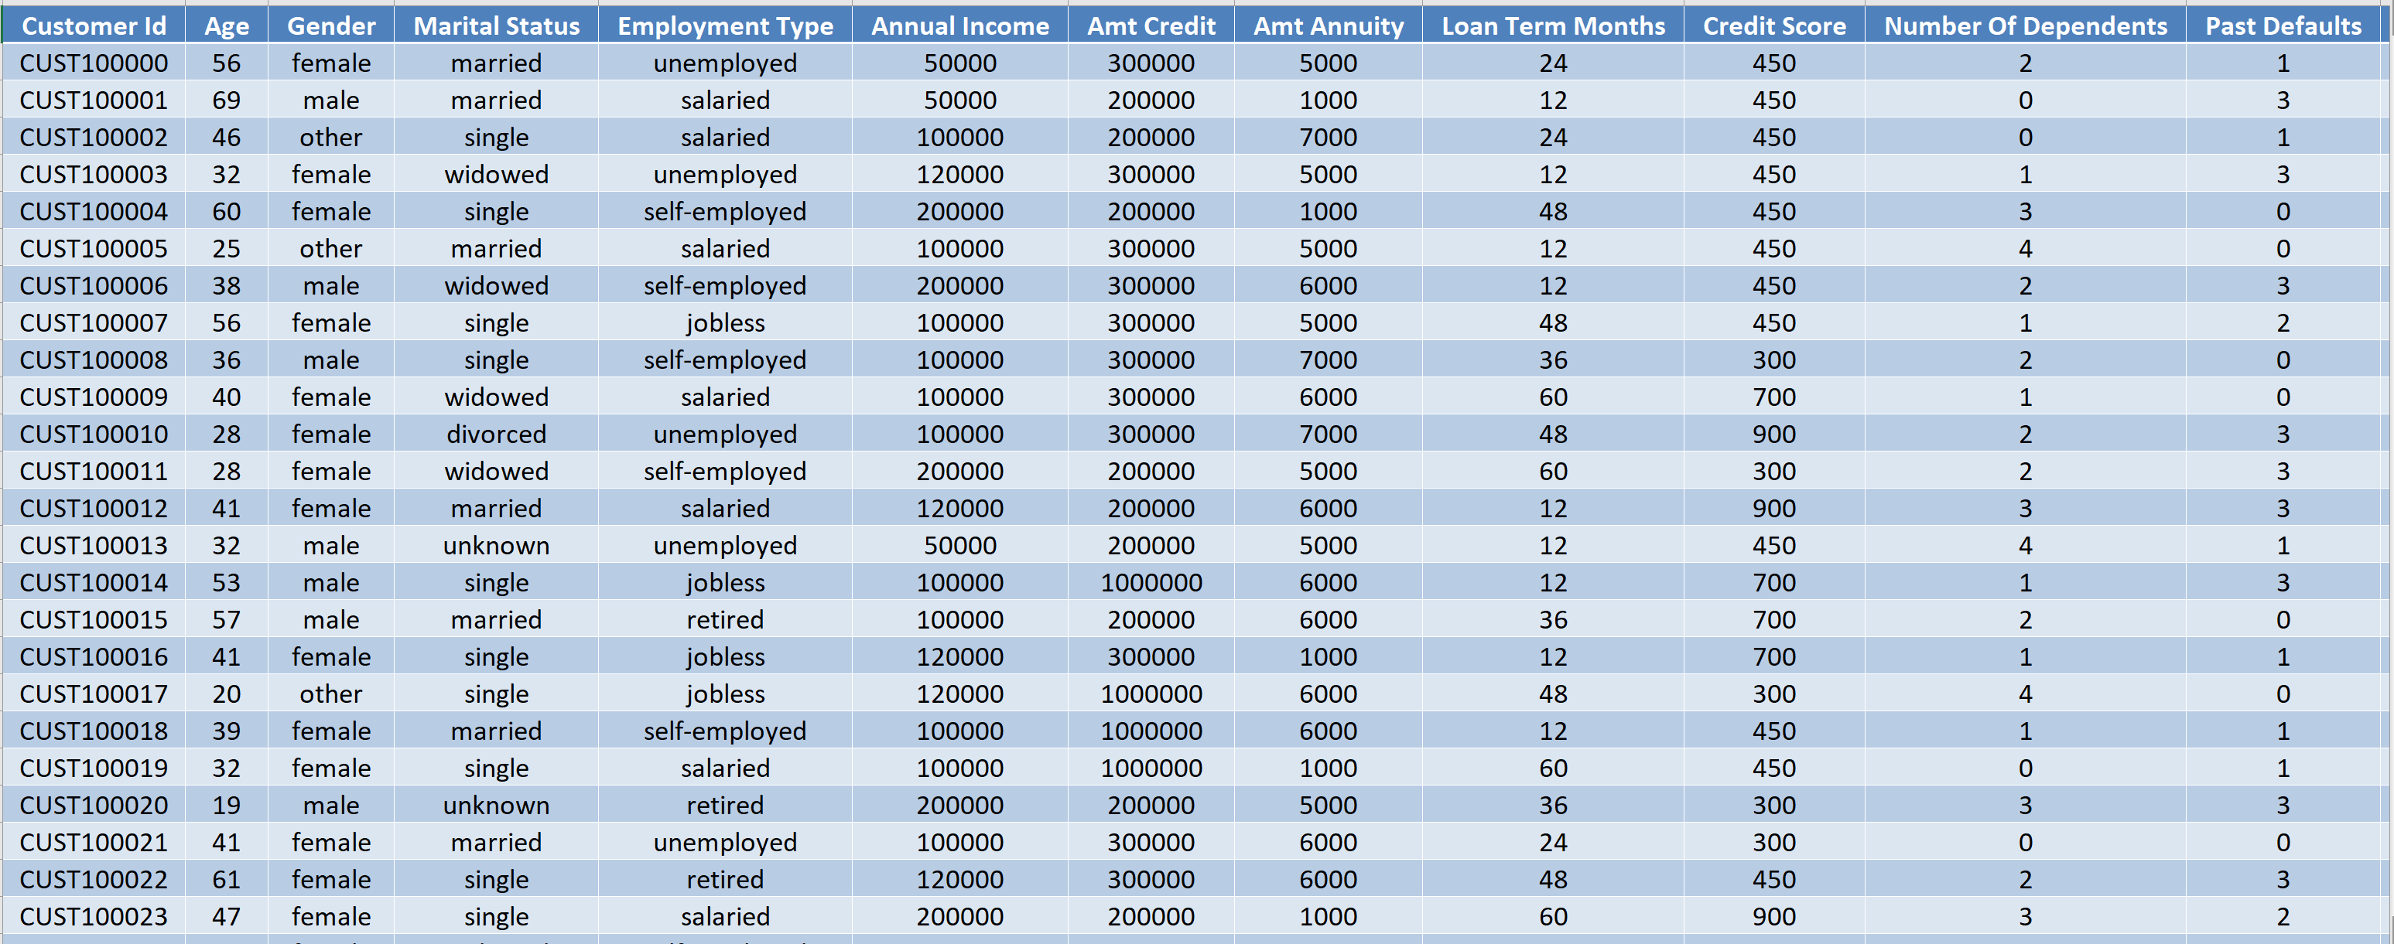

Slide 15





EXCEL DATA VISUALIZATION
Charts
Graphs
Dashboard
Comparison
Trend-analysis
Decision-making
Representation
Clarity
Understanding
Summary
Monitoring
Control
Trends
Insights
Growth
Analysis
Evaluation
Understanding
Awareness
Decision-making

Slide 16

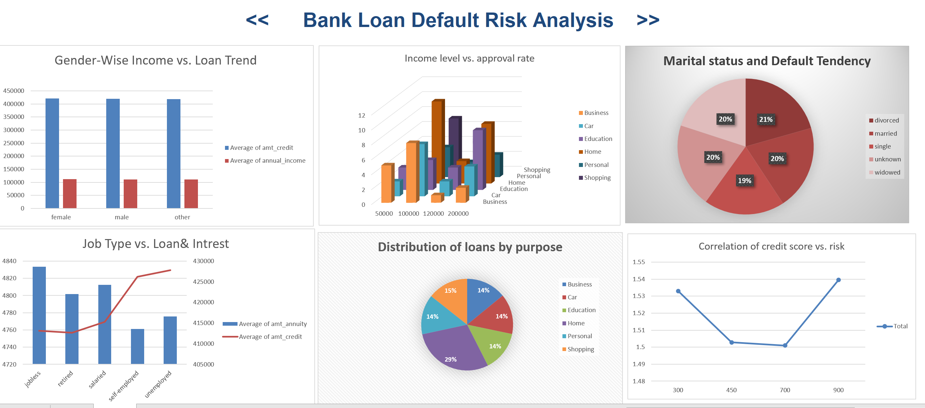

Slide 17






POWER BI DASHBOARD CREATION
Imported Excel data into Power BI
Designed an interactive dashboard with slicers and filters
Loan Status Overview, Credit Score Impact, Age Distribution
Import File (.xsls .csv .json )
Select Sheets or Tables
Accessibility
Select Report View
Select Chart (cluster column ,bar chart … )
Reformatt the chart from Build Visual
Select the data from sheets/tables
Comparison the chart
Visualization
Designed an interactive dashboard using slicers and filters
Included Debt-to-Income Ratio visualization to assess financial risk
Filtering
Customization
Exploration
Analysis
Assessment
Analysis Risk & Comparison Data
Adjust Slicing ,Filter ,Card & Charts

Slide 18



POWER BI DASHBOARD FEATURES
Filter by Age, Gender, Loan Type
Default Rate, and Average Income.
Helps To Analysis The Data
Analyzed how different age groups influence loan approval and default trends.
Compared loan performance and repayment behavior across genders.
Enabled users to customize views and gain targeted insights for better analysis.
Calculated the percentage of borrowers who failed to repay loans on time.
Examined how income levels affect the likelihood of loan default.
Displayed trends through bar and line charts for clear interpretation.
Measures the proportion of loans that were not repaid within the due period.
Shows the mean income level of borrowers in the dataset.
Assists banks in setting income-based eligibility and risk assessment criteria.

Slide 19
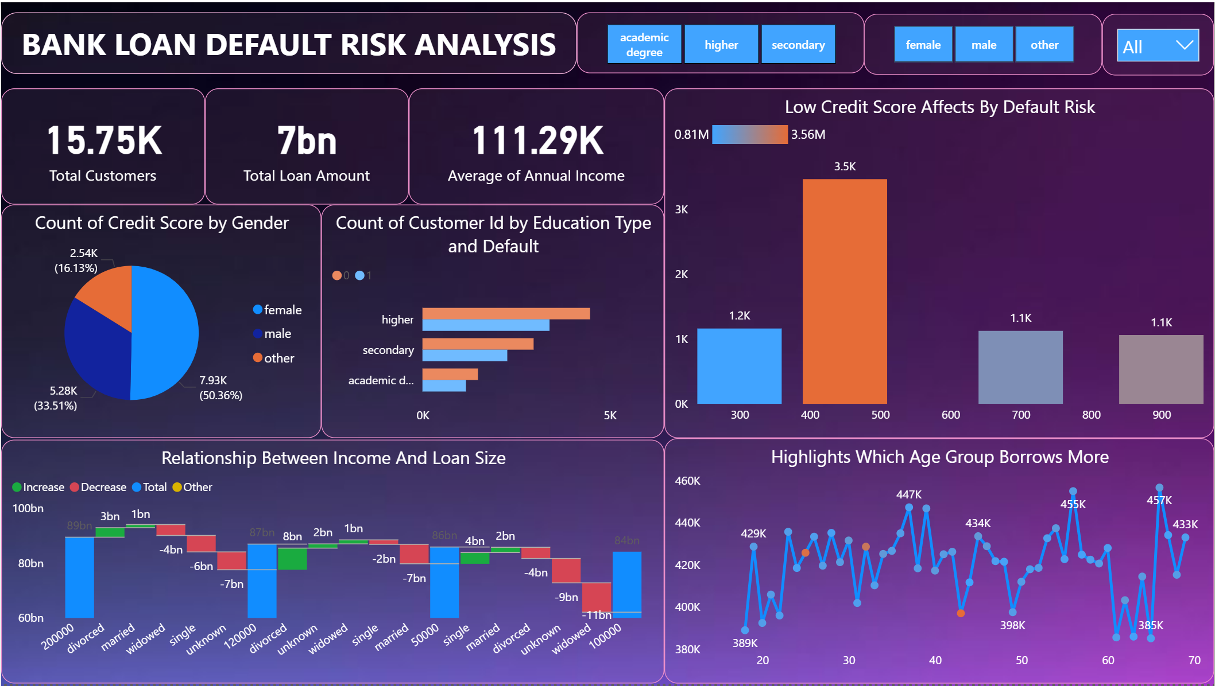

Slide 20



DATA VISUALIZATION INSIGHTS
Dashboard highlights default trends and key patterns
Easy identification of high-risk customer segments
Data-driven approach supports decision making
Displays how loan defaults vary over time and across borrower segments.
Reveals relationships between income, credit score, and default behavior.
Uses charts and graphs to make complex data easily understandable.
Classifies borrowers based on default probability and financial stability.
Helps focus on segments more likely to default for preventive action.
Enables banks to adjust loan terms or decline risky applications early.
Relies on real loan data instead of assumptions for analysis.
Enhances reliability in loan approvals and risk assessments.
Helps banks design effective lending policies and minimize financial losses.

Slide 21





BUSINESS IMPACT
Improved risk assessment for new applicants
Reduced financial losses from defaults
Enhanced decision-making through analytical insights
Analyzes applicants’ credit history, income, and financial stability.
Helps banks approve reliable applicants and reduce potential defaults.
Identifies potential defaulters before loan approval.
Enables banks to adjust interest rates or loan terms for high-risk borrowers.
Utilizes data models to forecast default probabilities accurately.
Presents complex data through clear, interactive visualizations.
Enhanced Risk Management
Reduced Financial Losses
Enabled early identification of high-risk borrowers.
Significantly reducing default risk and improving portfolio quality.
Helps adjust loan policies and interest rates for high-risk borrowers.
Minimizes bad debts and strengthens overall financial stability.

Slide 22



FUTURE IMPROVEMENTS
Integrate real-time credit score API
Add customer segmentation for targeted lending
Continuous improvement will enhance accuracy
Fetches borrower credit scores instantly during loan processing
Reduces manual verification time for quicker loan decisions.
Improves risk assessment by using real-time, verified credit data.
Groups customers based on income, credit score, and repayment behavior.
Helps identify and manage high-risk and low-risk borrower groups.
Enables banks to tailor loan products for each customer segment.
Regularly updates predictive models with new data for better accuracy.
Tracks model outcomes to identify areas for enhancement.
Strengthens decision-making efficiency and boosts long-term business value.

Slide 23



CONCLUSION
Customer Creditworthiness Insights
High default risk linked to low income and unstable jobs.
Regular repayments show strong credit behavior.
Model and Analysis Performance
Data cleaned using NumPy and Pandas.
Pivot tables and charts used for risk visualization.
Business Decision & Future Scope
Helps banks improve credit decisions.
Future scope: real-time data and ML-based prediction.

Slide 24

Thank you
Roshan Kumar
TEAM REPRESENTATIVE
roshantech08@gmail.com
www.linkedin.com/in/itz-roshan

