Slide 1


SMART INDIA HACKATHON 2024
TITLE PAGE
Problem Statement ID -SIH1587
Problem Statement Title- Student Innovation-Disaster Management includes ideas related to risk mitigation and Planning before, after or Duration of Disaster
Theme- Disaster Management
PS Category- Software
Team ID- DYP_SIH_29
Team Name (Registered on portal)-Phoenix Coders

Slide 2
IDEA TITLE
Phoenix
Coders
In India, with its vast population and diverse geography, effective disaster management is crucial. RAKSHA focuses on quick responsiveness, immediate aid, and fast dissemination of information, offering the public better, faster access to key resources. Our solution addresses disaster management across three critical phases of any calamity.
PHASES OF SOLUTION TO IMPROVE EFFICIENCY OF DISASTER MANAGEMENT
Pre Disaster
During The Disaster
Post Disaster
Early Warning System: Pre-calamity alerts from national authorities.
User Alerts: Local users create alerts, boosting awareness.
Enhanced Communication: Users can send SOS signals when regular methods fail.
Emergency Response System: Coordinates resources for timely rescue and relief.
Help Bot: Guides users through emergency steps.
Safe Shelter: Quickly locates shelters during emergencies.
Missing Person Reports: A dedicated interface allows users to report or search for missing individuals by uploading relevant details. Authorities or other users can help reunite people with their loved ones based on the shared information.
Remedial Aid: NGO support, Mental Health, Schemes & Insurance Policies.

Slide 3
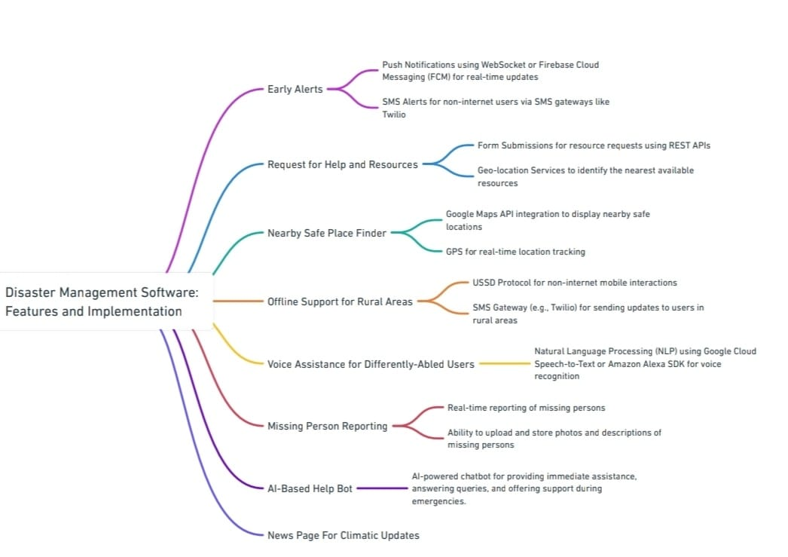
TECHNICAL APPROACH
Phoenix
Coders
Tech Stack:
Frontend: React, HTML5, CSS3, JavaScript, BootStrap.
Backend: Node.js, Express.js,Spring Boot, Python (for AI and NLP functions).
Database: MySQL.
APIs/Integrations: Google Maps API, Twilio (SMS), Dialogflow (AI chatbot),weather Api, Emergency service Api.
Cloud: AWS, Firebase (for real-time notifications).
Security: Spring Boot authentication, SSL encryption for data transmission.

Slide 4
FEASIBILITY AND VIABILITY
Phoenix
Coders
Feasibility:
Technical: Uses cloud services, APIs, and web frameworks for real-time data.
Financial: Moderate costs with potential NGO and government funding.
Operational: Useful for governments, NGOs, and citizens with regular updates.
Viability:
Sustainability: Partnerships with governments and organizations ensure longevity.
Revenue Model: Freemium or subscription-based models generate income.
Scalability: Cloud infrastructure supports global growth and new features.
Scalability:
Global Reach: Multi-language support.
Modular Expansion: Add features without disrupting the system.
Non-Internet Access: SMS alerts for non-internet phones
Radio-Station : Alerts sent trough Radio channels.
Voice Assistance: Voice commands for differently-abled users.
Collaboration: Integrates with third-party services and NGOs for real-time data.
Security:
Data Accuracy: Validate and update data regularly.
Traffic Management: Use cloud services and load balancers for scaling.
Cybersecurity: Strong encryption, firewalls, and regular audits.
Privacy Compliance: Enforce data protection and user consent.

Slide 5
IMPACT AND BENEFITS
Phoenix
Coders
Impacts:
Benefits:
1. Improves Preparedness: Provides real-time alerts.
2. Enhances Coordination: Streamlines communication for faster response.
3. Optimizes Resources: Efficiently allocates supplies and personnel.
4. Enables Quick Decisions: Supports data-driven evacuation and relief choices.
5. Increases Accessibility: Offers SMS alerts and voice assistance.
6. Speeds Recovery: Assists in damage assessment and rebuilding.
Social: Provides inclusive support for differently-abled groups, strengthens community collaboration, and reduces casualties through timely alerts.
Economic: Minimizes damage, lowers costs with efficient resource distribution, and accelerates business recovery.
Environmental: Reduces environmental impact, promotes sustainable rebuilding, and conserves resources.
This system also allows us to analyze the calamities of past and learn from them for a better future
In essence, the software provides timely, organized, and accessible disaster response, saving lives, reducing economic losses, and helping communities recover faster prioritizing sustainability.

Slide 6
RESEARCH AND REFERENCES
Phoenix
Coders
Research Links:
Reference Links:
Wit press report:
https://www.witpress.com/Secure/elibrary/papers/DMAN11/DMAN11008FU1.pdf
Uttarakhand State Disaster Management Authority Research Papers:
https://usdma.uk.gov.in/IEC/research-papers-32.aspx
NIDM research and Case studies:
https://nidm.gov.in/research.asp
Disaster Management in India – United Nations:
https://www.undp.org/india/publications/disaster-management-india-status-report
Kerala State Disaster Management Authority: https://sdma.kerala.gov.in/
Japan International Cooperation Agency: https://www.jica.go.jp/english/about/
Australian Government National Emergency Management Agency: https://nema.gov.au/#/map

