Slide 1

Endorse Collect Project Presentation Date: 21/09/2024
Industrial Training (ECS 591)
B.Tech CSE (5th Sem)
Project Guide:
Mr. Divyanshu Saxena
Jain Aman Ajay
TCA2209075
COLLEGE OF COMPUTING SCIENCES AND INFORMATION TECHNOLOGY
TEERTHANKER MAHAVEER UNIVERSITY, MORADABAD

Slide 2

Team Details
Student Name | Role
Jain Aman Ajay | Full-Stack Developer
Guidelines: Mention Team Names & their role in project
2
T011A/ Template Version 5.0

Slide 3
Project Brief
Endorse Collect is a web-based platform designed to simplify the process of collecting, organizing, and displaying client testimonials.
The scope of the project includes developing a responsive frontend using Next.js, a secure backend with Node.js and MongoDB, and deploying the application on Vercel for scalability and reliability.
The platform is structured into modules such as testimonial creation, management, and display, each designed to provide a seamless user experience.
Guidelines: Mention brief about the project and it’s functions/ modules
3
T011A/ Template Version 5.0

Slide 4
Methodologies/ Technologies/ Tools to be used
Frontend:
Next.js (React framework for server-side rendering and static site generation)
Tailwind CSS (for responsive and modern UI design)
Backend:
Node.js (for server-side logic)
Express.js (to handle API routing)
MongoDB (NoSQL database for storing testimonials)
Deployment:
Vercel (for hosting and deployment, ensuring scalability and speed)
Tools:
Development Environment: Visual Studio Code.
Version Control: Git, GitHub
API Testing Tool: Postman
4
T011A/ Template Version 5.0

Slide 5
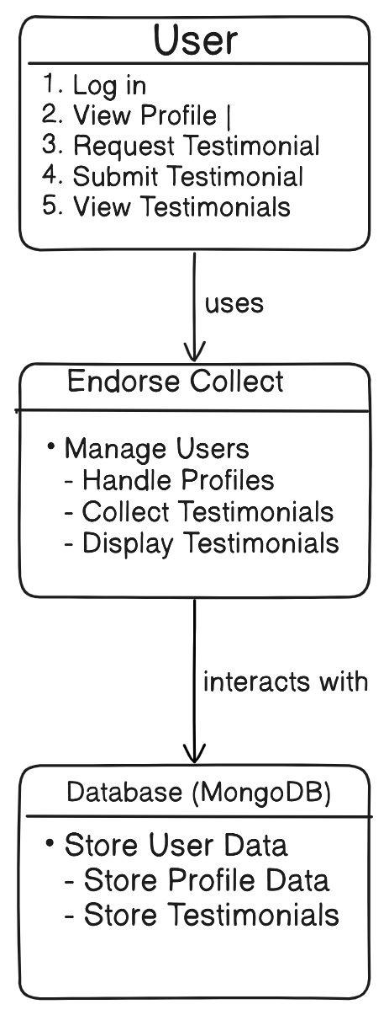
Context Diagram (Overall Project)
5
T011A/ Template Version 5.0

Slide 6
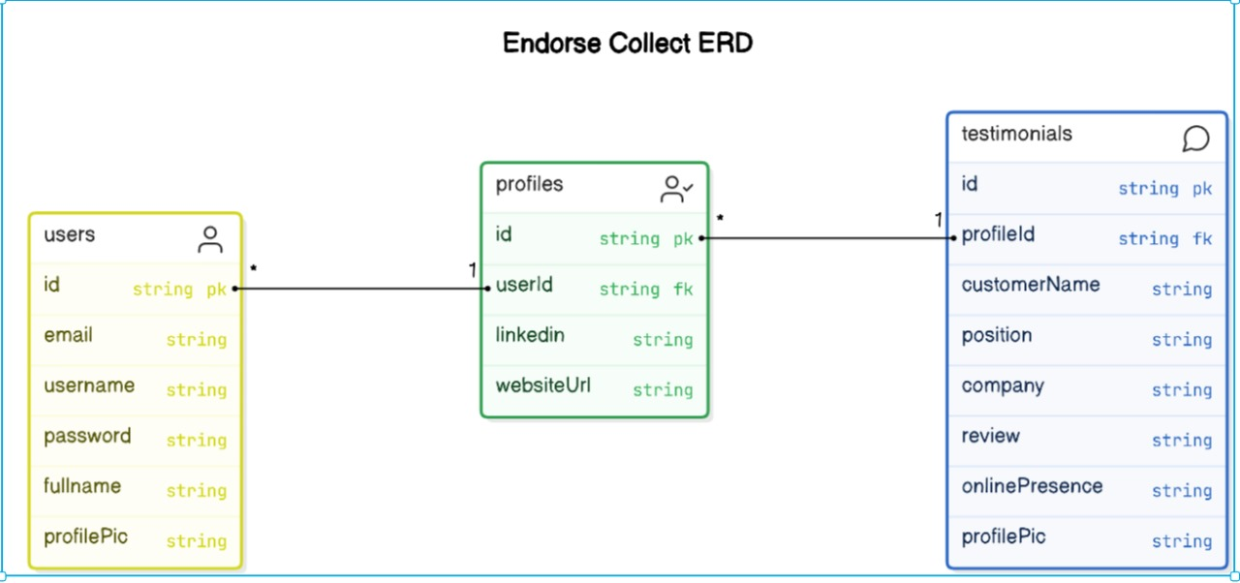
Entity Relationship Diagram (ERD)
6
T011A/ Template Version 5.0

Slide 7
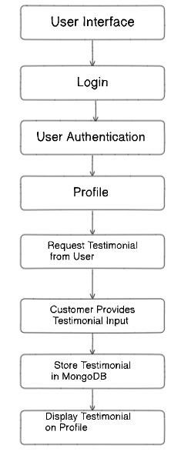
Data Flow Diagram (DFD)
Guidelines: Add more slides, if required to show all DFDs
7
T011A/ Template Version 5.0

Slide 8
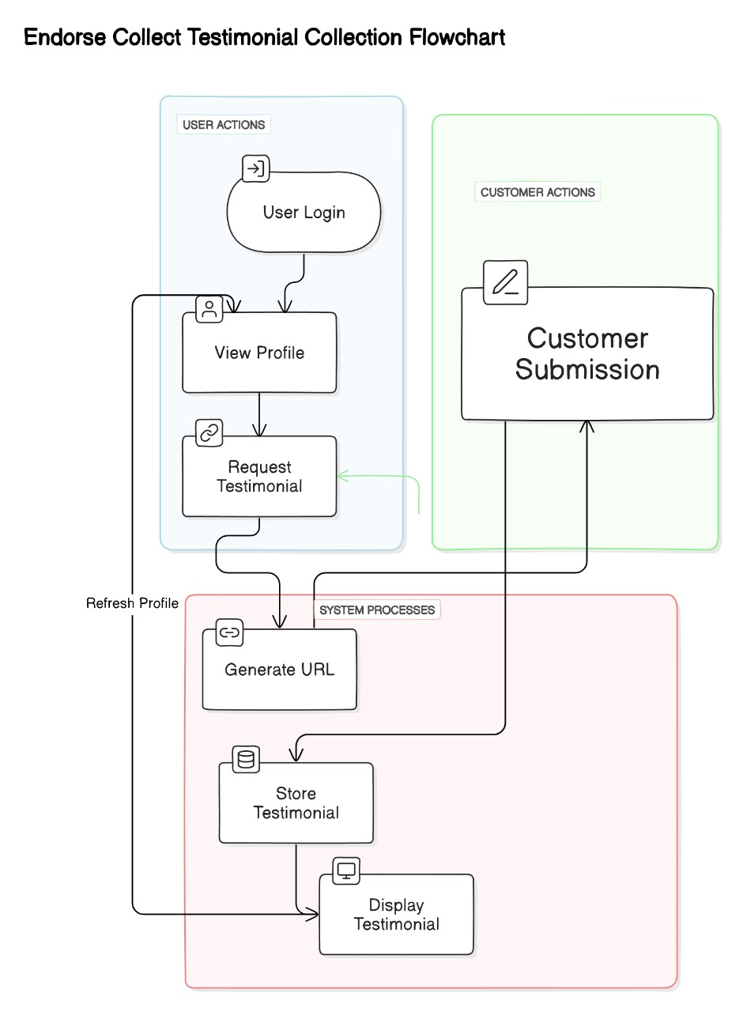
Flow Chart
Guidelines: This slide is optional
8
T011A/ Template Version 5.0

Slide 9
\
Advantage of The Project
• Streamlined Testimonial Management:
Easily collect, organize, and manage client testimonials in one centralized platform.
• User-Friendly Interface:
The intuitive design ensures that users can navigate the platform and manage testimonials with ease.
• Improved Credibility:
Displaying authentic client feedback helps businesses build trust and enhance their reputation.
• Responsive Design:
Accessible across all devices, ensuring a seamless experience for users on mobile and desktop.
Guidelines: Mention advantage from this project, the audience/ users who will get benefitted
9
T011A/ Template Version 5.0

Slide 10
References, if any
Next.js Documentation: https://nextjs.org/docs
MongoDB Documentation: https://docs.mongodb.com/
Node.js Documentation: https://nodejs.org/en/docs/
Vercel Deployment Guide: https://vercel.com/docs
10
T011A/ Template Version 5.0

Slide 11
THANKS

