Slide 1
TECHNICAL PROJECT PRESENTATION
UNO
UNO
UNO
UNO
WILD CARDS
Browser Multiplayer UNO — Reimagined for the Web
A production-quality, real-time card game playable instantly in any browser — no downloads, no accounts. Powered by a server-authoritative engine and a globally distributed realtime layer.
React 19
TypeScript
TanStack Start
Cloudflare Workers
Durable Objects
WebSockets
D1 SQLite
2–8 players · private rooms · smart bots · cross-device realtime

Slide 2
PRESENTATION OUTLINE
Agenda
1
01 Overview
7
07 Game Engine
What WildCards is and why it exists
Server-authoritative UNO rules
2
02 Problem & Objectives
8
08 Data, Auth & Multiplayer Flow
The gaps it addresses and the goals set
Sessions, persistence, live play
3
03 Key Features
9
09 Deployment & CI/CD
What players actually get
Shipping to the edge
4
04 Technology Stack
10
10 Performance, Security & Challenges
Every layer, framework and library
Hard problems, real answers
5
05 System Architecture
11
11 Demo & Next Steps
How the pieces fit together
See it live, then what's next
6
06 Realtime Transport
The auto-selecting delivery layer
WILD CARDS · Technical Project Presentation
2

Slide 3
WHAT IS WILDCARDS
Project Overview
WildCards is a production-quality, browser-based multiplayer implementation of the classic card game UNO. A single invite link drops players straight into a live game — the room is created instantly, bots fill empty seats, and every move is validated by an authoritative server so the rules can never be cheated.
2–8
≈30s
100%
0
players per room
turn timers keep games moving
server-authoritative rules
accounts or downloads required
One codebase, three environments
The frontend runs as a static site; TanStack Start powers SSR and type-safe server functions; a Cloudflare Worker + Durable Object hosts each room as a globally addressable relay. The same code deploys across tabs, browsers and devices.
WILD CARDS · Technical Project Presentation
3

Slide 4
WHY REBUILD A CLASSIC GAME
Problem Statement
1
Physical UNO is slow
2
Real-time multiplayer is hard
Setup, shuffling, rule disputes and scorekeeping interrupt the fun. Games can't happen without everyone in the same room.
State sync, latency, reconnects and fairness are notoriously difficult to get right — most web games cheat by trusting the client.
3
Most web clones feel broken
4
Trusting the client breaks the game
Dead lobbies, logins required, ads, slow servers, or single-device demos that fall apart under real concurrent play.
A client-authoritative card game can be modified to draw cards, see hands, or win instantly — fair play demands the server make every decision.
WILD CARDS · Technical Project Presentation
4

Slide 5
GOALS THAT SHAPED EVERY DECISION
Project Objectives
01 Instant, frictionless play
One click to start against bots; one invite link to gather friends. No signup, no downloads, no installs.
02 Server-authoritative fairness
Cards are dealt, shuffled and validated on the server. Clients only ever receive their own hand.
03 Rock-solid realtime
WebSockets by default, graceful fallbacks, reconnection, and a live poller that keeps every client converged on the same state.
04 A complete UNO ruleset
Draw-2 / Wild+4 stacking chains, missed-UNO penalties, skips, reverses, wild color selection, and automatic turn timeouts.
05 Professional engineering
Strict TypeScript, deterministic engine, CI pipeline with typecheck + build + lint, and a deployable edge architecture.
WILD CARDS · Technical Project Presentation
5

Slide 6
WHAT PLAYERS GET
Key Features
Instant play vs smart bots
Private rooms & invite links
Cross-device realtime
Start a match in one click; intelligent bots fill empty seats and follow the same rules as humans.
A 6-letter code and a shareable URL — up to 8 players join from any device or network.
Auto-selecting transport keeps every player in sync with live turn timers and a move log.
Full UNO rule engine
Stats & leaderboard
Polished, animated UI
Stacking +2 / +4 chains, missed-UNO penalties, skips, reverses, wild color picker, turn timeouts.
Guest profiles track wins, score and history with a global leaderboard — no account required.
Framer-Motion card physics, glassmorphism, dark theme, and full responsive layouts.
WILD CARDS · Technical Project Presentation
6

Slide 7
EVERY LAYER, FRAMEWORK AND LIBRARY
Technology Stack
Frontend
Backend & Infrastructure
React 19
TypeScript 5
Vite 8
TanStack Router
Cloudflare Workers
Durable Objects
TanStack Start
TanStack Query
Zustand
D1 (SQLite)
Hono
WebSockets
Tailwind CSS 4
Framer Motion
Radix UI
Zod
Supabase Realtime
BroadcastChannel
Recharts
JWT auth
Wrangler CLI
GitHub Actions
Game engine: pure, deterministic TypeScript
The core UNO logic (deck building, shuffling, turn order, stacking, scoring) lives in a zero-dependency TypeScript module. Being deterministic, it can run identically on the server for validation and in tests for verification.
WILD CARDS · Technical Project Presentation
7

Slide 8
HOW THE PIECES FIT TOGETHER
System Architecture
CLIENT
TANSTACK START SERVER
ROOM SERVER
Browser app
React 19 UI · TanStack Router
reads server-authoritative state
SSR + type-safe Server Functions
REST actions · guest auth
writes to room & DB
Cloudflare Worker + Durable Object
WebSocket relay · roster
authoritative state snapshot
D1 · SQLITE
AUTH
profiles · game history
leaderboard · stats
guest sessions · JWT
localStorage persistence
REALTIME TRANSPORT — auto-selecting, in priority order
1
WebSocket → Durable Object
2
Supabase Realtime Broadcast
3
BroadcastChannel
primary path — the Worker relays every event to all connected peers
fallback when the WS origin isn't configured or reachable
same-browser, cross-tab rooms with zero network
WILD CARDS · Technical Project Presentation
8

Slide 9
A MODERN TANSTACK APPLICATION
Frontend Architecture
File-based routing
TanStack Router with typed routes — landing, play, lobby, room/:code, leaderboard, profile.
Server Functions
getRoom / joinRoom / submitAction are type-safe RPCs the client calls like local functions.
Authored state, live UI
Zustand + React Query cache server state; local mirrors for instant, optimistic interaction.
Component library
Radix UI primitives, Tailwind design tokens, Framer Motion for card play animations.
Realtime client
A transport abstraction sends 'sync' nudges and reacts to peer messages by re-pulling authoritative state.
WILD CARDS · Technical Project Presentation
9

Slide 10
CLOUDFLARE WORKERS AT THE EDGE
Backend Architecture
One Durable Object per room
Rooms are keyed by code and live as globally addressable, co-located objects — instant, region-aware relay with persistent state.
1
WebSocket relay
The DO accepts sockets, binds identity to each connection, and fans every message out to the roster. Newcomers and reconnects get a full state snapshot.
2
Identity over the wire
A player can never impersonate another — identity is bound to the socket, and every action must carry the same playerId.
3
Server functions as the API
Join, start, act and leave are server functions that validate tokens, enforce rules, persist to D1, and return the authoritative state.
4
CORS + upgrade handling
The Worker handles OPTIONS and WebSocket upgrades with a single, shared CORS policy.
5
WILD CARDS · Technical Project Presentation
10

Slide 11
RELIABILITY THROUGH GRACEFUL DEGRADATION
Realtime Transport Layer
Every client sends two signals:
→ sync nudges “something changed, re-pull”
→ join / leave / hello roster events
LAYER 1
WebSocket → Durable Object
Primary path. The Worker fans out events to every peer over a persistent socket. Reconnect-safe: newcomers receive the full latest state.
LAYER 2
Supabase Realtime Broadcast
Fallback transport. Broadcasts channeled through Supabase when the WS origin is not deployed or reachable.
LAYER 3
BroadcastChannel (same browser)
Local fallback. Cross-tab rooms on the same machine need zero network — perfect for demos and quick multiplayer.
A 3-second poller re-pulls authoritative state regardless of transport, so clients always converge even if a push is missed.
WILD CARDS · Technical Project Presentation
11

Slide 12
PURE, DETERMINISTIC TYPESCRIPT — ZERO DEPENDENCIES
Server-Authoritative Game Engine
Deterministic core
The same pure functions create games, apply actions and score rounds — the server is the single source of truth.
Strict move validation
Every play is checked: is it this player's turn, is the card legal, is a color chosen for wilds, is the +2/+4 stack respected?
Full UNO ruleset
Skip, reverse (acts as skip with 2 players), draw-2 and wild+4 stacking chains, wild color selection, missed-UNO penalty (+2).
Automatic turn timeouts
A 30s timer auto-draws for idle players so games never stall.
Scoring
Winners bank the face value of every card left in opponents' hands — numbers, 20 for action cards, 50 for wilds.
engine.ts createGame() · applyAction() · canPlay() · legalCards() · handleTimeout()
WILD CARDS · Technical Project Presentation
12

Slide 13
SESSIONS, PERSISTENCE AND LIVE PLAY
Data, Auth & Multiplayer Flow
Guest-first identity
Live multiplayer loop
Guest sessions
1
Create / Join
No signup — a local profile (id, name, avatar) is created on first visit.
room code + token
2
Connect transport
JWT per room
WS / Supabase / BC
Joining a room returns a token stored in localStorage; every action carries it.
3
Dispatch action
D1 persistence
play · draw · uno · color
Profiles, game history, wins and leaderboard stats are persisted in SQLite.
4
Engine validates
turn + legality + rules
Privacy by design
Clients only ever receive their own hand — opponents' cards never leave the server.
5
Authoritative state
fan-out to all peers
WILD CARDS · Technical Project Presentation
13

Slide 14
SHIP TO THE EDGE, VERIFY EVERY COMMIT
Deployment & Continuous Integration
Deployment targets
CI pipeline — GitHub Actions
FRONTEND
Cloudflare Pages — static build of the React app, edge-cached, globally distributed.
Typecheck
tsc --noEmit
strict, no silent type drift
BACKEND
Cloudflare Workers — Durable Object room server deployed via wrangler.
Build
vite build
production bundle compiles
REALTIME
WebSocket origin on the Worker; Supabase channels as fallback.
Lint
eslint .
DATABASE
Cloudflare D1 (SQLite) for profiles, history and leaderboard.
code quality gates
One command to deploy
cd worker && wrangler deploy — then point VITE_REALTIME_WS_URL at the new wss:// origin. The frontend builds and ships independently.
WILD CARDS · Technical Project Presentation
14

Slide 15
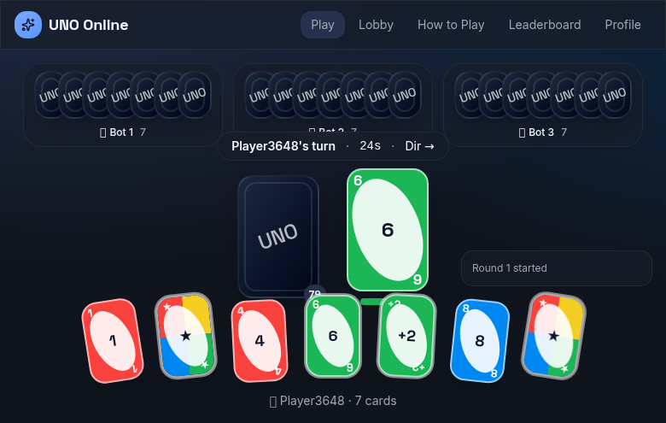
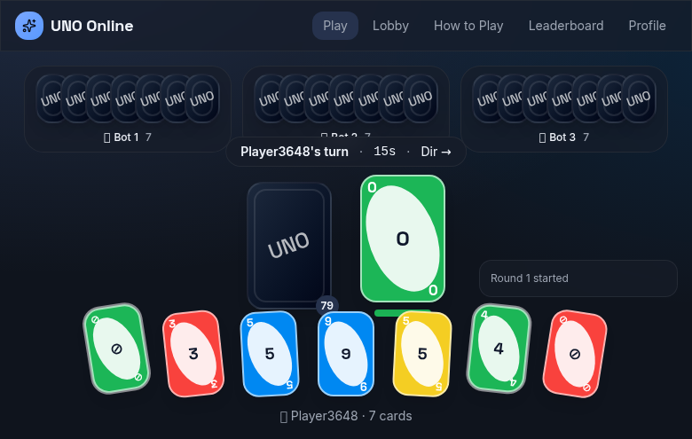
FROM MATCH SETUP TO THE WINNING CARD
Gameplay Experience
Choose your challenge — bots or a private room
Live board — opponents, deck, discard pile, turn timer and move log
WILD CARDS · Technical Project Presentation
15

Slide 16
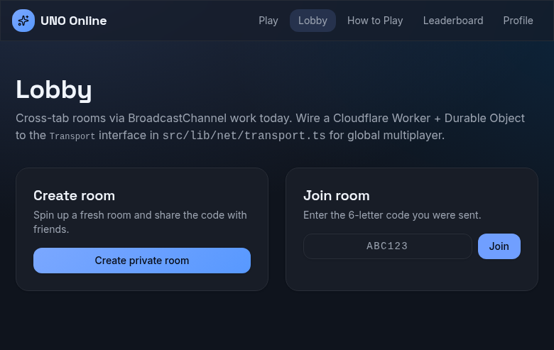
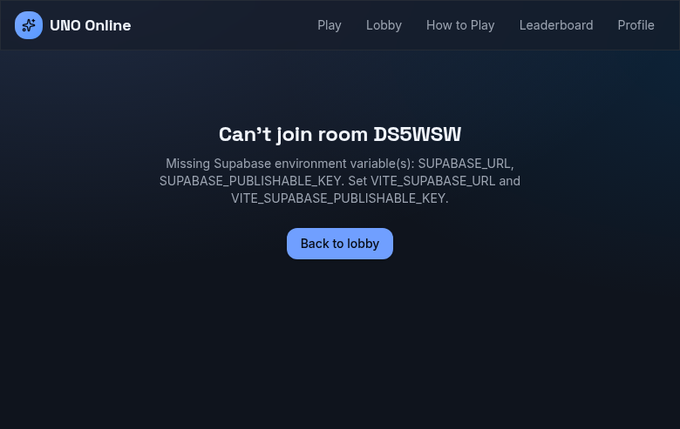
GATHER THE CREW IN SECONDS
Private Rooms & Lobby
Create or join a room by 6-letter code
Room lobby — copy invite link, host starts when ready
How it works: Host opens a room → gets a code + link → shares it → players join from any device → the host deals the first round.
WILD CARDS · Technical Project Presentation
16

Slide 17
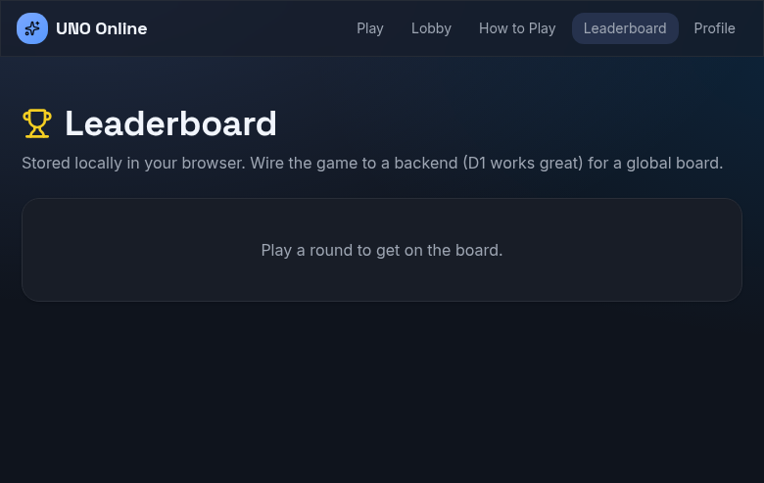
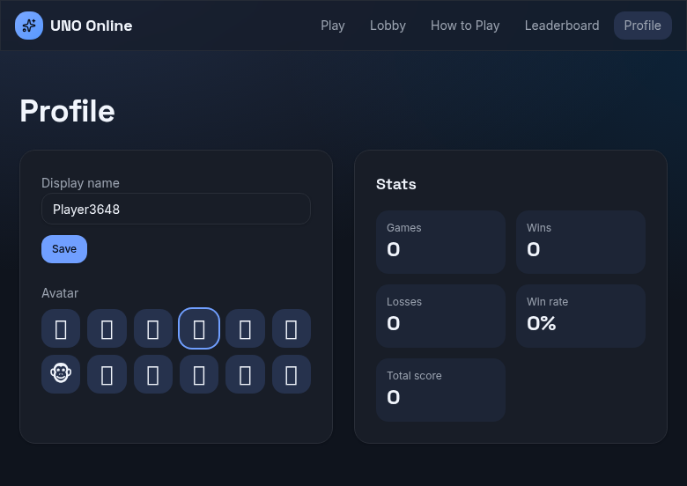
EVERY GAME COUNTS
Stats & Progression
Global leaderboard — win streaks and totals
Personal profile — games, wins and history
No accounts: a guest profile follows the player across sessions via local storage; leaderboard stats are server-persisted in D1.
WILD CARDS · Technical Project Presentation
17

Slide 18
ENGINEERING UNDER PRESSURE
Performance, Security & Reliability
PERFORMANCE
SECURITY
RELIABILITY
Edge-distributed rooms
Server-authoritative
Graceful transport fallback
Durable Objects run close to players; static assets are served from the Cloudflare edge cache.
No client trust: dealing, shuffling, legality and scoring all happen server-side.
WS → Supabase → BroadcastChannel with a 3s poller that guarantees convergence.
Slim realtime protocol
Socket-bound identity
Reconnect snapshots
Only 'sync' nudges and roster events travel the wire — state is pulled once, rendered locally.
Actions carry the same playerId as the socket — impersonation is structurally impossible.
Late joiners and reconnects receive the full authoritative state instantly.
Lazy hydration
JWT room tokens
CI enforcement
Client routes hydrate only when needed; animations are GPU-friendly.
Every room action is authenticated; tokens persist per room in localStorage.
Typecheck, build and lint gate every commit to prevent regressions.
Hand privacy
A player never receives opponents' cards — the server only broadcasts results.
WILD CARDS · Technical Project Presentation
18

Slide 19
REAL PROBLEMS, ENGINEERED ANSWERS
Challenges & Solutions
1
Realtime that survives anything
Solution: Built an auto-selecting transport (WS → Supabase → BroadcastChannel) plus a 3s state poller, so clients always converge even when a push is lost.
Issue: Fragile single-channel WebSockets.
2
Cheat-proof multiplayer
Solution: Moved every decision into a deterministic server engine; clients receive only their own hand and can only nudge peers to re-pull state.
Issue: Client-authoritative games are trivially hackable.
3
Concurrency in card games
Solution: Room sequence numbers, socket-bound identity, and re-fetch-on-nudge semantics make every action idempotent and self-healing.
Issue: Double-plays, stale actions, race conditions.
4
Type-safety across the wire
Solution: Zod-validated search params and shared types between client and server functions keep the contract compile-time checked end to end.
Issue: Mismatched client/server contracts.
5
Keep the build green
Solution: CI runs typecheck, build and lint; a strict ESLint config (including the no-control-regex edge case) keeps the pipeline passing.
Issue: Every commit risks regressions.
WILD CARDS · Technical Project Presentation
19

Slide 20
WHERE WILDCARDS GOES NEXT
Future Scope
Accounts & OAuth
Matchmaking & ladder
AI difficulty tiers
Let players claim their guest profile with email or social login and sync stats across devices.
Ranked queues, ELO-style ratings and seasonal leaderboards for competitive play.
Smarter bots with personality: aggressive, defensive and classic-strategy models.
Mobile-first & PWA
Tournaments
Spectator mode
Installable offline shell, touch-optimized controls, and push-friendly room invites.
Brackets, timed events and custom house rules for organized play.
Watch live rooms with a full move history and commentary.
WILD CARDS · Technical Project Presentation
20

Slide 21
SEE IT IN ACTION
Live Demo
What we'll run through:
1
Start a game vs bots
One click — bots fill the table and the first hand is dealt.
2
Open a private room
Create a room, copy the invite link, join from a second tab/device.
3
Play a full turn
Legal plays, wild color choice, draw, and the live turn timer.
4
Trigger an edge case
Say UNO late, start a +2 / +4 chain, and watch the server enforce it.
5
Check the scoreboard
Finish a round and see the profile + leaderboard update.
Run locally
pnpm dev — then open http://localhost:3000 and pick Play vs Bots or Create a Room.
WILD CARDS · Technical Project Presentation
21

Slide 22
THANK YOU
Questions welcome
WildCards — browser multiplayer UNO, reimagined for the web.
React 19 · TypeScript · TanStack Start · Cloudflare Workers · Durable Objects · D1 · WebSockets

