Slide 1
Analytics Ascend 2024
User Interaction Data Analysis
Team Name: Analytico
Presented by: DINESH S
Date: 3-12-2024
View at : GITHUB

Slide 2
Introduction
The goal of this case study is to analyze user interaction data from a platform to derive actionable insights, identify trends, and recommend strategies for enhancing User Engagement , Retention ,Revenue Generation

Slide 3
Table of contents
- Dataset Overview
Data Exploration
Segmentation
Data Visualization
Predictive Modeling
Insights and Recommendations
Conclusion

Slide 4
Dataset Overview
Demographics (e.g., Age, Gender)
Activity Data (e.g., Last Activity Date, Total Wager)
Financial Transactions (e.g., Total Deposit, Total Withdrawal)
Game Participation (e.g., Total Game Count)

Slide 5
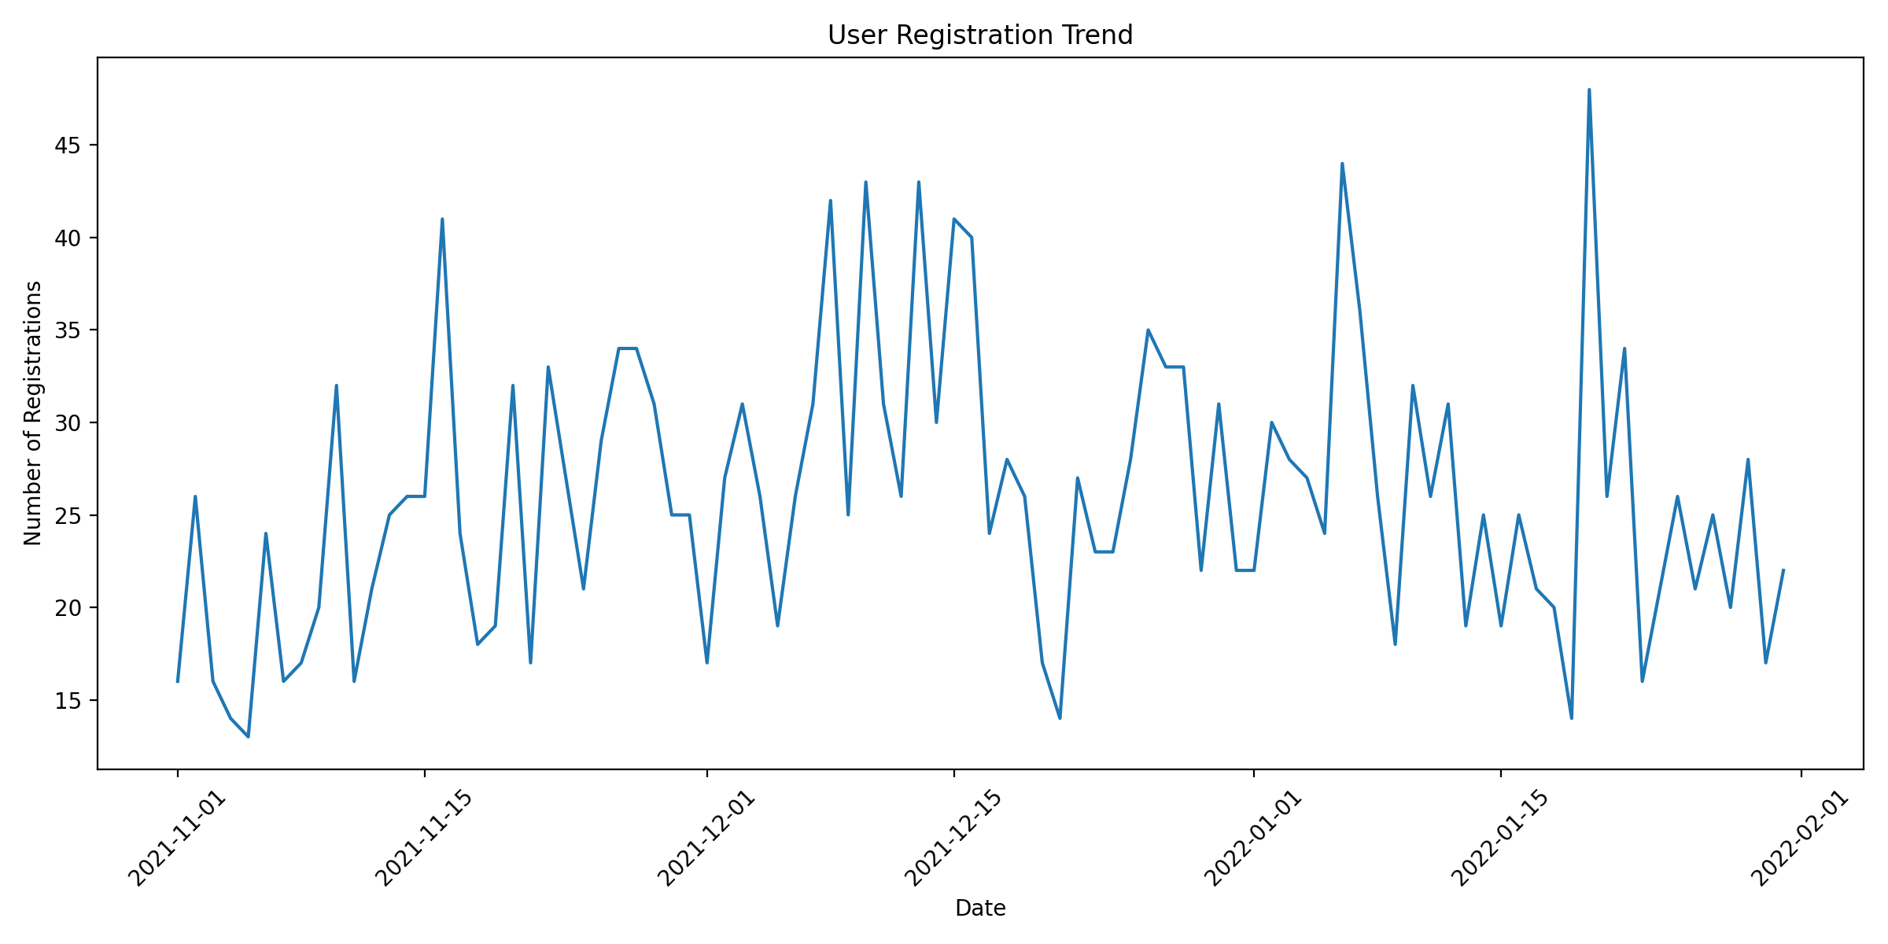
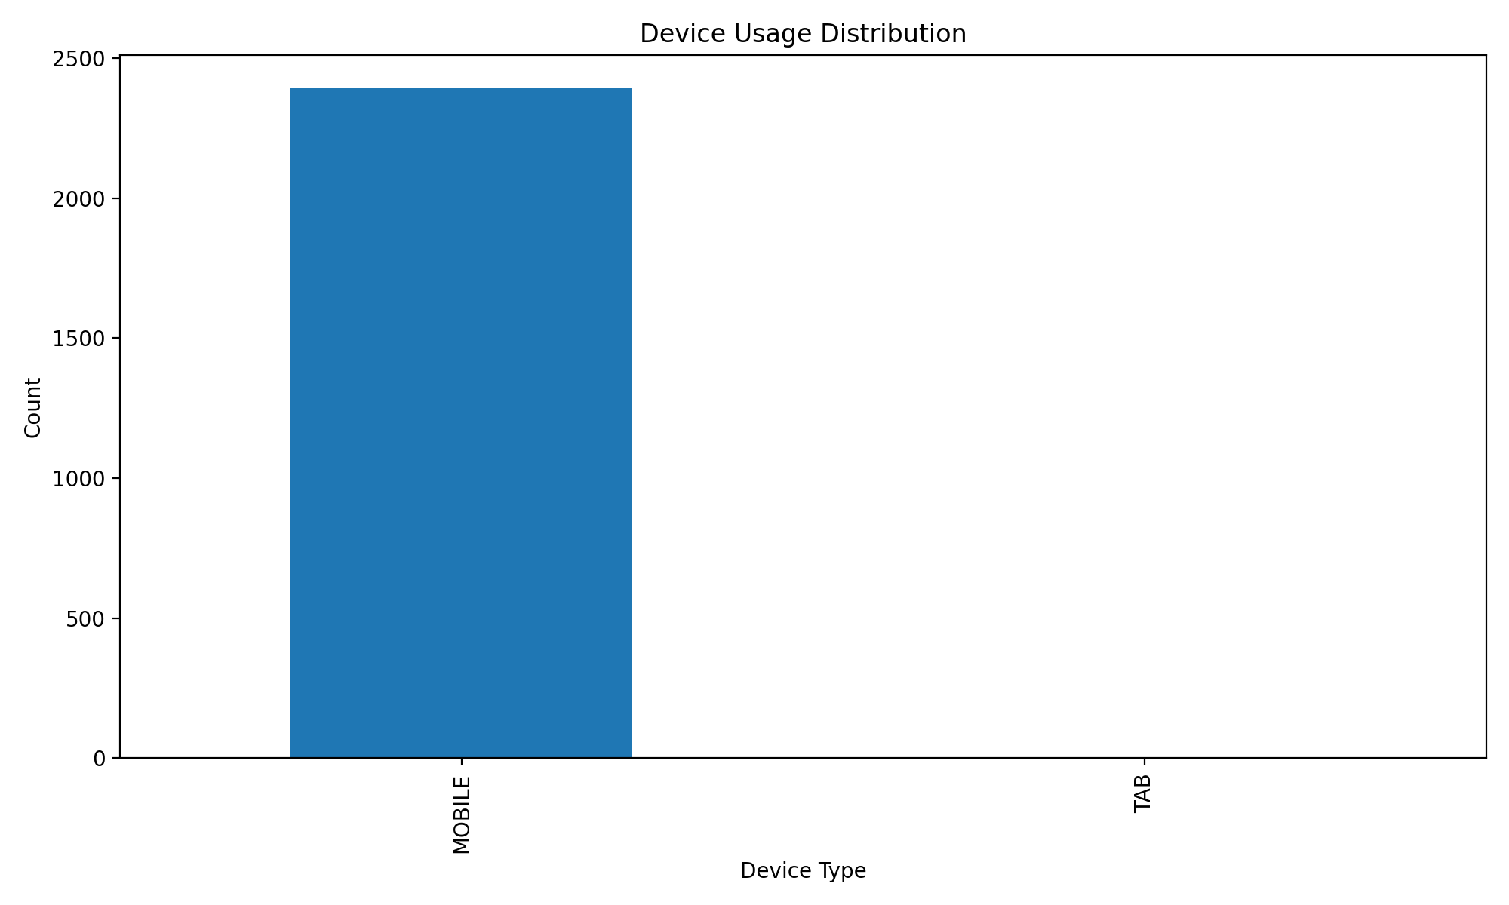
Data Exploration
User Registration Trends: A look into the registration patterns, focusing on dates and user device preferences. an
Device Usage Distribution: Examined user preferences across mobile, desktop, and tablet platforms.

Slide 6
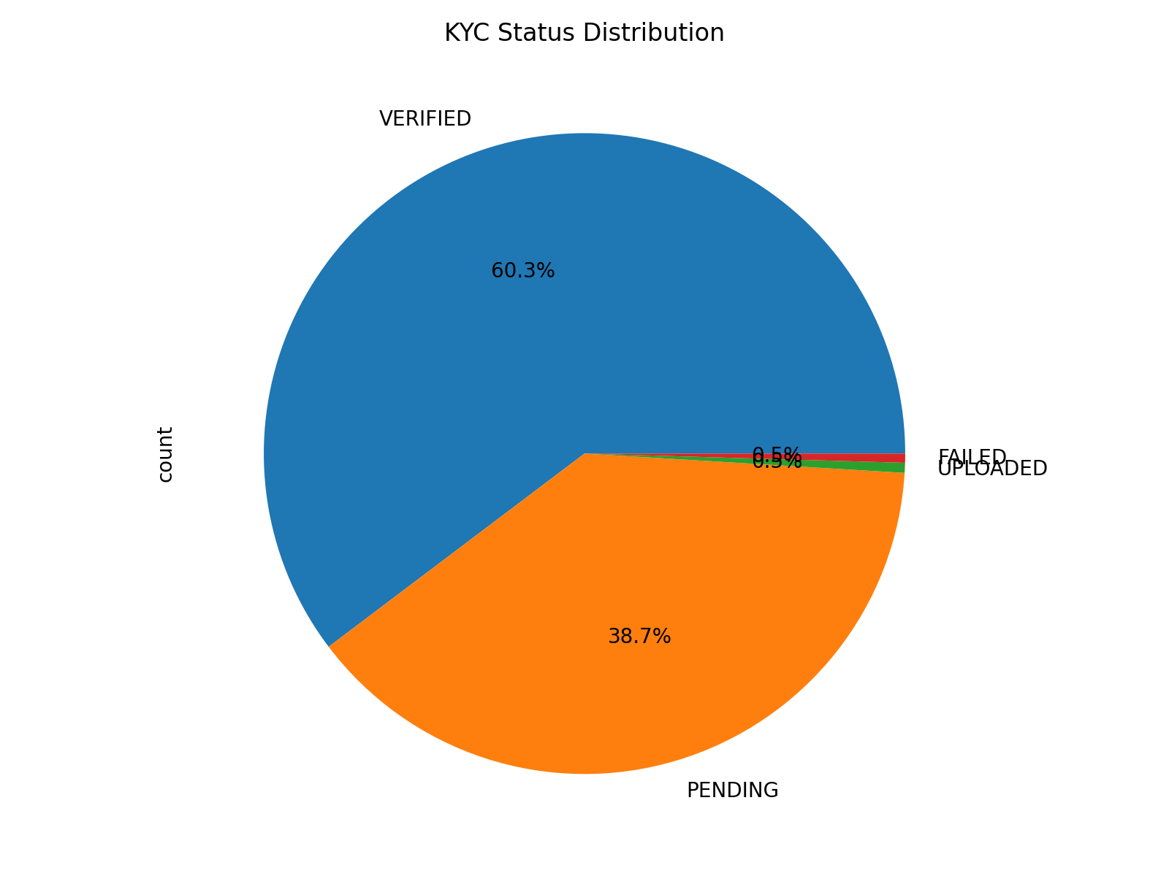
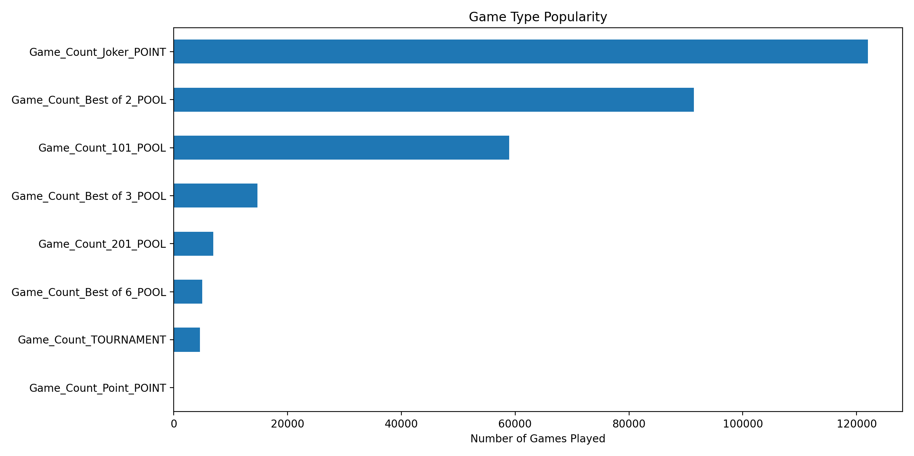
Game Type Popularity: Identified the most frequently played games.
KYC Status Distribution: Assessed the proportion of verified vs. unverified users.

Slide 7
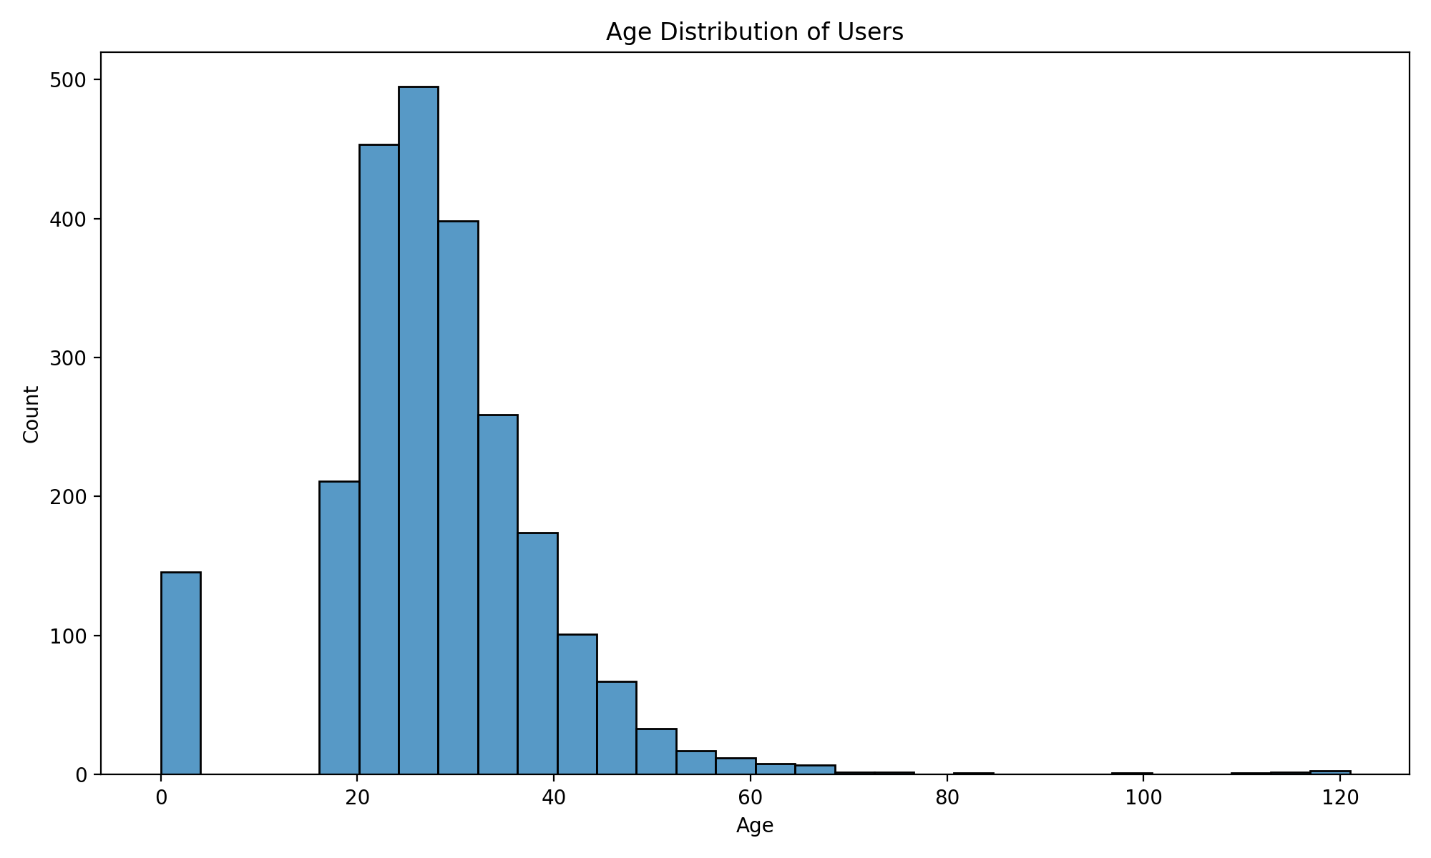
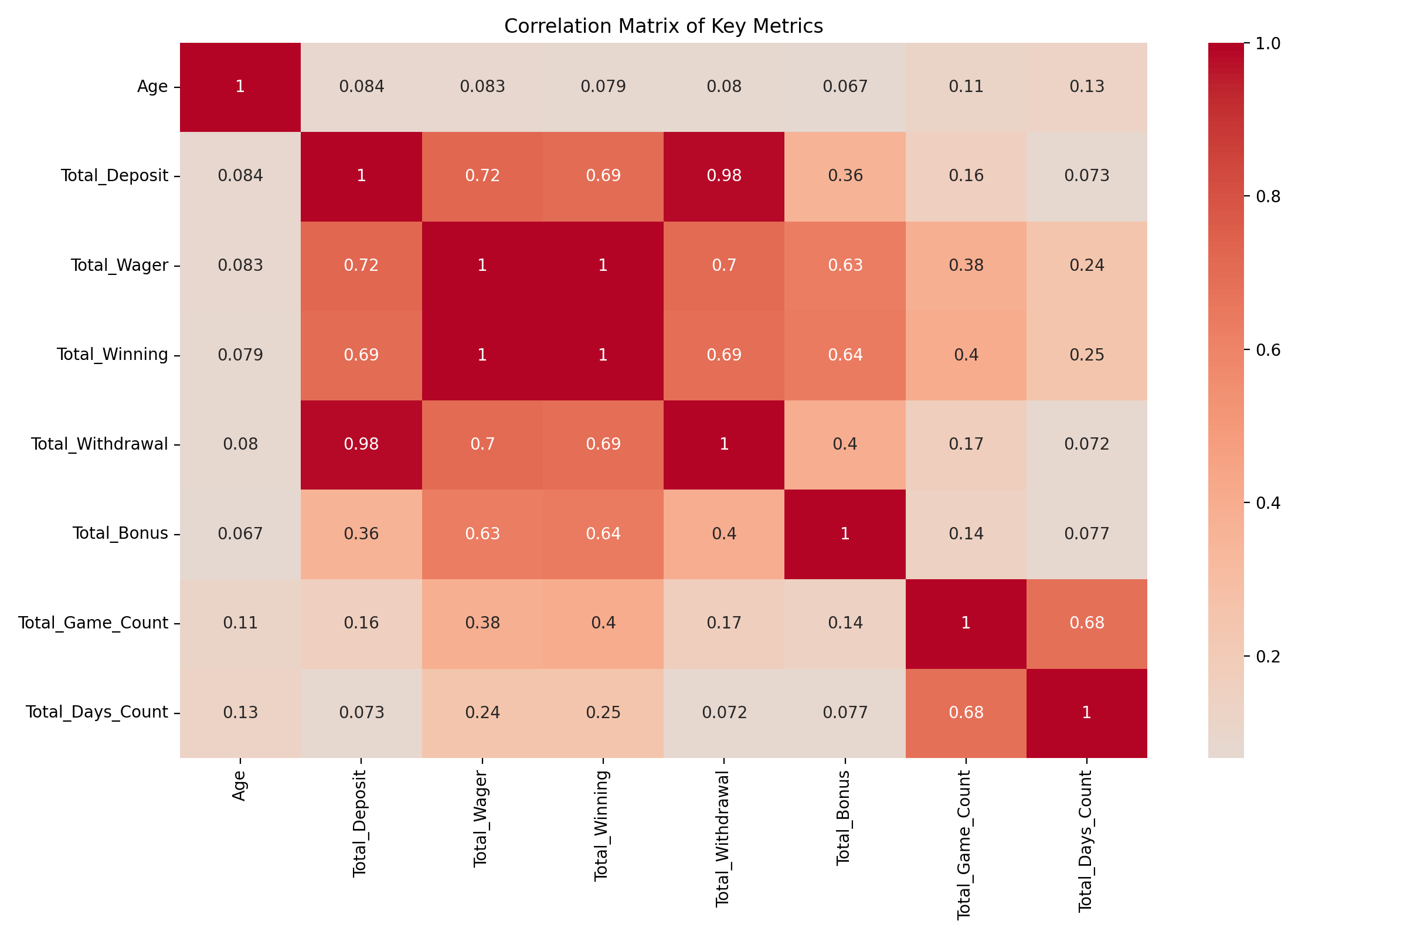
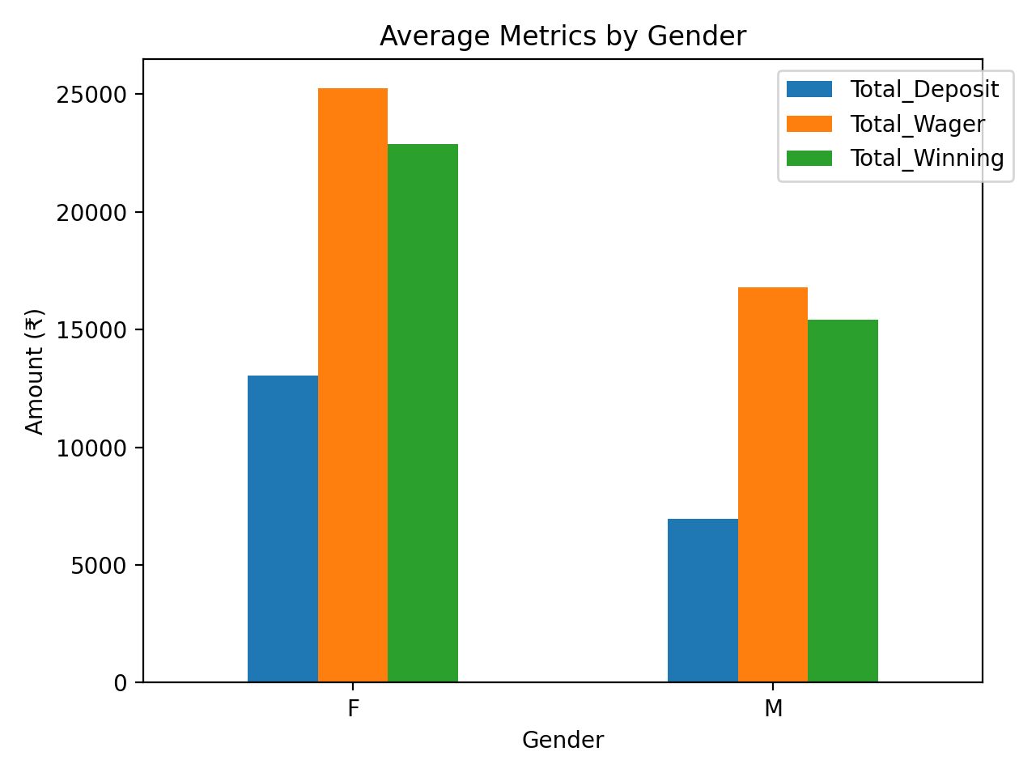
Correlation Matrix: Explored relationships among key metrics such as deposits, wagers, and game counts.
Gender-based Metrics: Compared deposits, wagers, and winnings between male and female users.
Age Distribution: Analyzed the demographic spread of user ages.

Slide 8
Key Metrics
Total Users:2393
Active Users (with wagers):2362
Conversion Rate: 98.70%
Average Revenue per User: ₹7305.25
Total Deposits: ₹17481471.00
Total Wagers: ₹41341517.05
Total Winnings: ₹37957054.46
Average Games per User: 126.93355620559967
 | Days_Since_Registration
count | 2393.0
mean | 11.8633514417
std | 18.8536689908
min | 0.0
25% | 0.0
50% | 2.0
75% | 16.0
max | 93.0

Slide 9
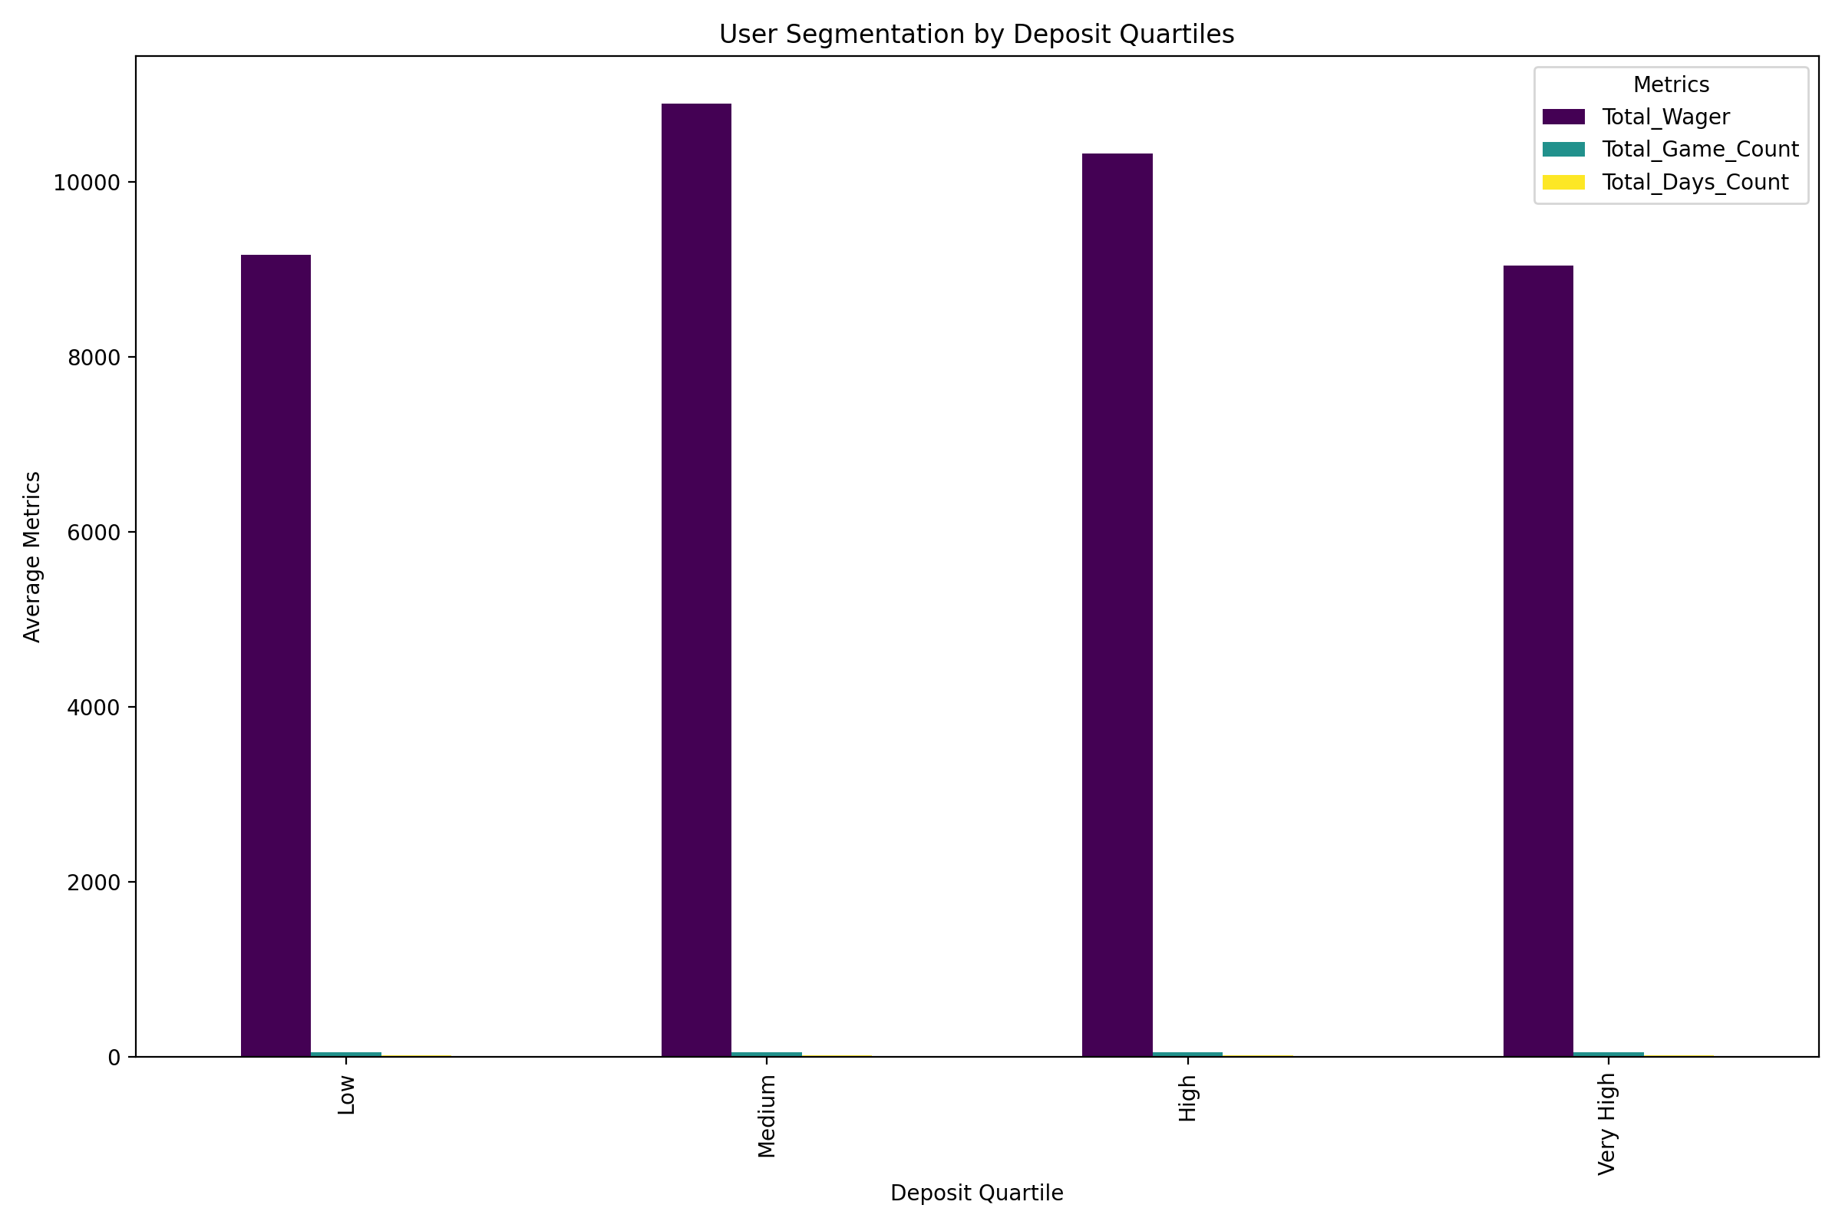
Segmentation
Categorized users into quartiles based on their total deposit amounts: Low, Medium, High, and Very High.

Slide 10
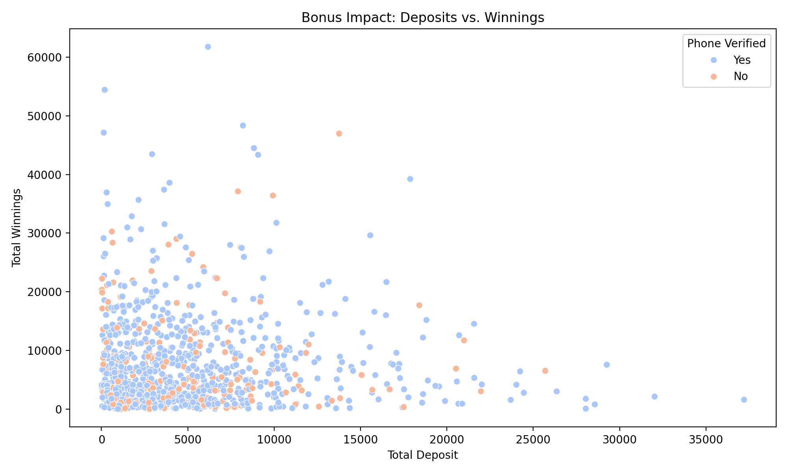
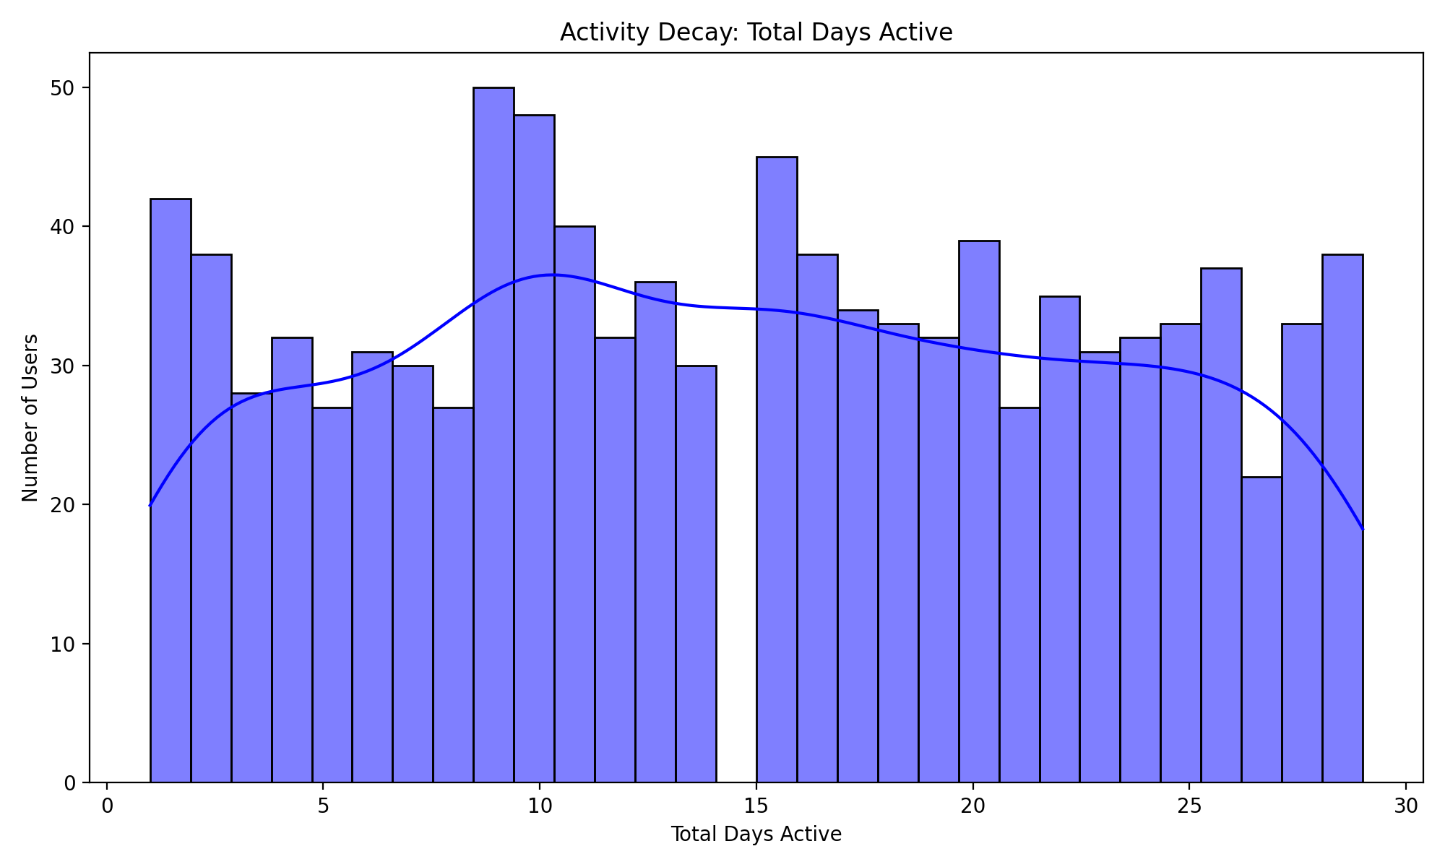
Data Visualization
Activity Decay: Histogram displaying the distribution of user activity based on the number of days active.
Bonus Impact Deposits vs. Winnings : Scatter plot showing the relationship between total deposits and total winnings, colored by verification status.

Slide 11
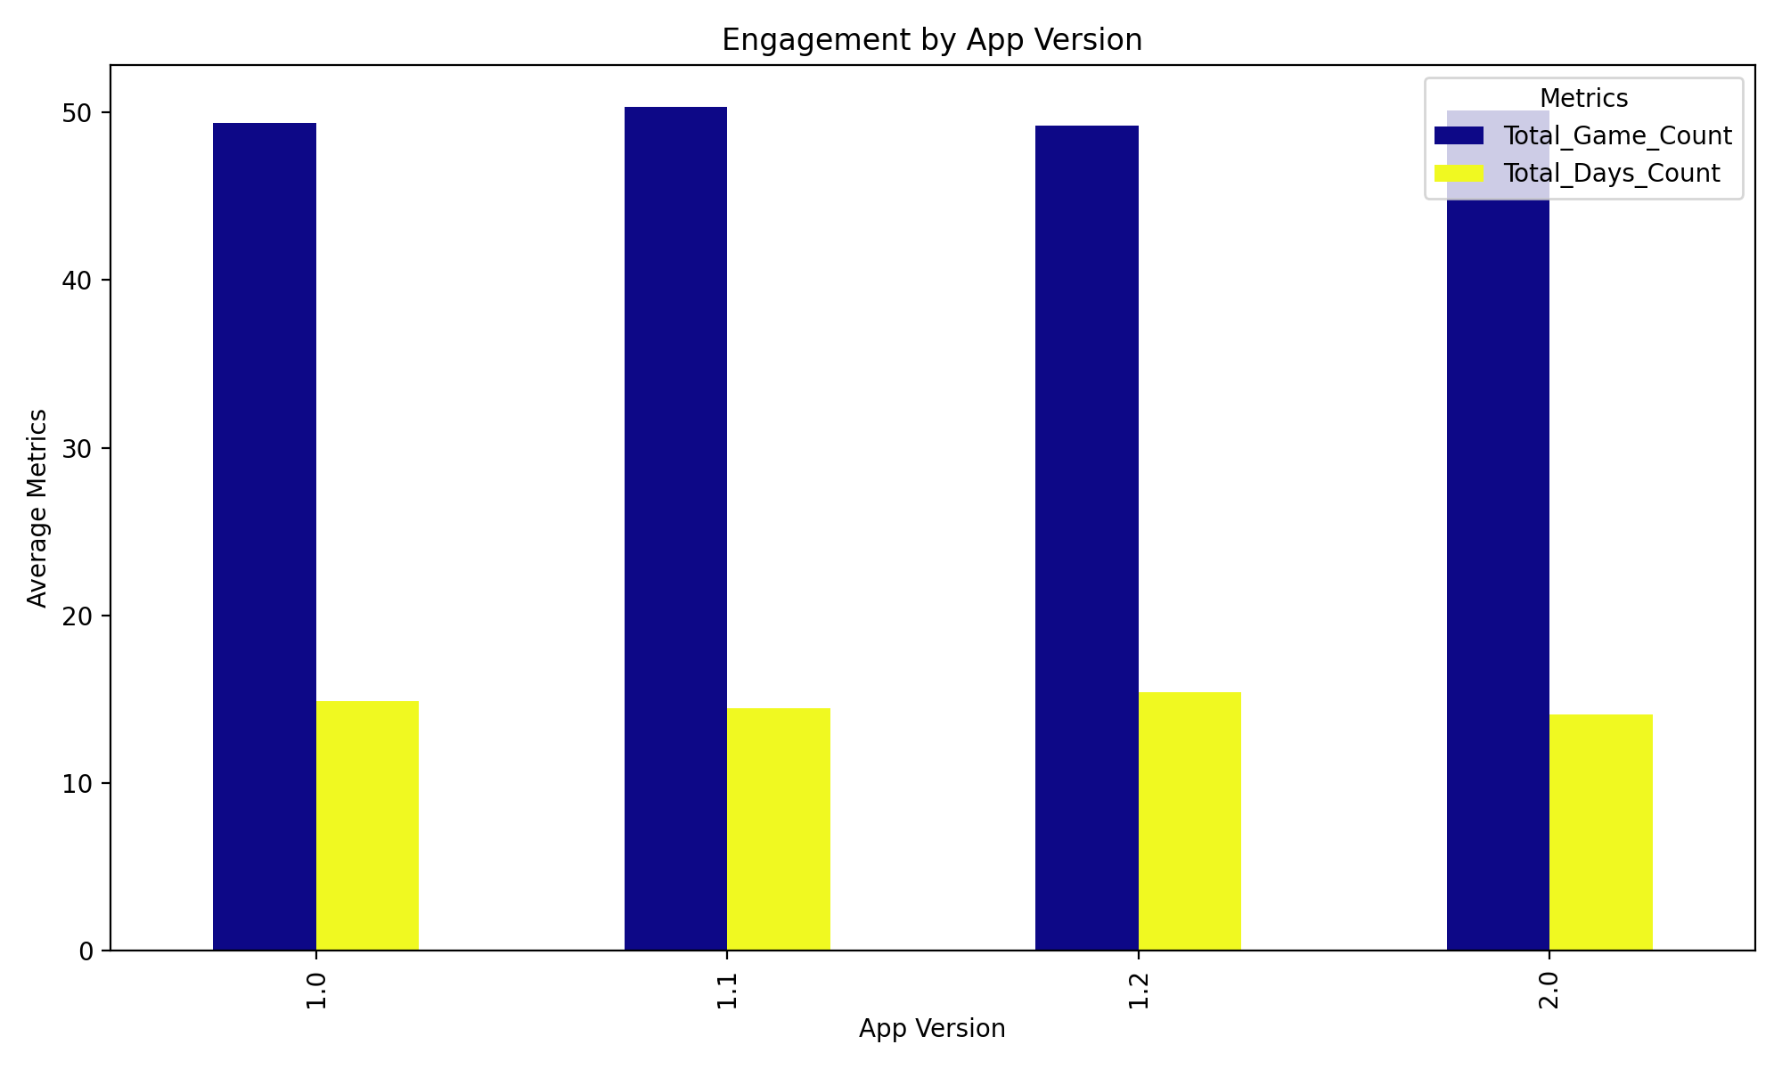
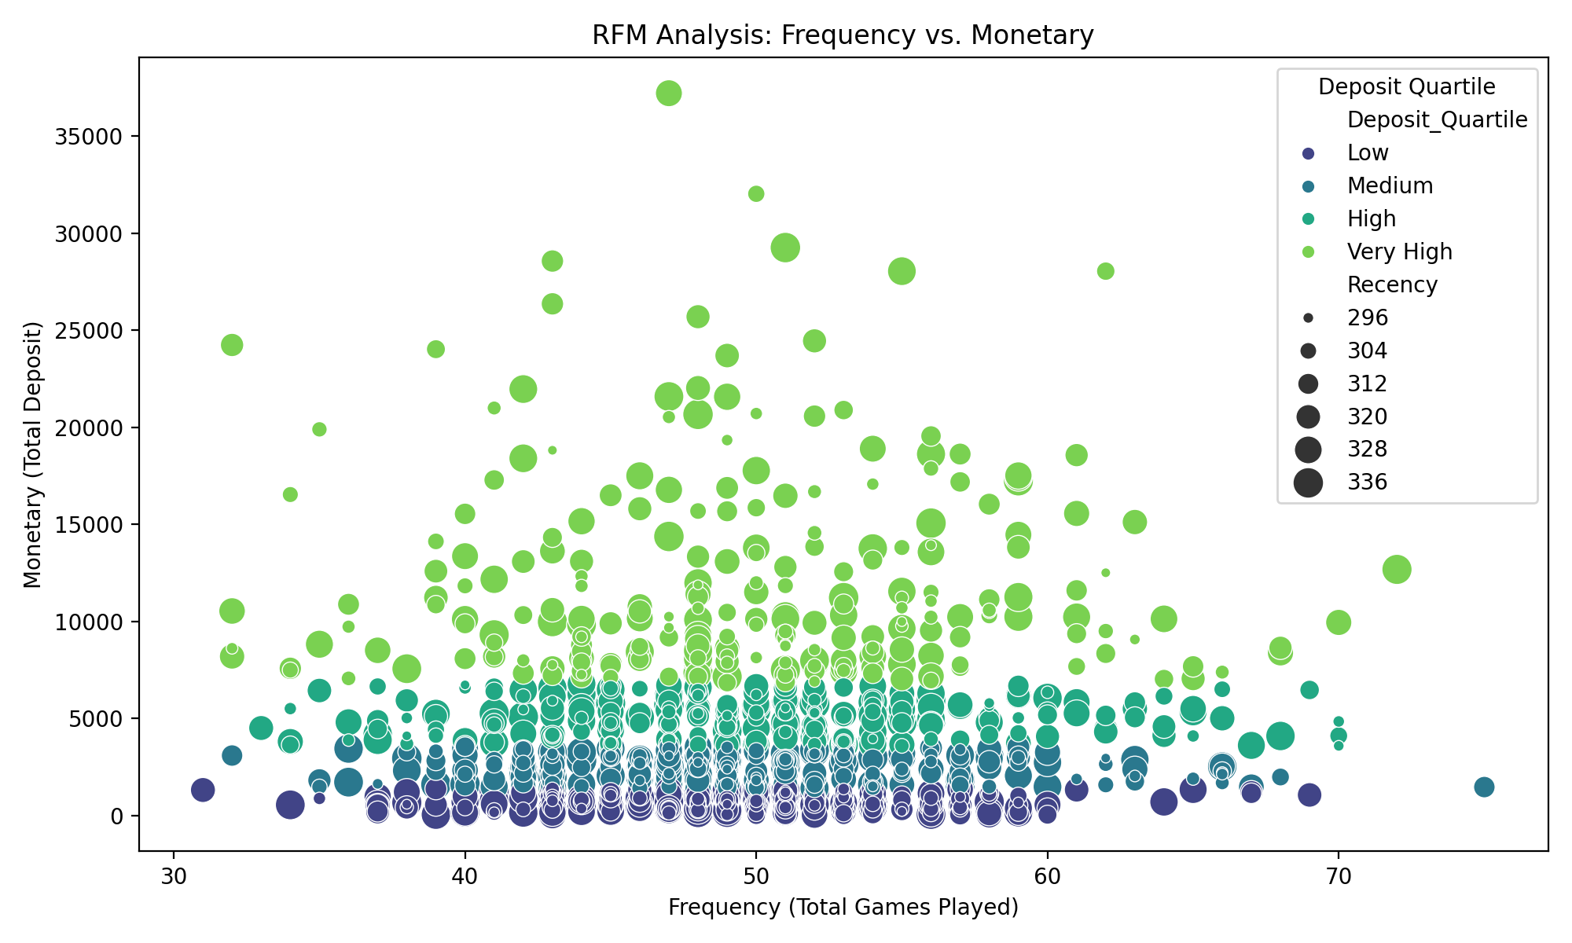
Engagement by App Version: Bar chart comparing user engagement metrics (total games played, days active) across different app versions.
RFM Analysis Frequency vs. Monetary : Scatter plot analyzing users based on their frequency (total games played) and monetary value (total deposit).

Slide 12
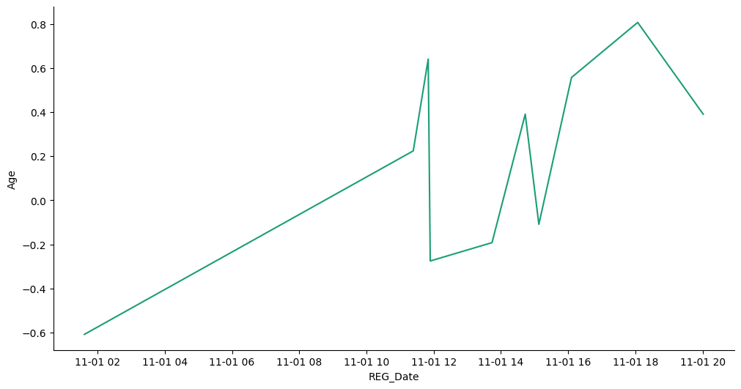
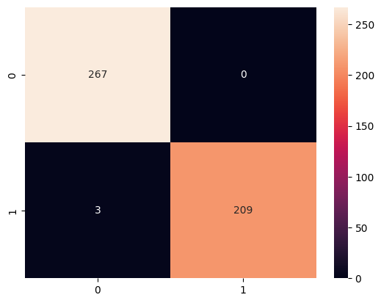
Predictive Modeling
Behavioral Forecasting: Used historical data to forecast future user behavior, including deposit patterns and game participation.

Slide 13
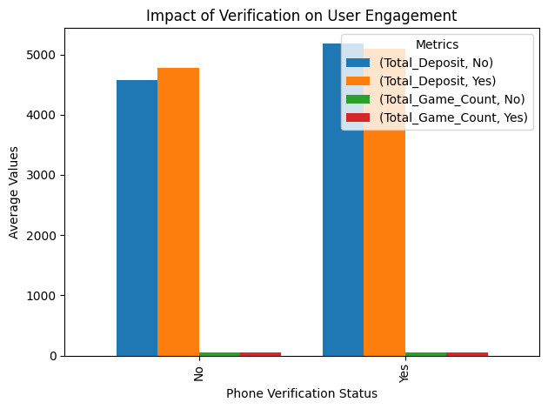
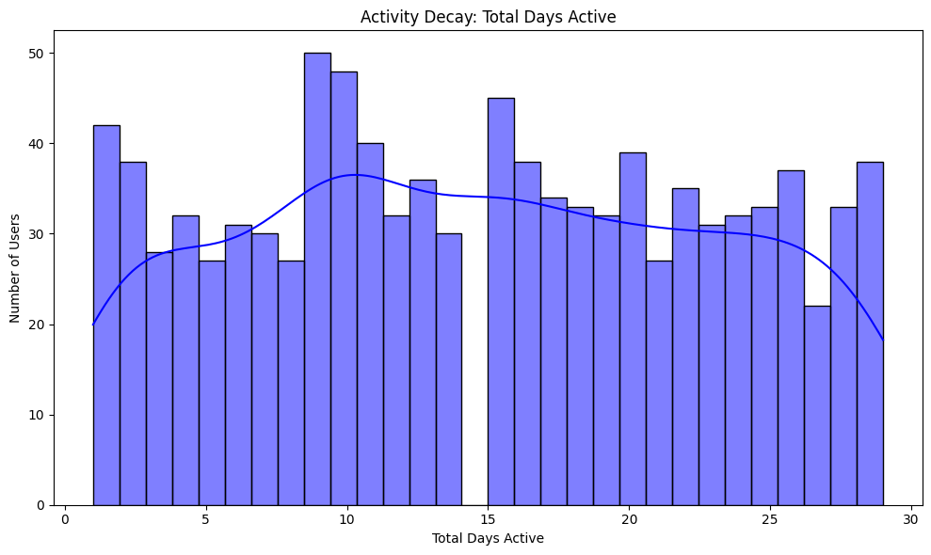
Lifetime Value Prediction: Estimated the potential revenue from users over their lifetime, helping prioritize high-value customers.

Slide 14
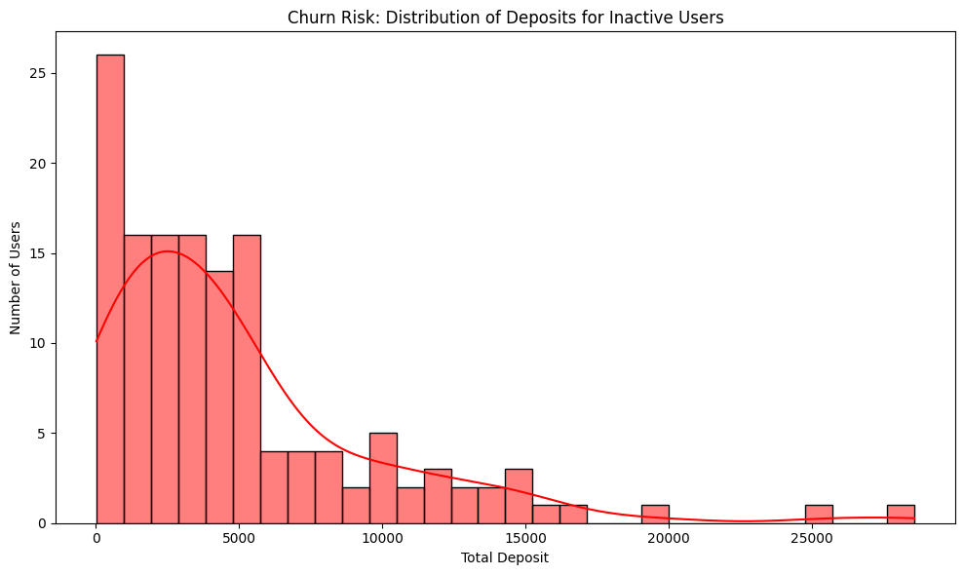

Churn Prediction: Developed a model to predict users likely to stop engaging with the platform, allowing for proactive retention strategies.

Slide 15
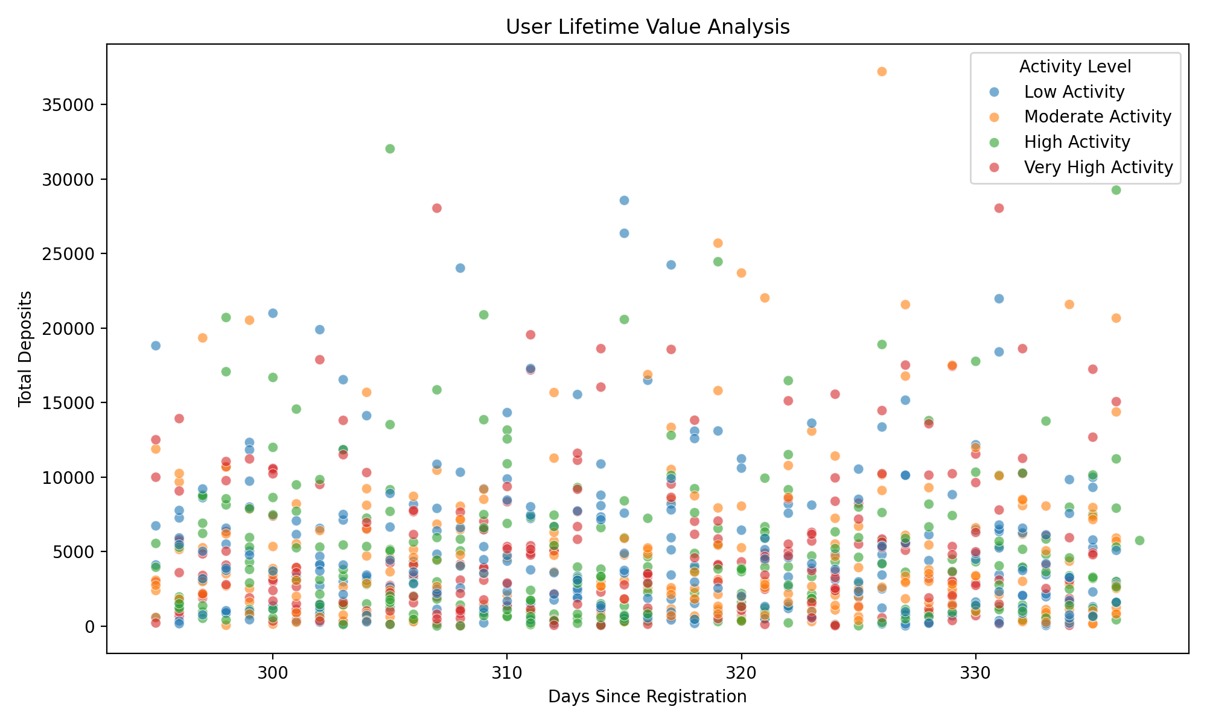
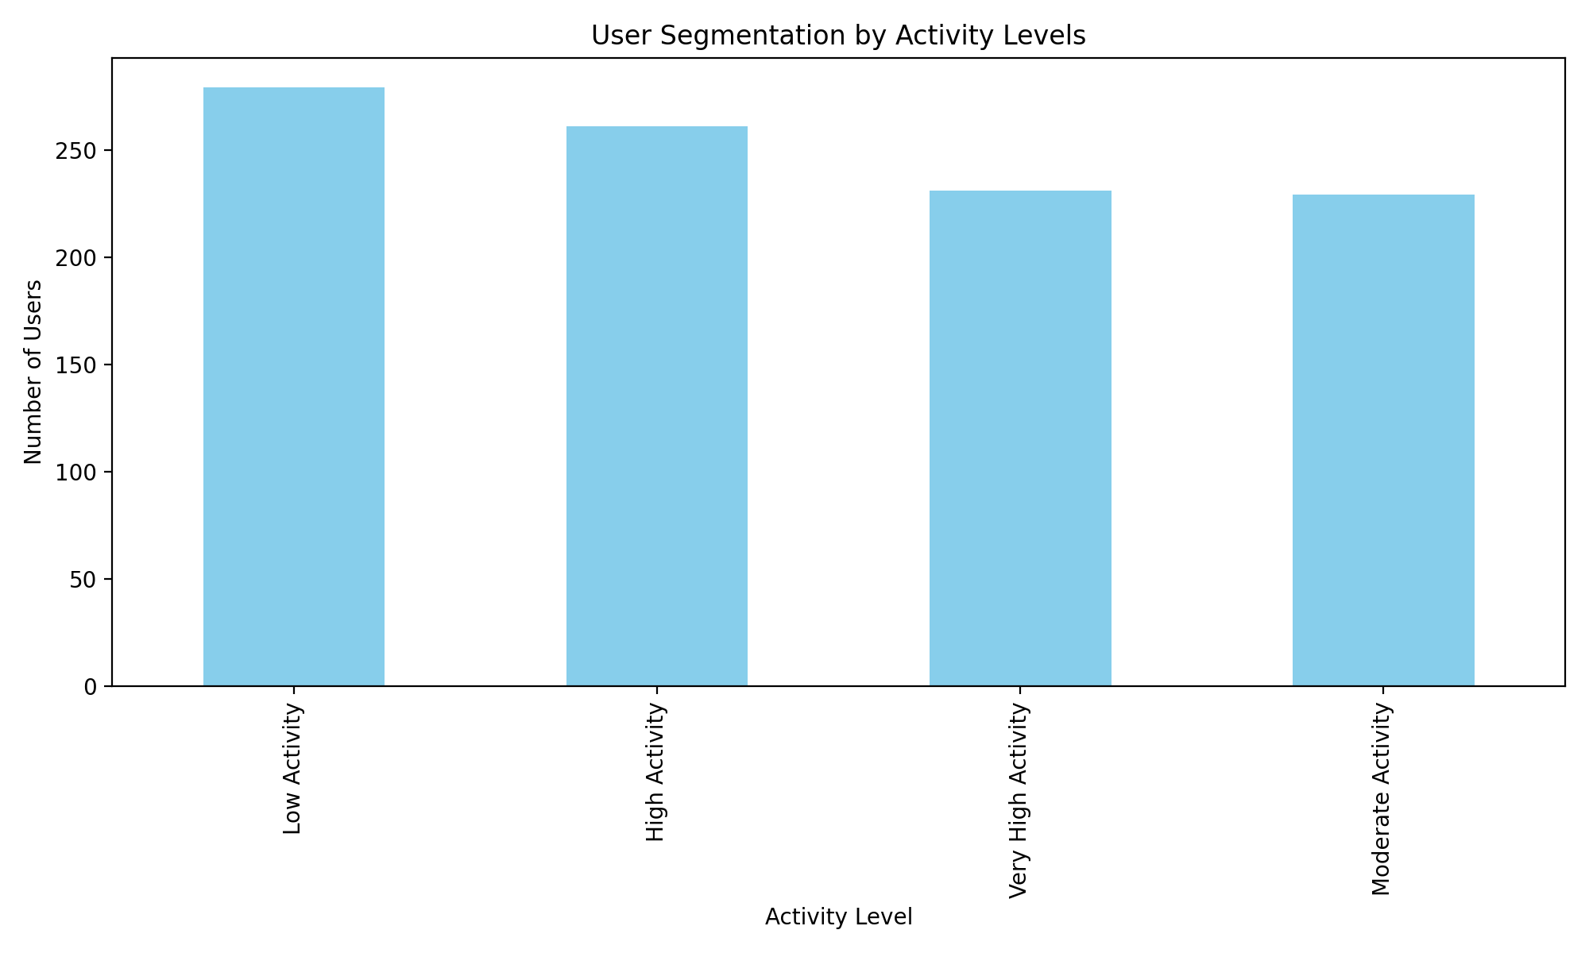
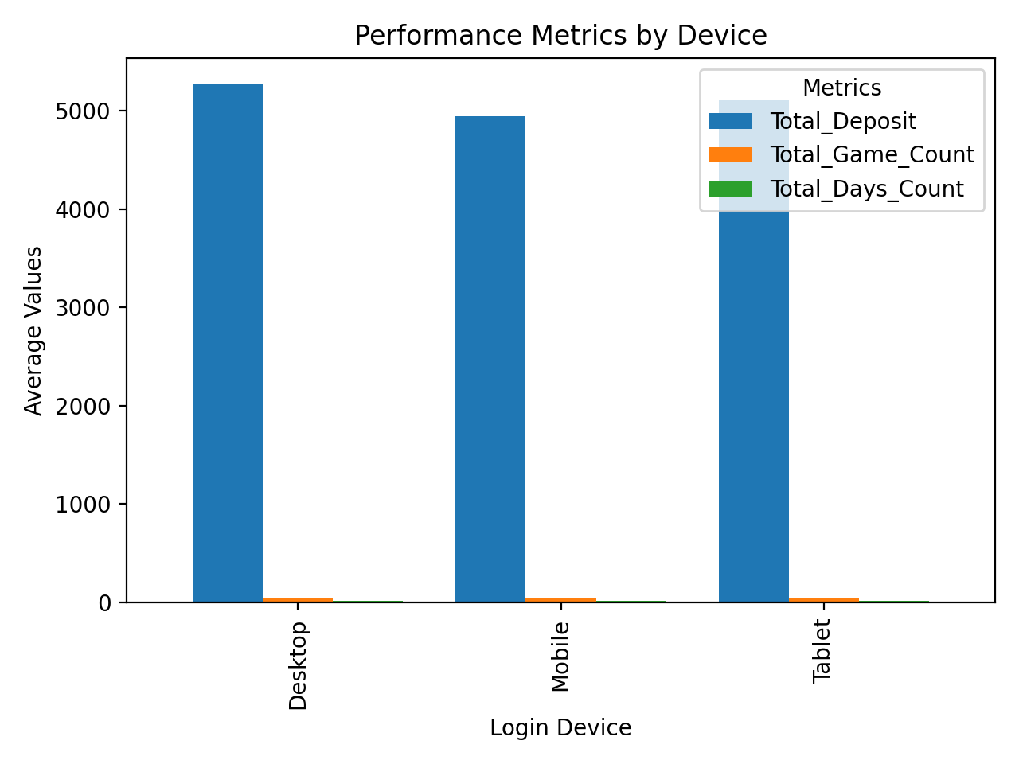
Insights and Recommendations
Key Insights:
Desktop users show slightly higher engagement metrics
Users are fairly evenly distributed across activity levels, suggesting a healthy user base distribution
Shows the relationship between user tenure and total deposits across different activity levels

Slide 16
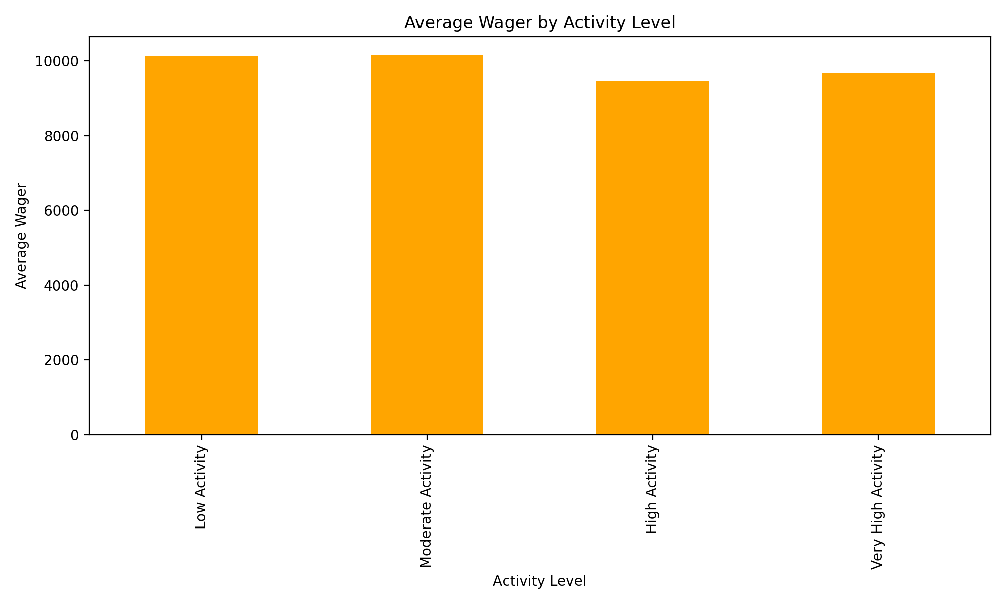
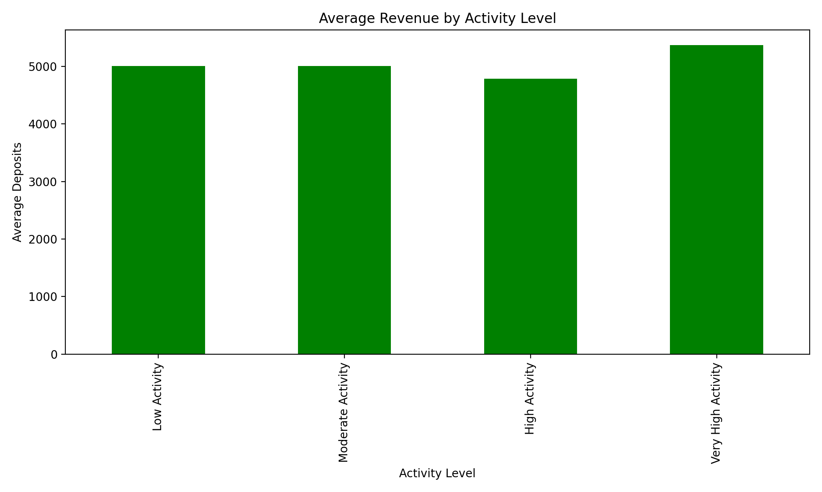
Very High Activity users show the highest average deposits
There’s a strong correlation between activity level and wagering behavior

Slide 17
Conclusion
The analysis reveals that understanding user behavior through data-driven insights is key to enhancing platform engagement, retention, and revenue.

Slide 18
Thank you!
Mail: personalaccdinesh@gmail.com
Linkedin:DINESH S
View project @GITHUB

