Slide 1

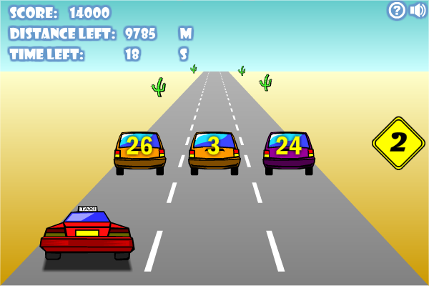

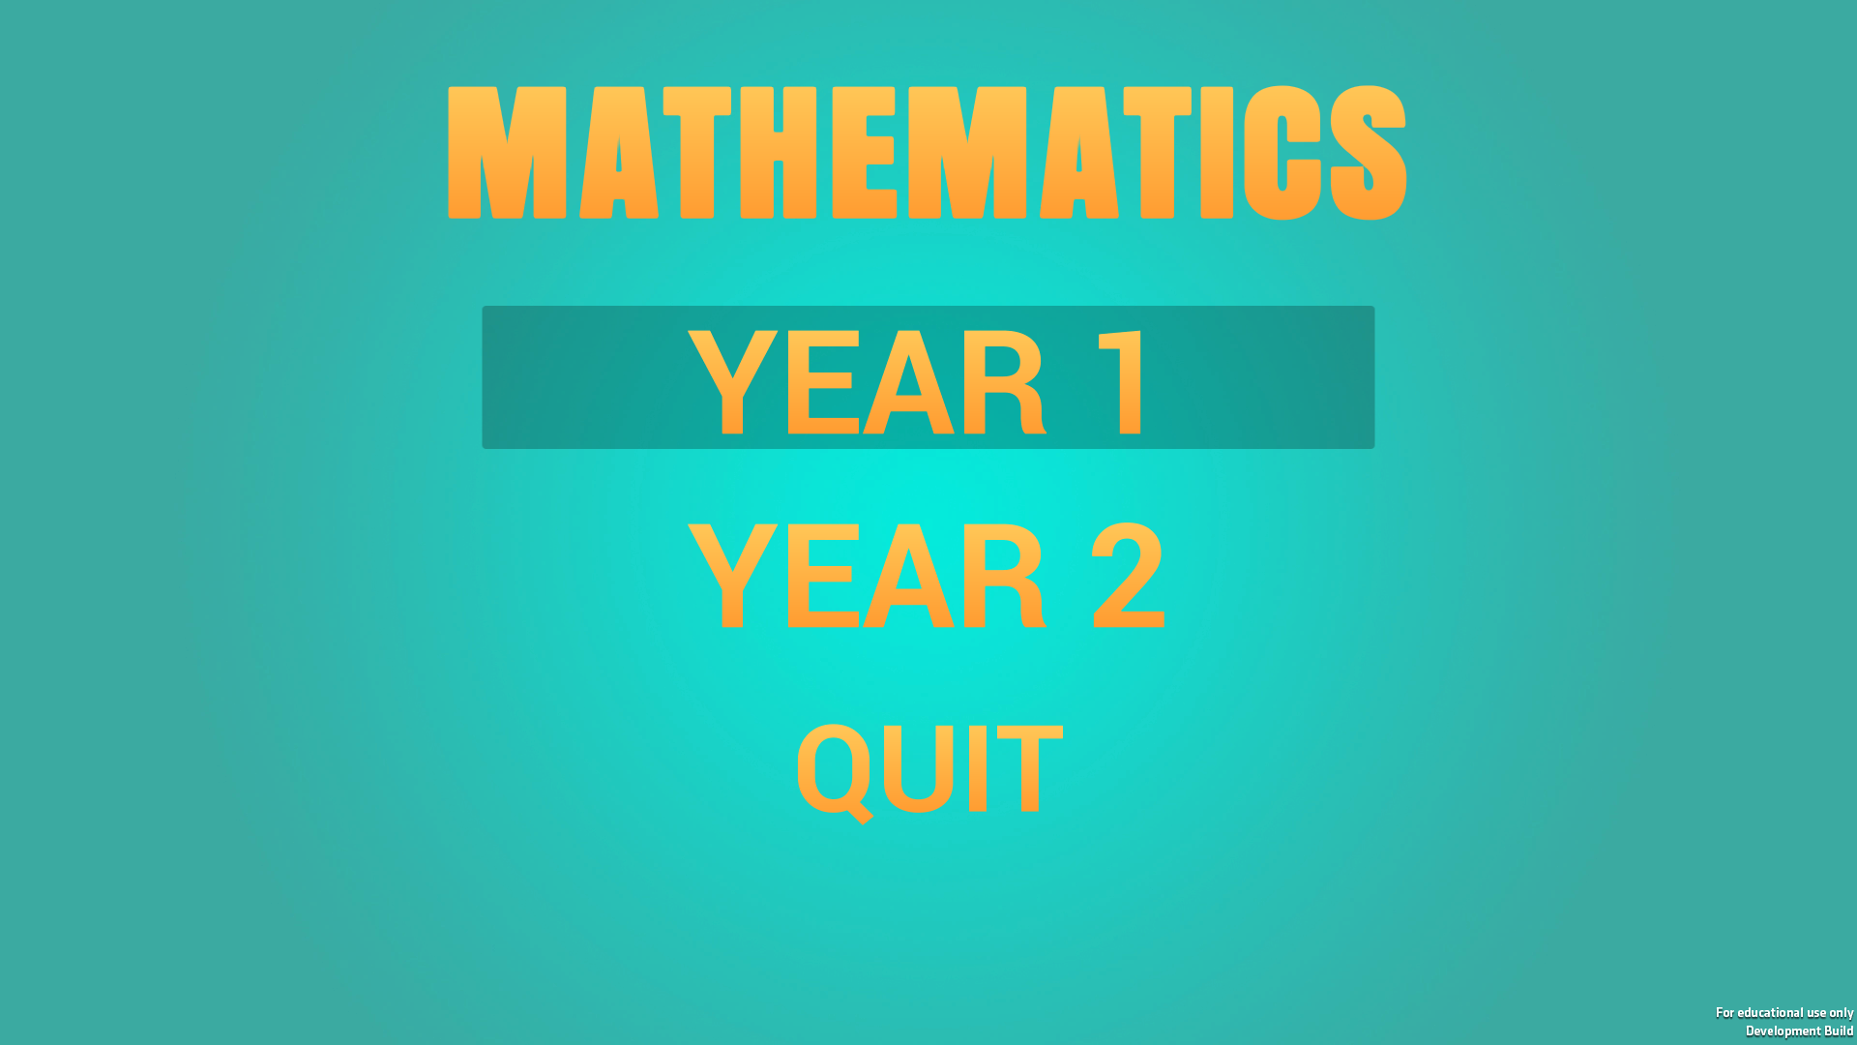
The Development of Software to help teach Mathematics to Primary School Children
Nicholas Flint
15008134
Introduction
background
Developing for children
It is reported by Korbey (2014) that 55% of children play video games weekly, and using computer games within the classroom.
Video games can help to increase students’ motivation for learning and their self-confidence (Wastiau, et al., 2009).
Technology is an ever increasing aspect of peoples lives. So much that it has been integrated into the Key Stage 1 curriculum where students are being taught to “create and debug simple programs (Department for Education, 2014).
Vibrant Colour Schemes
Simplistic Layout
Animation
Easy to read and understand
Game-Based Learning
Games don’t need to include “gold coins or badges” in order to motivate the player (D’Angelo, et al., 2014).
Almost 70% of primary and secondary schools have tablets that are used for education (Coughlan, 2014).
A modified version of Minecraft has been developed purely for education by Mojang.
Minecraft Education Edition Logo (Mojang AB, 2018)
Crazy Taxi M-12 (Coolmath.com, Inc., 2018)
objectives
Literature Cited:
Gain an understanding of the Unity Engine
Develop Educational Software designed for schoolchildren.
Follow closely to the National Curriculum
Implement a system to track student progress while playing
Research the themes around developing for schoolchildren
Coolmath.com, Inc., 2018. Crazy Tazi M-12. [Online] Available at: http://www.coolmath-games.com/0-crazy-taxi-m12 [Accessed 20 April 2018].
Coughlan, S., 2014. Tablet Compters in '70% of Schools'. [Online] Available at: http://www.bbc.co.uk/news/education-30216408 [Accessed 10 April 2018].
D’Angelo, C. et al., 2014. Simulations for STEM Learning: Systematic Review and Meta-Analysis. Menlo Park: SRI Education.
Department for Education, 2014. Computing. In: The National Curriculum in England. s.l.:Department for Education, pp. 230-233.
Korbey, H., 2014. Surprising Insights: How Teachers Use Games in the Classroom. [Online] Available at: https://ww2.kqed.org/mindshift/2014/06/09/surprising-insights-how-teachers-use-games-in-the-classroom/ [Accessed 23 November 2017].
Mojang AB, 2018. Minecraft: Education Edition. [Online] Available at: https://education.minecraft.net [Accessed 20 April 2018].
Wastiau, P., Kearney, C. & Van den Berghe, W., 2009. How are Digital Games used in schools, Belgium: European Schoolnet.
Main Menu of the Finished Product

