Slide 1
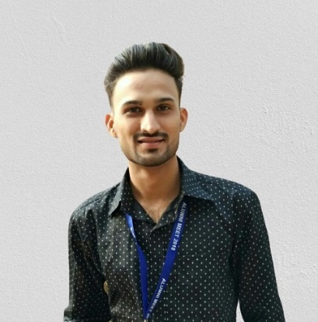
Resume
Ankit Dubey has overall 2.5 years of experience with 1.5 years of relevant experience in Big data. He has worked on several projects that encompassed the full software development lifecycle. As a result of this work, he has valuable experience in defining, designing, implementing, developing and maintaining data-driven scalable big data solutions for data extraction, data transformation and data loading by using big data technologies like Hadoop, Spark, Hive. In addition to his industry and technical expertise, Ankit also has proven skills in Python and SQL.
The Majority of Ankit’s experience include in developing various applications and solving various use cases mainly dealing with Big data problems. He has worked on PySpark developer where he created a reconciliation applications using Python and Apache Spark. He has also worked as ETL developer thereby creating components like joins and filter using the Java-Spark and loading the transformed data in MySQL database. He is always keen in learning new technologies and looking for various opportunities to upskill himself.
Ankit Dubey has also experience in Survey programming thereby making online questionnaire using SPSS Dimensions and Keto Tool. He has experience in making the online survey interactive as per the client requirements using custom JS, HTML, CSS.
Projects
Project : Vodafone Ziggo Migration and Operation(AAP Team)
Competency: Shadow Resource
Time period : 9 months
Service Area: Development and Documentation
Supporting Client in maintaining the data pipelines in PySpark, Scala, Hue, Nagios and AWS​. Worked on automation script to redact the manual work for the client.​ Providing the on-call Support to the client in night.
Project : Vodafone Ziggo Cloud Migration and Operation
Competency: Shadow Resource
Time period : 2 months
Service Area: Development and Documentation
Vodafone Ziggo is a Data Migration Project in collaboration with Deloitte Netherland , targeting on migrating data from Informatica to Cloud via AWS, Snowflake.
Project : TDH(Tax data hub)
Competency: Shadow Resource
Time period : 4 months
Service Area: Development and Documentation
Tax Data Hub is to serve as an enterprise-grade central data repository for all Client Tax Reporting and Compliance needs.
Previous Experience
Industry : Ugam solutions
Competency: Analyst
Industry Segment: Software Development and Survey programming
Service Area: Python, PySpark, Dimensions
Associate Analyst - 1 Year, Analyst – 1.5 years
The project was to design and develop a software for managing client inventory and stock management needs.
Ankit Dubey
Consultant | Consulting -SA&MA:Analytics & Cognitive
Hyderabad
KRB Towers, Plot no 1 to 4 & 4A
1st, 2nd & 3rd floor, Jubilee enclave, Madhapur
M: +91 9892231557
ankitdubey@deloitte.com | www.deloitte.com

