Slide 1
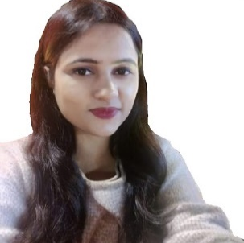

Simran Singh|Consultant – Consulting SAMA: Analytics & Cognitive
simransingh@deloitte.com | Deloitte Touché Tohmatsu India LLP , Mumbai Mobile: +91 7218218899
Professional Summary:
Simran is a Consultant in SAMA A&C at Deloitte and brings her expertise in SQL development. She has a total professional experience of four and half years, of which she worked nine months at Deloitte India. She has earlier worked in client facing roles in Zensar Technologies and IBM. She has worked as SQL developer. Along with this she has experience of creating dashboards using Power BI. She has also worked closely to Scrum Masters and client to fulfil job of BA by creating use case. At Deloitte, Simran has been trained on several cutting-edge technologies such as Snowflake, Data Visualization using Microsoft Power BI & Tableau and overview of cloud services offered by Azure. Pursuing Executive MTech from IIT Patna.
Relevant skills:
Technical:
Visualization & Reporting : Microsoft Power BI
Ticketing : TFS, Azure DevOps
Scheduling : UC4, SSIS
Programming : SQL, C#, Snowflake, HTML
Methodology : Agile
Cloud : Azure
Domain:
Insurance
Healthcare
CSR
Certifications:
Microsoft Certified : Azure Fundamentals (AZ-900)
Databricks Lakehouse Platform Accreditation
Education:
Bachelor of Engineering from Savitribai Phule Pune University
Key Projects:
Power BI
Experienced in developing interactive dashboards.
Snowflake Developer
Experience on working in migration and build for snowflake environment.
Well versed with different layer of snowflake and database object.
Exposure to SnowSQL.
Role based access control to integrate active directory groups with the required access.
Familiarity with building data ingestion and orchestration pipeline using AWS.
Running copy commands to load data from AWS S3 stage to Snowflake tables.​
Build non-functional requirements for Snowflake (CI/CD, monitoring, monitoring, data quality)
Well versed with Snowflake query profile, and snowflake information schema table.
SQL, SSIS, Dot Net Developer
The roles was to do enhancement and development of Dot Net based applications.
Creating SQL SP, Views. Strong SQL experience with complex queries.
SQL procedure performance tuning.
Creating SSIS packages and maintain the data as per business rules.
Creating jobs and automating the repetitive issues of production.
Developing Power BI dashboard for client to automate the monthly reports.

