Slide 1

ALI HASSAN
Crownfield Eye Hospital
Physical Implementation & SQL Development
Relational database systems coursework
Notes:
Introduce the Crownfield Eye Hospital database project. Emphasize that this presentation walks through the end-to-end design from unnormalized hospital intake records to a validated Third Normal Form MySQL implementation.

Slide 2

Project Overview
SYSTEM SCOPE & PLATFORM ARCHITECTURE
Goal: Transform raw, unnormalized hospital clinical intake into a functional 3NF relational schema.
Platform: MySQL 8.0 with InnoDB for ACID compliance and strict foreign key checks.
Scope: DDL schema generation, realistic DML seeding, clinical analytical queries, automated triggers and role-based access control.
Notes:
Highlight the engineering scope: eliminating update anomalies, organizing disparate records across clinical departments, and establishing a secure production-ready database.

Slide 3
Business Rules & Assumptions
CARDINALITY CONSTRAINTS & CLINICAL LOGIC
RULE 01
RULE 02
RULE 03
Clinician Specialty
Multiple Prescriptions
Tripartite Linkage
Each clinician belongs to exactly one specialty department (e.g., Cornea, Retina, Glaucoma) to ensure clear accountability.
One appointment encounter can generate zero, one, or multiple medication orders and lens prescriptions.
Every scheduled appointment strictly binds exactly one registered patient, one primary clinician, and one clinic room.
Notes:
Detail how real clinical workflows map to cardinality: 1:1 clinician to specialty simplifies scheduling, while 1:M appointment-to-prescription handles multi-drug ophthalmic treatment regimens.

Slide 4
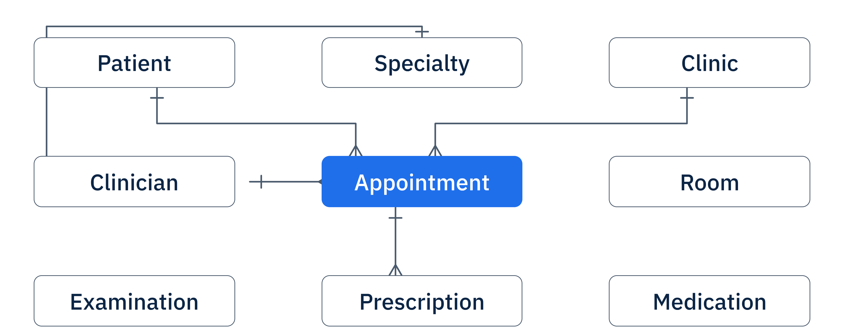
Conceptual Design: Nine Core Tables
CROW'S FOOT ERD · 9 CORE TABLES IN 3NF · INSERT ERD IMAGE HERE
Notes:
Point out the 9-table decomposition: separation of transitive dependencies removes modification anomalies. The user can reference the interactive Crow's foot connections directly.

Slide 5
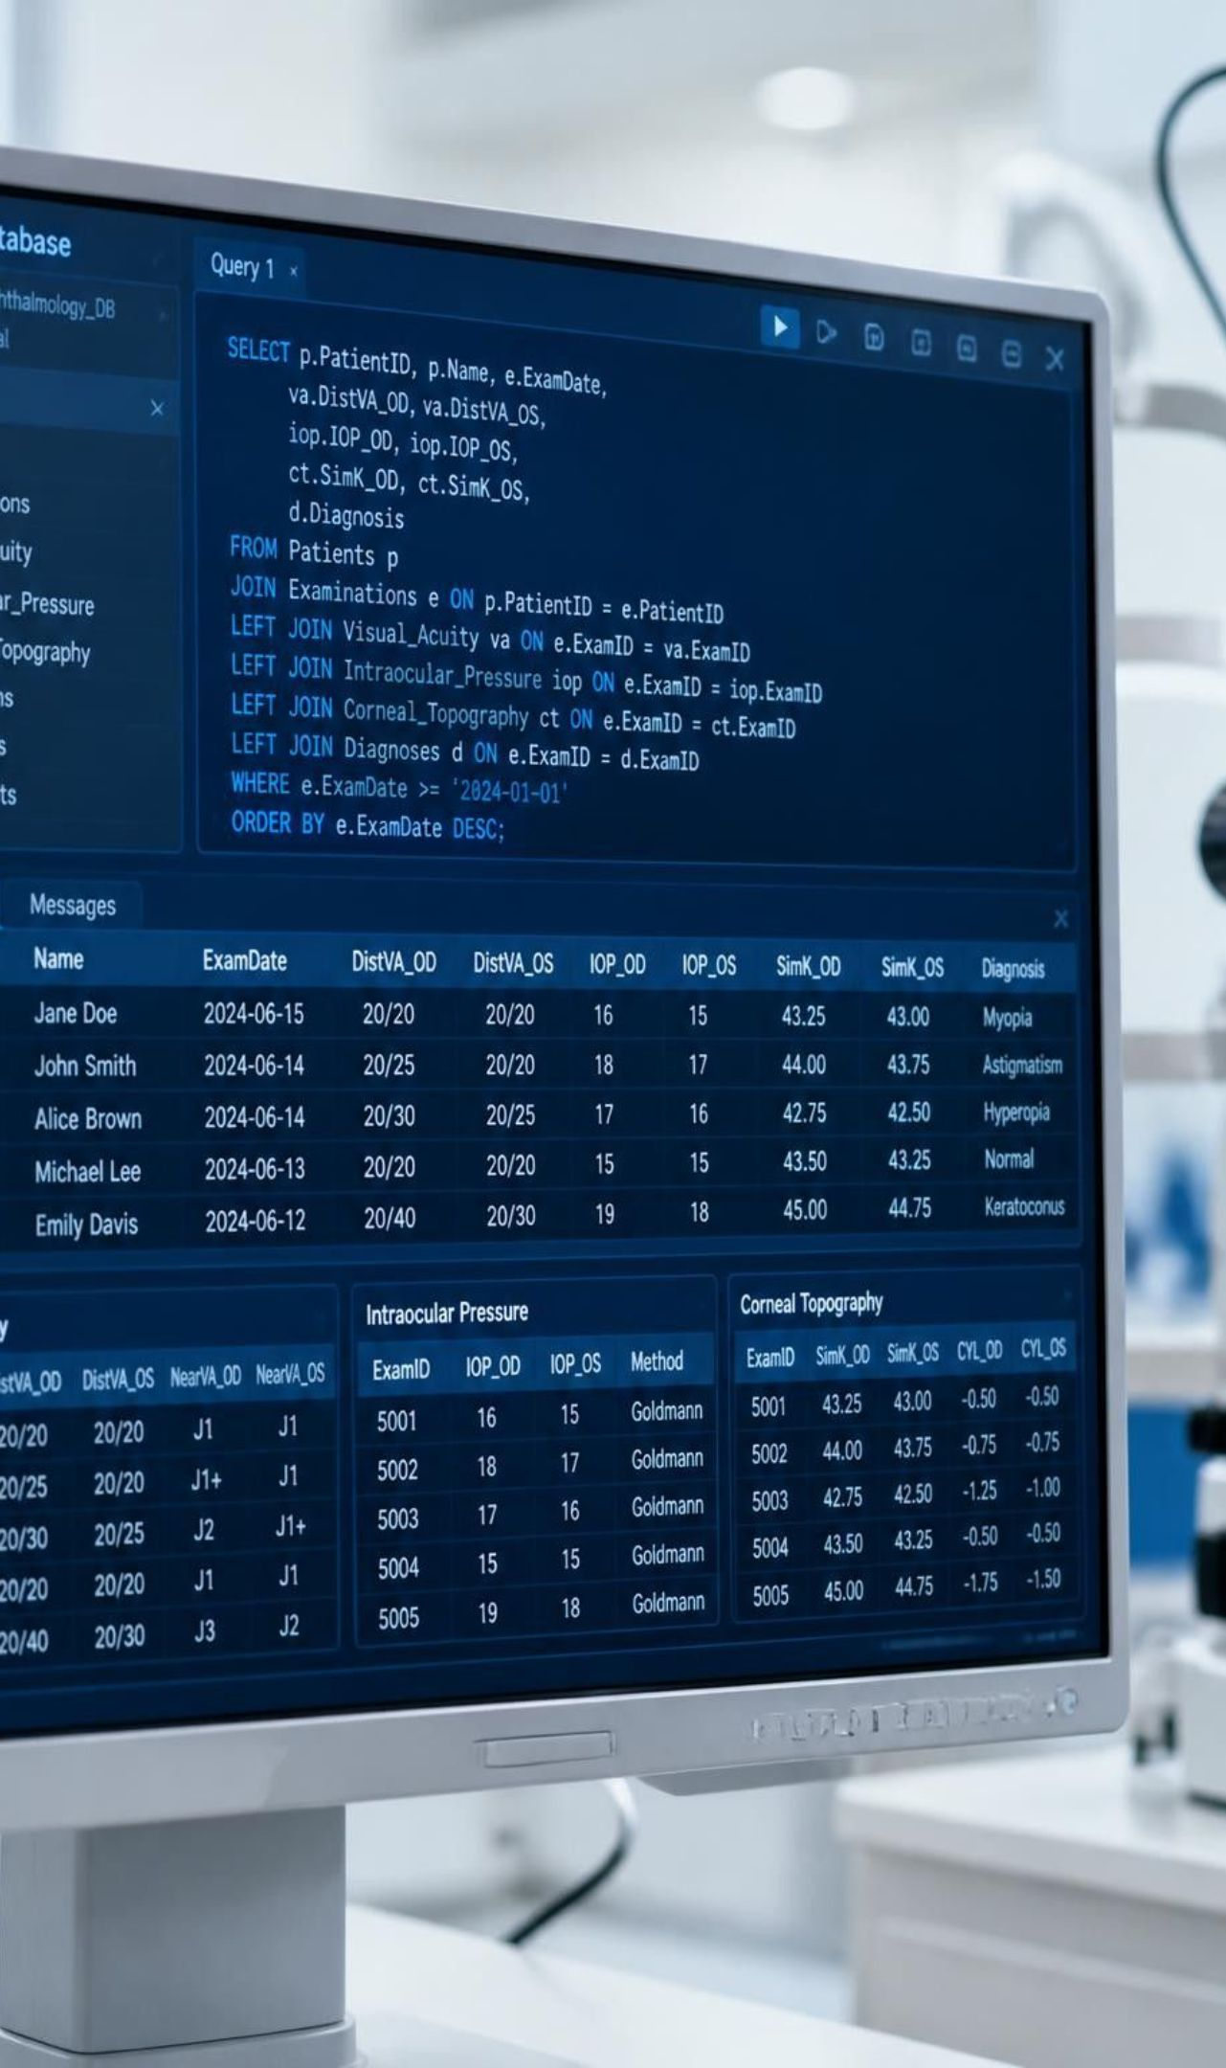
Schema Creation (DDL)
DEPENDENCY-ORDERED SCRIPT EXECUTION
01
Independent parent tables: Create Patient, Clinic, and Specialty first, with primary keys and unique healthcare identifiers.
02
Dependent relational tables: Establish Appointment, Clinician, and Prescription with explicit foreign keys to parents.
03
Integrity & constraints: Primary and Foreign Keys enforce links; enforce ON DELETE RESTRICT, non-null check constraints, and indexed appointment date-time slots.
Notes:
Explain why DDL execution order is vital: attempting to create child tables before their respective referenced parents triggers foreign key resolution errors in MySQL InnoDB.

Slide 6

Data Population (DML)
PARENT-FIRST INSERTION & REFERENTIAL INTEGRITY
1
Primary entity seeding: Insert dummy records parent-first into Specialty, Clinic, and registered Patient entities.
2
Relationship testing: Seed dependent appointments and cross-reference prescriptions; test every relationship, boundary dates and duplicate constraints.
3
Integrity preservation: Verify all foreign keys are active; permit zero orphan rows or unreferenced clinical records.
Notes:
Describe the data population strategy: realistic synthetic patient records test edge cases like simultaneous appointments and multi-drug prescriptions without compromising clinical ethics.

Slide 7
Six Queries, Real Insights
ANALYTICAL SQL ACROSS HOSPITAL WORKFLOWS
Q1
Q2
Q3
Clinic Utilization
Volume by Specialty
Patient Treatment History
Multi-table INNER JOIN: appointments, doctors, rooms; peak clinic room traffic.
GROUP BY Specialty.name and COUNT(appointment_id): cornea, retina and glaucoma demand.
Examinations, diagnoses and prescriptions aggregated in a single patient’s chronological timeline.
Q4
Q5
Q6
Drug Dispensation Totals
Clinician Workload
Follow-up Tracking
SUM(dosage_units) by medication code: pharmacy inventory burn rate audit.
AVG() consultation duration and weekly caseload per ophthalmologist.
Subquery identifies patients with diagnosed degenerative conditions and no scheduled follow-up visits.
Notes:
Highlight the SQL mechanics: queries leverage index scans on foreign keys, demonstrate JOIN complexity, and deliver actionable operational intelligence for hospital administrators.

Slide 8
Advanced Features
STORED PROCEDURES & AUTOMATED DATABASE TRIGGERS
STORED PROCEDURE
AUTOMATED TRIGGER
sp_BookAppointment
trg_AuditPrescriptionChange
Encapsulates transactional booking logic. Validates patient status, clinician availability, and clinic room collision in a single atomic transaction.
Executes AFTER INSERT OR UPDATE on the Prescription table. Automatically logs timestamp, prescribing doctor, and previous dosage into an immutable audit table.
Parameters: in_patient_id, in_doctor_id, in_clinic_id, in_slot_time
Security & compliance enforcement for controlled ophthalmic compounds
Notes:
Stored procedures decouple business logic from client applications, while triggers provide an automated, tamper-proof compliance trail required by healthcare standards.

Slide 9

Database Security
LEAST-PRIVILEGE ROLE-BASED ACCESS CONTROL (RBAC)
Role | Access scope · SQL GRANT permissions
Administrator | Full operational control · ALL PRIVILEGES on crownfield_db
Doctor | Clinical encounters & Rx · SELECT, INSERT, UPDATE on clinical tables
Receptionist | Appointments & patient registration · SELECT, INSERT on Patient & Appt
Patient | Own medical file · SELECT via filtered patient view
All roles provisioned with granular DCL commands and encrypted connections.
Notes:
Discuss RBAC implementation: doctors cannot alter administrative billing configurations, receptionists cannot see clinical notes or diagnoses, and patients view only their own records via secured views.

Slide 10

Version Control on GitHub
STRUCTURED, DOCUMENTED REPOSITORY
/schema · DDL table definitions
Versioned SQL scripts: tables, indexes and referential constraints.
/seed · DML population scripts
Normalized seed dataset: patients, clinical schedules and prescriptions.
/queries & /security
Analytical & RBAC modules: production queries, stored procedures, audit triggers and GRANT statements.
Notes:
Review repository deliverables: modular SQL scripts allow assessors to cleanly drop, recreate, seed, and query the entire Crownfield Eye Hospital database with a single build script.

