Slide 1

Bike Sharing Demand Final Project
Fazmi Mohamed
Dima Kudriashov
Tharinda Embuldeniya
Charan Yadav
Pravin Bhandari

Slide 2
Project analysis slide 10
What Is This About
Bike sharing systems are a means of renting bicycles where the process of obtaining membership, rental, and bike return is automated via a network of kiosk locations throughout a city. Using these systems, people are able to rent a bike from a one location and return it to a different place on an as-needed basis. Currently, there are over 500 bike-sharing programs around the world.
The data generated by these systems makes them attractive for researchers because the duration of travel, departure location, arrival location, and time elapsed is explicitly recorded. Bike sharing systems therefore function as a sensor network, which can be used for studying mobility in a city.
In this competition, participants are asked to combine historical usage patterns with weather data in order to forecast bike rental demand in the Capital Bike share program in Washington, D.C.

Slide 3
Project analysis slide 2
Overview
MODELING
DATA SUMMARY
E2E Process
OUTLIER ANALYSIS
VISUALIZING
FEATURE ENGINEERING
DATA CLEANING

Slide 4
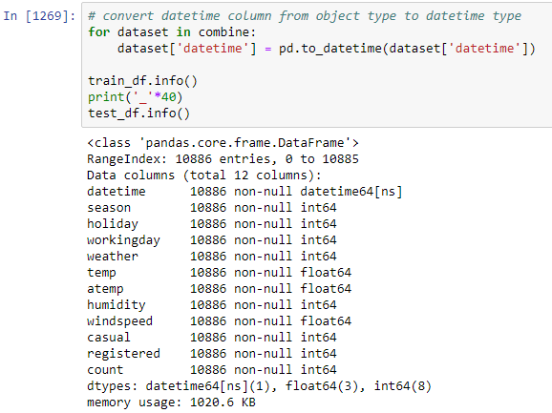
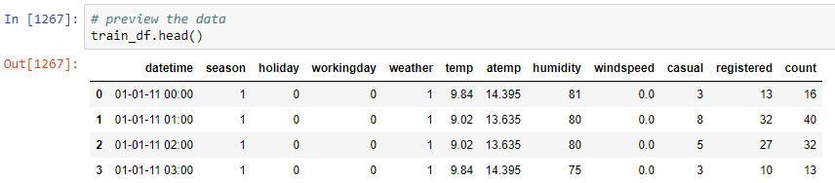
Project analysis slide 7
Data Summary
DATASET SIZE & VARIABLES TYPE
Here we have shows all the variable types and the size of our data set from Kaggle.
HEAD OF THE CSV
This is the first few rows of the CSV file.
Notes:
As a first step lets do three simple things on the data.
Dataset size.
Get a glimpse of data by printing few rows of it.
What type of variables contribute our data.

Slide 5
Project analysis slide 7
Data Summary
Date time | Season | Holiday | Working day | Weather | Temp | atemp | Humidity | Wind speed | Casual | Registered | count
Hourly date | 1 = Spring | Whether the day is considered a holiday | Whether the day is neither a weekend nor holiday | 1: Clear, Few clouds, Partly cloudy, Partly cloudy | Temperature in Celsius | “Feels like" temperature in Celsius | Relative humidity | Speed of the wind | # Non-registered user rentals initiated | # Registered user rentals initiated | # Total rentals
Time stamp | 2 = Summer |  |  | 2: Mist + Cloudy, Mist + Broken clouds, Mist + Few clouds, Mist
 | 3 = Fall |  |  | 3: Light Snow, Light Rain + Thunderstorm + Scattered clouds, Light Rain + Scattered clouds
 | 4 = Winter |  |  | 4: Heavy Rain + Ice Pallets + Thunderstorm + Mist, Snow + Fog
You are provided hourly rental data spanning two years. For this competition, the training set is comprised of the first 19 days of each month, while the test set is the 20th to the end of the month. You must predict the total count of bikes rented during each hour covered by the test set, using only information available prior to the rental period.

Slide 6
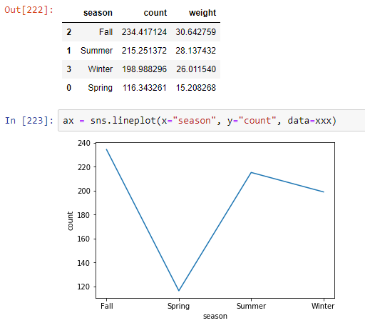
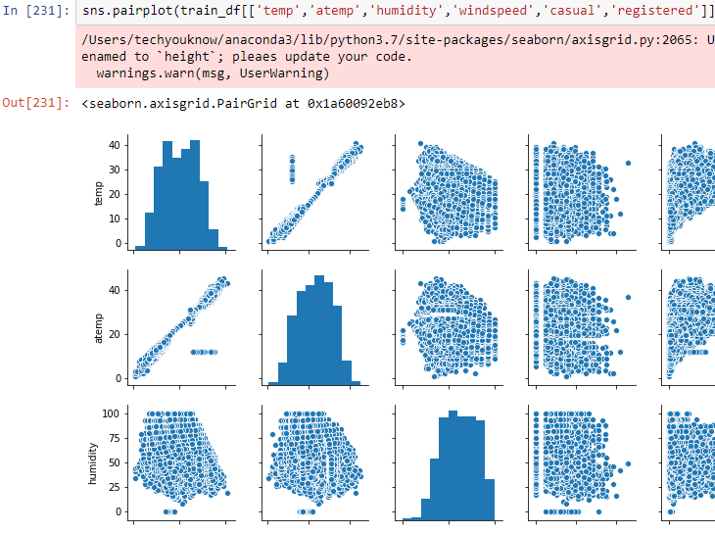
Project analysis slide 7
Visualizing
COUNT DISTRIBUTION BY SEASON
SAMPLE OF THE DIFFERENT COLUMNS
Notes:
Explain why it doesn't make sense, mistake from the data set.

Slide 7
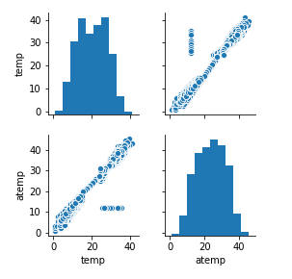
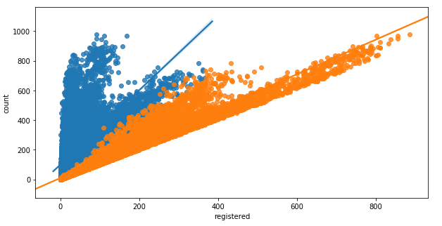
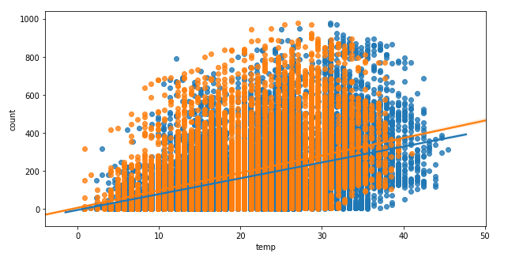
Project analysis slide 7
Data Cleaning
CASUAL VS REGISTERED
TEMP VS ATEMP
casual” and “registered” attributes are also not taken into account since they are leakage variables in nature and need to be dropped during model building.
atemp” variable is not taken into account since “atemp” and “temp” has strong correlation with each other.
Notes:
Once we get the hang of the data and attributes, next step we generally do is to find out whether we have any missing values in our data.
Luckily we do not have any missing value in the data.
One way which I generally prefer to visualize missing value in the data is through missingno library in python.
temp” and “humidity” features have positive and negative correlation with count respectively. Although the correlations between them are not very prominent, still the count variable has got little dependency on “temp” and “humidity”.
“windspeed” is not going to be a really useful numerical feature and that is visible from the correlation value with “count”.
“atemp” variable is not taken into account since “atemp” and “temp” has strong correlation with each other. During model building any one of the variables has to be dropped since they will exhibit multicollinearity in the data.
“casual” and “registered” attributes are also not taken into account since they are leakage variables in nature and need to be dropped during model building.
Regression plot in seaborn library in python is one useful way to depict the relationship between two features. Here we consider “count” vs “temp”, “humidity” and “windspeed”. Although we have three numerical features which have some correlation with the dependent variable “Count”, its not going to help us a lot in predicting and it is clearly visible from the regression plots shown below. So as a next step let us see how the categorical variables help us in model building

Slide 8
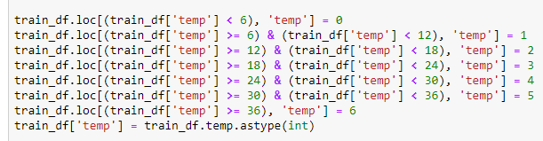
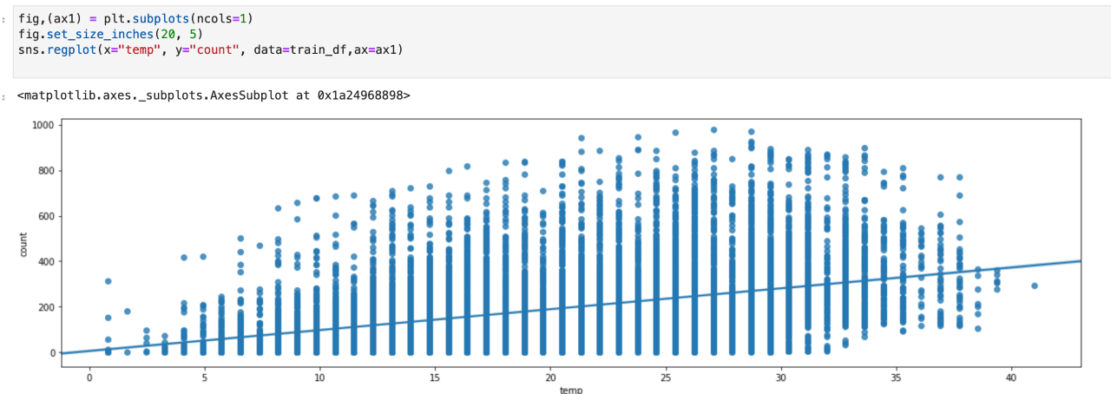
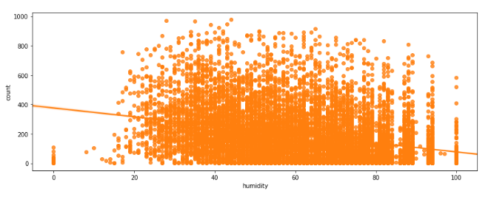

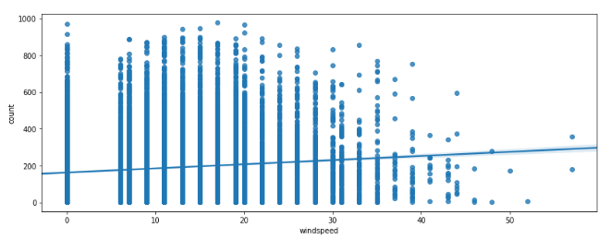

Project analysis slide 7
Feature Engineering
TEMP CATEGORY
HUMIDITY CATEGORY
WIND CATEGORY
Notes:
As we see from the above results, the columns season, holiday, workingday and weather should be of categorical data type.
But the current data type is int for those columns. Let us transform the dataset in the following ways so that we can get started with our EDA.
Temp, Wind, Humadity.

Slide 9
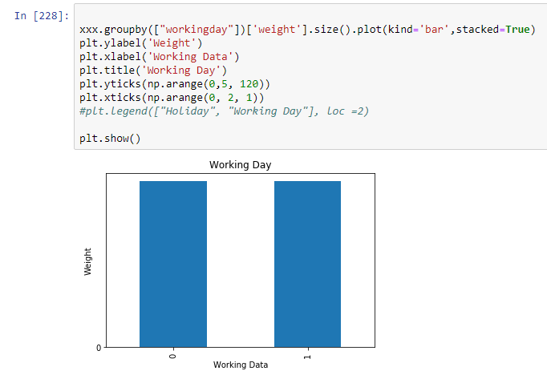
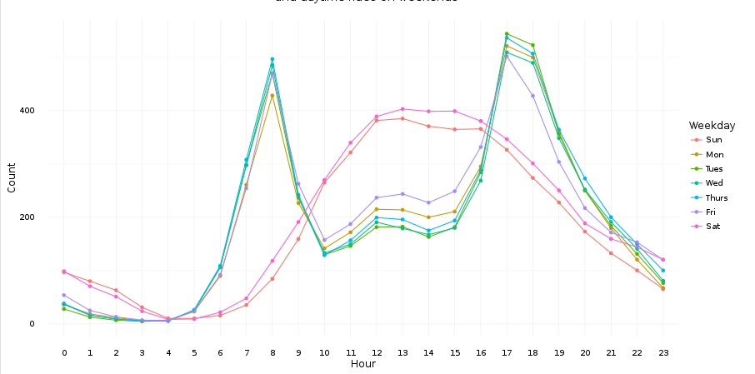
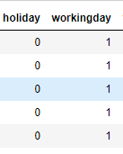
Project analysis slide 7
Outlier Analysis
WORKING DAY VS WEEKEND
HOURLY DEMAND WITHIN A DAY
Although work-days and weekends have surprisingly identical number of rentals, the distribution within a day is quite different
There are two distinct trends:
on workdays people rent bikes to go to and from work (spikes around 8 and 5 o’clock)
on weekends and holidays people rent bikes for leisure during the entire daylight time
Notes:
At first look, “count” variable contains lot of outlier data points which skews the distribution towards right (as there are more data points beyond Outer Quartile Limit).
Besides, the following inferen0ces can also been made from the simple box plots given below.

Slide 10

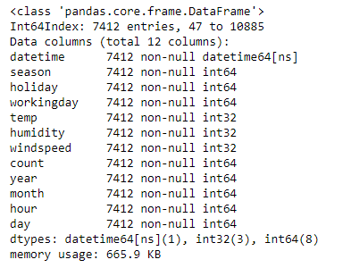
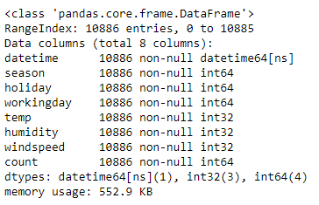
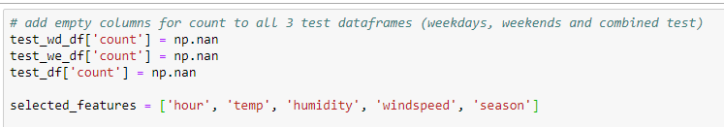
Project analysis slide 7
Modeling
DATASET AFTER CLEANING
SELECTED FEATURES
Choosing what matters for the prediction.
Notes:
How the Dataset looks like before modeling.
Adding new column called “Count” which is containing empty values to be populated with predicted count, based on our modeling.
Selected features: Parameters from the initial dataset, since we believe those are the only one matters.

Slide 11
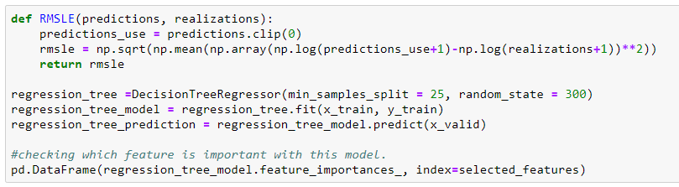
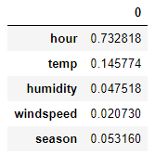
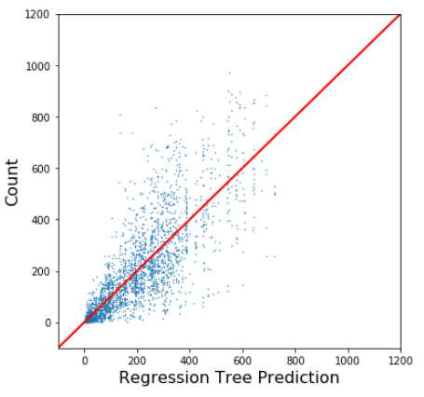
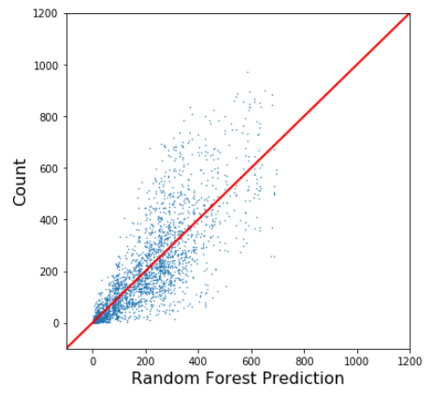


Project analysis slide 7
Modeling
PREDICTED VS ACTUAL COUNT (ENTIRE DATASET)
REGRESSION TREE
RANDOM FOREST

Slide 12
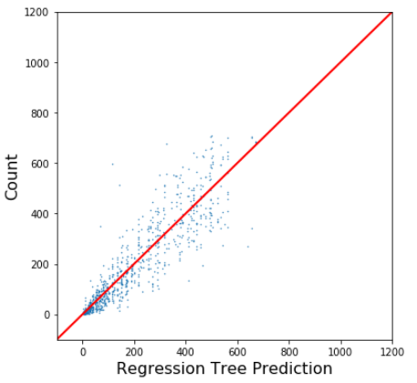
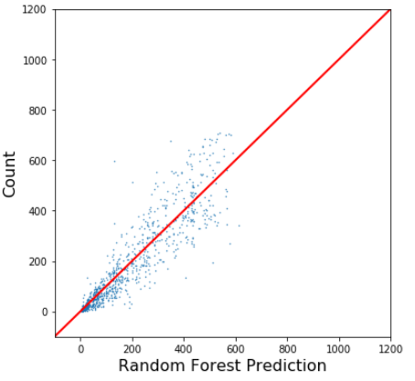


Project analysis slide 7
Modeling
PREDICTED VS ACTUAL COUNT (WEEKENDS AND HOLIDAYS)
REGRESSION TREE
RANDOM FOREST

Slide 13
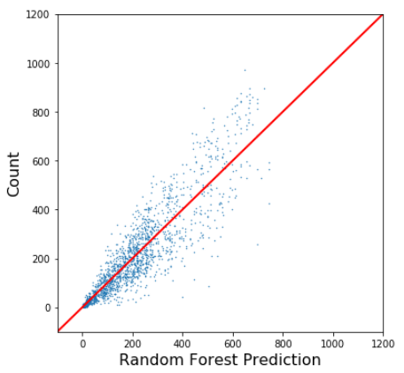
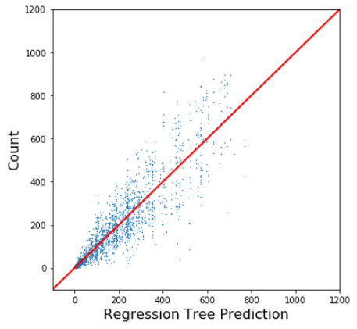


Project analysis slide 7
Modeling
PREDICTED VS ACTUAL COUNT (WORKDAYS)
REGRESSION TREE
RANDOM FOREST

Slide 14


Thank You

