Slide 1
CS 631 Advanced Software Engineering
Presentation
On
Integrating Knowledge Life Cycle within Software Development Process to Produce a Quality Software Product
By
Team Members:
Kaveri Hari Charan Yadav(S01996273)
Hafsa Sami (S01994757)

Slide 2
Contents
Introduction
Knowledge Management
Knowledge Management in Software Engineering
Knowledge Management in System Development Life Cycle
Success factors Emphasis the integration of KLC and SDLC
A Proposed KLC/SDLC framework
Conclusion
Report
Critic
References

Slide 3
Introduction
Information Technology plays a vital role in all aspect of business and daily work.
Software Engineering and Development process is not an easy task and requires involvement of people from different disciplines.
To overcome this complexity, Knowledge Management is the key factor.
The main objective of software engineering is to improve organization production and quality.

Slide 4
Knowledge Management
Knowledge Management (KM) a method that simplifies the process of sharing, distributing, creating, capturing and understanding of a company's knowledge.
The two important strategic of knowledge management are
Codification
Personalization
Knowledge Life Cycle(KLC) has five phases
Create
Capture
Transform
Practice
Sharing

Slide 5
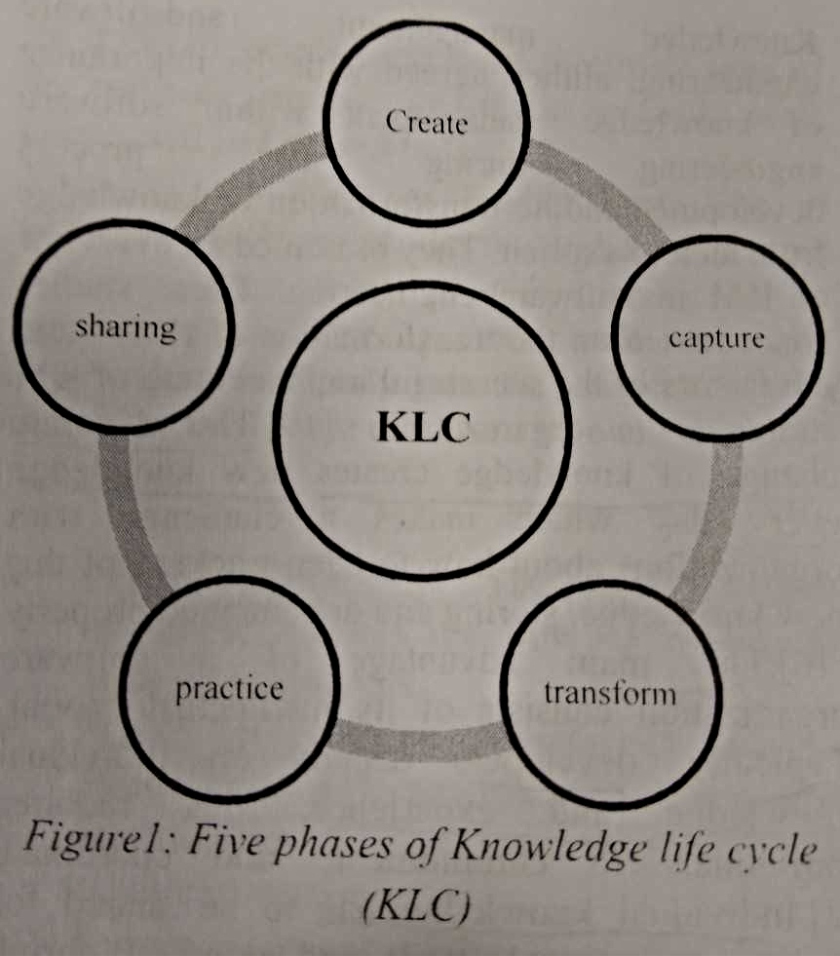
KLC is a technique involved in many organizational aspects to improve the quality of woks especially in software engineering field.

Slide 6

Knowledge Management in Software Engineering
The purpose of knowledge management is to enhance people knowledge to be shared and use and reuse within all organizational levels.
Software engineering is a complicated process that required individual involvement in different phases and activities.

Slide 7
The dynamic change of knowledge.
KM in a software development process is seen as an opportunity to create a common language of understanding among software developers, so that they can interact, negotiate and share knowledge and experiences.

Slide 8
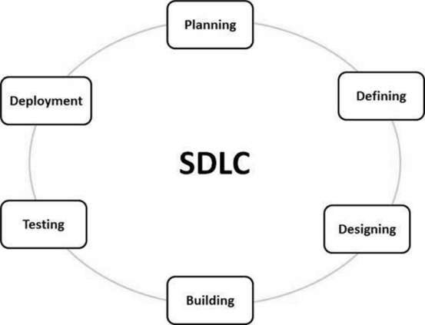
Knowledge Management in System Development Life Cycle
The main objective of knowledge management in software engineering is to facilitate the flow of knowledge and information for each phase in SDLC process.

Slide 9
Success factors Emphasis the integration of KLC and SDLC
KM can improve the software development process by simplifying learning, sharing knowledge and expertise, improving product and reducing time and money.
People Collaboration
People Involvement
Top Management Support
Knowledge Management System

Slide 10

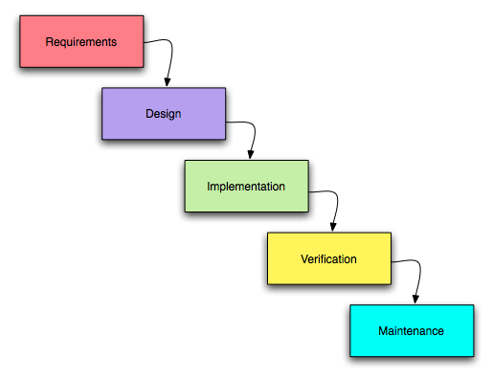
A Proposed KLC/SDLC framework
SDLC and KLC process

Slide 11
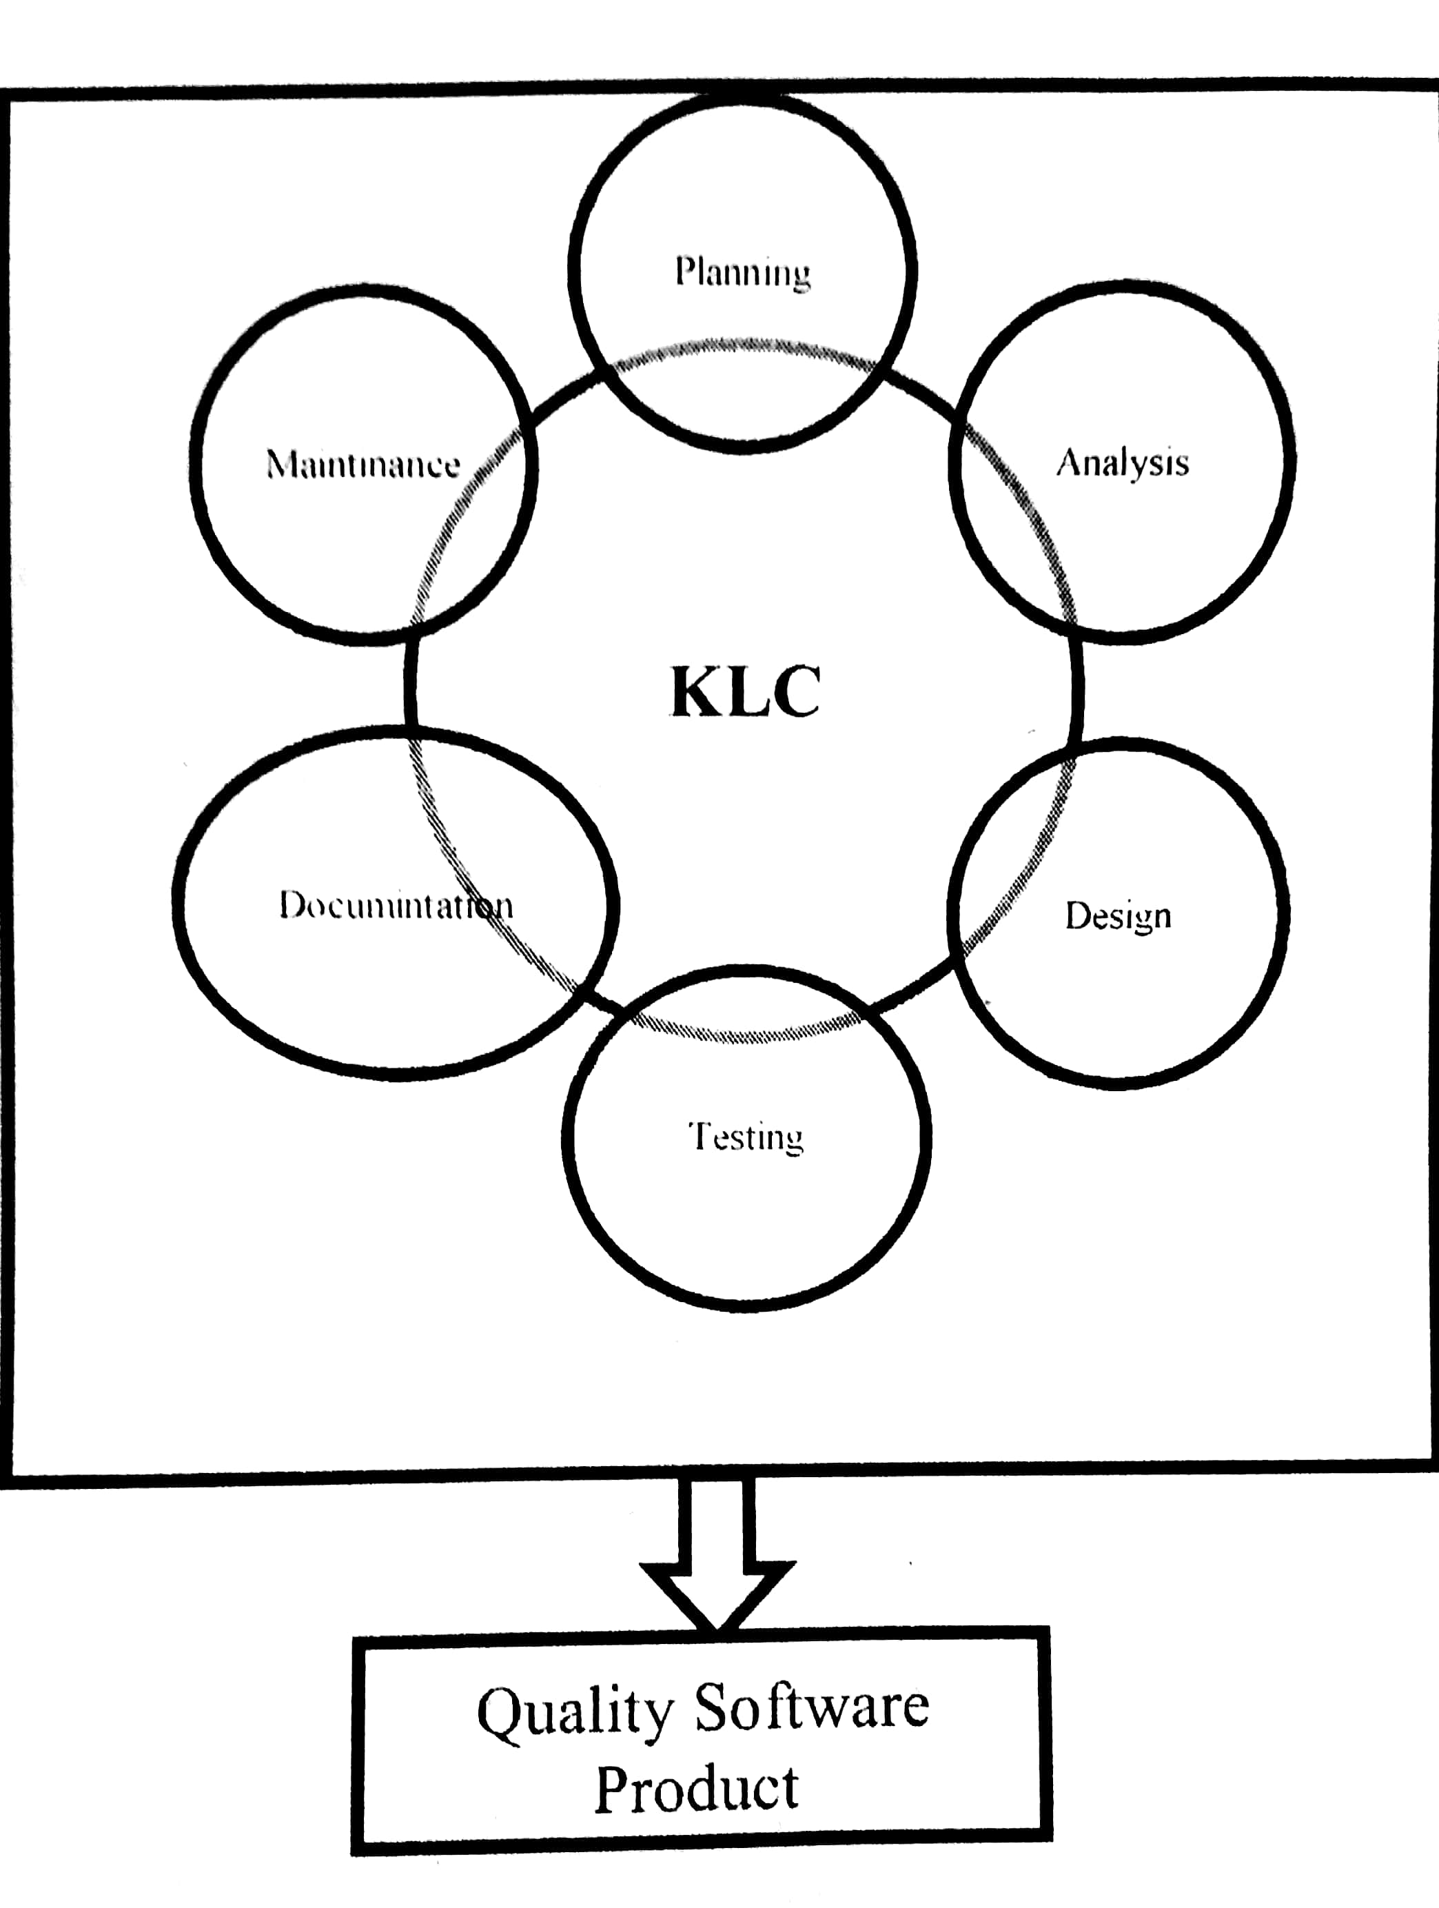
The Figure shows the integration of Knowledge life cycle with software development life cycle.

Slide 12
Using integration of KLC with SDLC domain knowledge software development process increases the effectiveness, efficiency and performance and also reduces defect density.

Slide 13
Conclusion
To provide a quality product, organizations have to keep track of what knowledge is required during software development process and should have knowledgeable people involvement from different discipline.

Slide 14
Report
The purpose of this research is about
* Involvement of KM within software engineering during development process.
* Integrating of KLC and SDLC
Result : Improving the organization performance by producing better products.
By collaborating different disciplines people together with KM may lead to better software development which results in quality outcome.

Slide 15
Critic
Doesn’t suitable for the larger projects.

Slide 16
References
Carreteiro P, de Vasconcelos JB, Barão A, Rocha Á. A Knowledge Management Approach for Software Engineering Projects Development. New Advances in Information Systems and Technologies. 2016 Mar 15;444:59.
Dingsøyr T, Conradi R. A survey of case studies of the use of knowledge management in software engineering. International journal of software engineering and knowledge engineering. 2002 Aug;12(04):391-414.
Hilburn TB, Hirmanpour I, Khajenoori S, Turner R, Qasem A. A Software Engineering Body of Knowledge Version 1.0. CARNEGIE-MELLON UNIV PITTSBURGH PA SOFTWARE ENGINEERING INST; 1999 Apr.

Slide 17
Thank You

