Slide 1

A K8-Based Mechanism for Remote Monitoring
and Control of IoT Devices
Sina Shabani Kumeleh
SUMMER OF 2023

Slide 2
Motivation

Slide 3
Motivation
Potential capabilities inside Edge Computing
Lack of a centralized and unified solution
Lack of a well documented and open source solution
Current solutions (if any) are not scalable
And very complex

Slide 4
Related Works

Slide 5
Related Works - Container Technologies
Kubernetes
Highly scalable container platform
Battle-Tested
Fault Tolerant
Massive community
Basically the cloud we know today
Virtual Kubelet
A Kubernetes node proxy
Registers itself as a node with a custom backend
Open source
Growing community

Slide 6
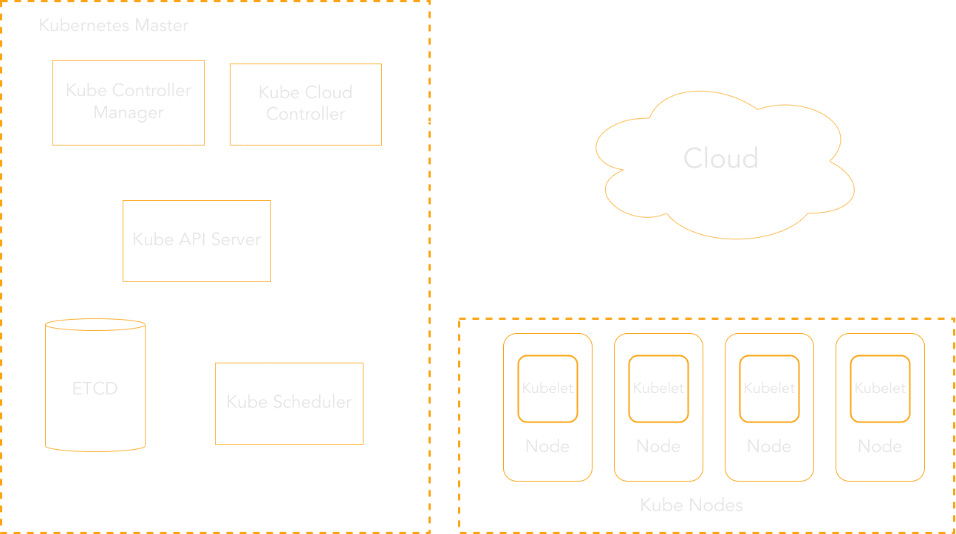
Kubernetes

Slide 7
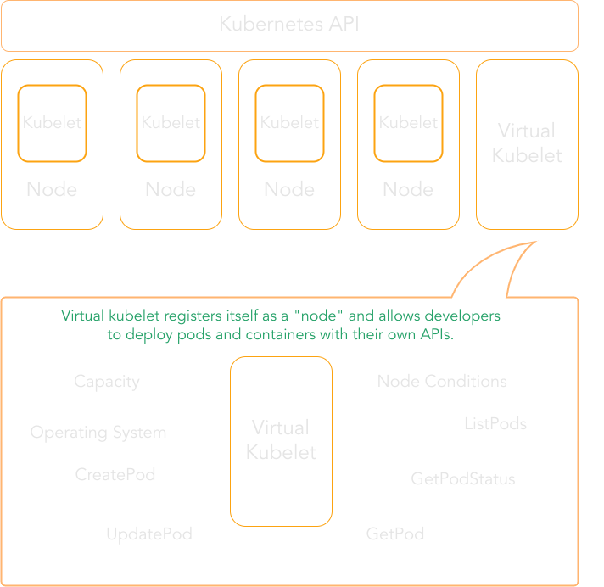
Virtual Kubelet

Slide 8
Design

Slide 9
Design
Scalable
Kubernetes
Fan-Out design
Simple
Used simple and popular transport protocols
HTTP
Used simple and popular data serialization
JSON
Written in Golang
Massive concurrency support
Simple to learn
Massive community

Slide 10
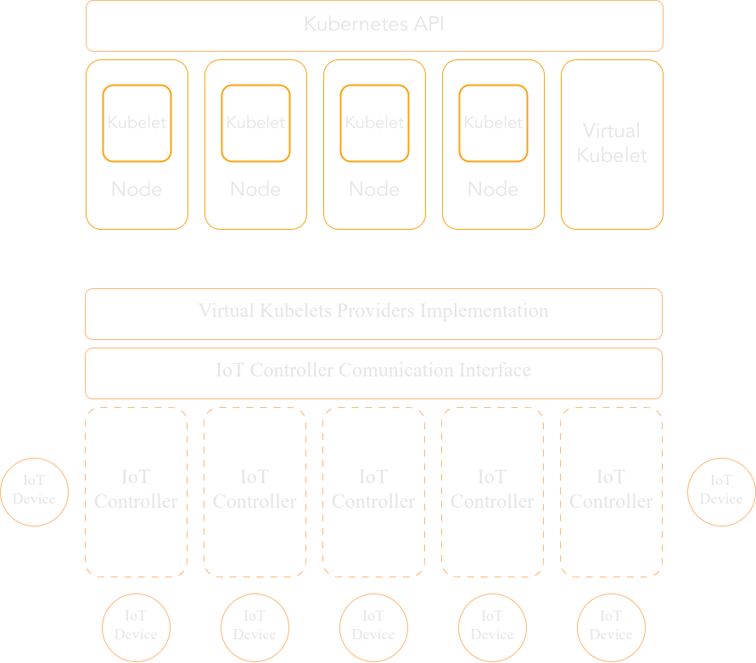
Design

Slide 11
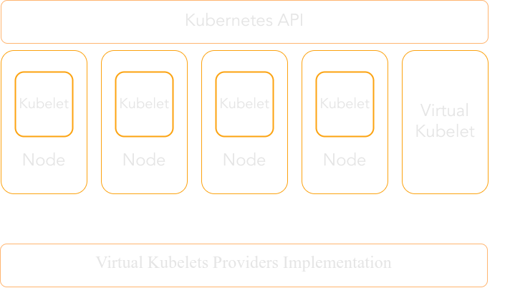
Design - Provider
By implementing virtual kubelet’s provider interface, we can have kubernetes node with a custom backend that receives kubernetes client API calls.

Slide 12
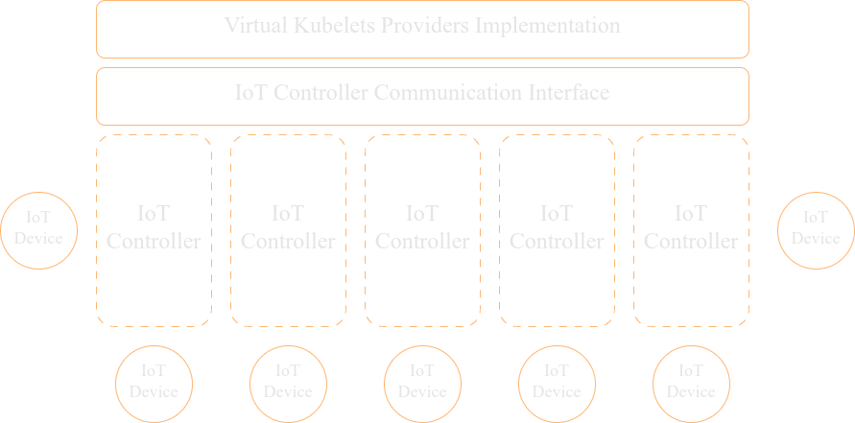
Design - Communication Interface
Provider communicates with Communication Interface through callbacks.
Communication Interface then fetches Device states by sending HTTP requests to IoT Controllers.
Communication Interface uses a Fan-Out technique.

Slide 13
Design - Simulation Software
Simple CRUD software
Attempts to simulate a smart lock system
Can have multiple controllers
And multiple devices per controllers
Written in Golang

Slide 14
Design - Graphical User Interface
Was not the the goals of this project
However provided to show the concept better
Simple GUI with two main part
One that connects to Kubernetes and shows Pods and Nodes
One that connects to the simulation software and shows IoT Controllers and Devices
Written with Vuejs

Slide 15
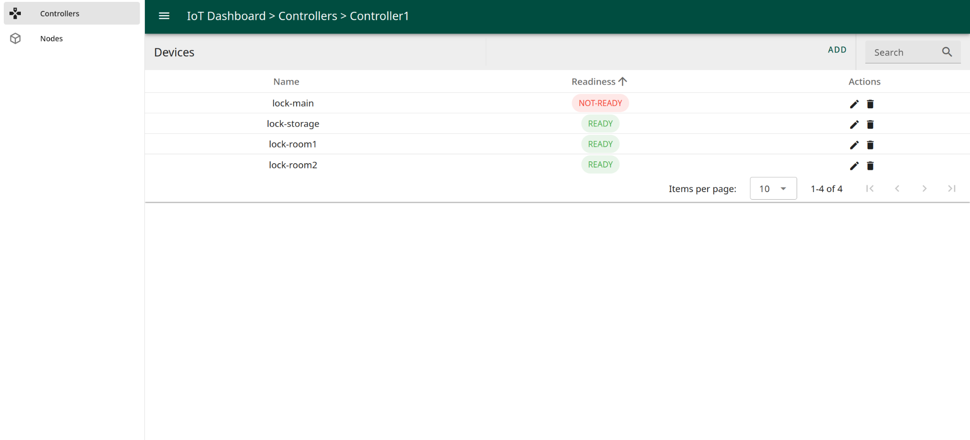
Design - Graphical User Interface

Slide 16
Performance Benchmark

Slide 17
Performance Benchmark
Benchmarks are generated with custom software
Benchmark software is written in Golang as for the rest of the project
A shell script then takes this software and generates desired results
The results are then fed to a python script that draws the charts using matplotlib
The entire project ran on a single Raspberry Pi 4 Model B Rev 1.4 with 4 cores and 8GiBs of DDR3 memory.

Slide 18
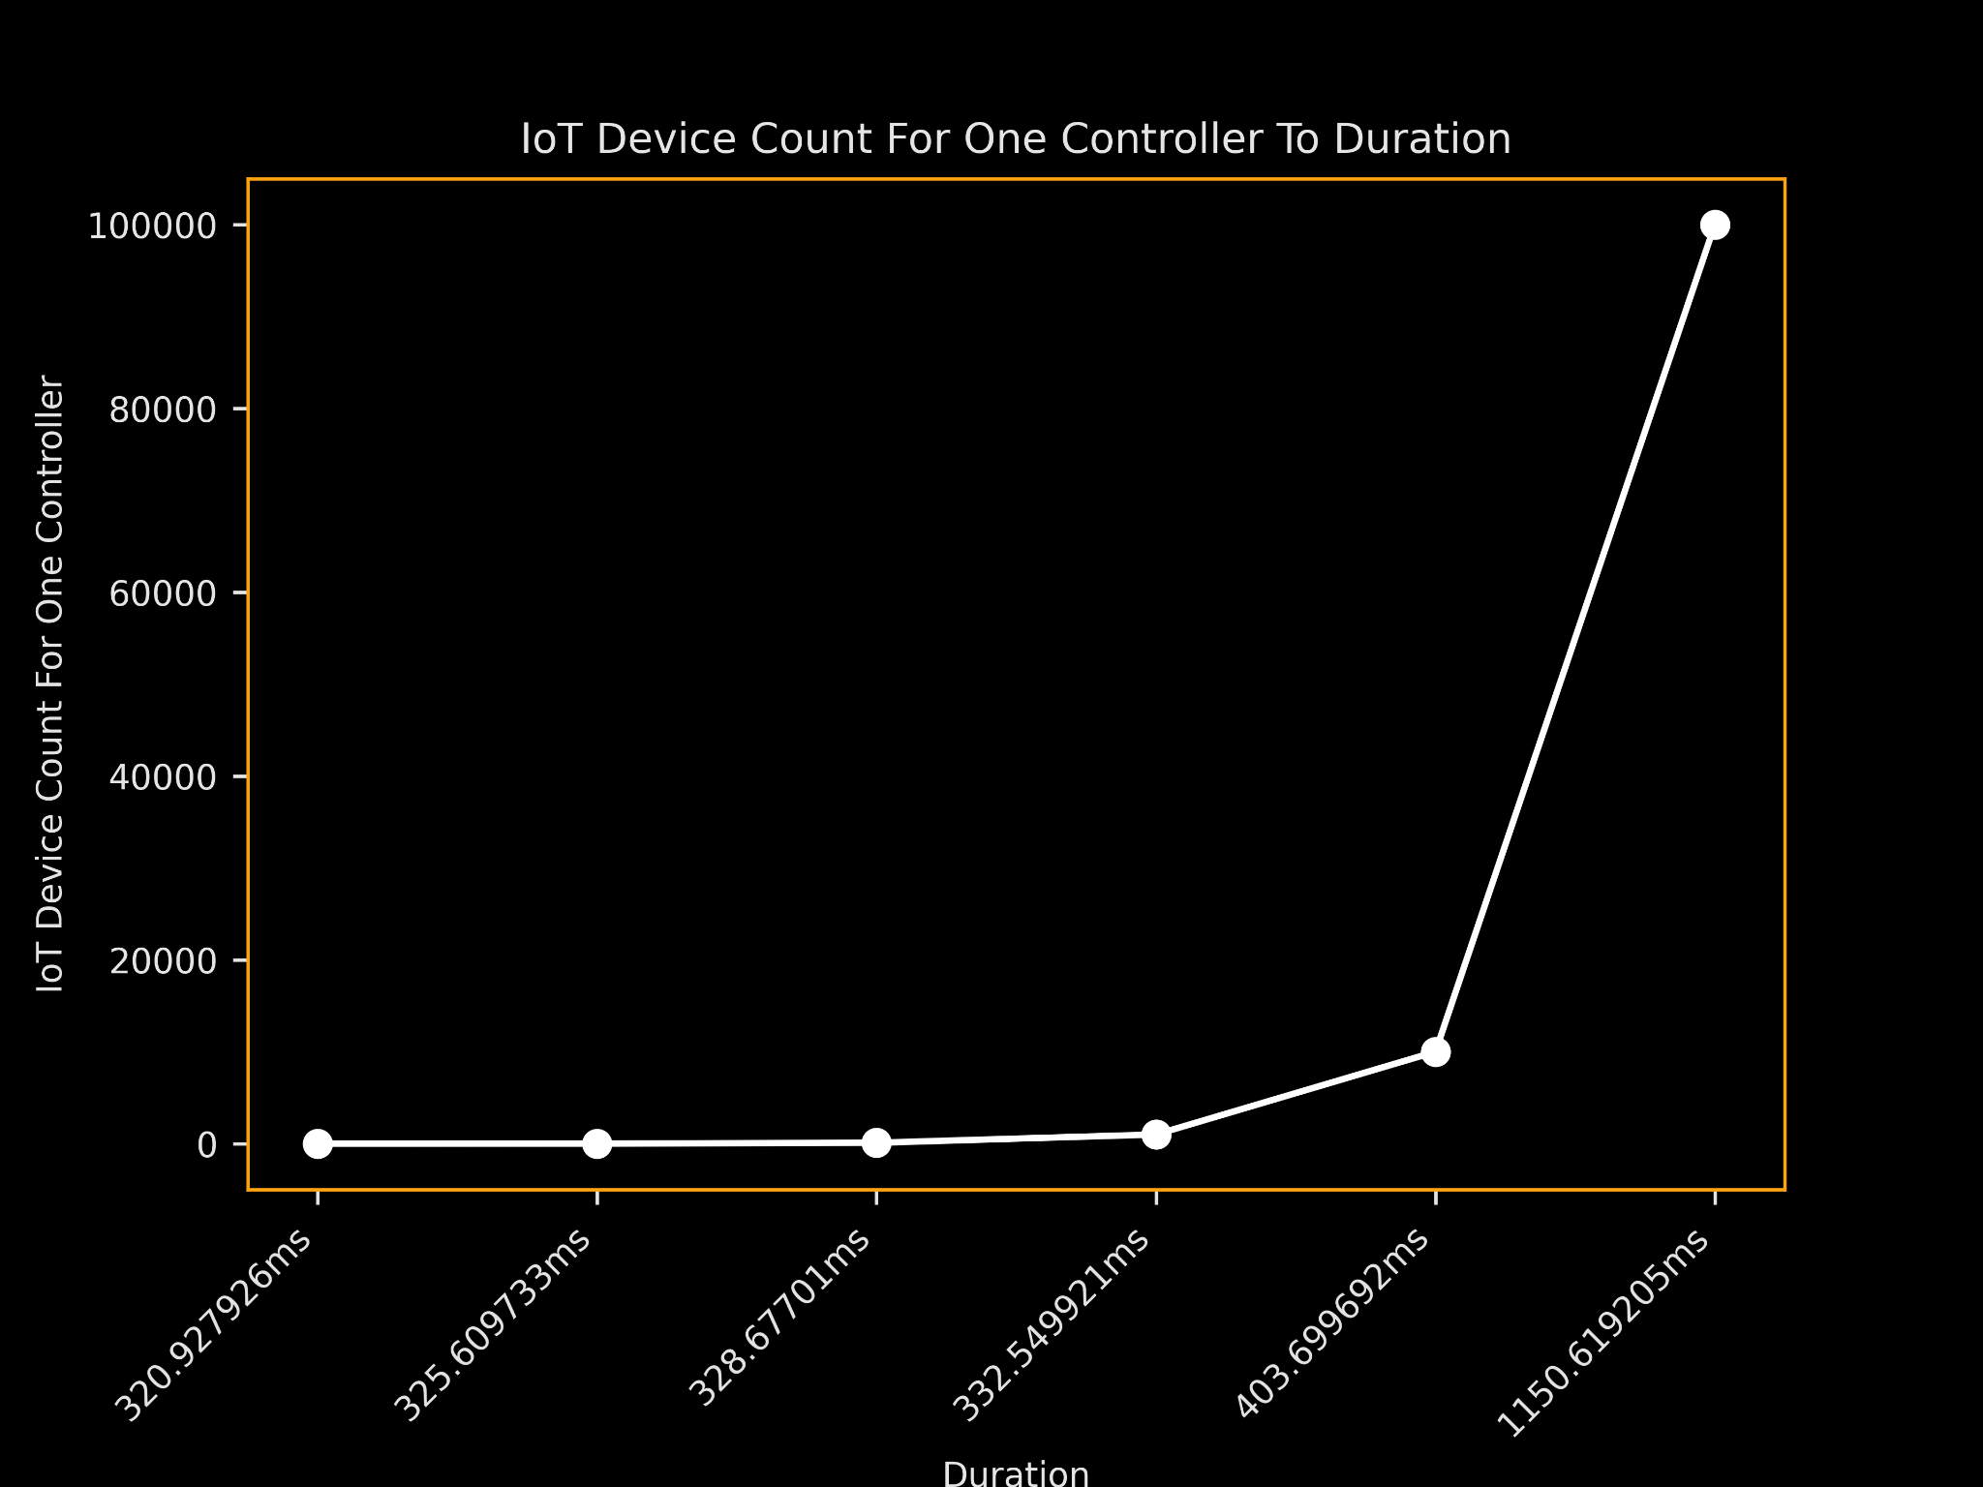
Performance Benchmark
Only a single provider
As you can see with a single controller we were able to control 100K IoT Devices with reasonable time.
It took 1.15 seconds to fetch the state of 100K devices from a single controller
This gives us a highly scalable and performant way of controlling IoT Devices.

Slide 19
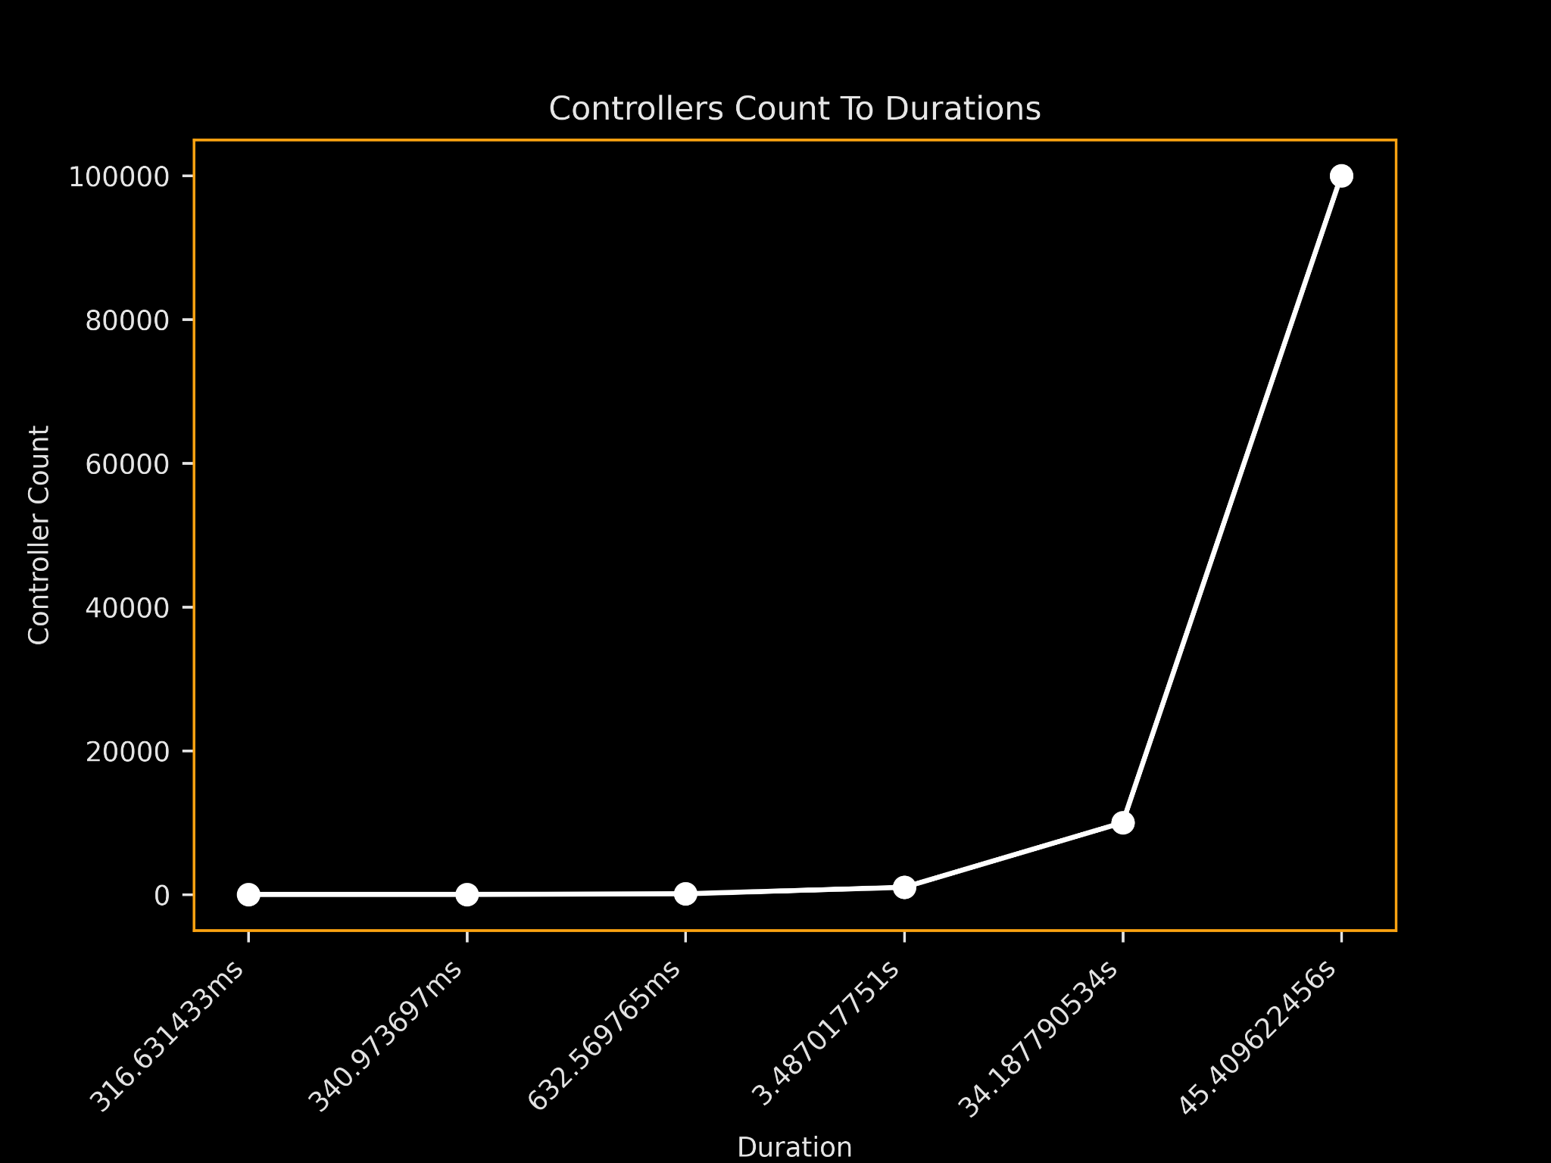
Performance Benchmark
Still a single provider
This time we tested a single device per controllers and then changed controller’s count.
It takes Significantly more to fetch IoT Device states.
Still reasonable.
We have 10x HTTP traffic
Easily scalable through adding more provider

Slide 20
Future Work

Slide 21
Future work
Security
Authentication
TLS
WireGuard
More performant transport protocols
Websockets
gRPC
More performant data serialization
Protocol buffers
Framework
Better developer experience
Better monetization

Slide 22

Any Questions?
Thanks.

