Slide 1
Business Need
for DevOps
Why Every Business Needs DevOps Today
| Assignment II | Group 17
Notes:
Good morning everyone our topic is Buisness Need for devops

Slide 2
What We Cover
01
Why DevOps Was Needed
06
Measurable Business Impact
02
What DevOps Actually Means
07
Before vs After DevOps
03
The DevOps Lifecycle — Step by Step
08
04
Real World: How Spotify & Amazon Use DevOps
09
05
Key Pillars: CI/CD, Automation, Culture
Notes:
🔹 Slide 2 – What We Cover
First, we’ll understand why DevOps was needed
Then, what DevOps actually means in real-world terms
After that, we’ll go through the lifecycle step by step
We’ll look at real-world companies using DevOps
Then key pillars like CI/CD, automation, and culture
Finally, business impact and comparison before vs after DevOps

Slide 3
Market Demand for DevOps
Software Moves Fast
Cloud & Agile Are Standard
Companies now expect daily updates. Release cycles measured in months are a competitive risk.
Cloud computing and agile teams are now the norm. DevOps plugs right into this way of working.
Industry Giants Lead the Way
High Career Demand
Amazon deploys every 11 seconds. Netflix runs 700+ microservices. DevOps makes this scale possible.
DevOps engineers rank among the highest-paid in tech. Companies can't hire them fast enough.
Notes:
Slide 3 – Market Demand for DevOps
Today, apps need updates very frequently
Earlier updates were slow, now speed is important
Cloud and Agile are widely used now
Companies like Amazon and Netflix deploy very fast
DevOps engineers are highly in demand
So DevOps is now necessary, not optional

Slide 4
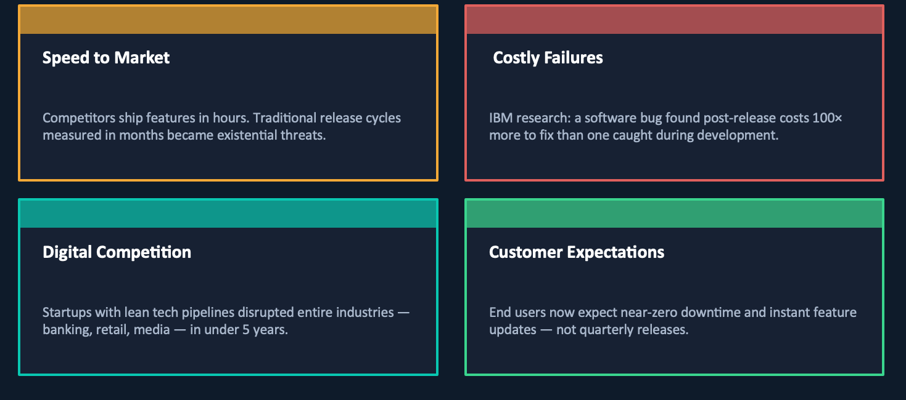
The Business Reality of DevOps
Notes:
🔹 Slide – Business Reality of DevOps (Natural Flow)
In today’s business environment, speed has become a competitive advantage
Companies can’t afford slow releases anymore — users expect quick updates
If a company is slow, users can easily switch to competitors
That’s why businesses need faster development and reliable deployments
Companies like Amazon and Netflix release updates very frequently to stay ahead

Slide 5
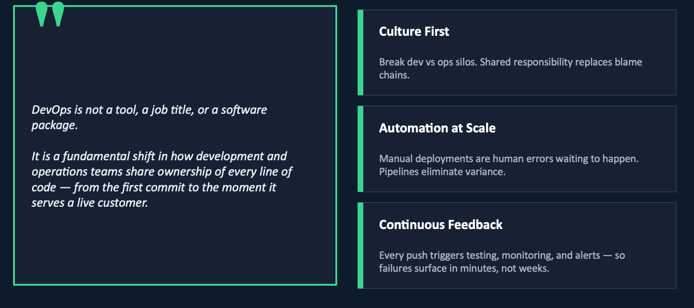
What DevOps Actually Means
Notes:
🔹 Slide 4 – What DevOps Actually Means
DevOps = Development + Operations working together
No separate teams, everything is collaborative
Goal is faster and stable delivery
Focus on automation and continuous improvement
It’s not just tools — it’s a mindset improve there wording not look like i am reading

Slide 6
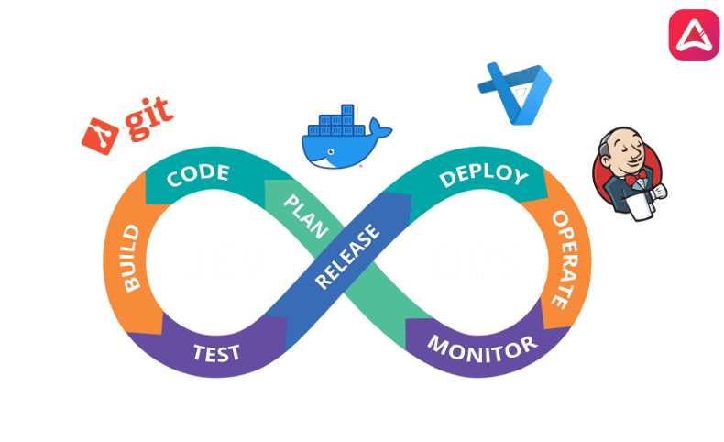
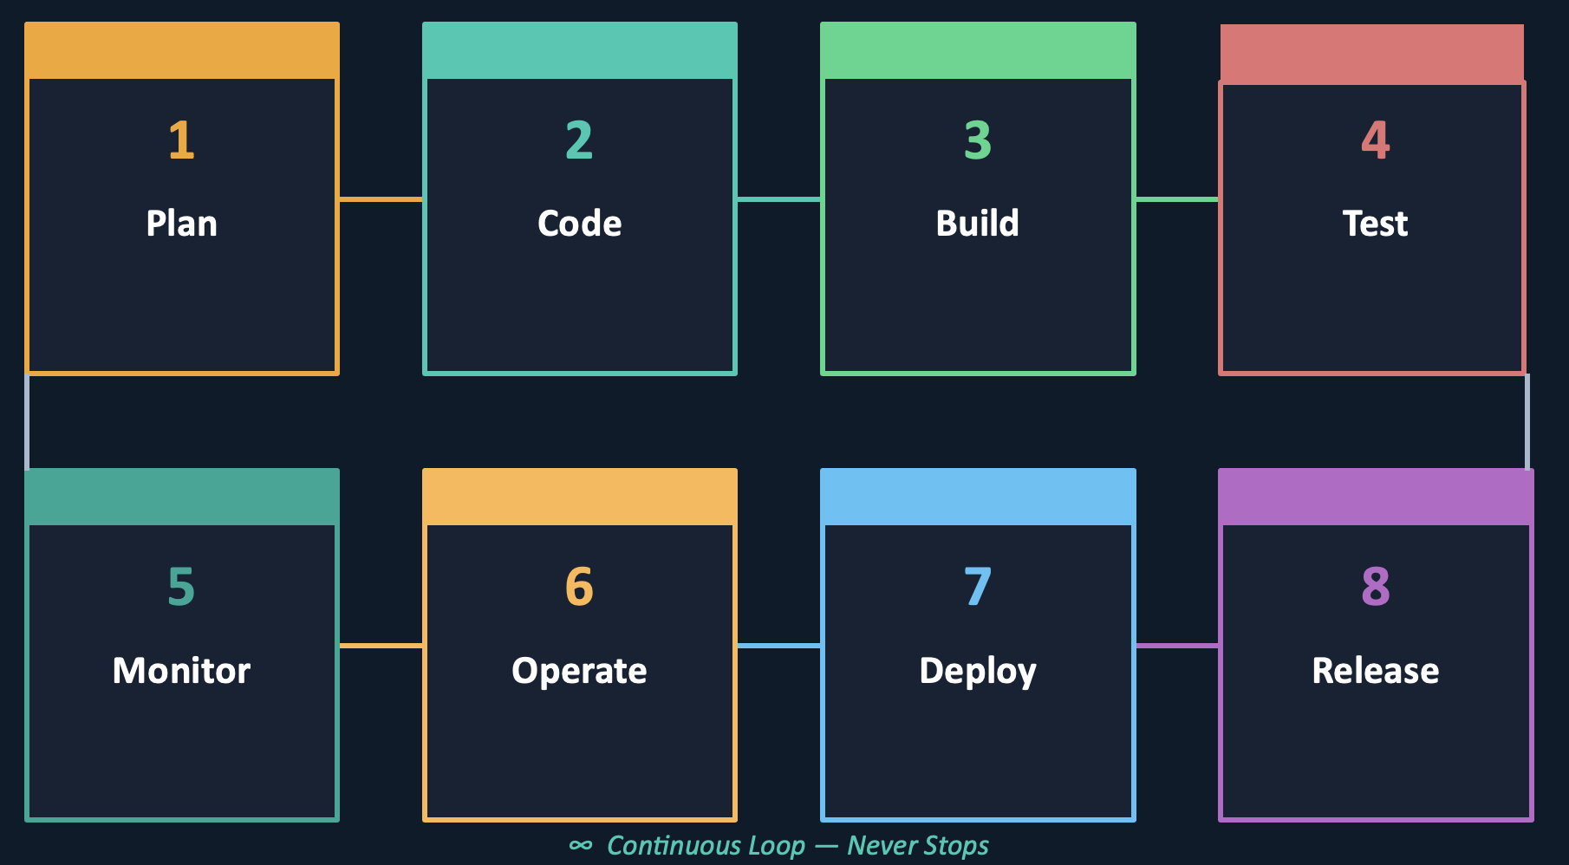
The DevOps Lifecycle — End to End
Notes:
Slide 5 – DevOps Lifecycle
so DevOps lifecycle is like a continuous loop… not one-time process
it starts with planning… where requirements are decided
then developers write code
after that build phase… code is compiled and packaged
then testing happens… to catch bugs early before release
next is deployment… code goes to production
after deployment monitoring starts… to track performance
feedback comes from users and system… and goes back to planning again

Slide 7
Improved Collaboration
HOW TEAMS CHANGE
WHAT YOU GAIN
● Developers and Ops work side by side
● Faster issue resolution — no handoffs
● Both teams own deployments together
● Better communication across the org
● Problems are solved as one unit
● No finger-pointing — only teamwork
● Shared responsibility for every release
● Happier teams, fewer surprises in prod
Notes:
🔹 Slide 6 – Collaboration
earlier dev and ops used to blame each other
now both work together from start
deployment is shared responsibility
problems are solved as a team
overall communication improves a lot

Slide 8
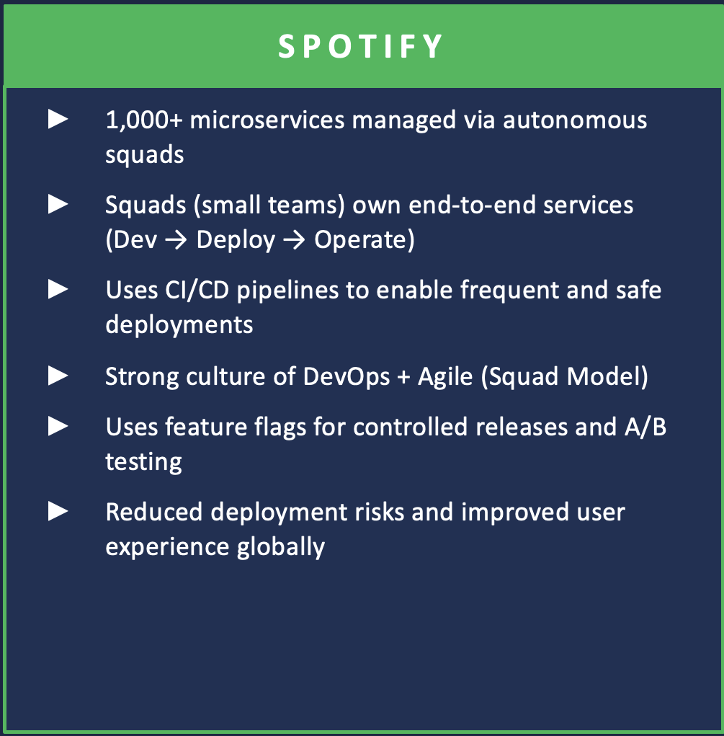
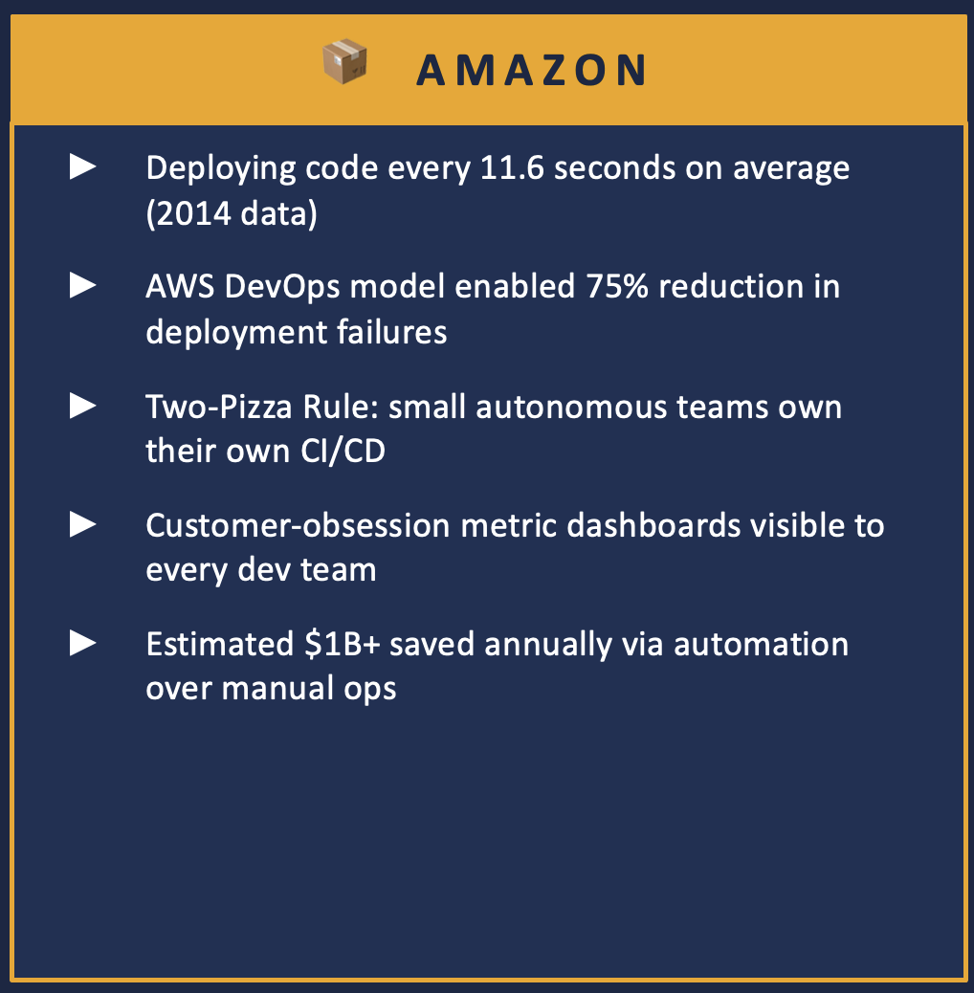
Real-World Case Study: Netflix & Amazon
Notes:
🔹 Slide 7 – Real-World Case: Netflix & Amazon
* Netflix uses DevOps to manage hundreds of microservices
* They deploy updates frequently without downtime
* Amazon deploys changes every few seconds
* These companies rely heavily on automation and monitoring
* Without DevOps, managing this scale would not be possible

Slide 9
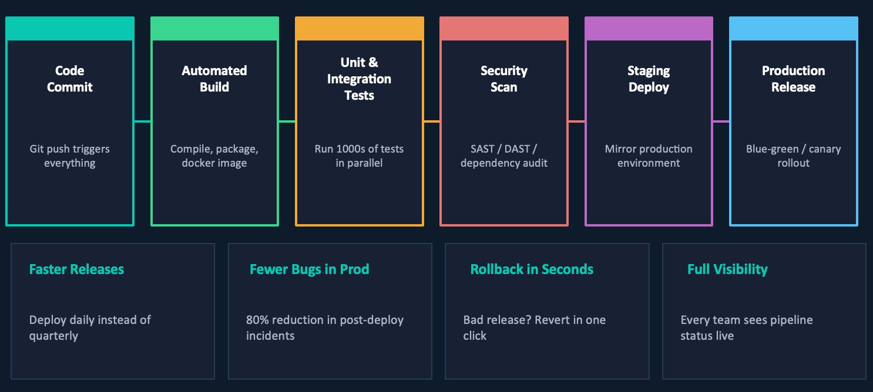
CI/CD: The Backbone of DevOps Velocity
Notes:
🔹 Slide 8 – CI/CD (continuous integration continuous delivery)
*so whenever a developer pushes code… pipeline automatically starts
*first step is build… where code is compiled and artifact is created like docker image
*after that automated tests run… unit tests + integration tests to catch bugs early
*along with that security scans also happen… like checking vulnerabilities
*if everything passes… code moves from staging to production environment f
*then final deployment happens in production
*we can use strategies like blue-green or canary to avoid risk
*whole pipeline is automated… no need of manual intervention
👉 developer pushes code → pipeline triggers → build → test → deploy
👉 earlier this process used to take days… now it happens in minutes

Slide 10
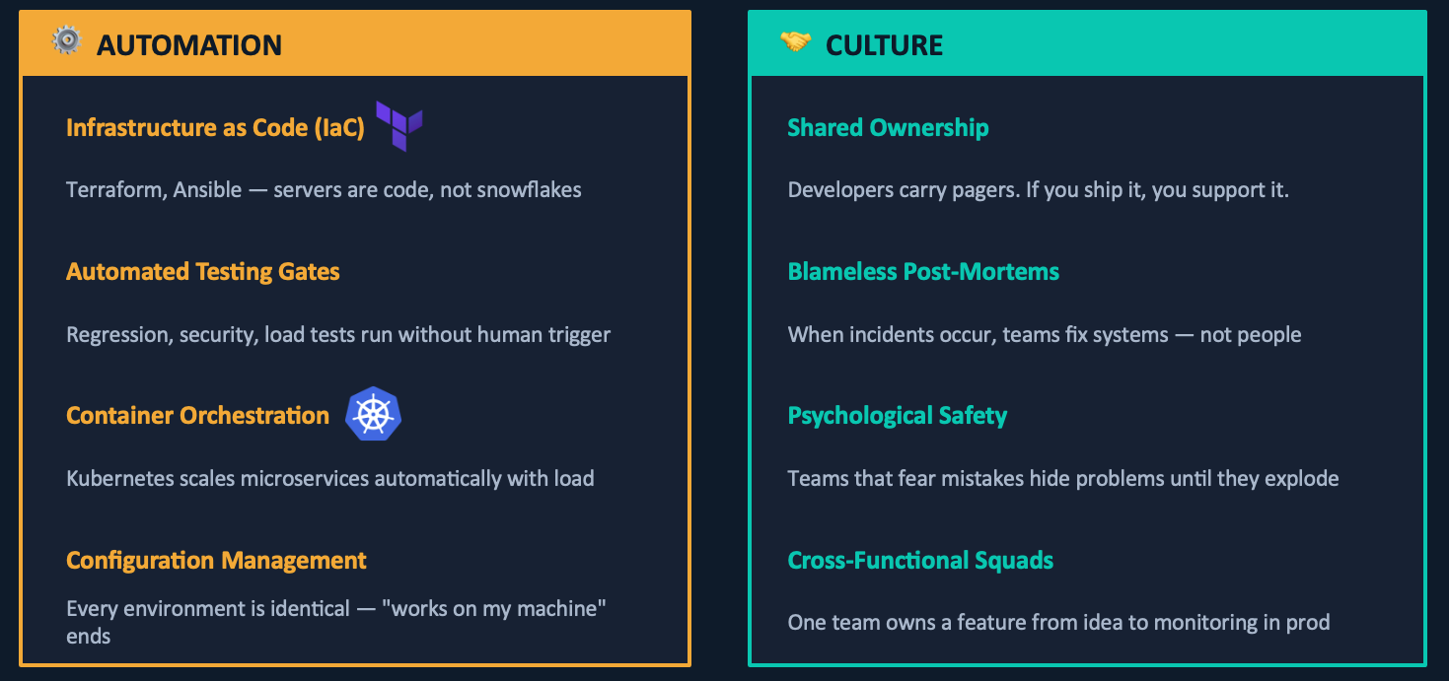
Automation & Culture: The Two Pillars
Notes:
🔹 Slide 9 – Automation & Culture
DevOps is built on two things: automation and culture
Automation reduces manual work using tools like Terraform and ansible
Testing is automated to ensure quality
Kubernetes --- orchestration that helps manage containers and auto scaling
Configuration stays consistent across environments
Culture part:
Teams share ownership
No blame — only improvement
Everyone works together from development to deployment
👉 Example:
If a bug occurs, whole team fixes it instead of blaming

Slide 11
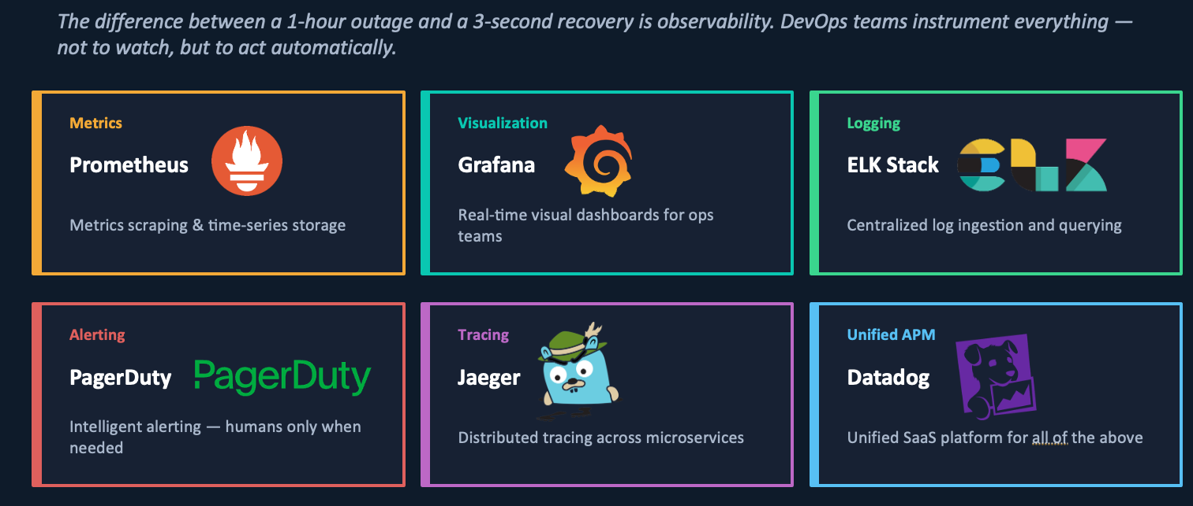
Monitoring, Observability & Feedback Loops
Notes:
🔹 Slide 10 – Monitoring & Observability
Monitoring -- helps track system performance in real time
Tools like Prometheus collect metrics like CPU usage
Grafana -- shows dashboards for visualization
ELK -- is used for stack handles logs
PagerDuty -- sends alerts only when necessary
Jaeger helps trace requests across services
👉 result:
faster recovery, less downtime

Slide 12
Cost Efficiency
Automate the Grind
Catch Bugs Early
Repetitive manual tasks are handled by pipelines. Teams focus their energy on real work.
Automated tests find errors before they reach production. Less rework means lower cost.
Use Resources Wisely
Avoid Costly Downtime
Infrastructure scales on demand. No idle servers, no over-provisioning, no wasted spend.
Real-time monitoring catches issues before users are affected. Fewer incidents, less damage.
Notes:
🔹 Slide 11 – Cost Efficiency
*automation saves time and effort
* It help in early bug detection and reduces cost
*cloud scaling avoids wastage of resources
*monitoring prevents major failures and downtime

Slide 13
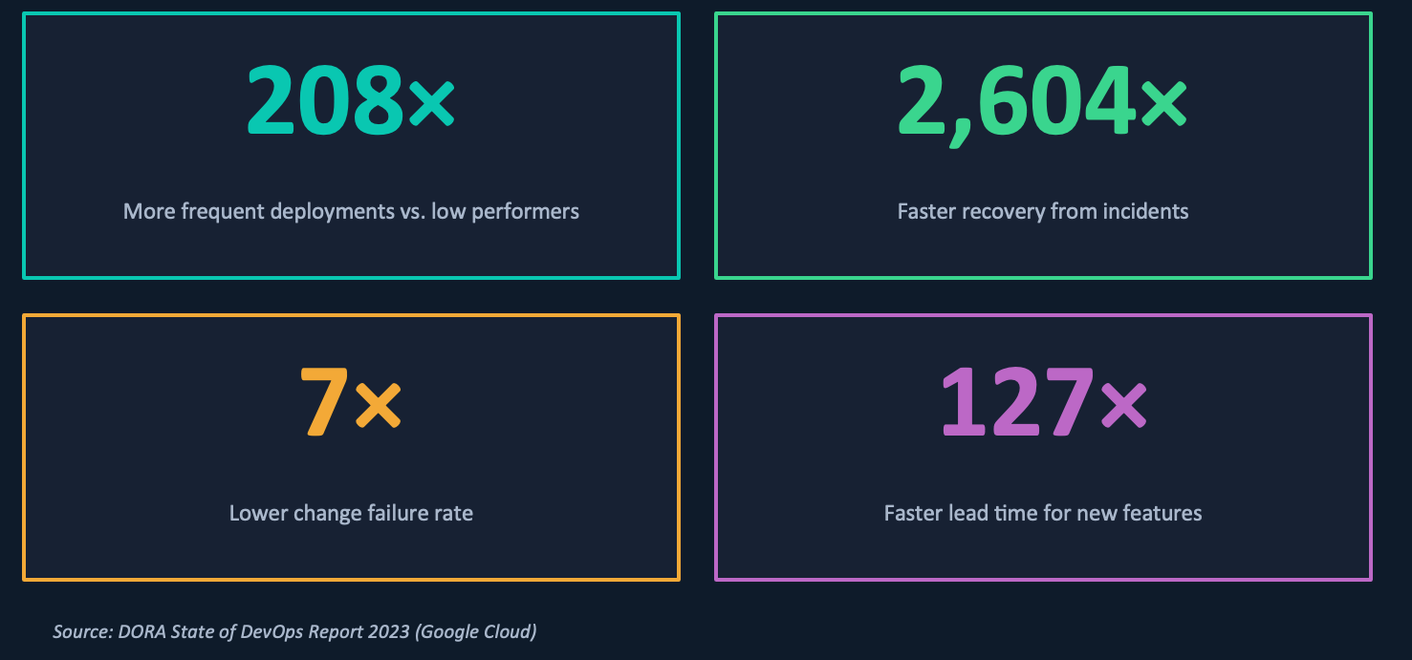
Measurable Business Impact
Notes:
DevOps gives measurable improvements…
companies deploy way more frequently
recovery from failures becomes very fast
failure rates are much lower
features are delivered quickly
👉
200+ times more deployments
2600+ times faster recovery
👉 example:
companies like Netflix release updates continuously without issues

Slide 14
Competitive Advantage
Ship Faster
Better Quality Products
Release features in days, not months. Faster delivery means happier customers and more revenue.
Every commit is tested automatically. Fewer bugs reach production, fewer customers are affected.
Respond to Change Quickly
Stay Ahead of Competitors
When market conditions shift, DevOps teams can adapt in days. Others take months to catch up.
Companies using DevOps outpace rivals. Innovation is faster when deployments are fearless.

Slide 15
Before vs. After DevOps
BEFORE DevOps
AFTER DevOps
Releases every 3–6 months
Deploy multiple times per day
Dev blames Ops for outages
Shared ownership — no blame game
Testing at end of cycle
Automated tests on every commit
Manual provisioning of servers
Infrastructure spins up via code
Silent failures found by customers
Alerts before users ever notice
Knowledge siloed in individuals
Documented, automated, team-wide
Notes:
now
🔹 Slide 14 – Before vs After DevOps
earlier releases took months → now deployments happen daily
dev and ops were separate → now shared responsibility
testing at the end → now continuous testing
users found bugs → now system detects early
👉 strong line:
shift from slow and reactive → fast and proactive

Slide 16
Question and Answer (Q&A) — Part 1
Q & A
What is DevOps and why did businesses start using it?
A
DevOps combines Development and Operations teams into one workflow. Businesses adopted it because traditional release cycles took months, causing delays and costly bugs. DevOps allows faster, safer, and more frequent software releases.
What is CI/CD and how does it help a team?
A
CI/CD stands for Continuous Integration and Continuous Delivery. Every time a developer pushes code, it is automatically tested and deployed. This means bugs are caught early, releases happen faster, and there is no need for big risky launches.

Slide 17
Question and Answer (Q&A)
Q & A
How does DevOps improve teamwork between developers and operations?
A
DevOps breaks down the wall between Dev and Ops. Both teams share responsibility for the product, which means fewer handoffs, less blame, and faster problem-solving. A shared ownership mindset leads to better communication and more reliable software.
What measurable results do companies see after adopting DevOps?
A
According to the DORA 2023 report, top DevOps teams deploy 208 times more often and recover from issues 2,604 times faster than slow teams. They also have a 7x lower failure rate. Companies like Netflix and Amazon directly credit DevOps for their ability to scale and compete.

Slide 18
References & Sources
DORA State of DevOps Report 2023 — Google Cloud | dora.dev/research/2023
[1]
→ Survey of 36,000+ professionals. Shows top DevOps teams are far faster and more reliable than others.
Kim, G. et al. — The Phoenix Project (IT Revolution, 2013) | itrevolution.com/the-phoenix-project
[2]
→ A book that introduced DevOps thinking. Shows how IT should be a value creator, not just a cost center.
Humble, J. & Farley, D. — Continuous Delivery (Addison-Wesley, 2010) | continuousdelivery.com
[3]
→ A practical guide to building automated deployment pipelines. Key reference for CI/CD pipeline design.
Netflix Tech Blog — Chaos Engineering at Scale | netflixtechblog.com
[4]
→ Netflix explains how they intentionally break systems to find weaknesses. Shows how reliability is built proactively.

Slide 19
Key Takeaways
◆ DevOps is a cultural and technical shift — not a product to buy
Thank
You
◆ Business pressures (speed, competition, failures) made it inevitable
◆ CI/CD, automation, and teamwork are the key tools
◆ Research shows top teams deploy 200× more often than slow teams
Questions from the audience are welcome.
◆ Netflix and Amazon credit DevOps for their success
◆ When DevOps fails, it’s usually a culture problem, not a tool problem
Business Need for DevOps | Assignment II

