Slide 1
Presented By: Vinodh Raj M
NM ID: au962821104107
Register Number: 962821104107
Email ID: rajvinodh75@gmail.com
Department: Computer Science and Engineering
College Name: University College of Engineering Nagercoil

Slide 2
Text to Image Generation AI using Transformers

Slide 3


AGENDA
Data Preparation
Model Selection and Integration
Model Configuration and Parameters
Image Generation Process
Code Implementation
Result Evaluation
Applications and Use Cases

Slide 4

PROBLEM STATEMENT
Developing a system capable of generating high-quality images from textual descriptions or prompts involves leveraging artificial intelligence (AI) models to understand and interpret natural language inputs, and then generating corresponding visual representations.

Slide 5

PROJECT OVERVIEW
Objective:
Develop a system to generate high-quality images from text prompts using advanced AI models.
Technologies:
Stable Diffusion model
Transformers library
Methodology:
Natural Language Understanding (NLU): Extract semantic information from text prompts.
Image Generation: Use Stable Diffusion to synthesize images from extracted semantics.
Quality Assurance: Assess image fidelity, realism, and coherence.

Slide 6

WHO ARE THE END USERS?
Graphic designers are the primary end users of the text-to-image generation system. They rely on the system to create visually compelling content for various projects, including marketing campaigns, branding initiatives, and artistic endeavors. By leveraging advanced AI models like Stable Diffusion and Transformers, graphic designers can efficiently translate textual descriptions into high-quality images, streamlining their workflow and enabling them to explore new creative possibilities. This system empowers graphic designers to produce captivating visual assets that resonate with their target audience, enhancing brand communication and driving engagement across different platforms.

Slide 7

YOUR SOLUTION AND ITS VALUE PROPOSITION
My solution is a text-to-image generation system powered by advanced AI models, including the Stable Diffusion model and the Transformers library. This system enables users to generate high-quality images from textual descriptions or prompts, bridging the gap between natural language understanding and computer vision tasks.
Efficiency: Our system streamlines the process of creating visual content by automating the generation of images from text prompts.
Quality: Leveraging state-of-the-art AI models, our system produces high-fidelity images that accurately reflect the semantics of the input text.
Innovation: By harnessing the power of advanced AI technologies, our system represents a cutting-edge solution at the forefront of AI-driven content generation.

Slide 8

THE WOW IN YOUR SOLUTION
Seamless Integration of AI Technologies: By seamlessly integrating advanced AI models like Stable Diffusion and Transformers, our solution empowers users to effortlessly translate text into high-quality images, bridging the gap between natural language understanding and computer vision.
Cutting-Edge Innovation: Leveraging the latest advancements in AI-driven content generation, our solution represents the forefront of innovation, delivering realistic and contextually relevant images that captivate and engage audiences.

Slide 9
MODELLING
Pretrained Model Selection: Choose a pretrained model for text-to-image generation.
Input Encoding: Tokenize textual descriptions and encode them as input to the pretrained model.
Conditional Generation: Condition the pretrained model on the encoded text to generate images.
Quality Assessment: Evaluate the quality and coherence of generated images.
Fine-Tuning: Fine-tune the pretrained model on specific text-to-image generation tasks.

Slide 10
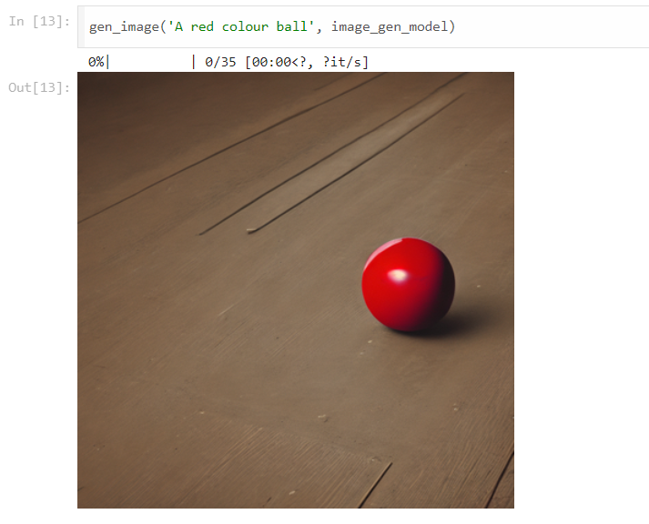
RESULTS
In summary, the result of this project is a powerful text-to-image generation system that empowers users to effortlessly create high-quality images from textual descriptions. This system has the potential to revolutionize content generation processes and unlock new opportunities for creative expression and communication.
Demo Link

