Slide 1
Practical Constant-Time Programming
Cedarcrypt 2026, Cyprus
14th July, 2026

Slide 2
Anjan Roy
PhD @ DiS, Radboud University, The Netherlands
SWE @ Avail Project, UAE
Ex-Polygon Labs, Ex-TII

Slide 3
What is constant-timeness? (1/4)
Encrypted message can be decrypted.
A cryptographic program can be functionally correct and conformant to some specification but still not be safe.
Passing known answer test (KAT) vectors.
Implementation flaws of a correct algorithm, leaking secret state.

Slide 4
What is constant-timeness? (2/4)
Passive observers looking for hints
Active attackers injecting faults
Compiler turning against us 🥲

Slide 5
What is constant-timeness? (3/4)
A functionally correct and conformant program can still leak its internal secret state, through timing.
You access memory or decide to (not) take a branch based on a secret value!
Instruction latency may depend on operand!

Slide 6
What is constant-timeness? (4/4)
How long it takes to execute an instruction, which branches it takes, which memory addresses it touches – none of them should depend on a secret.

Slide 7
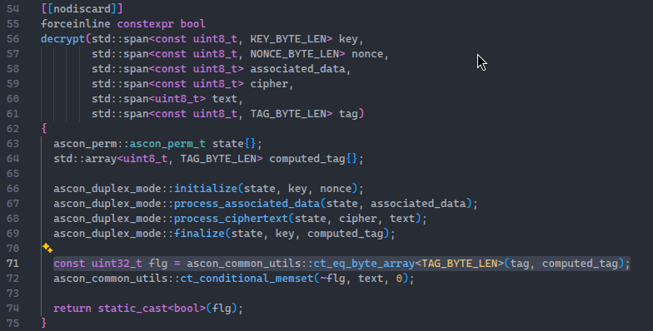
Example: Ascon-AEAD128 decrypt
Unverified plaintext must not be released

Slide 8
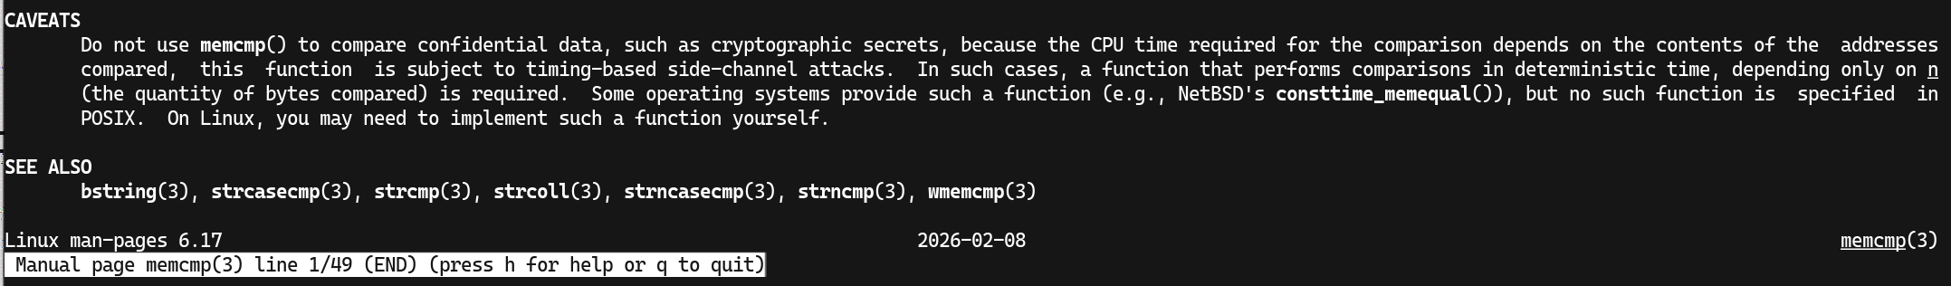
Why not memcmp?

Slide 9
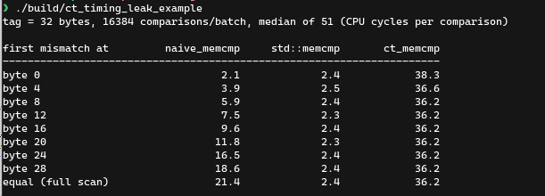
Convince me!
On Intel x86_64, with GCC-15 -O3, timed with rdtsc

Slide 10
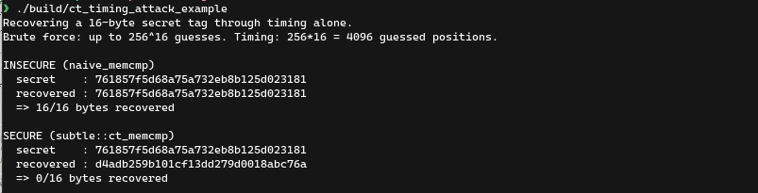
Nah, recover it!

Slide 11
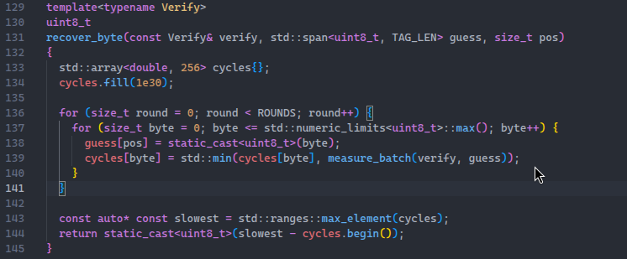
Hm, how?

Slide 12
Yeah, it is real.
Constant-timeness for cryptographic implementations is important.

Slide 13
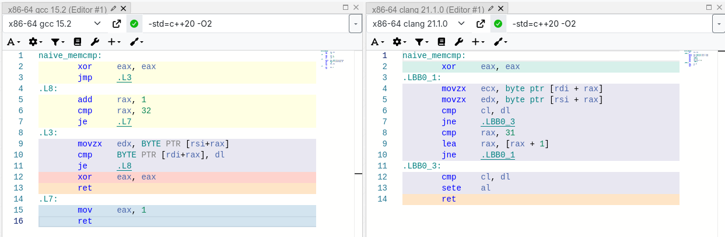
How to write ct_memcmp? (1/7)
naive_memcmp: Early exit. Exploitable. Flawed.

Slide 14
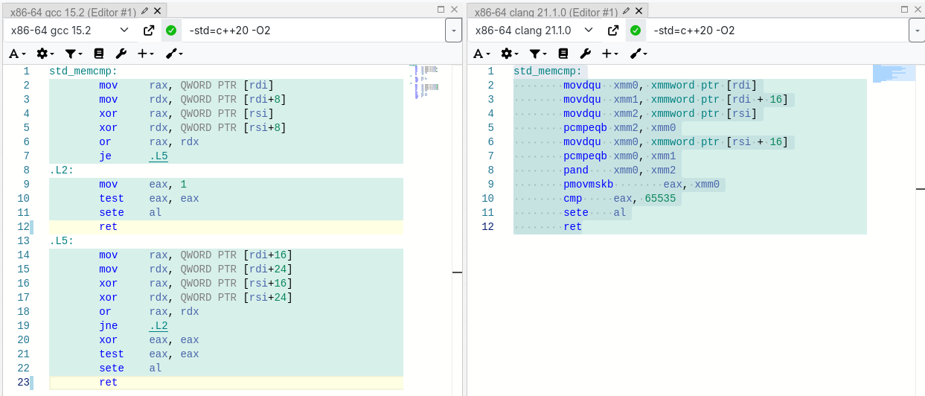
How to write ct_memcmp? (2/7)
Optimization-hungry Clang auto-vectorizing!
std::memcmp: Old friend GCC exits early!

Slide 15
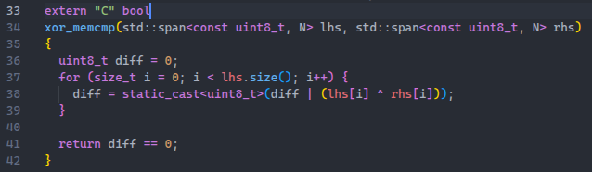
How to write ct_memcmp? (3/7)
At i = 0, lhs = 1, rhs = 1
diff = 0
At i = 1, lhs = 1, rhs = 2
diff = 3

Slide 16
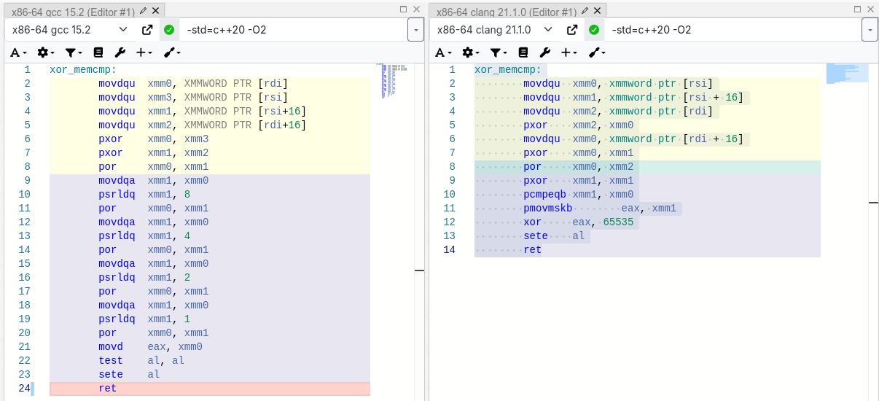
How to write ct_memcmp? (4/7)
Fine today ✅. May be not tomorrow. New compiler optimization-pass might break your “CT” fn.

Slide 17
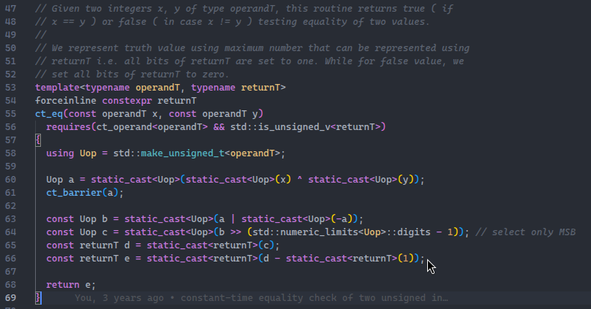
How to write ct_memcmp? (5/7)
ct_memcmp: The future-proof way

Slide 18
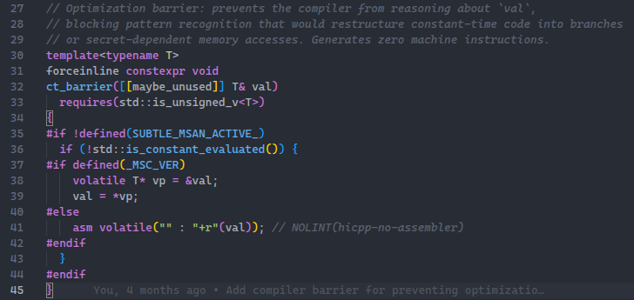
How to write ct_memcmp? (6/7)
Barrier? Turns off compiler reasoning. At zero runtime cost 🤩

Slide 19
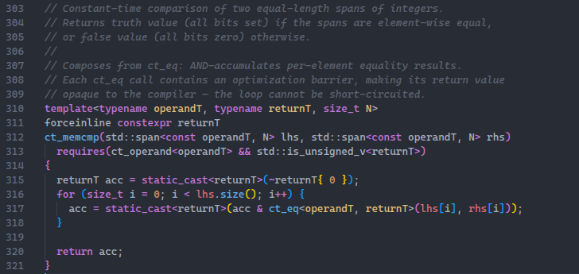
How to write ct_memcmp? (7/7)
Plug-in. Get ct_memcmp.

Slide 20
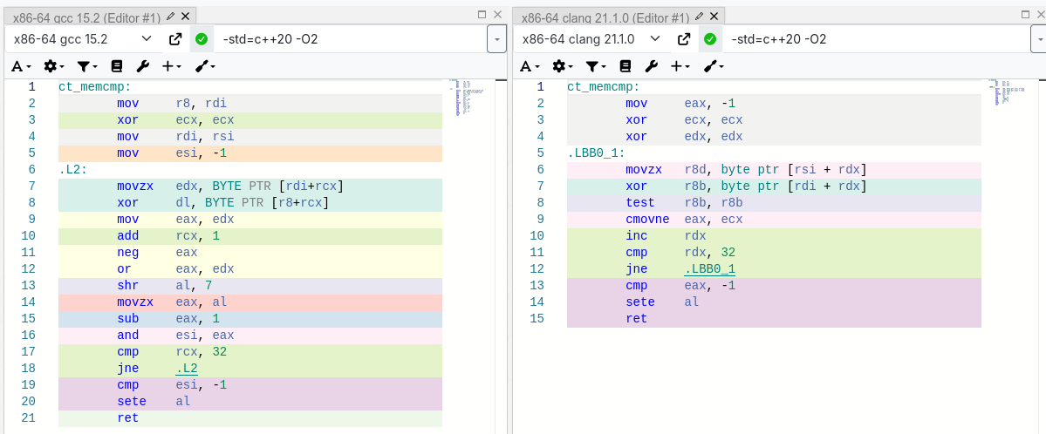
Wait, is ct_memcmp actually CT?
Yes, across compilers and their optimization levels.

Slide 21
And this is nicer
flexible
Operands can be of many types
Can return many types
Works for any size of buffers
But “many” is not well-defined❗
Yes. Use C++20’s concepts. Compile-time executable constraints on template params.
Not the slide 😬

Slide 22

That’s all to constraint the compiler
A C++20 concept

Slide 23
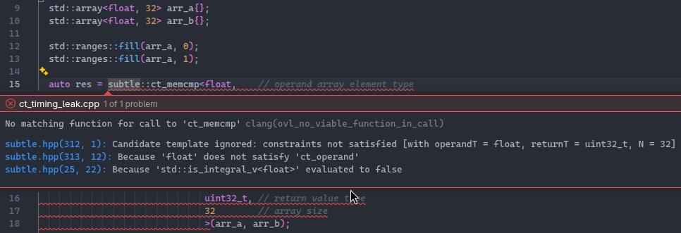
Compile-time error messages!
Can’t misuse the API and get runtime errors!

Slide 24
Is memcmp the only one that needs to be CT?
No.

Slide 25
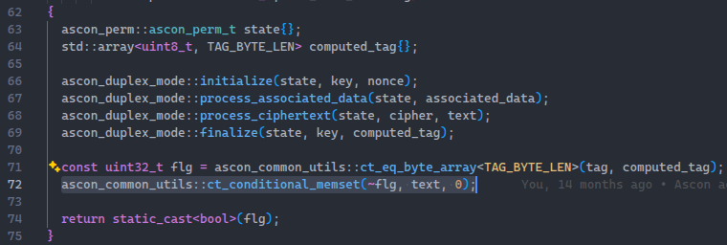
memset, but conditional
Such that the condition itself is secret!
It better be constant-time ✌

Slide 26
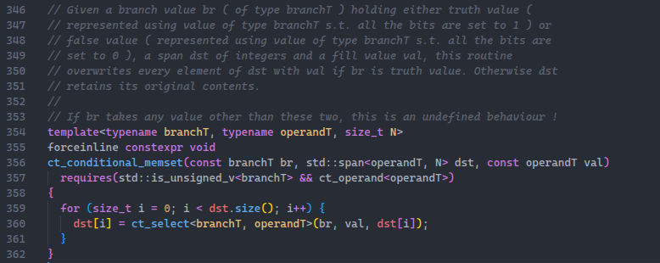
How to memset conditionally?
This is secret
Build on ct_select

Slide 27
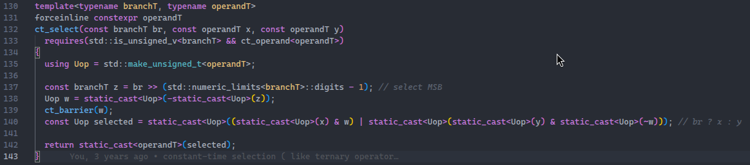
ct_select: A reusable one
result = condition ? a : b;

Slide 28
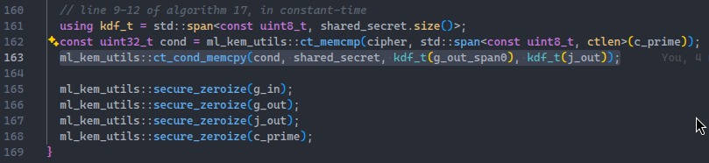
ct_conditional_memcpy: Built on ct_select
Fujisaki-Okamoto Transform in ML-KEM (FIPS 203)

Slide 29
What else to build on ct_select?
A look-up from a table, where the index to read from is a secret.
Call it ct_lookup.

Slide 30
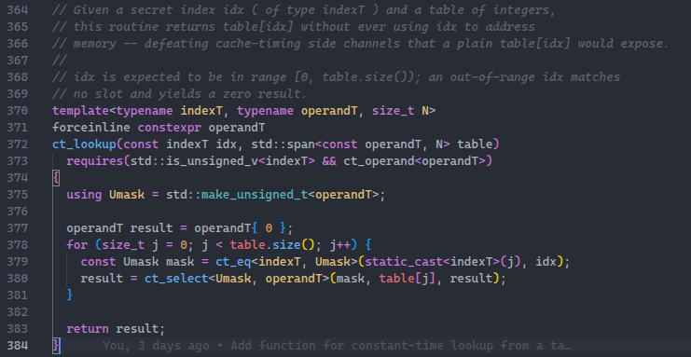
ct_lookup = ct_eq + ct_select

Slide 31
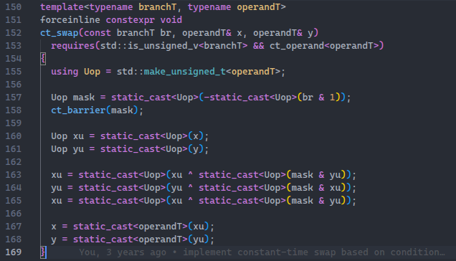
ct_swap: Secret condition-based swapping
Classic textbook swap without a temporary
x = x ^ y
y = y ^ x
= y ^ (x ^ y)
= x ✅
x = x ^ y
= (x ^ y) ^ x
= y ✅

Slide 32
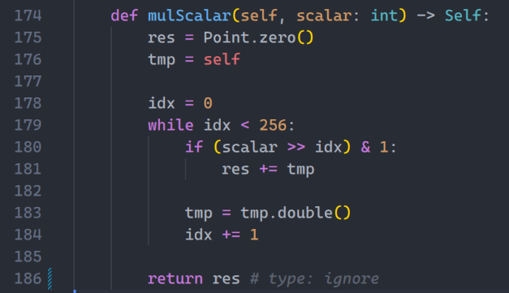
ct_swap inside ECDSA KeyGen
Secret key
loop:
ct_swap(bit, res, tmp);
tmp += res;
res = res.double();
ct_swap(bit, res, tmp);
Not CT
Instead use conditional swapping

Slide 33
You might need more
Comparing integers across bit-widths <, >, <=, >=, !=
And signedness 🥲

Slide 34
Build using composition
Bake ct_le(<=)
Get ct_gt (>)
Get ct_min and ct_max for free
Have ct_eq
Get ct_ge (>=)
Get ct_ne (!=)
Get ct_lt (<)

Slide 35
So, that’s all, right?
In PQC, mostly over small integers and vectors, matrices of them
Not really.
Constant-time arithmetic operations (+, -, x, /, %)
Elliptic curve cryptography (ECC) needs it over large bitwidth integers!
Do not forget me!
- Falcon (FN-DSA)

Slide 36
Ok, but how to test CT?
Write a lot of tests.

Slide 37
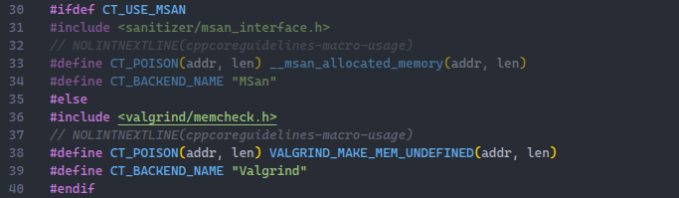
Runtime Analysis
LLVM Clang compile-time instrumentation
Valgrind runtime instrumentation

Slide 38
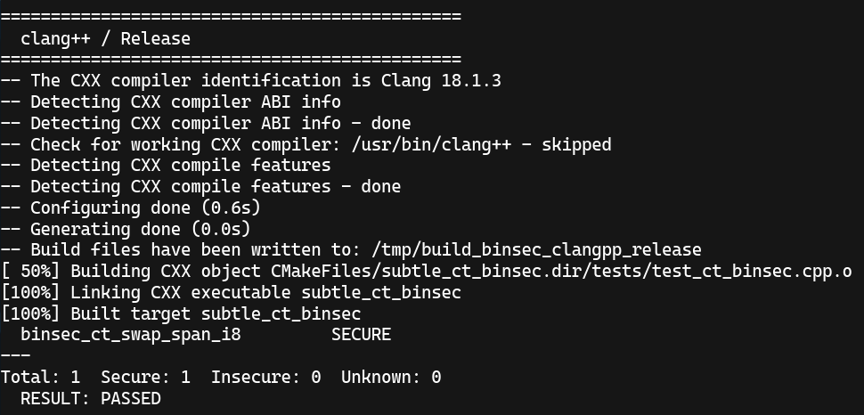
Static Analysis
Binsec

Slide 39
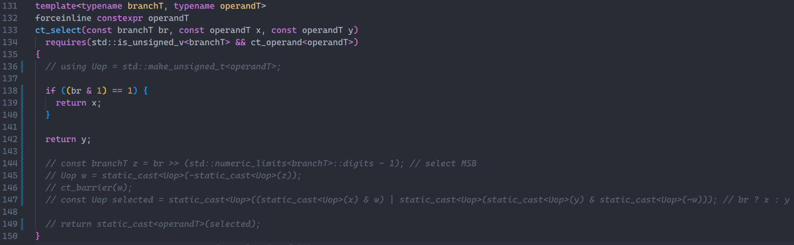
Case study: conditional memcpy (1/16)
Not CT

Slide 40
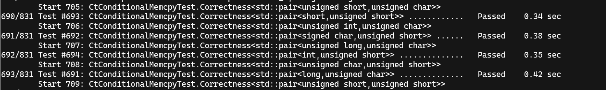
Case study: conditional memcpy (2/16)
Not constant-time, but functionally correct ! ✅

Slide 41
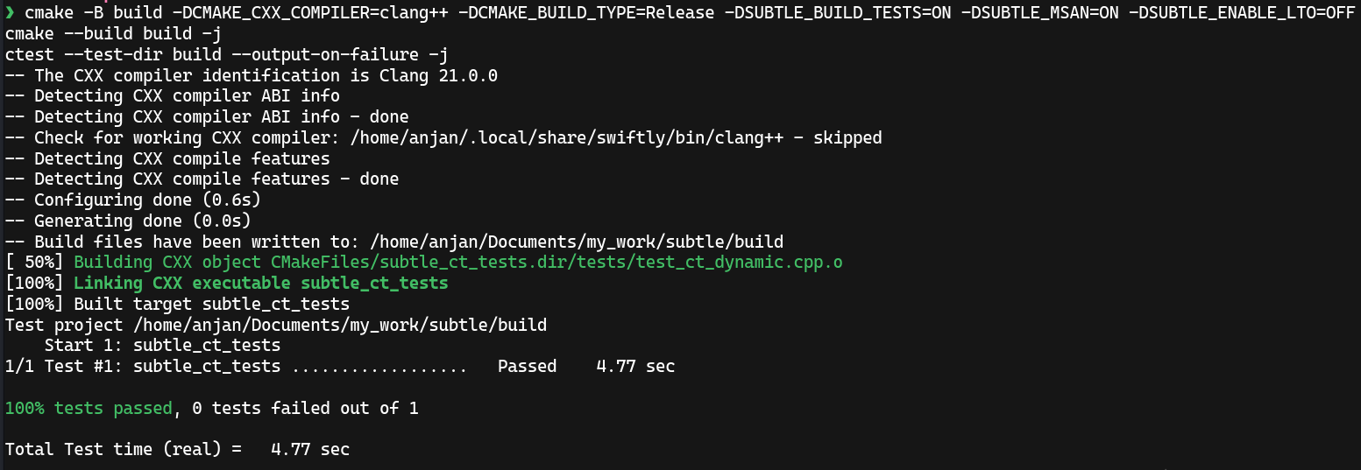
Case study: conditional memcpy (3/16)
Clang/MSan + -O3, does not detect ❌

Slide 42
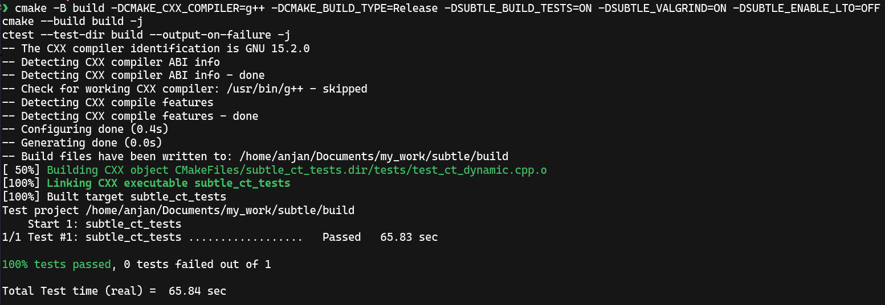
Case study: conditional memcpy (4/16)
GCC + -O3 + Valgrind, does not detect ❌

Slide 43
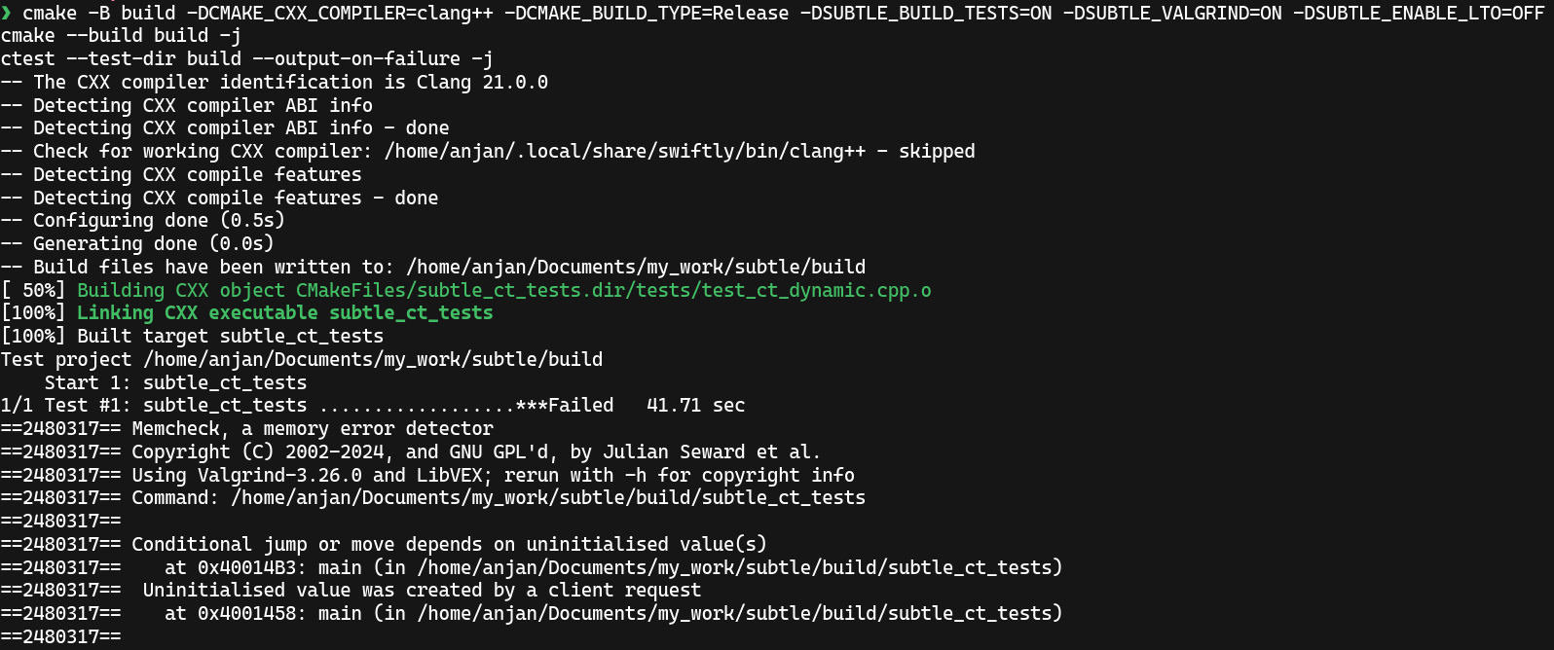
Case study: conditional memcpy (5/16)
...
Clang + -O3 + Valgrind, finally someone 🙌

Slide 44
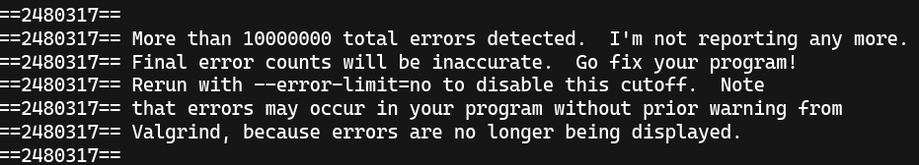
Case study: conditional memcpy (6/16)
Clang + -O3 + Valgrind

Slide 45
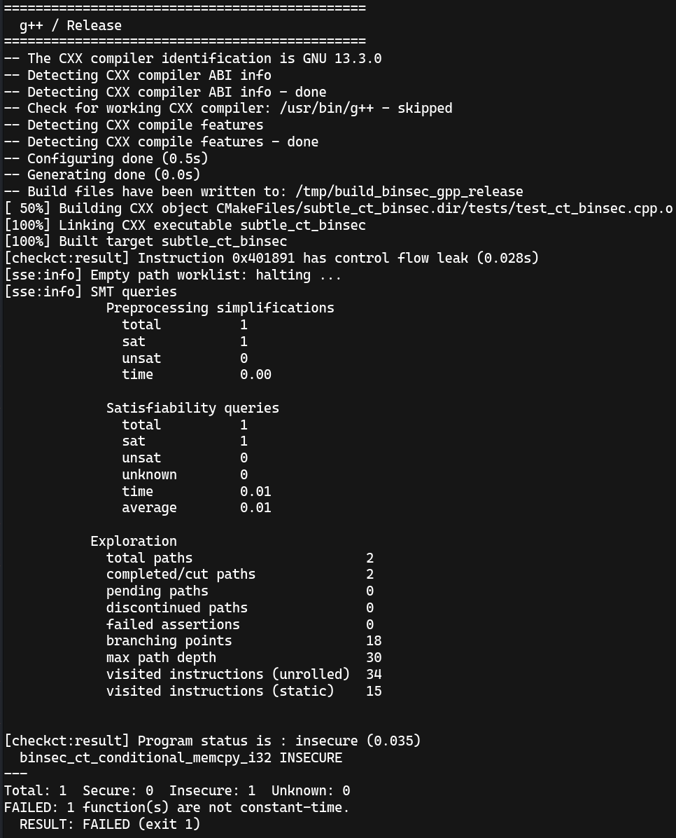
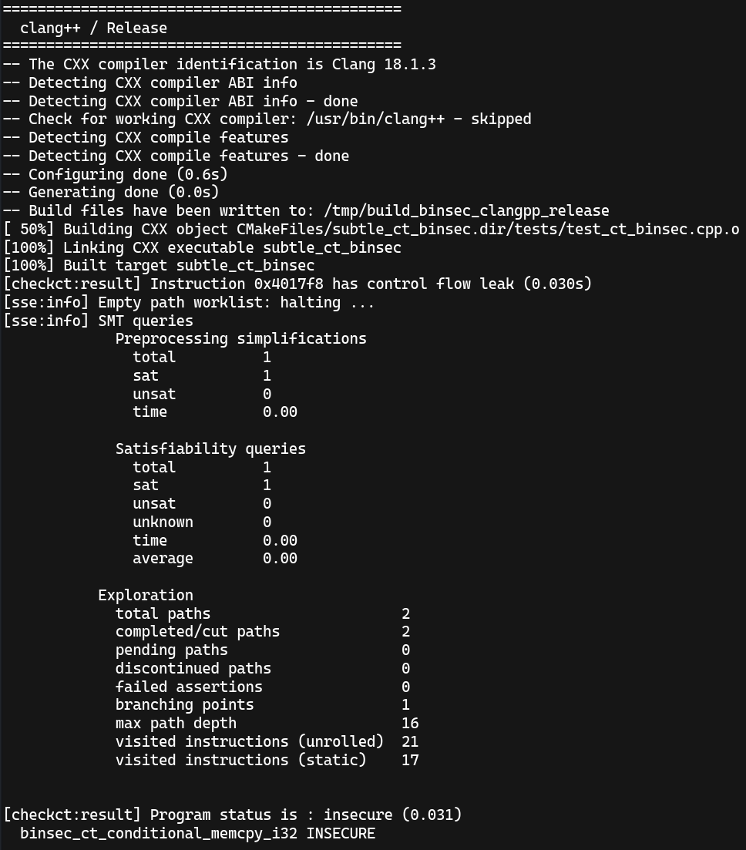
Case study: conditional memcpy (7/16)
(GCC,Clang) + -O3 + Binsec 🫡

Slide 46
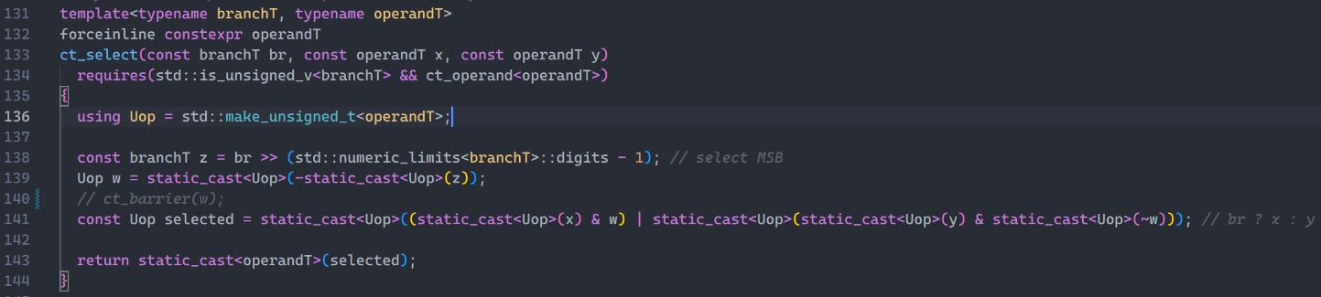
Case study: conditional memcpy (8/16)
Disabled

Slide 47
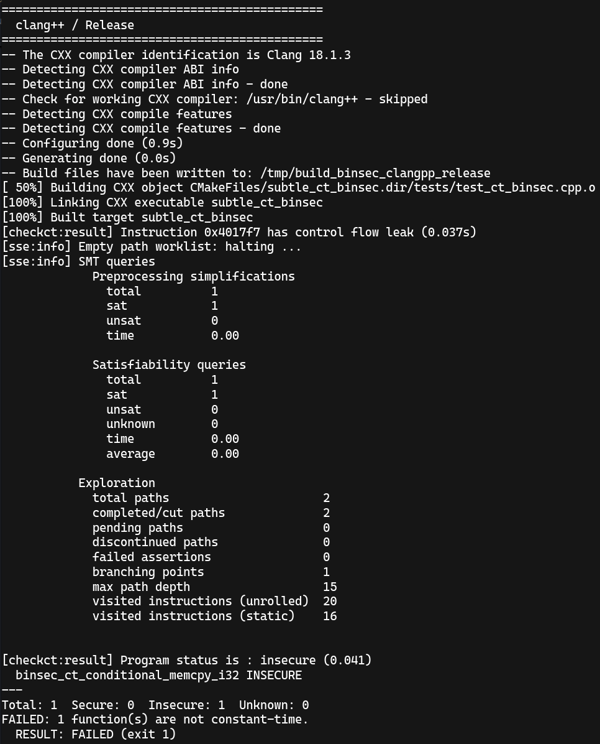
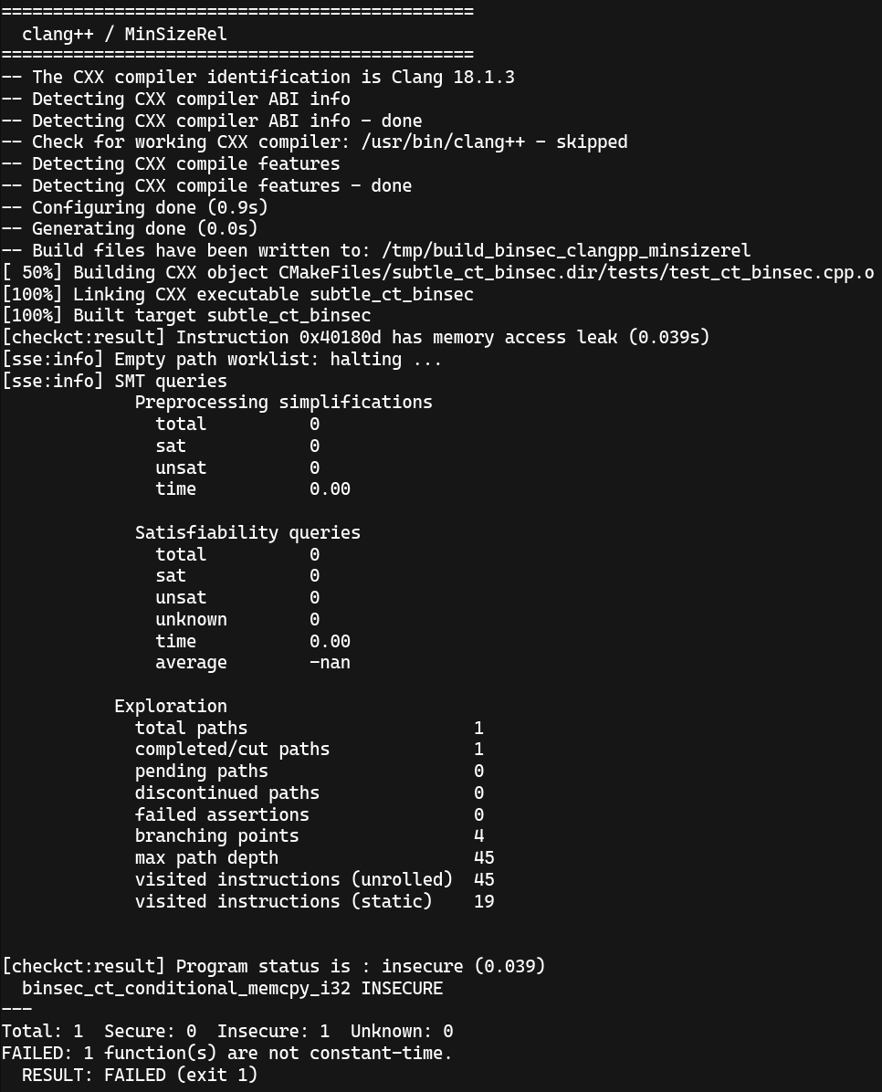
Case study: conditional memcpy (9/16)
Clang + (-O3, -Os) + Binsec

Slide 48
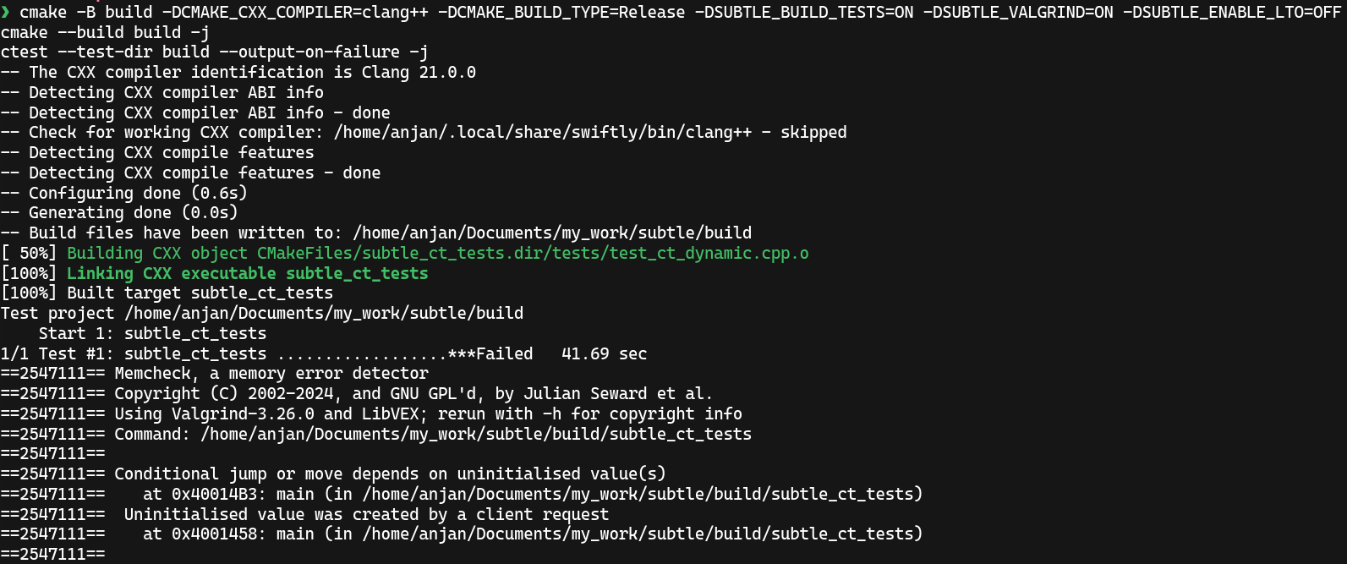
Case study: conditional memcpy (10/16)
Clang + -O3 + Valgrind ✅

Slide 49
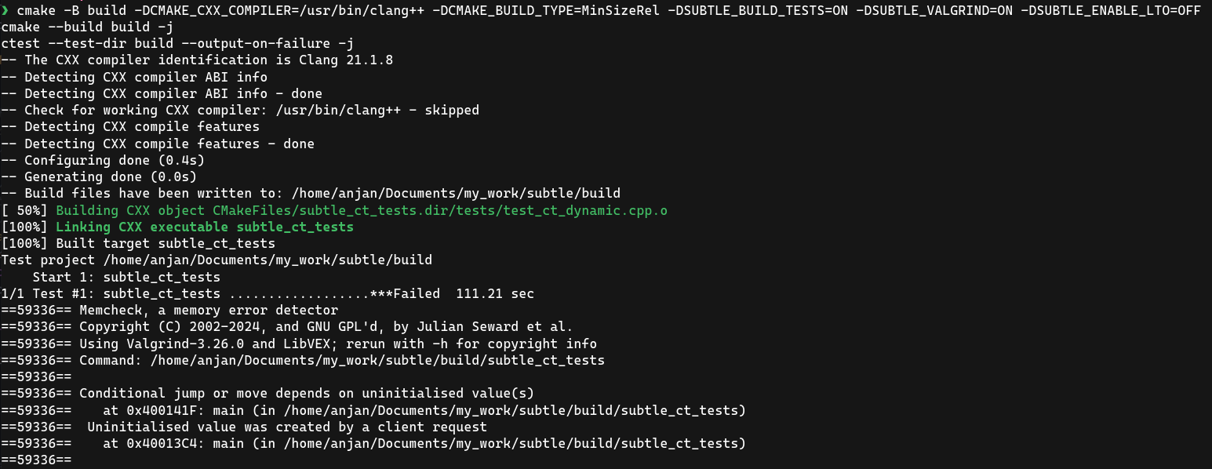
Case study: conditional memcpy (11/16)
Clang + -Os + Valgrind ✅

Slide 50
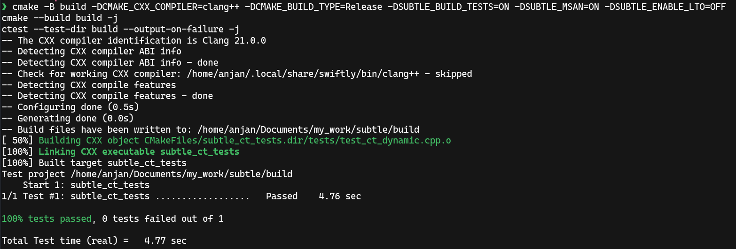
Case study: conditional memcpy (12/16)
Clang + -O3 + MSan ❌

Slide 51
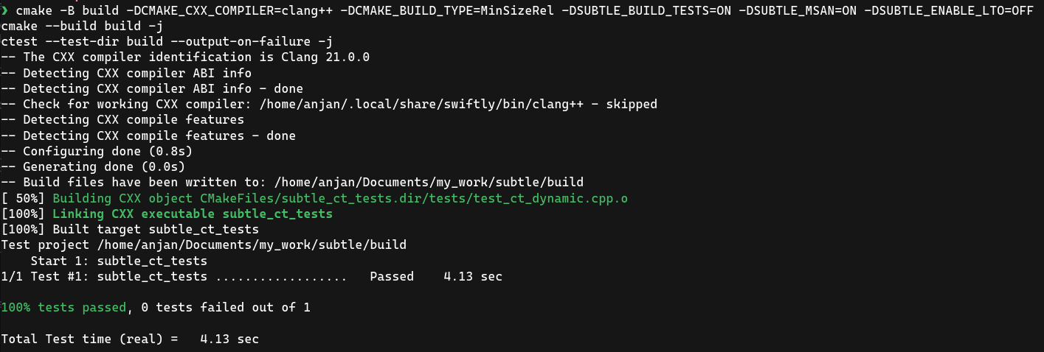
Case study: conditional memcpy (13/16)
Clang + -Os + MSan ❌

Slide 52
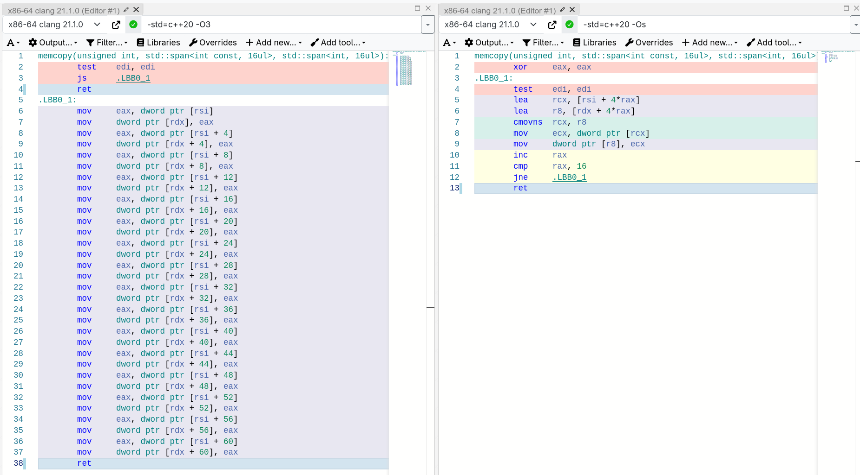
Case study: conditional memcpy (14/16)
ct_barrier is must have.
Else an eager to optimize compilers, like Clang, will just optimize it away.

Slide 53
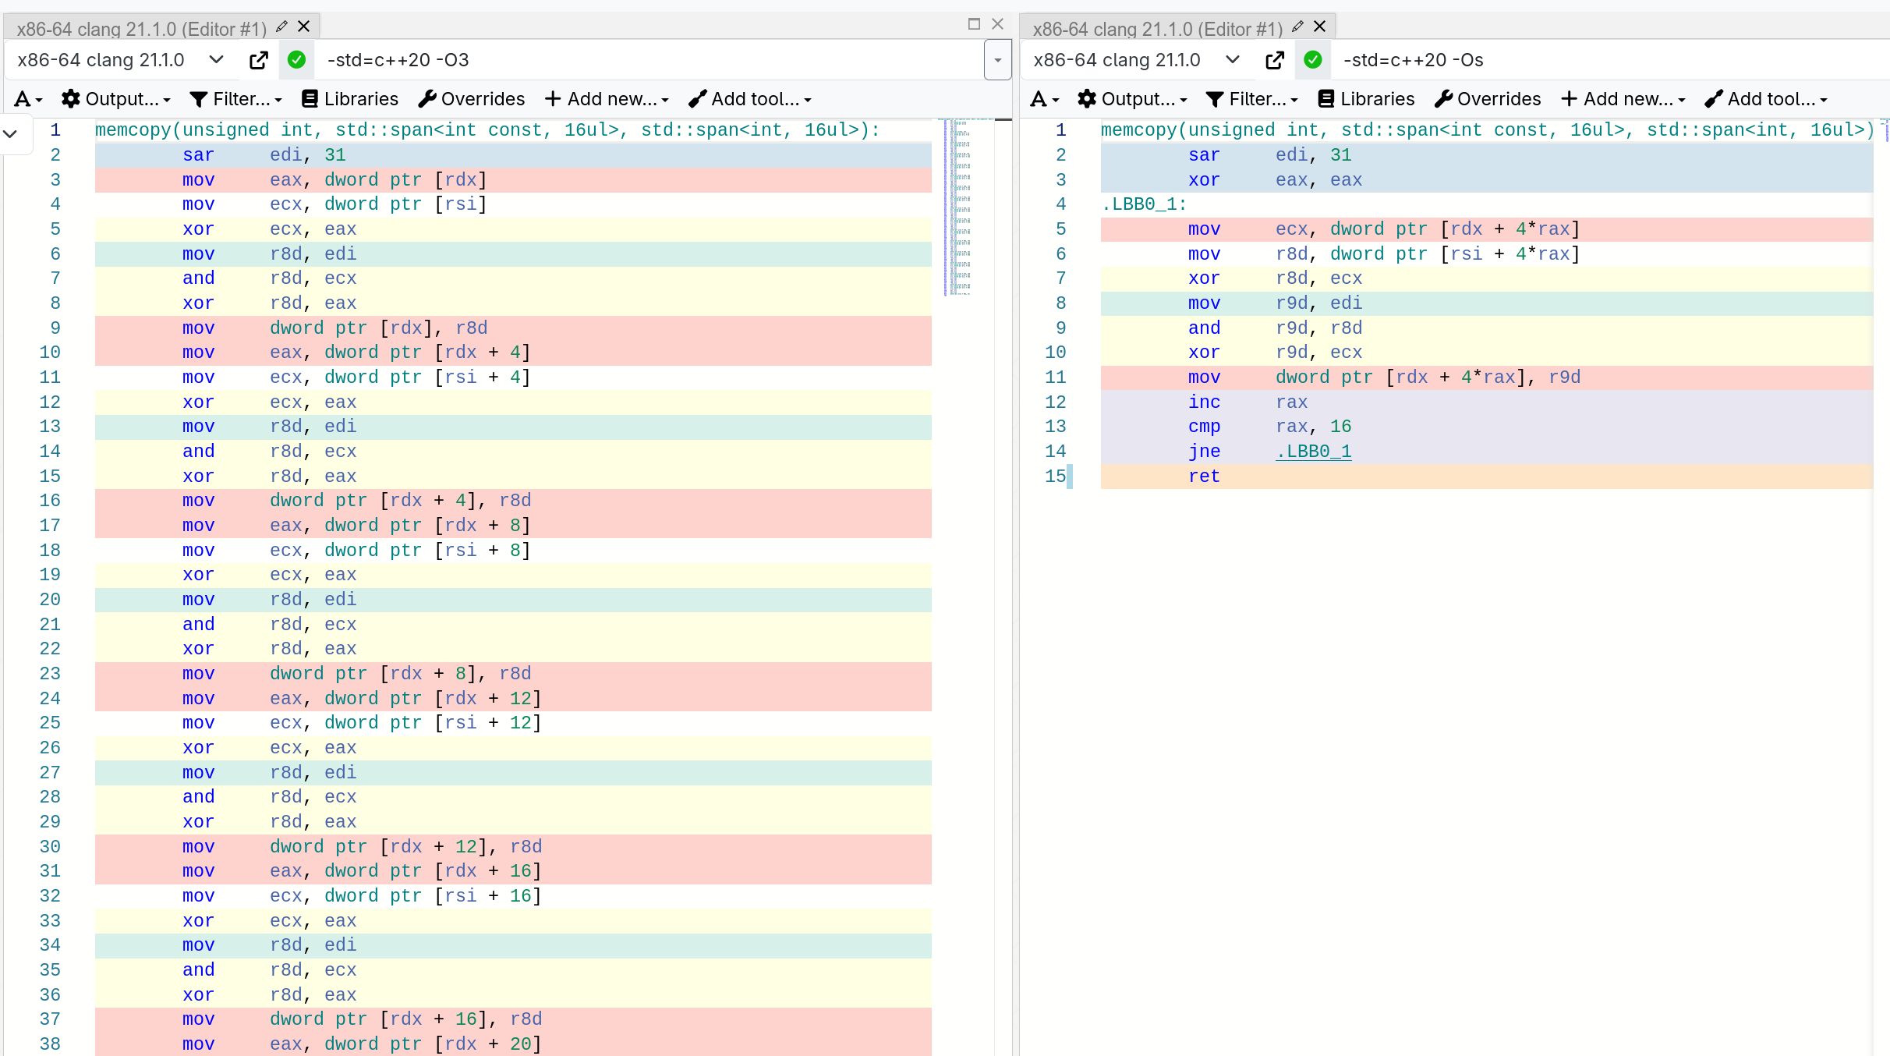
Case study: conditional memcpy (15/16)
ct_barrier added back. Constant-time across optimization levels.

Slide 54
Case study: conditional memcpy (16/16)
Memory Sanitizer | Compile-time instrumentation ⭐
Valgrind | Runtime instrumentation ⭐⭐
Binsec | Symbolic analysis over binary ⭐⭐

Slide 55
Ok, so how to test CT?
Write a lot of tests.
And run them in different configurations with different tools.

Slide 56
There are more tools available
None of them is a silverbullet !
dudect
FlowTracker
ct-verif
ct-LLVM
Jasmin language
Fiat-Crypto
Constantine
...
n)__builtin_ct_select

Slide 57
But, what about Spectre🐘?
Exploits “branch prediction” and “speculative execution” features
Compiler generated instruction is not what the CPU executes “exactly”
Yet another side-channel to extract secret key material
A constant-time program alone won’t save!

Slide 58
And what about DOITM?
Data Operand Independent Timing Mode
Mainly div/ idiv, -ffast-math
But no guarantees, just assumptions that add/ xor/ and will be CT

Slide 59

Recommendation: Use subtle for CT

Slide 60
Recommendation: Enable Spectre mitigations
#include <sys/prctl.h>
prctl(PR_SET_SPECULATION_CTRL, PR_SPEC_STORE_BYPASS, PR_SPEC_DISABLE, 0, 0);
Abstracted by Linux system headers

Slide 61
Recommendation: Enable Data Independent Timing (DIT)
asm volatile("msr DIT, #1");
On arm64, from userspace

Slide 62
Summary
Only timing is enough to extract secret.
Ops involving secret, must be constant-time.
There are tools to enforce CT, at scale.
None of them is perfect.
Compiler is a good friend, most of the time.
Do not forget to check h/w level guarantees.

