Slide 1
Balamurugan G
Final Project
3/21/2024 Annual Review

Slide 2
PROJECT TITLE
Image classification
3/21/2024 Annual Review

Slide 3


AGENDA
PROBLEM STATEMENT
PROJECT OVERVIEW
WHO ARE THE END USERS?
YOUR SOLUTION AND ITS VALUE PROPOSITION
THE WOW IN YOUR SOLUTION
MODELLING
RESULTS
3/21/2024 Annual Review

Slide 4

PROBLEM STATEMENT
This project is about creating a smart system that can recognize objects in images, like cars or birds, using a special type of neural network called a CNN. We're training it with a bunch of pictures from the CIFAR-10 dataset. Our goal is to teach it to accurately spot different things in these images. After setting up the network and training it, we'll check how well it performs on images it hasn't seen before. Finally, we'll plot a graph to see how it improves over time, and report how good it is at recognizing objects.
3/21/2024 Annual Review

Slide 5

PROJECT OVERVIEW
In this project, we're building a smart system that can look at pictures and tell us what's in them. We're using a type of artificial brain called a neural network to teach the system. Our dataset contains lots of images showing different things like cars, birds, and more. First, we set up the neural network to understand these images better. Then, we train it by showing it many pictures and telling it what's in each one. After training, we test it on new pictures to see how well it can recognize things. Finally, we'll see how the system improves over time and share its accuracy in recognizing objects.
3/21/2024 Annual Review

Slide 6

WHO ARE THE END USERS?
General Consumers
Researchers and Developers
Businesses
Educational Institutions
3/21/2024 Annual Review

Slide 7

YOUR SOLUTION AND ITS VALUE PROPOSITION
Our solution is all about making it easy to recognize things in images accurately. By using a special type of brain called a convolutional neural network and training it with lots of pictures from the CIFAR-10 dataset, we've created a system that can spot objects with high accuracy. It's simple to use because we've written the code in a way that anyone can understand, whether you're just starting out or already an expert. Plus, you can easily adapt it to work with different datasets or tasks beyond just recognizing objects in pictures. And if you're interested in learning about how it all works, our solution provides a hands-on experience that teaches you about deep learning and image recognition. So whether you're a researcher, developer, business, or student, our solution offers accuracy, ease of use, adaptability, and educational value for all kinds of users.
3/21/2024 Annual Review

Slide 8

THE WOW IN YOUR SOLUTION
Our solution is like having a super-smart friend who can instantly recognize what's in any picture you show them. It's like magic! By using fancy technology called a convolutional neural network and training it with lots of pictures, we've made this friend super accurate. And the best part? You don't need to be a computer whiz to use it! We've made the whole thing easy to understand and use, so anyone can give it a try. Whether you're curious about how it all works or you need a reliable tool for recognizing things in images, our solution has got you covered. It's like having your own personal image recognition wizard right at your fingertips!
3/21/2024 Annual Review

Slide 9
MODELLING
The code snippet utilizes a convolutional neural network (CNN) architecture for image classification tasks. The CNN model starts with a convolutional layer containing 32 filters, each of size (3, 3), followed by a ReLU activation function to extract features from input images. Subsequently, a max-pooling layer with a pool size of (2, 2) is applied to downsample the feature maps. This process repeats with another set of convolutional and max-pooling layers, this time with 64 filters in the convolutional layer. Afterward, a third convolutional layer with 64 filters is added for further feature extraction. The Flatten layer is then introduced to transform the 3D feature maps into a 1D vector, preparing them for classification. Two dense layers follow, consisting of 64 neurons each with ReLU activation, and the final layer with 10 neurons representing the output classes. The model is compiled using the Adam optimizer, Sparse Categorical Crossentropy loss function, and accuracy as the metric for evaluation. It undergoes training on the CIFAR-10 dataset for 10 epochs, and the test accuracy is evaluated afterward. Finally, the training and validation accuracy curves are plotted to visualize the model's performance over the training epochs.
3/21/2024 Annual Review

Slide 10
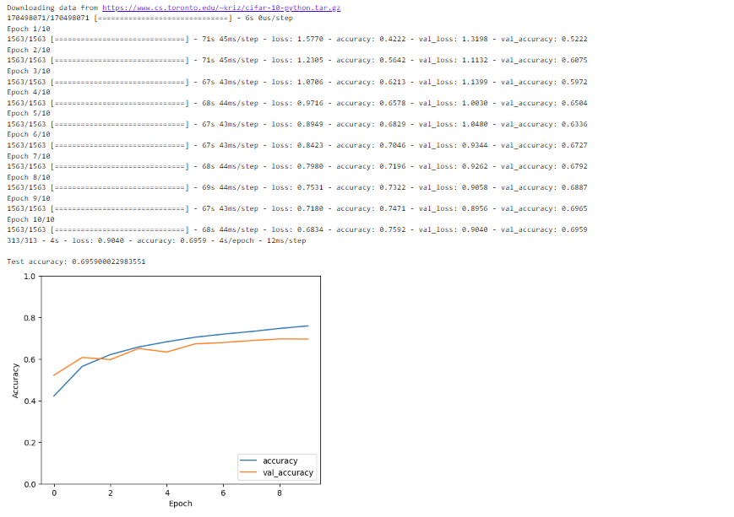
RESULTS
https://github.com/itzmebala/NM_AIML
3/21/2024 Annual Review

