Slide 1
Variations on Diffie-Hellman Key Exchange to Optimize the Resistivity
Harshit Shirsat
4NM17CS068
6th Sem B
Gagandeep Bekal
4NM17CS062
6th Sem B

Slide 2
Working Principle Of DHE:
The two end users Alice and Bob, while communicating over a channel they know to be private, mutually agree on positive whole numbers P and G, such that p is a prime number P and G is a generator of P.
The generator G is a number that, when raised to positive whole-number powers less than P, never produces the same result for any two such whole numbers.
The value of P may be large but the value of G is usually small.
Once Alice and Bob have agreed on P and G in private, they choose positive whole-number personal keys a and b, both less than the prime-number modulus P.
We generate two keys for Alice and Bob named x and y respectively using the power function.

Slide 3
Then we generate shared secret keys on both the sides ka and kb respectively using the power function.
The shared secret key will be same on both sides.
It is essential that the value of a and b are not transmitted on public network as these values play an important role in calculating the shared key.
We make use of our own encryption and decryption technique where we assign prime number values to each alphabet.
Then we use the shared secret key to perform operation on the input message to create an encrypted message.
We use the same secret shared key at the receiver’s end to reverse the computation.
Hence we get the actual message which is transmitted successfully.

Slide 4
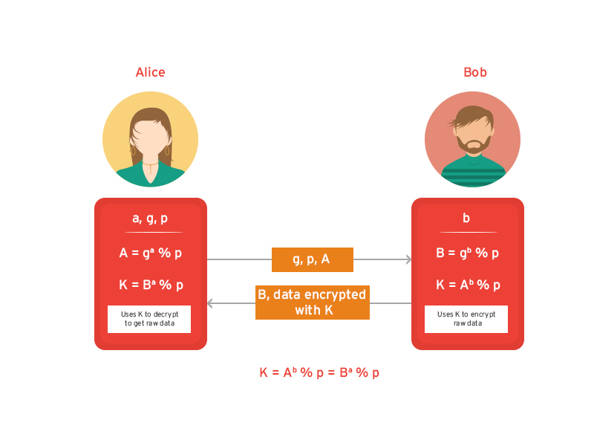
Diagramatic Representation:

Slide 5
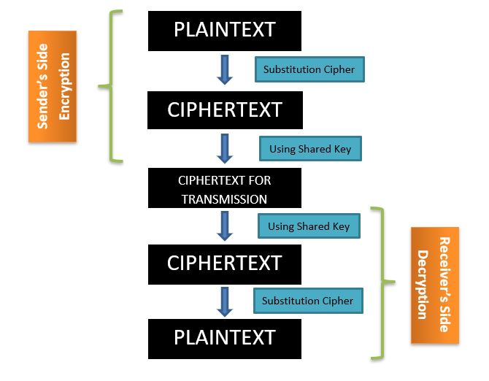
What we have done:

Slide 6
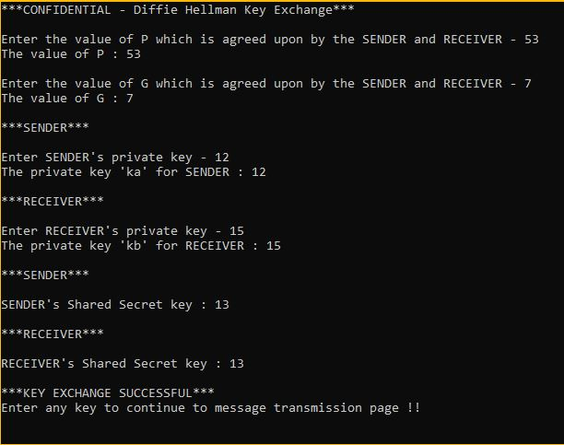
Generating Shared Key using DHE:

Slide 7
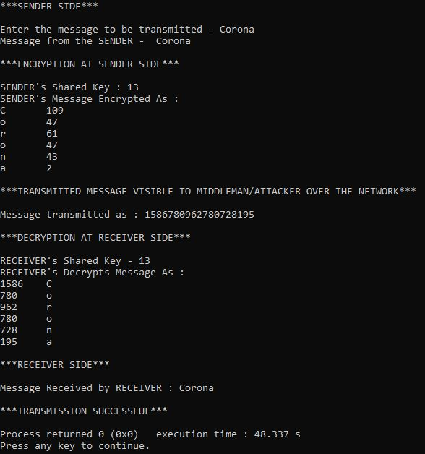
Transmission of Message:

Slide 8
THANK YOU

