Slide 1
MATLAB to Python
Pandas

Slide 2

What’s Pandas for?
Pandas
NumPy
Matplotlib
Scikit-Learn
Pandas is a Python Library, mainly used to analyse data.
For example: Exploration of dataset
Data cleaning and preparation for visualization
Store the cleaned data back into a CSV, Excel or JSON file formats
Jupyter Notebook best preferred for dataset operations

Slide 3
Pandas First Steps
Installation
conda install pandas
OR
pip install pandas
OR
!pip install pandas (in a Jupyter notebook)
Import
import pandas as pd

Slide 4
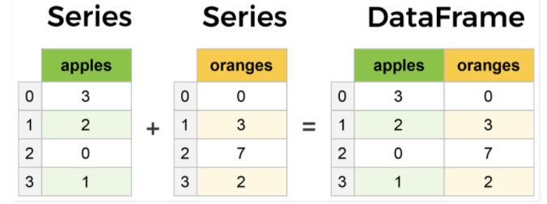
Core components of pandas: Series and DataFrames

Slide 5
Most important operations on DataFrames
Creating DataFrames from scratch
Reading datasets
Viewing your dataset
Getting info about your data
Handling duplicates
Working with missing values
Removing null values
Imputation
Understanding your variables
Indexing and Slicing
Applying functions

Slide 6
Thank you!

