Slide 1
Digital Portfolio
By MOHANRAJ S
REGISTER NO AND NMID: 212400957 – 512410D7F9642D4A25A4C864917AC89C

Slide 2
Problem Statement
- Traditional resumes are static and limited in showcasing real skills.
- Recruiters often lack interactive proof of candidates’ work.
- Students struggle to highlight technical projects effectively.
- A digital portfolio bridges this gap by providing an engaging, interactive medium.

Slide 3
Project Overview
- Development of a personal digital portfolio website.
- Sections included: About Me, Skills, Projects, and Contact.
- Designed with modern UI/UX principles and responsive layout.
- Serves as a digital resume accessible anytime, anywhere.

Slide 4
End Users
- Recruiters → Evaluate skills & projects.
- Employers → Identify potential candidates.
- Clients → Assess project capabilities before hiring.
- Institutions → For academic/project reviews.
- Peers & Networks → Showcase expertise.

Slide 5
Tools and Technologies
- Frontend → HTML5, CSS3, JavaScript.
- Design → Responsive Web Design (RWD).
- Version Control → Git & GitHub.
- Frameworks (Optional) → Bootstrap / Tailwind CSS.

Slide 6
Portfolio Design and Layout
- About Me → Educational background & introduction.
- Skills → Technical expertise (languages, frameworks).
- Projects → Showcasing academic & personal work.
- Contact → Email, GitHub, LinkedIn.
- Layout → Clean, professional, mobile-first.

Slide 7
Features and Functionality
- Fully responsive design (mobile, tablet, desktop).
- Smooth navigation & transitions.
- Project showcase with descriptions & images.
- Contact form & social links.
- Easy to update with new content.

Slide 8
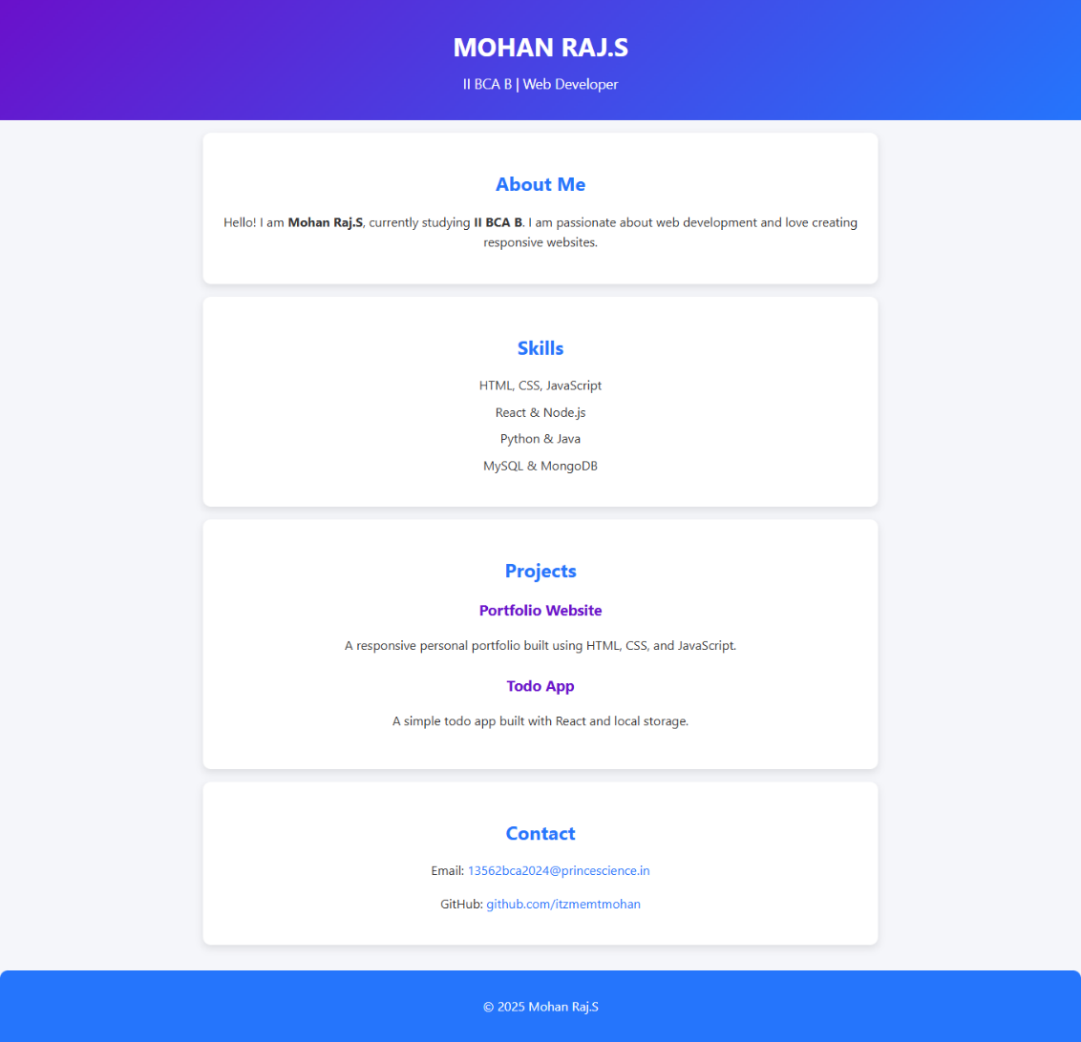
Results and Screenshots

Slide 9
Conclusion
- The project enhances digital visibility and personal branding.
- Provides an edge in recruitment & networking.
- Can be extended with blogs, animations, or additional projects.

Slide 10
GitHub Link
🔗 GitHub Portfolio: https://itzmemtmohan.github.io/My-portfolio-/

