Slide 1
PROJECT ESE PRESENTATION
CHRIST VISITOR PASS
Aaron Mathew Shaji (2247201)
Apoorva Vasishtha (2247240)
Mohit Mehta (2247267)
Department of Computer Science,
CHRIST (Deemed to be University)

Slide 2
01
02
03
04
AGENDA
Introduction/Overview
Existing System and Disadvantages
Proposed System and Advantages
Modules
05
Software Requirement Specification

Slide 3
Introduction
A visitor management system (VMS) is an essential tool for any college that is concerned with the safety and security of its students, faculty, and staff.
The CHRIST VisitorPass App manages the entry and exit of visitors to the university.
The primary purpose of the CHRIST VisitorPass App is to manage the flow of visitors on campus and ensure that they are properly vetted and tracked while they are on the premises.
The app can include features such as registration, identity verification, report generation, and web app support in the mobile interface.
The integration of the project with other security systems can also be considered as future scope.

Slide 4
Introduction Continues..
The app can include features such as registration, identity verification, report generation, and web app support in the mobile interface. The integration of the project with other security systems can also be considered as future scope.
During the registration process, visitors can provide their personal and contact information, along with their current photo, which is then verified at the Main Gate by the Security Guard Officer.
Reports provide the college with valuable information on visitor activity. Dashboards presenting insights about the classification of visitors through illustrations and reports are also a major component of the project.
Finally, the support of using web app in the mobile interface can help to provide a comprehensive security solution for the college.

Slide 5
Existing System
Our university does not have a digitalized system for visitor management.
Visitors to the university are currently required to make a manual entry in a record book at the main gate.
.
The manual entry system collects limited information such as name, phone, and signature only.
The manual entry system is inefficient and insecure.

Slide 6
Existing System
The lack of a robust data collection process makes it difficult to recognize visitors for security purposes.
A digitalized visitor management system would streamline the registration process and improve campus security.
A digitalized system could capture a more comprehensive set of visitor information, including biometric data, photographs, and identification documents.
A digitalized system could enable real-time monitoring and management of visitor traffic, making it easier to control access to restricted areas and prevent unauthorized entry.

Slide 7
Proposed System and Advantages
The proposed system is a digitalized data management system for visitors to the university.
The system will manage the flow of visitors on campus and ensure they are properly vetted and tracked while on the premises.
The system will include features such as registration, identity verification, reporting and analytics, integration with other security systems, and mobile web app support.
During registration, visitors will provide their personal and contact information, along with a current photo.
The photo will be verified by the Security Guard Officer at the main gate, and a visitor pass will be created upon approval.
The system will include a navigation feature to help guide visitors to their primary location on campus.

Slide 8
Proposed System and Advantages
The system will include a navigation feature to help guide visitors to their primary location on campus.
The navigation feature will use the Christ Map and show visitors the path to their destination.
The advantages of this system include:
Improved efficiency in the visitor registration process.
Enhanced security by capturing a more comprehensive set of visitor information and enabling real-time monitoring and management of visitor traffic.
Better accuracy and reliability of data collection, reducing the risk of errors or manipulation.
Increased convenience for visitors with the navigation feature, making it easier to find their destination on campus.

Slide 9
Advantages
Improved security: The Web app verifies visitor identities, controls access to specific areas, and maintains a record of their activity to enhance college security.
Streamlined process: The Web app automates tasks such as pre-registration and identity verification, saving time and improving efficiency for college staff.
Accurate visitor tracking: The Web app maintains a record of all visitors, including personal and contact information, enabling accurate tracking of visitor activity on campus.
Increased visibility: The Web app generates reports and analytics, providing valuable insights into visitor activity to enhance security measures.
Improved visitor experience: The Web app features mobile app support to reduce wait times, provide real-time updates, and streamline the process of managing visitors for an overall improved experience.

Slide 10
MODULES
Admin module
Visitors module
Faculty module
Dashboard module
Vehicle Entry Module
Check-Out module
Navigation Module

Slide 11
MODULES
Admin module
This module will be used and operated by the Security Guard office at the university’s
Main gate. This module would contain 2 Pages,
Visitor Entry Approval
Entries
Visitors module
This module will be used by the Visitors who are coming to the university.
A QR code redirecting to this webpage will be placed near the Main Gate Entrance.
The visitor needs to scan this QR code and make an entry on the app with their details.
Then, the security guard approves or rejects the request.

Slide 12
MODULES
Faculty module
This module will be used by all the working university faculty.
The faculty member can send a request to the Main Gate that they are expecting a person.
Dashboard module
This module will be used by the Admin.
This module will basically reflect the analysis of all the people who have visited during any selected period of time and for what purpose.
Navigation Module
This module will be used by the visitor.
The module will help guide the visitor to their primary location.

Slide 13
MODULES
Vehicle Entry Module
This module will be used by people who are coming via vehicles.
In this module, the driver of the vehicle needs to make an entry about the number of people visiting and everyone’s respective details.
A visitor’s pass will be generated based on the license number (which is the main identifier).
A mechanism to validate the max number of Vehicles allowed for visitors inside the campus on the basis of parking will also be done.
Check-Out module
This module will be used by the visitor for their check out.
In this module, another QR Code will be placed beside the Entry QR Code, scanning which they
can mark their check out from the university.

Slide 14
Software Requirement Specification

Slide 15
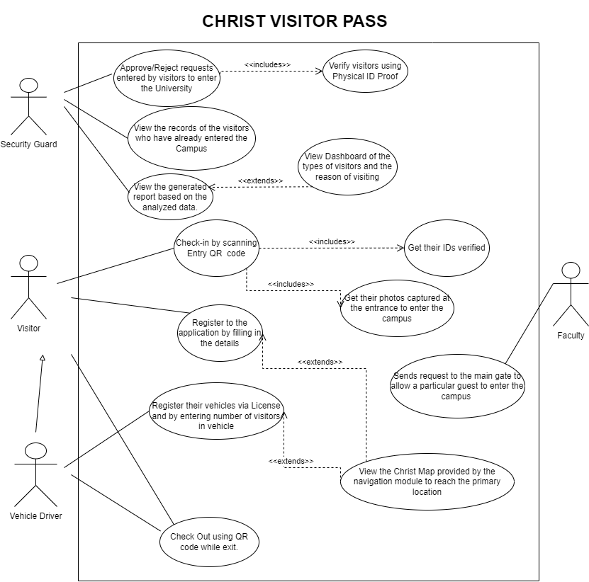
Use Case Diagram

Slide 16
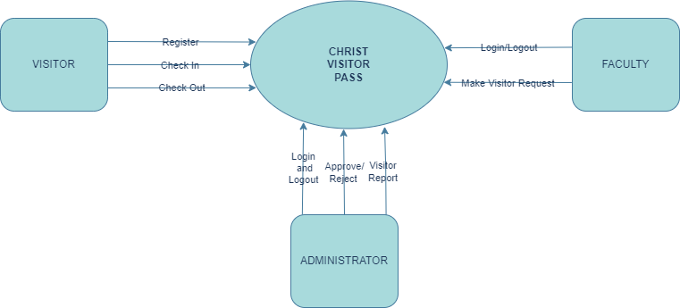
DFD (Data Flow Diagram)
Level 0

Slide 17
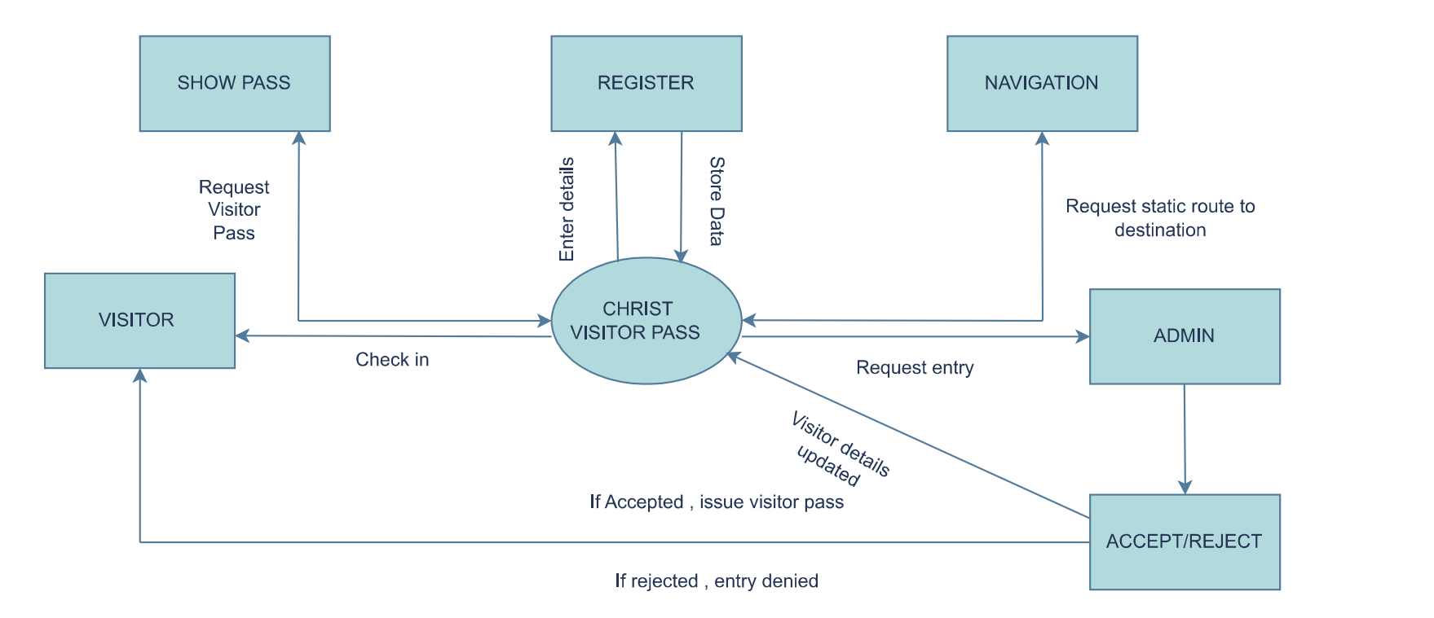
DFD (Data Flow Diagram)
Level 1 (Visitor Module)

Slide 18
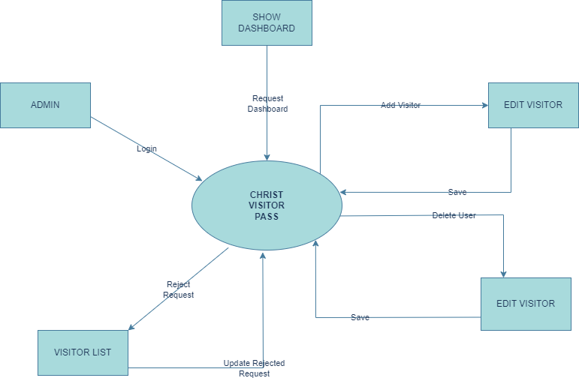
DFD (Data Flow Diagram)
Level 1 (Admin Module)

Slide 19


