Slide 1
Face Recognition
Attendance
System

Slide 2

PROJECT ON
‘Face Recognition Attendance System’
In partial fulfilment of the requirement for award of the degree of
BACHLEOR OF BUISNESSADMINSTRATION
(COMPUTER APPLICATION)
By
Miss. Neha Sanjay Shinde roll no:78
Miss. Sakshi Rajendra Saste roll no:74

Slide 3
Content
Introduction
Analysis
System design
File design
Table design
Form design
Report
Advantages and Limitation
Future Enhancement
Bibliography

Slide 4
Chapter no 1 Introduction

Slide 5
Company profile
Vidya Pratishthans is charitable trust established on 16th October 1972 to provide affordable quality education to the students of Baramati and vicinity area at their doorsteps.
Face recognition can store data of infinity number of student and also help to store daily attendance of student

Slide 6
Introduction
A face recognition attendance system is a facial recognition technology to recognize and verify an student facial features and to record attendance automatically. Face detection attendance system detects the facial expressions of student and marks attendance. face recognition is used in various company, organization, school, college, bank and other enterprises.
Traditional method of attendance marking is a tedious task in many schools and colleges. This is time consuming but face recognition save time and automatically mark the attendance and save record in database.

Slide 7
Scope of the system
Provides an automated attendance system ,reliable and eliminate disturbance and time loss of traditional attendance systems
Present a system that can accurately evaluate student's performance depending on their recorder attendance rate
Present a system that can accurately evaluate student's performance depending on their recorded attendance
Regular maintenance and technical support are necessary to ensure the system functions correctly over time.

Slide 8
Purposed of system
The system consists of a camera that capture the image of the students and send it to the image enhancement module. After enhancement the image comes in the face detection and recognition modules and then the attendance is marked on the excel sheet.
Reduce the paper work.
Provides quick & faster result with better accuracy.
Increased efficiency and capability.
Improved data accuracy and analysis.

Slide 9
Chapter no 2 Analysis

Slide 10
Fact finding techniques
There are fact finding techniques related to “Face recognition Attendance System
Interviewing :-
We use this technique frequently in the system analysis because the technique is best method for producing the qualitive information and allow us to discover are area to proposed system the interview are structured and unstructured analysis users interview to collect information from individual there are two types interview.
▪

Slide 11
Structured Interview:
We select this method for the interview but at the time of actual interview this method is not works on it so we change this methods and select the unstructured interview.
Unstructured Interview:
An unstructured interview is an interview without any set format but in which the interviews may we have to use for gathering information about organization. In interview we take interview of …….. Pawar in that interview we ask some questions.
1. How many student are studing in bba ca department?
2. How many classes are in this deparment?
3. Which type of method used for attendance?
4. How do you record student information?

Slide 12
Record View :
Creating a record view for a face recognition attendance system involves designing a user interface that allows administrators or users to view attendance records.
Observation :
Face recognition attendance systems use computer vision and facial recognition technology to track and record attendance

Slide 13
Feasibility study :
A feasibility study is a high-level capsule version of entire. System analysis and Design process .The study beings by classifying the problem definition. Feasibility is to determine if it’s worth doing. Once an acceptance problem definition has been generated ,the analyst develops a logical model of the A search of alternative is analyzed carefully.

Slide 14
Technical study
a. Hardware Requirement :-
• IP camera/web Camera
• Laptop with 8 GB RAM or above
• Secondary memory to store all images and database
b. Software Requirement :-
• Windows 8 or Higher
• Visual Studio Code
• Latest Version Of All Libraries
• Tkinter

Slide 15
Economical study
Economic feasibility defines whether the expected benefit equals or exceeds the expected costs. It is also commonly referred to as cost/benefit analysis. The procedure is to determine the benefits and the savings expected from the system and compare them with the costs. A proposed system is expected to outweigh the cost. This is a small project with no cost for development. The system is easy to understand and use. Therefore, there is no need to spend on training to use the system. This system has the potential to grow by adding functionalities for students as well as teachers. This can Hence, the project could have economic benefits in the future.

Slide 16
Operational feasibility
Operational feasibility is the measure of how well a proposed system solves the problems with the users. Operational feasibility is dependent on human resources available for the project and involves projecting whether the system will be used if it is developed and implemented. The project is operationally feasible for the users as nowadays almost all the teachers/staffs are familiar with digital technology.

Slide 17
Chapter no 3 System design

Slide 18
Entities and attribute :
sr no | Entities | Attribute
1 | Department | dep_id, dep_name
2 | Student | Sid, sname
3 | recognition enrollment | id , name
Entity and relationship :
sr no | Emtity | Relationship
1 | Department to student | One to many
2 | student to enrollment | One to one
3 | student to face recognition | One to one

Slide 19
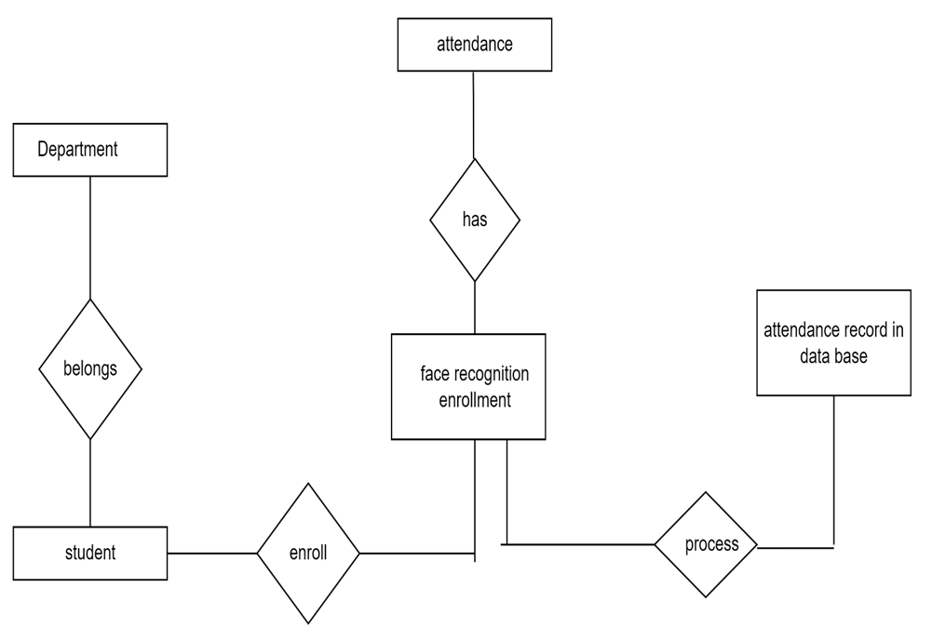
ER Diagram
1
1
1
1
m

Slide 20
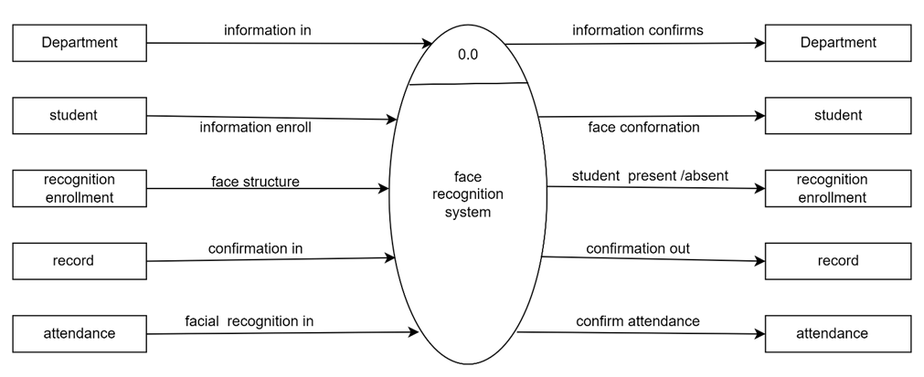
Context Level Diagram

Slide 21
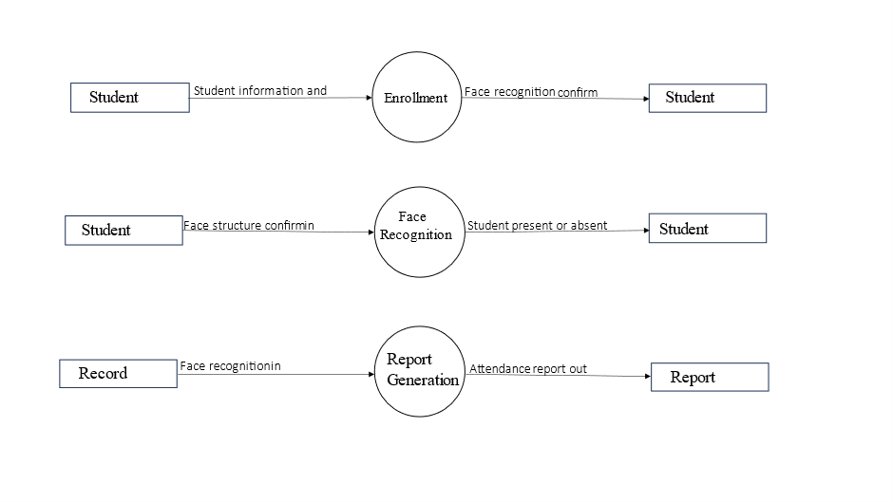
First Level DFD

Slide 22
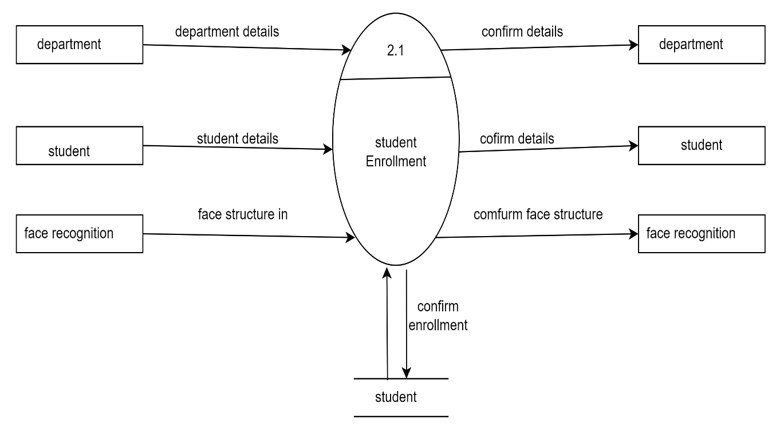
Second Level DFD

Slide 23
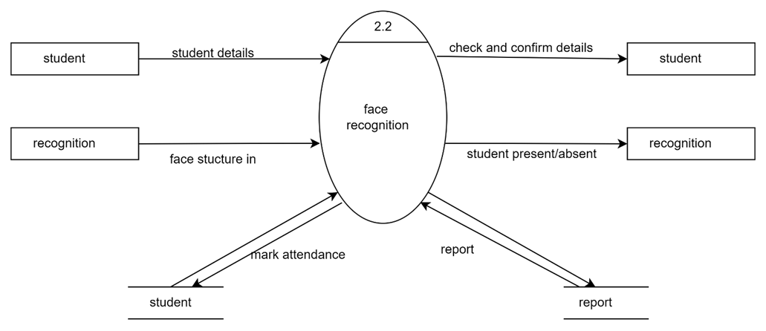

Slide 24
Chapter no 4 File design

Slide 25
File Design
Department
Data Element | Description | Data type | Size | List of specific values | Data Store | Remark
d_id | Department id | Number | 10 | Department id | Department id | It all contain number
d_name | Department name | Text | 20 | Department name | Department id | It all contain text

Slide 26
Student
Data Elements | Description | Data type | Size | List of specific values | Data store | Remarks
sid | Student id | Number | 10 | Student id | Student id | It contain all number
sname | Student name | Text | 20 | Student name | Student name | It all contain text
Recognition
Data Elements | Description | Data type | Size | List of specific values | Data store | Remarks
id | id | Number | 10 | id | id | It contain all number
name | name | yext | 20 | name | name | It contain all text

Slide 27
Chapter no 5 Table design

Slide 28
Table design
Table name : Department
Sr no | Attribute | datatype | size | constraint | Description
1 | d_id | number | 5 | Primary key | Department id
2 | d_name | text | 20 | Not null | Department name
Table name : student
Sr no | Attribute | datatype | size | constraint | Description
1 | sid | number | 5 | Primary key | Student id
2 | sname | text | 20 | Not null | Student name

Slide 29
Table name : recognition enrollment
Sr no | attribute | Data type | size | constraint | description
1 | id | number | 5 | Not null | Enrollment id
2 | name | name | 20 | Not null | Name used for enrollment

Slide 30
Chapter no 6 Form design

Slide 31
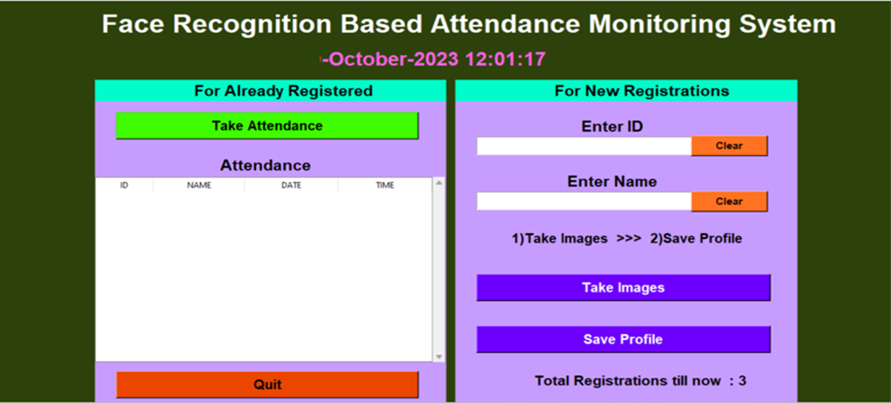

Slide 32
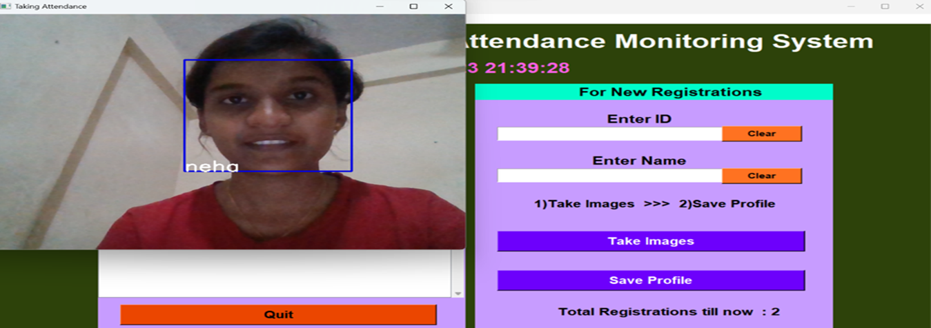
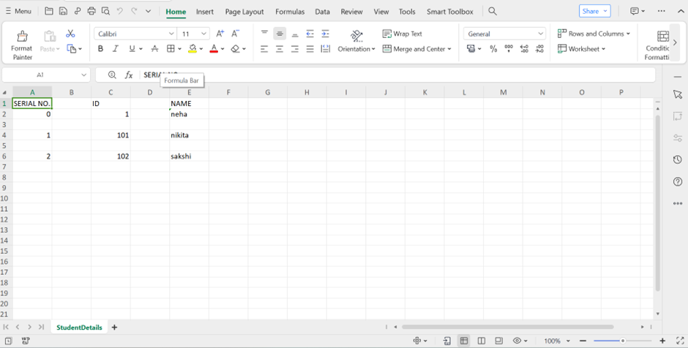

Slide 33
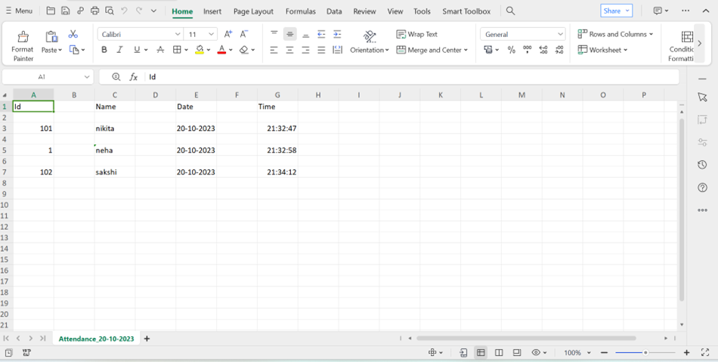

Slide 34
Chapter no 7 Report

Slide 35
Report
Sr no | id | Name | Class | Present/absent
1 | 1 | Neha shinde | TYBBACA | present
2 | 101 | Nikita Devkar | TYBBACA | present
3 | 02 | Rutuja bandgar | TYBBACA | present
4 | 03 | Sakshi saste | TYBBACA | present

Slide 36
Chapter no 8 Advantages and Disadvantages

Slide 37
Advantages
Reduce paperwork and save time
Eliminates Duplicate data entries
Increased privacy and security where student cannot present himself or his friend while they are not
Reduce manual process errors and provides a reliable attendance system

Slide 38
Disadvantages
Problem with false rejection when people change their hairstyle grow or shave a beer or wear glasses.
Face recognition system can't tell the difference between identical twins

Slide 39
Chapter no 9 Future Enhancement

Slide 40
Future Enhancement :-
The system we have development has successfully, able to accomplish the task of marking the attendance in the classroom automatically and output is obtained in an excel sheet as desired in real-time.
However, in order to develop a dedicated system which can be implemented in an educational institution, a very efficient algorithm which is insensitive to the lighting condition of the classroom has to be developed. Also a camera of optimum resolution has to be utilized in the system. Another important aspect where we can a work towards is to creating an online database of the attendance and the automatic update of the attendance.

Slide 41
This can be done by creating a standalone module which can be installed in the classroom having access to internet, preferably a wireless system. This development can greatly improve the application of the project.

Slide 42
Chapter no 10 Bibliography

Slide 43
Bibliography
Website :
www.googole.com
www.youtube.com
www.chatgpt.com

